Slide 1
OBE Implementation
Module-1: Course Objective Setting
Submitted By: Team Dynamic Minds
P.Mahathi - AP23110011157 Sk.Shanum – AP23110011161
P.Praneeth – AP23110011170 D.Rishitha- AP23110011181
S.Harshith Reddy-AP23110011193 B.Jathin- AP23110011215
B-TECH| CSE- Q|SEMESTER-3|2023-2027

Slide 2
Introduction to Project
This project module manages records for various "course objectives," each defined by a unique ID, title, description, and outcomes. It supports basic CRUD (Create, Retrieve, Update, Delete) operations, along with sorting and searching functionalities. Data is stored in a text file for persistence, ensuring accessibility across sessions. This project demonstrates effective data management, structured course planning, and provides a foundation for evaluating each objective's impact on student learning outcomes.

Slide 3
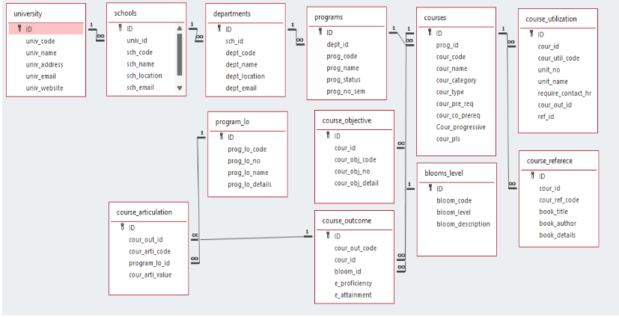
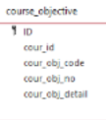
Architecture Diagram

Slide 4
Module Description : Course Objective Setting
The Course Management System is a console-based application written in C that allows users to manage courses and their objectives. The system provides functionalities for creating, retrieving, updating, deleting, and searching courses based on various criteria. It also includes features for sorting courses and comparing algorithm complexities, making it a comprehensive tool for educational institutions or training programs.

Slide 5
Module Description : Course Objective Setting
Course Management: Create, retrieve, update, and delete courses with details like course ID, code, and objectives.
Search Functionality: Search for courses by objective code and list them by objective number.
Sorting: Sort courses by ID using the Bubble Sort algorithm.
Algorithm Comparison: Compare time complexities of searching (Linear vs. Binary) and sorting (Bubble vs. Quick) algorithms.
Pseudocode Display: Show pseudocode for searching and sorting algorithms, along with their time and space complexities.
Data Structure: The system uses a Course structure to store course information, including ID, code, objective code, number, and details.
File Handling: Courses are saved in a text file (courses.txt) in a comma-separated format, ensuring data persistence.
User Interaction: The application features a command-line interface with a menu for easy navigation and input validation

Slide 6
Course Objective Setting:Programming Details
File name:Dynamic_minds_objective_setting
Function/method name
Create: Dynamic_minds_objective_setting_create
Update: Dynamic_minds_objective_setting_update
Retrieve: Dynamic_minds_objective_setting _retrieve
Delete: Dynamic_minds_objective_setting _delete
Sorting: Dynamic_minds_objective_setting_sortCoursesById
Searching: Dynamic_minds_objective_setting_searchCourseByCode
Storing: Dynamic_minds_objective_setting _storing

Slide 7
Course Objective Setting: Programming Details
Comparison(both searching and Sorting):
For
Searching- Dynamic_minds_course_objective_setting_Compare_Search_Algorithms
For Sorting- Dynamic_minds_course_objective_setting_Compare_Sort_Algorithms
Time Complexity(both searching and Sorting):
For Searching- Dynamic_minds_objective_setting_ complexity_searching
For Sorting- Dynamic_minds_objective_setting_ complexity_sortingh\

Slide 8
Course Objective Setting: Field/table details
Field Name | Data type
id | integer
cour_id | String
cour_obj_code | String
cour-obj_no | String
cour_obj_detail | String

Slide 9
Course Objective Setting: Programming Details
Algorithm Details(pseudocode or steps)(both searching and Sorting):
For
Searching- Dynamic_minds_course_objective_setting_displaysearchPseudocode
For
Sorting- Dynamic_minds_course_objective_setting_displaysortPseudocode
File name(for storing the details)
File name to be used is:-courses .txt

Slide 10
Course Objective Setting : Sorting Algorithm used
Sorting Algorithm Name: BUBBLE SORT
Algorithm:
Step 1: Start at the beginning of the list.
Step 2: compare each pair of adjacent elements (i.e., compare the first and second elements, the second and third elements, etc.).
Step 3: If the current element is greater than the next element, swap them.
Step 4: Continue this process for all elements in the list. After one complete pass through the list, the largest element will have "bubbled" to the end of the list.
Step 5: Repeat the process for the remaining elements, ignoring the last element (which is now sorted).
Step 6:Continue until no more swaps are needed, indicating that the list is sorted

Slide 11
Course Objective : Comparison of Sorting Algorithm
Algorithm used for comparison: Quick Sort
Algorithm:
Step 1:
Choose a pivot element from the array. There are many strategies for selecting the pivot:First element,Last element,Random Element,Median of the Array
Step 2:Partition the array into two sub-arrays:One sub-array contains all elements smaller than the pivot.The other sub-array contains all elements greater than the pivot.
Step 3:Recursively apply the same process to the two sub-arrays (i.e., quick sort the left and right partitions).
Step 4:The base case of the recursion is when the sub-array has fewer than two elements, in which case it is already sorted.

Slide 12
Course Objective Setting: Time Complexity of Sorting Algorithm
Sl.No | Algorithm Name | Complexity of Algorithm
1) | Bubble sort | O(n^2)
2) | Quick sort | O(nlogn)

Slide 13
Course Objective : Searching Algorithm used
Algorithm Name: Linear Search
Algorithm:
Step 1:
Start at the Beginning: Begin with the first element of the array or list.
Step 2:
Compare Each Element: Check if the current element matches the target value you’re looking for.
Step 3:
Return Index if Found: If a match is found, return the current index, indicating the position of the target element.
Step 4:
Continue if Not Found: If the current element does not match, move to the next element and repeat the process.
Step 5:
End if Not Found: If the target is not found after checking all elements, return -1 (or an indicator that the target is absent from the array).

Slide 14
Course Objective: Comparison of Searching Algorithm
Algorithm used for comparison: Binary Search
Algorithm:
Step 1:
Start with Sorted Data: Ensure the array or list is sorted. Binary search only works on ordered data.
Step 2:
Set Initial Bounds: Define two pointers: low at the beginning of the list and high at the end.
Step 3:
Find the Middle Element: Calculate the middle index, mid = (low + high) / 2, and compare the middle element with the target value.
Step 4:
Check for a Match:
If the middle element is the target, return mid as the index where the target was found.
If the middle element is less than the target, set low to mid + 1 (search in the right half).
If the middle element is greater than the target, set high to mid - 1 (search in the left half).
Step 5:
Repeat: Repeat steps 3–4, adjusting the low and high bounds, until the target is found or low exceeds high, meaning the target is not in the list.
Step 6:
Return Not Found: If the target is not found, return -1 or another indicator that the target isn’t present.

Slide 15
University : Time Complexity of Searching Algorithm
Sl.No | Algorithm Name | Complexity of Algorithm
1) | Linear Search | O(n)
2) | Binary Search | O(log n)

Slide 16
SOURCE CODE(Routine of crud,searching and sorting operations)
#include <stdio.h>
#include <stdlib.h>
#include <string.h>
#include <stdbool.h>
#define MAX_COURSE_ID 10
#define MAX_COURSE_NAME 50
#define MAX_OBJ_CODE 10
#define MAX_OBJ_NO 10
#define MAX_OBJ_DETAILS 100
#define MAX_COURSES 100
#define FILE_PATH "courses.txt"
typedef struct {
int id;
char cour_id[MAX_COURSE_ID];
char name[MAX_COURSE_NAME];
char cour_obj_code[MAX_OBJ_CODE];
char cour_obj_no[MAX_OBJ_NO];
char cour_obj_details[MAX_OBJ_DETAILS];
} Course;

Slide 17
// Function prototypes void Dynamic_minds_course_objective_setting_create(); void Dynamic_minds_course_objective_setting_ retrieve(); void Dynamic_minds_course_objective_setting_ update(); void Dynamic_minds_course_objective_setting_delete(); int main() { int choice; do { printf("\nCourse Management System\n"); printf("1. Create Course\n"); printf("2. Retrieve Courses\n"); printf("3. Update Course\n"); printf("4. Exit\n"); printf("Enter your choice: "); if (scanf("%d", &choice) != 1) { while (getchar() != '\n'); // Clear input buffer printf("Invalid input. Please enter a number.\n"); continue; } }

Slide 18
switch (choice) { case 1: Dynamic_minds_course_objective_setting_create(); break; case 2: Dynamic_minds_course_objective_setting_retrieve(); break; case 3: Dynamic_minds_course_objective_setting_update(); break; case 4: Dynamic_minds_course_objective_setting_delete(); break; case 5: printf("Exiting program.\n"); break; default: printf("Invalid choice. Please try again.\n"); } } while (choice != 5); return 0; }

Slide 19
void Dynamic_minds_course_objective_setting_create() { Course newCourse; printf("Enter course ID (integer): "); if (scanf("%d", &newCourse.id) != 1) { while (getchar() != '\n'); // Clear input buffer printf("Invalid input. Course ID should be an integer.\n"); return; } // Clear input buffer before reading strings while (getchar() != '\n'); printf("Enter course code: "); fgets(newCourse.cour_id, MAX_COURSE_ID, stdin); strtok(newCourse.cour_id, "\n"); // Remove newline character printf("Enter objective code: "); fgets(newCourse.cour_obj_code, MAX_OBJ_CODE, stdin); strtok(newCourse.cour_obj_code, "\n"); printf("Enter objective number: "); fgets(newCourse.cour_obj_no, MAX_OBJ_NO, stdin); strtok(newCourse.cour_obj_no, "\n"); printf("Enter objective details: "); fgets(newCourse.cour_obj_details, MAX_OBJ_DETAILS, stdin); strtok(newCourse.cour_obj_details, "\n");

Slide 20
FILE *file = fopen(FILE_PATH, "a"); if (file == NULL) { perror("Error opening file for appending."); exit(EXIT_FAILURE); } fprintf(file, "%d,%s,%s,%s,%s\n", newCourse.id, newCourse.cour_id, newCourse.cour_obj_code, newCourse.cour_obj_no, newCourse.cour_obj_details); fclose(file); printf("Course added successfully.\n"); } // Function to retrieve and display all courses void Dynamic_minds_course_objective_setting_retrieve() { //code for displaying all the courses } // Function to update an existing course void Dynamic_minds_course_objective_setting_update() { //code for upating the course } functions for deleting the course,sorting,searching,comparing and displaying their pseudo codes

Slide 21
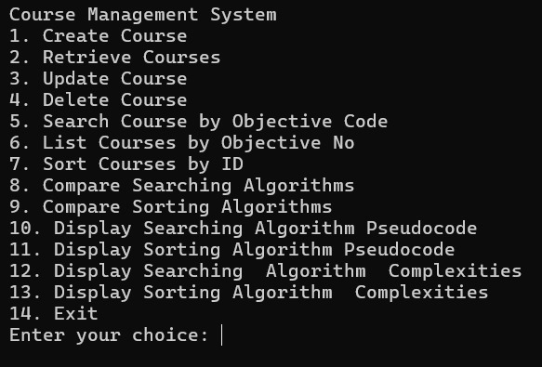
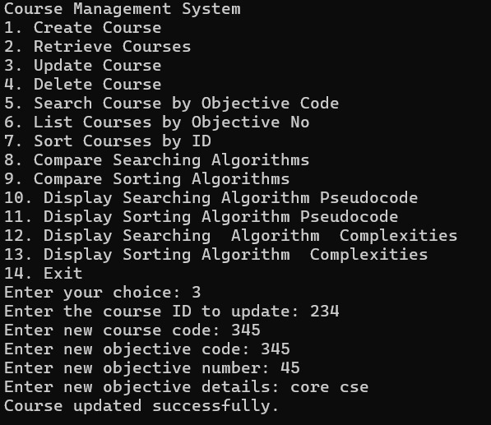
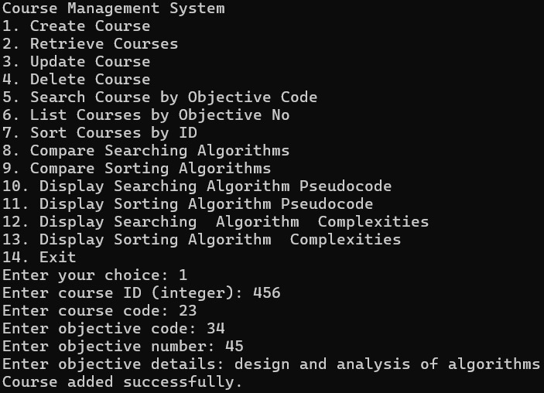
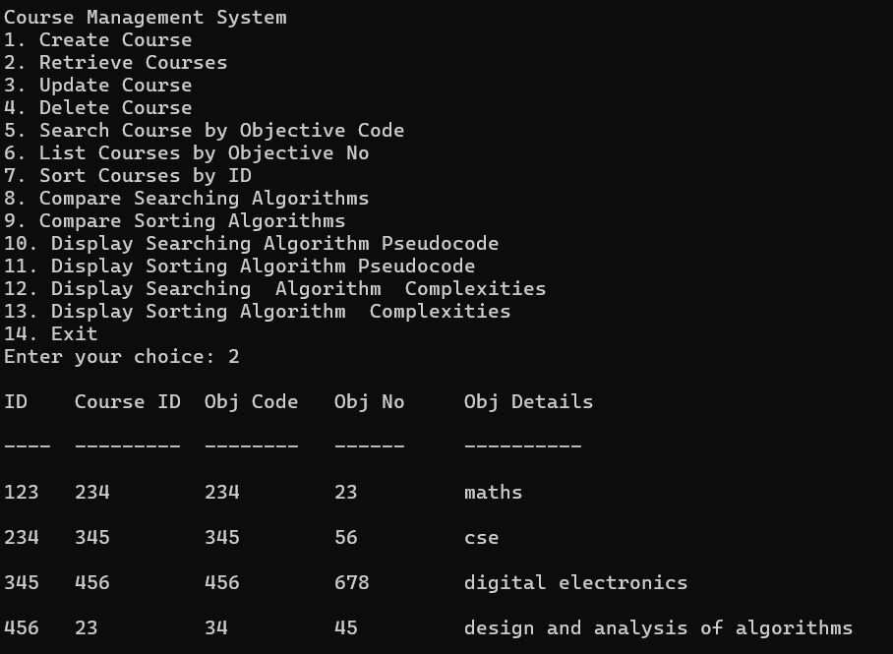
Sample Screen Shots[*Screen shot of CRUD,Sorting,Searching,Comparison(both sorting and Searching and Storage)]

Slide 22
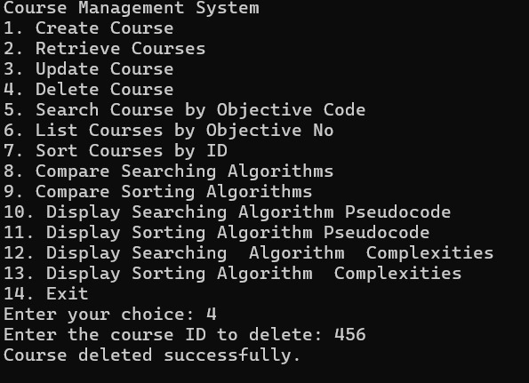
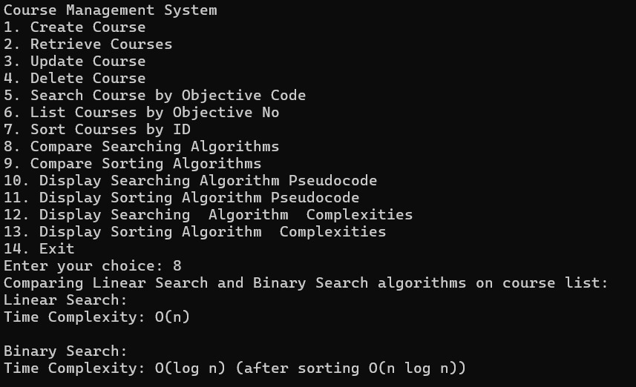
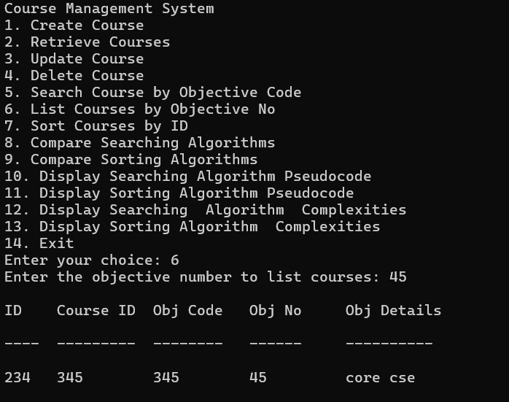
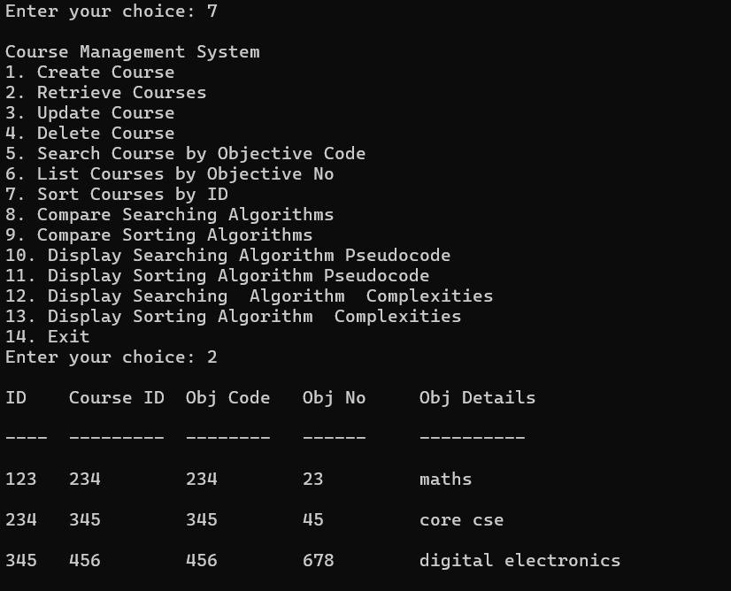
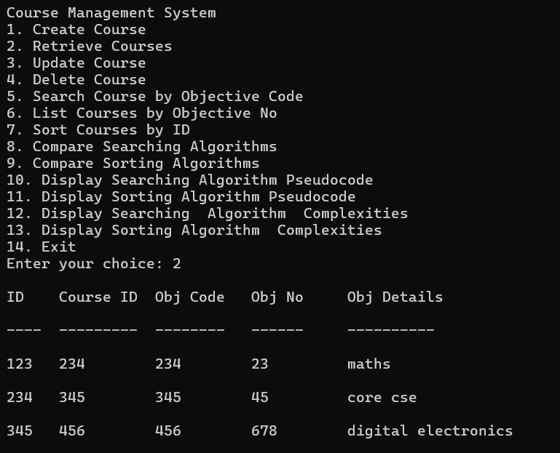
Sample Screen Shots[*Screen shot of CRUD,Sorting,Searching,Comparison(both sorting and Searching and Storage)]

Slide 23
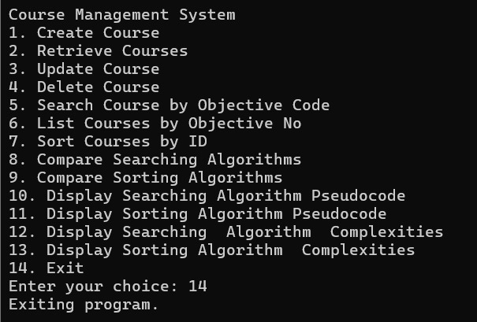
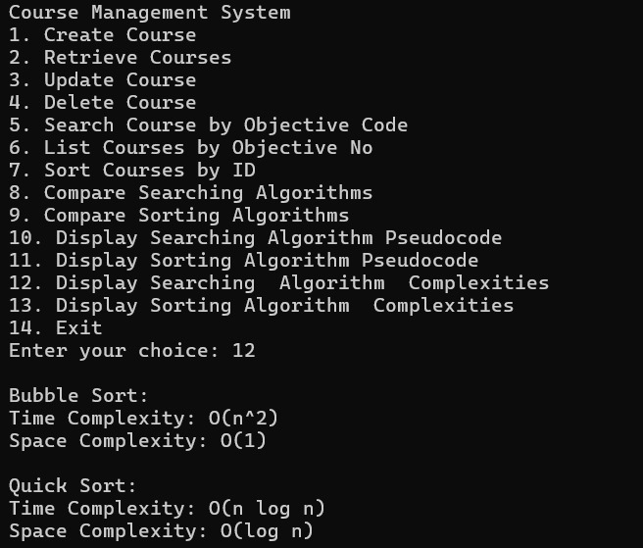
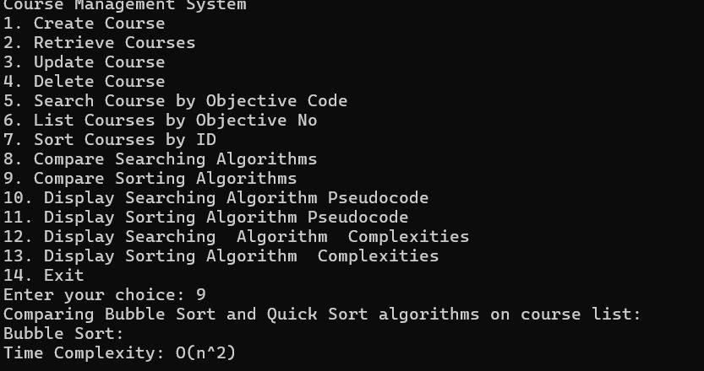
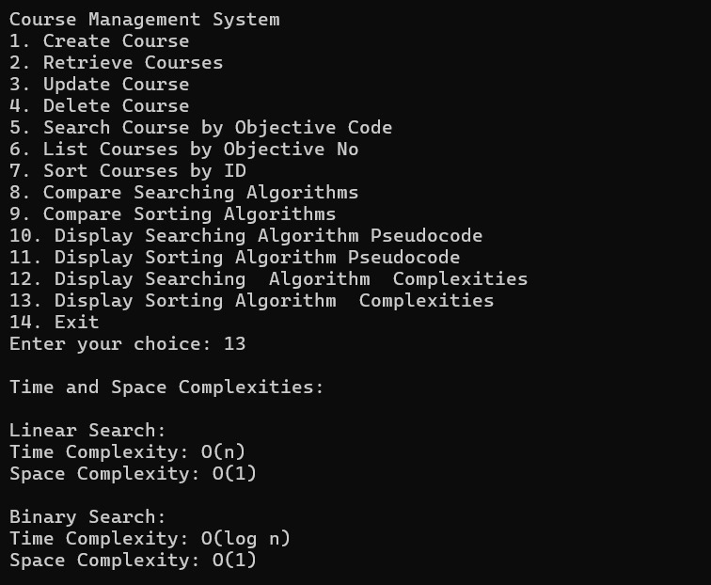
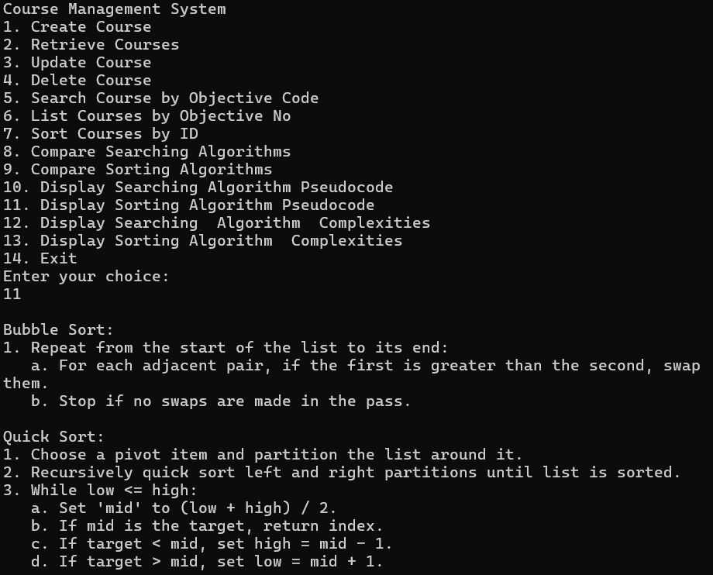
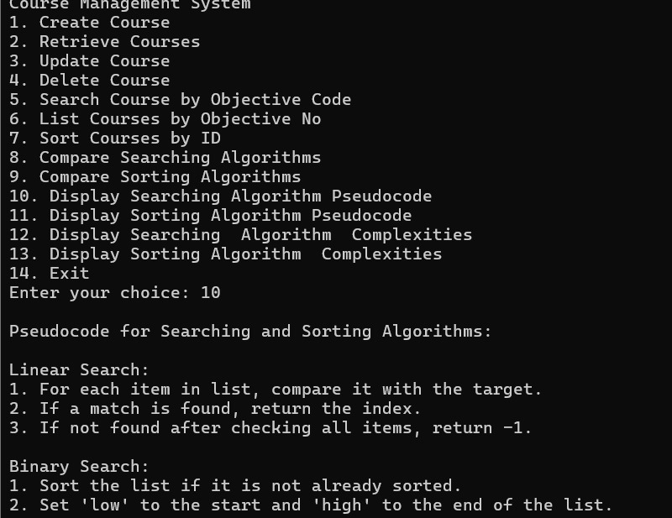
Sample Screen Shots[*Screen shot of CRUD,Sorting,Searching,Comparison(both sorting and Searching and Storage)]

Slide 24
Conclusion
The project on Course Objective Setting in the context of Design and Analysis of Algorithms highlights the importance of clear, actionable goals for enhancing student understanding and skill development. By defining specific, measurable objectives, students gain a focused pathway to mastering fundamental concepts, from basic algorithmic strategies to complex analysis techniques. The project underscores how well-defined objectives not only guide learning but also improve instructional effectiveness, ultimately leading to a stronger grasp of critical algorithm design principles and a deeper appreciation for the complexity and efficiency of computational problem-solving.

Slide 25
Thank You

