Slide 1

A holistic framework for crime prevention, response, and analysis with emphasis on women safety using technology and societal participation
TEAM
Ayla Praneeth 22R05A6702
Esther Rani 21R01A6709
Sathwik Vellanki 21R01A6762
D. Sai Deepak 22R05A6704
Project Guide :
Mr. P. V. Madhusudan
Assistant Professor

Slide 2
Abstract
Women’s safety is a major concern despite various efforts worldwide. Criminal records are often hard to access, and existing safety devices and apps are not very effective. Crime response, analysis, and prevention are usually not well-connected, creating safety gaps.
Our system addresses this by combining crime analysis, prevention, and emergency response with community involvement. We use maps to identify crime hotspots and patterns. Data from our mobile app and wearable gadgets, along with criminal records, help improve safety measures. Tested in Pilani, Rajasthan, this solution is scalable to other smart cities. The app and gadgets are affordable for users, and a website helps law enforcement manage and enhance safety.

Slide 3
Introduction
Gender-based disparities and violence against women are major global issues. Despite progress, many women still face violence, impacting their ability to participate fully in society.
Our solution integrates crime analysis, prevention, and emergency response. Using GIS technology, we identify crime hotspots and patterns. Our mobile app and wearable device can send alerts to nearby volunteers, contacts, and law enforcement during emergencies.
An interactive website visualizes crime data and tracks real-time movements, assisting law enforcement. This scalable framework can be implemented to improve safety in smart cities.

Slide 4
OBJECTIVE
To develop an integrated safety system for women in smart cities that addresses crime analysis, prevention, and emergency response. This system employs Geographic Information System (GIS) technology to map and identify crime hotspots and patterns. It includes a mobile app and wearable device designed to send real-time alerts to nearby volunteers, contacts, and law enforcement. Additionally, an interactive website provides data visualization and real-time monitoring capabilities, enabling law enforcement to track movements and respond swiftly. The goal is to enhance safety, improve crime response times, and support effective prevention strategies, ultimately contributing to a safer environment for women.

Slide 5
EXISTING SYSTEM
Current systems for women's safety include various approaches but have significant limitations:
Law Enforcement: Crime mapping and response are primarily managed by police but often lack real-time public access and integration.
Wearable Devices: These devices usually raise alarms or send alerts to contacts and law enforcement but are ineffective if the user is away from their contacts.
Mobile Apps: Many apps provide safety features like emergency alerts but often lack comprehensive integration with crime prevention and response systems.
These systems generally offer limited societal intervention and fail to address gaps in crime response, analysis, and prevention. They often lack the integration needed for effective, real-time safety management.

Slide 6
LIMITATIONS OF EXISTING SYSTEM
Law Enforcement
Gaps: Limited real-time access for the public, inadequate focus on prevention due to resource constraints.
Wearable Devices
Gaps: Ineffective outside contact coverage areas, limited integration with other safety measures.
Mobile Apps
Gaps: Lack of comprehensive integration with crime data and prevention systems, variable effectiveness depending on location and situation.

Slide 7
PROPOSED SYSTEM
Our proposed system focuses on developing a comprehensive website to enhance women's safety by integrating crime analysis, prevention, and emergency response. Key features include:
Crime Analysis and Mapping
Description: Utilizes GIS technology to identify crime hotspots and patterns by analyzing socio-economic data and criminal history.
Benefit: Provides users with crucial information to make informed decisions and take preventive measures.
Emergency Response Integration
Description: The website supports real-time tracking and emergency alerts, allowing users to trigger alerts that notify law enforcement and nearby volunteers.
Benefit: Ensures prompt assistance during emergencies and effective coordination with community resources.
Interactive Data Visualization
Description: Displays GIS analysis and real-time data on a user-friendly interface. Law enforcement can monitor movements and update crime records.
Benefit: Enhances decision-making and response capabilities by providing a clear overview of current safety conditions and trends.

Slide 8
ADVANTAGES OF PROPOSED SYSTEM
Comprehensive Management
Integrates crime analysis, prevention, and response in one platform.
Real-Time Tracking
Provides live updates and tracking of victims and volunteers.
GIS Integration
Uses GIS to identify crime hotspots and trends.
Interactive Interface
Offers an easy-to-use website for data visualization and management.

Slide 9
ALGORITHMS
Decision Trees: Splits data into branches to make decisions. Simple and interpretable.
Gradient Boosting: Builds models sequentially to correct errors, often outperforming random forests.
K-Nearest Neighbors (KNN): Classifies based on the closest K data points. Simple and lazy learning.
Logistic Regression: Models binary/multiclass outcomes using independent variables. Good for probability estimation.
Naïve Bayes: Assumes feature independence for classification. Fast and efficient.
Random Forest: Combines multiple decision trees to improve accuracy and reduce overfitting.
Support Vector Machine (SVM): Finds the optimal boundary to separate classes in high-dimensional spaces.

Slide 10
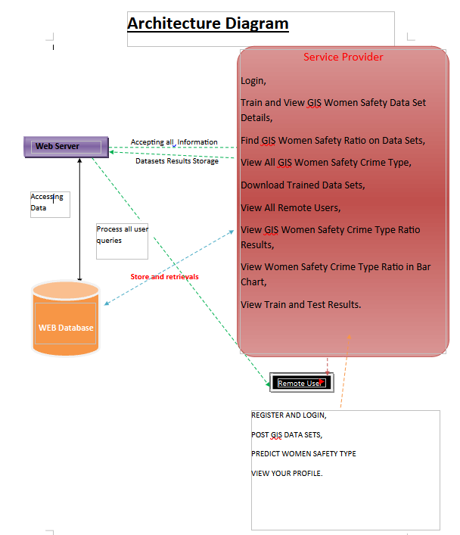
ARCHITECTURE DIAGRAM

Slide 11
MODULES
The Service Provider module allows users to log in and perform various tasks, including training and viewing GIS women safety datasets, finding safety ratios, and downloading trained datasets. They can also view crime types, ratios in bar charts, and train/test results.
The View and Authorize Users module enables admins to view registered users, access their details (e.g., username, email), and authorize or manage accounts.
In the Remote User module, users must register and log in to access features like posting GIS datasets, predicting safety on these datasets, and viewing their profile.

Slide 12
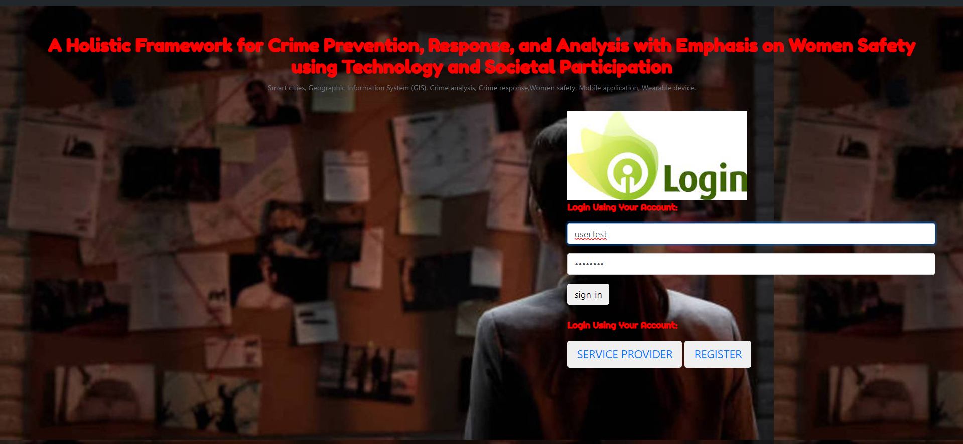
RESULTS

Slide 13
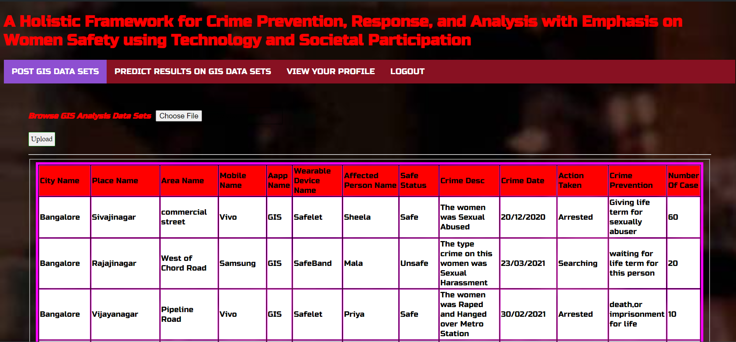

Slide 14
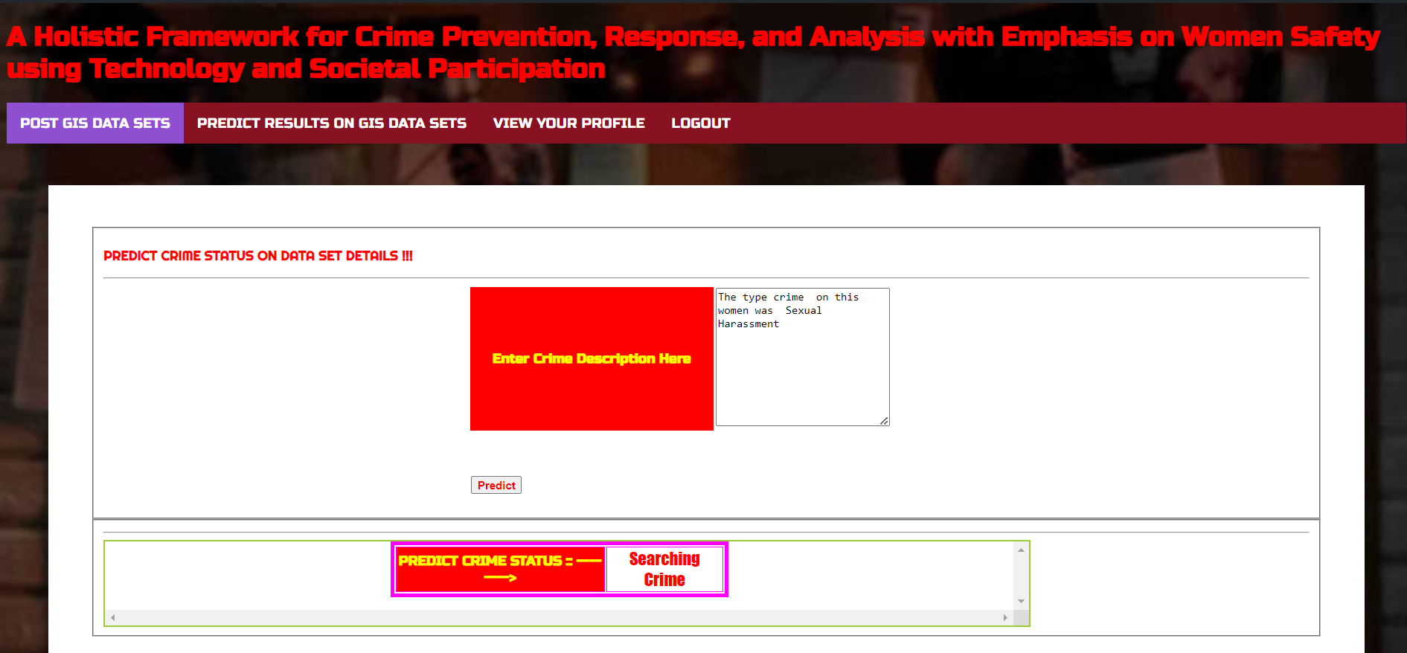

Slide 15
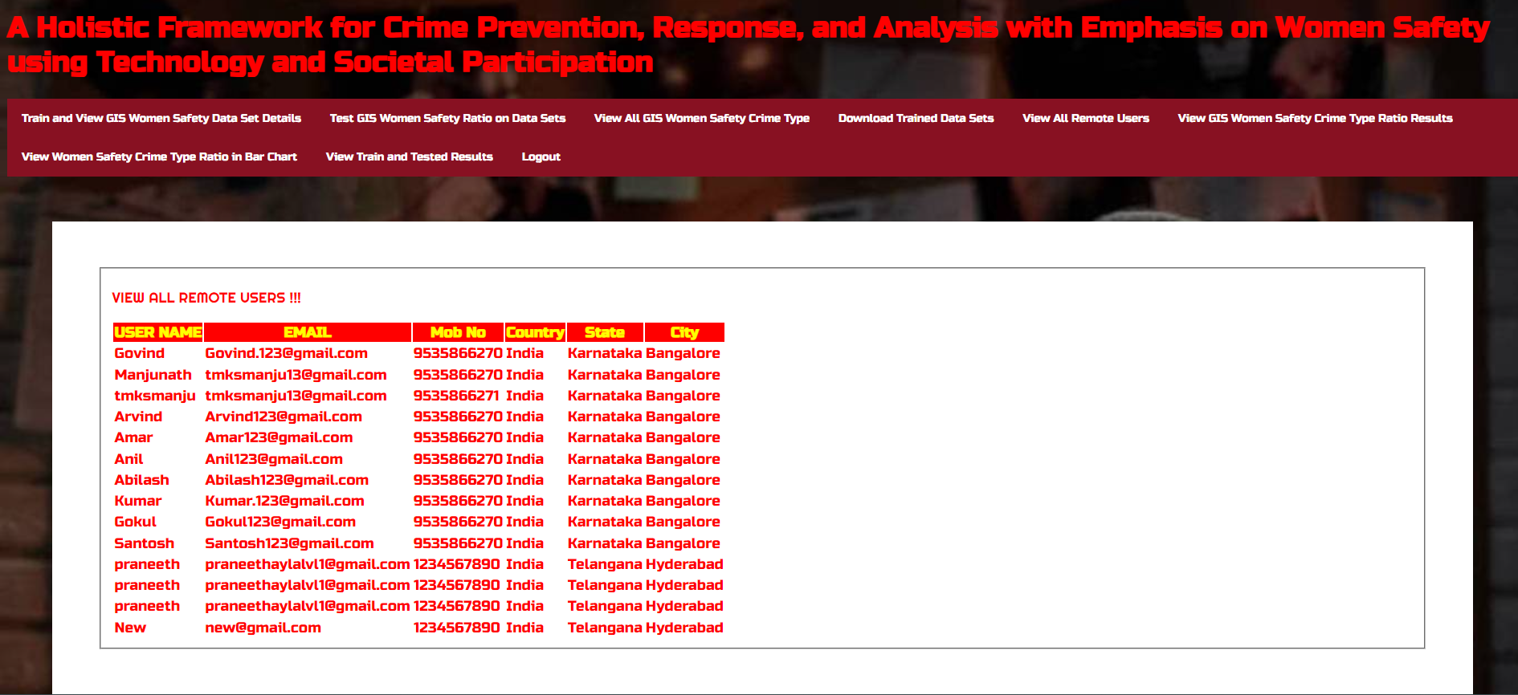

Slide 16
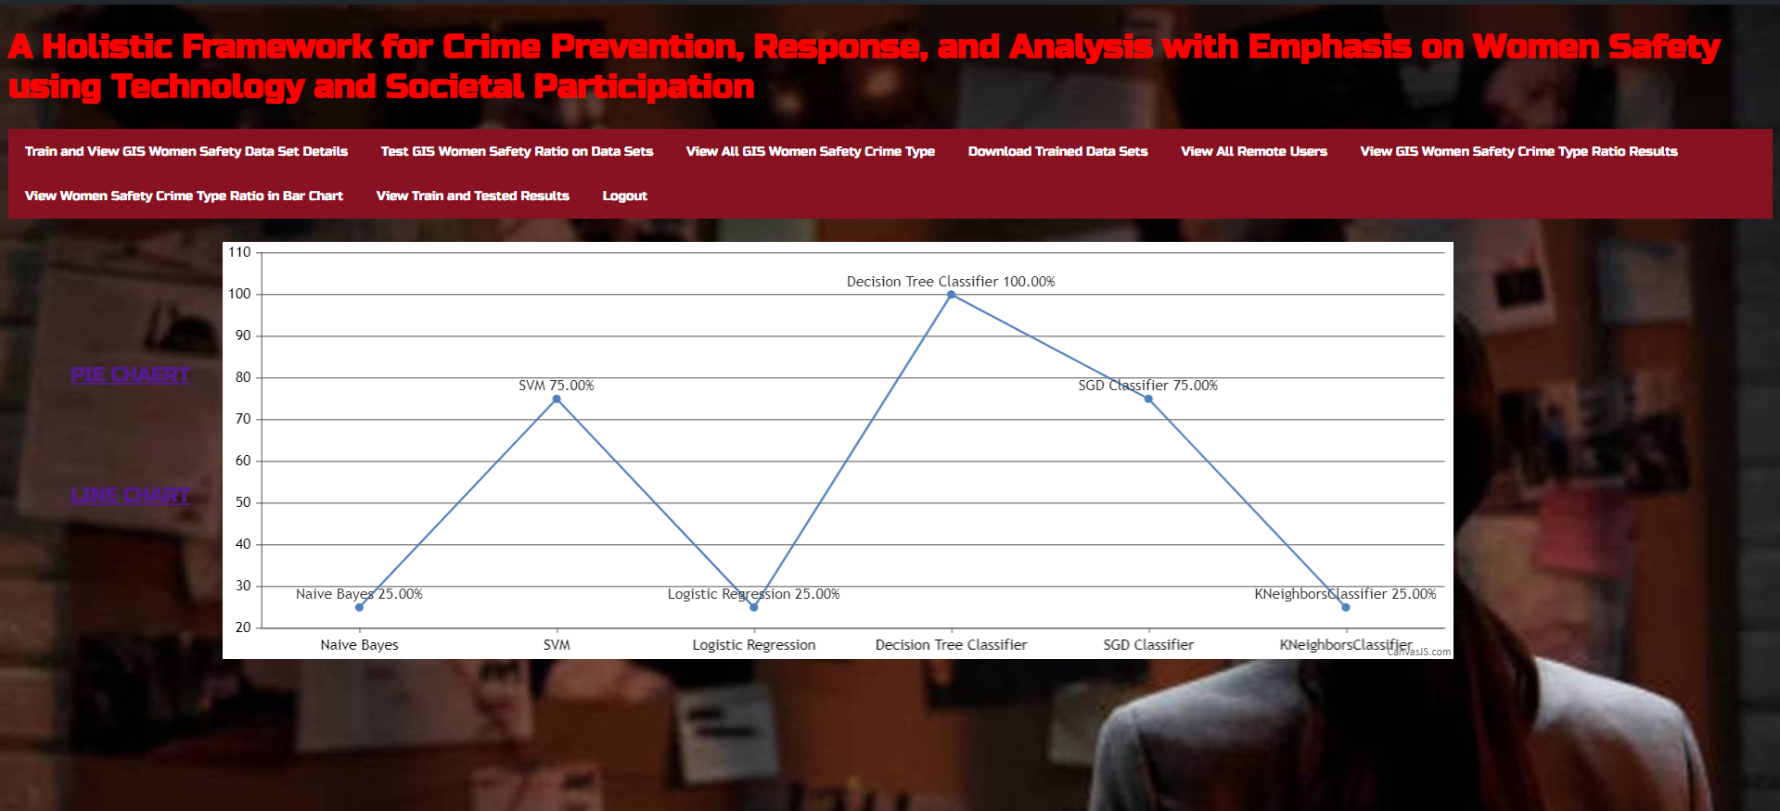

Slide 17
CONCLUSION
Creating safer cities for women requires a comprehensive approach to crime prevention, analysis, and response, incorporating socio-economic factors and technological solutions.
Key Components:
Web GIS: Manages a geospatial database for criminal records, hotspot analysis, and visualization.
Mobile Application: Sends alerts, tracks individuals in danger, and shows local crime hotspots. It allows users to respond to emergencies and is monitored by administrators.
Website: Integrates mobile, wearable, and GIS data, offering real-time tracking, safety stats, and volunteer responses. It also allows administrators to update crime data and oversee the system.
This integrated system facilitates proactive crime response, tracks users in danger, and supports preventive measures. It combines technological tools with societal involvement to address women's safety and can be scaled for use in smart cities. The system’s design and testing will continue to refine its effectiveness.

Slide 18
FUTURE ENHANCEMENT
Broaden Data Sources: Add social media and surveillance data for better crime prediction.
AI Integration: Use AI for advanced crime analysis and real-time threat detection.
User Interface Improvements: Make apps and websites more intuitive and user-friendly.
Emergency Services Integration: Connect directly with emergency services for faster responses.
Multilingual Support: Add multiple languages for broader accessibility.
Wearable Upgrades: Enhance wearables with more sensors and features.
Community Tools: Add features for community feedback and education.
Regular Updates: Implement routine updates and maintenance.

Slide 19
REFERENCES
“Violence against women a barrier to peaceful future for all | UN News”. Available: [UN News].
“10 Safety Apps For Women”. Available: [Businessworld].
"Safelet – The SOS-Bracelet". Available: [Safelet].
E. Brooke, "Meet Siren, a Ring Designed to Prevent Assault - Fashionista". Available: [Fashionista].
W. L. Gorr, K. S. Kurland, Z. M. Dodson, GIS Tutorial for Crime Analysis, Esri Press, 2018.

