Slide 1
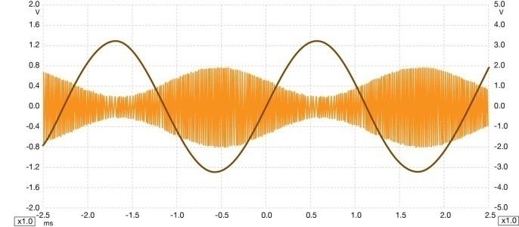
20ITT41 & PRINCIPLES OF COMMUNICATION
UNIT – 1 Amplitude Modulation
S.Janarthanan
Assistant Professor( SL.G)
Department of EIE
Kongu Engineering College
Perundurai,Erode-638060

Slide 2
20ITT41 & PRINCIPLES OF COMMUNICATION
Preamble This course explains the concepts of Analog and Digital communication systems that are used for the transmission of information from source to destination. A detailed quantitative framework for analog and digital transmission techniques is addressed.
Unit - I Amplitude Modulation: 9+3
Principles of amplitude modulation – AM envelope - Frequency spectrum and bandwidth - Modulation index and percentage modulation - AM power distribution - AM modulator circuits – Low level AM modulator - AM transmitters – Low level transmitter - AM receivers – Super heterodyne receivers
Unit - II Angle Modulation: 9+3
Angle Modulation – FM and PM waveforms - Phase deviation and modulation index - Frequency deviation - Direct FM and PM demodulators - Frequency spectrum of angle modulated waves - Bandwidth requirement - Narrowband FM and Broadband FM -Average power - FM and PM modulators, Direct FM transmitter - Angle modulation Vs. Amplitude modulation –Indirect FM
transmitter.
Unit - III Digital Modulation: 9+3
Sampling - Time Division Multiplexing - Digital T-carrier System – Pulse code modulation – Amplitude shift keying – Frequency and phase shift keying – Modulator and demodulator - bit error rate calculation.
Unit - IV Data Communication: 9+3
Data communication codes: ASCII - BAR codes - Error Control - Error Detection - Redundancy checking - Error Correction -Hamming – Line coding: AMI – NRZ - RZ - Serial interfaces : RS232 - RS485 - Data communication circuits – Data communication modems - Public Switched Telephone Network(PSTN) – ISDN.
Unit - V Spread Spectrum: 9+3
PN sequence code and its properties- Direct sequence spread spectrum system - Processing gain- Frequency hopping spread spectrum.

Slide 3
20ITT41 & PRINCIPLES OF COMMUNICATION
TEXT BOOK:
1. Wayne Tomasi, “Electronic Communications Systems: Fundamentals through Advanced”, 5th Edition, Pearson Education,
2008.
REFERENCES:
1. Michael Moher and Simon Haykin, “Communication System”, 5th Edition, Wiley India Pvt. Ltd., New Delhi, 2011.
2. Frenzel and Louis E., “Principles of Electronic Communication Systems”, 3rd Edition, Tata McGraw Hill Publishing Company,
New Delhi, 2008.
3. Anokh Singh, “Principles of Communication Engineering”,S. Chand & Co., New Delhi, 2006.
COURSE OUTCOMES:
On completion of the course, the students will be able to
CO1 illustrâtes amplitude modulation techniques Applying (K3)
CO2 use the different angle modulation schemes Applying (K3)
CO3 apply the concepts of digital modulation techniques Applying (K3)
CO4 detect and correct the errors introduced in the channel using error control coding schemes Applying (K3)
CO5 illustrate the spread spectrum techniques for modern communication Applying (K3)

Slide 4
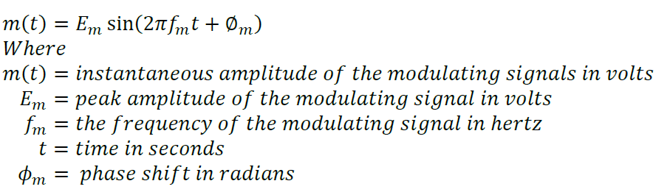
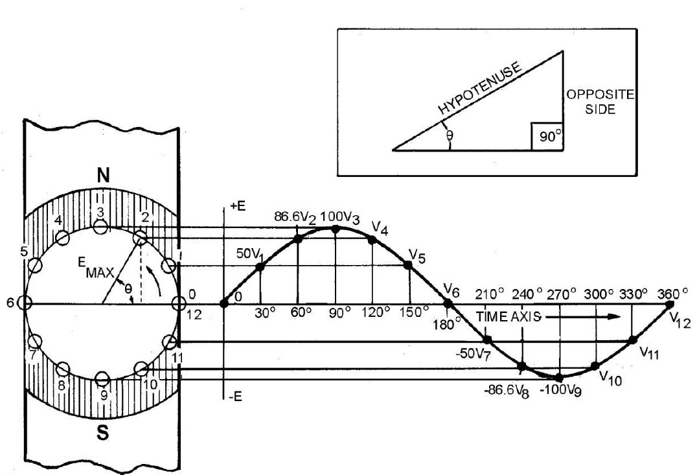
Signal Representation
The basic alternating waveform for all complex waveforms is the sine wave

Slide 5

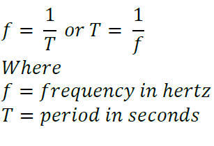
Signal Representation
Amplitude :The maximum value, above or below the reference line, is called the peak amplitude. The value at any given point along the reference line is called the instantaneous amplitude
Phase: Phase or phase angle indicates how much of a cycle has been completed at any given instant. This merely describes the angle that exists between the starting point of the vector and its position at that instant.
Frequency : The rate at which the vector rotates determines the frequency of the sine wave that is generated; that is, the faster the vector rotates, the more cycles completed in a given time period. The basic time period used is 1 second. If a vector completes one revolution per 1 second, the resultant sine wave has a frequency 1 cycle per second (1 hertz).
Period: The period of a cycle is the elapsed time from the beginning of a cycle to its completion

Slide 6
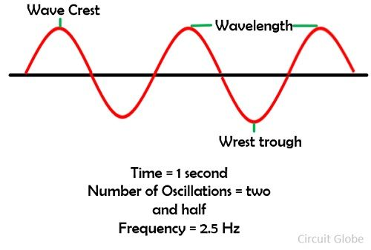
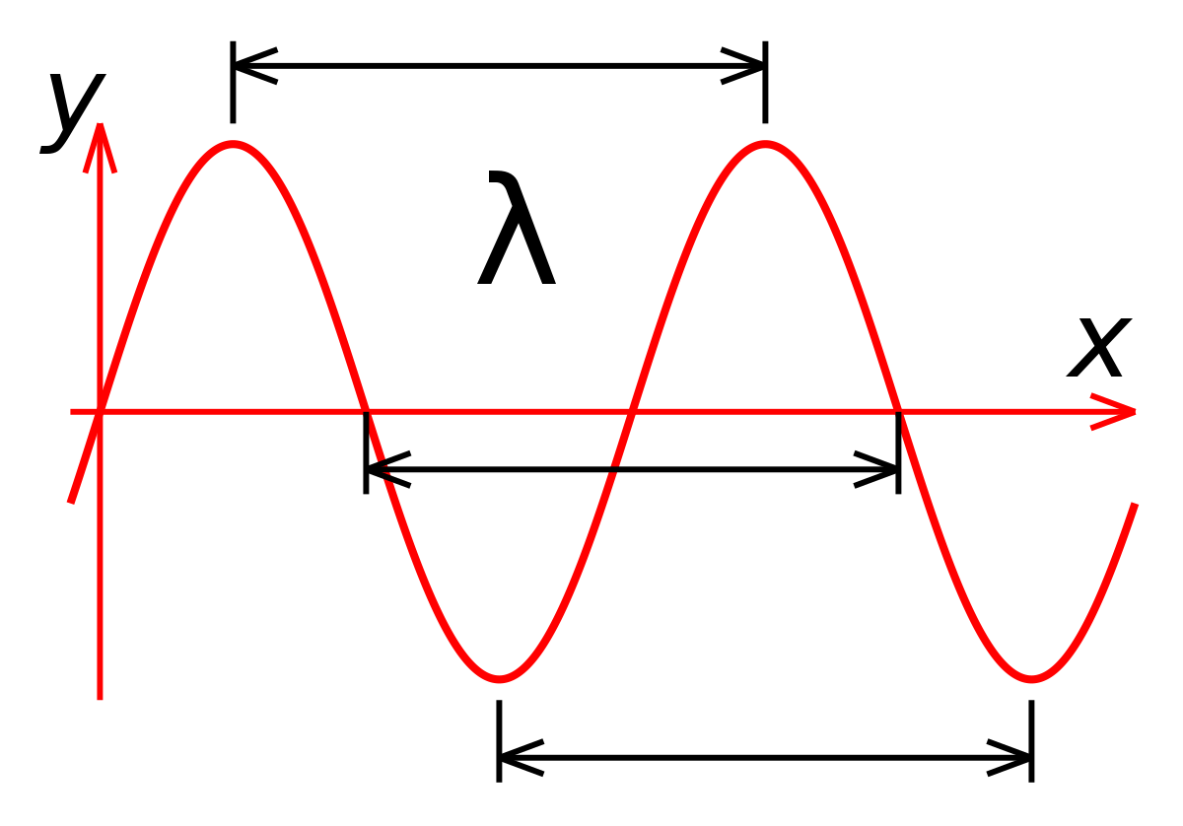
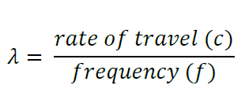
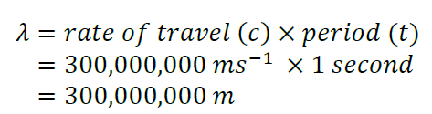
Signal Representation
Wavelength : The wavelength of a sine wave is determined by its physical length. During the period a wave is being generated, its leading edge is moving away from the source at 300,000,000 meters per second. The physical length of the sine wave is determined by the amount of time it takes to complete one full cycle. This wavelength is an important factor in determining the size of equipments used to generate and transmit radio frequencies.

Slide 7
Amplitude Modulation
In amplitude modulation, the amplitude of a carrier signal is varied by the modulating voltage, whose frequency is invariably lower than that of the- carrier. In practice, the carrier may be high frequency (HF) while. the modulation is audio.
Formally, AM is defined as a system of modulation in which the amplitude of the carrier is made proportional to the instantaneous amplitude of the modulating voltage.
A carrier signal is modulated only in amplitude value
The modulating signal is the envelope of the carrier
AM is a nonlinear process
Sum and difference frequencies are created that carry the information

Slide 8
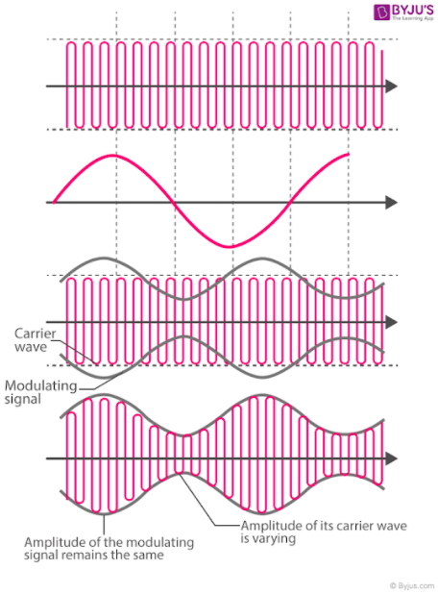
Amplitude Modulation

Slide 9


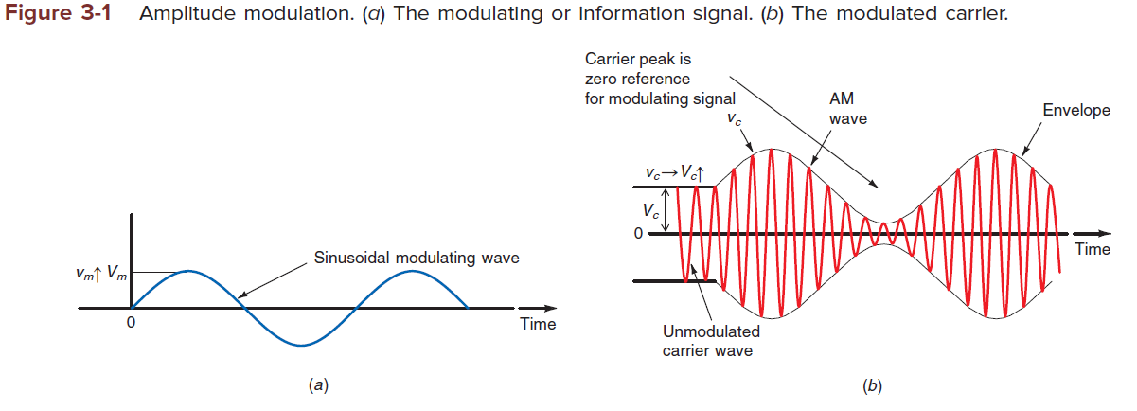
AM SIGNAL Representation
The sine wave carrier with the simple expression
A sine wave modulating signal can be expressed with a similar formula
where Ʋm =instantaneous value of information signal
Vm = peak amplitude of information signal
fm = frequency of modulating signal
Values for the carrier signal and the modulating signal can be used in a formula to express the complete modulated wave. First, keep in mind that the peak value of the carrier is the reference point for the modulating signal; the value of the modulating signal is added to or subtracted from the peak value of the carrier. The instantaneous value of either the top or the bottom voltage envelope 1 can be computed by using the equation

Slide 10


AM SIGNAL Representation
The sine wave carrier with the simple expression
A sine wave modulating signal can be expressed with a similar formula
where Ʋm =instantaneous value of information signal
Vm = peak amplitude of information signal
fm = frequency of modulating signal
The instantaneous value of either the top or the bottom voltage envelope 1 can be computed by using the equation
which expresses the fact that the instantaneous value of the modulating signal algebraically adds to the peak value of the carrier. Thus, we can write the instantaneous value of the complete modulated wave 2 by substituting 1 for the peak value of carrier voltage Vc as follows:

Slide 11


AM SIGNAL Representation
where the first term is the carrier;
the second term, containing the difference (fc –fm),is the lower sideband;
the third term, containing the sum (fc + fm)is the upper sideband.

Slide 12
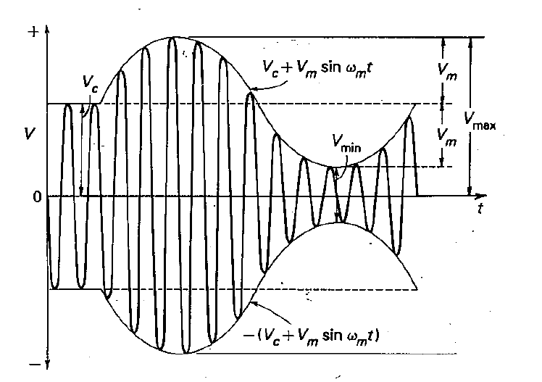
Amplitude-modulated wave and Envelope

Slide 13
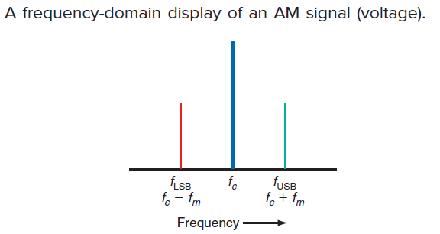
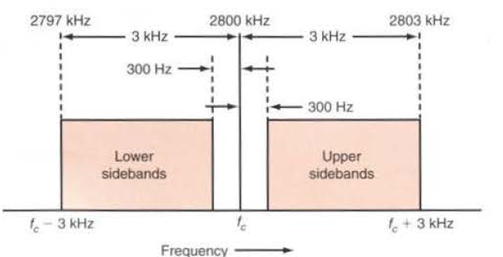
Frequency Spectrum of AM wave

Slide 14
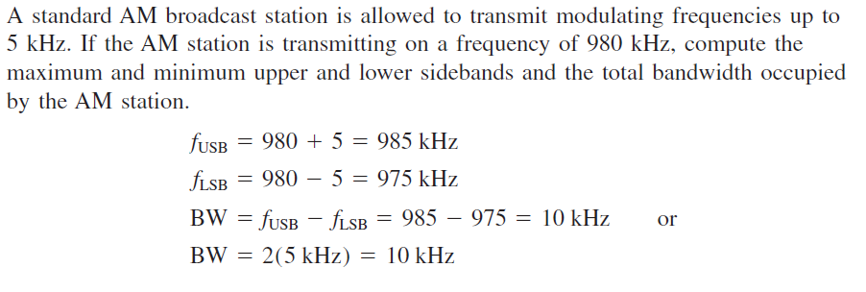
AM Example

Slide 15

Modulation Index and Percentage of Modulation
The modulating signal voltage V, must be less than the carrier voltage V,. Therefore the relationship between the amplitude of the modulating signal and the amplitude of the carrier signal is important. This relationship also known as the modulation index m (also called the modulating factor or coefficient, or the degree of modulation). is the ratio

Slide 16
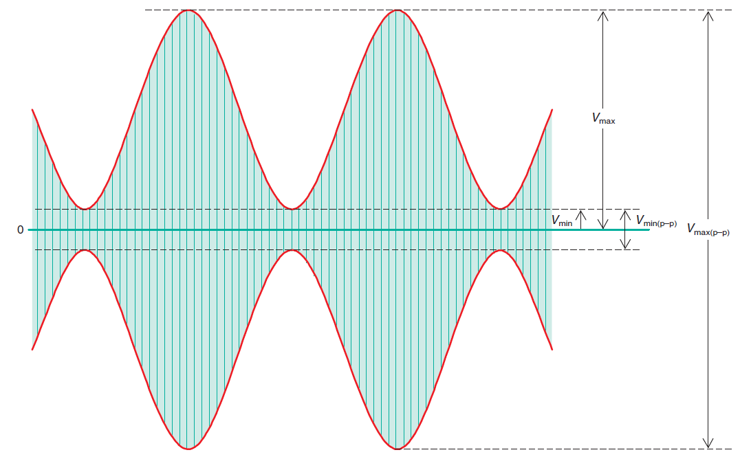
Modulation Index

Slide 17



Modulation Index
The peak value of the modulating signal Vm is one-half the difference of the peak and trough values:
The peak value of the carrier signal Vc is the average of the Vmax and Vmin values:
The modulation index is

Slide 18
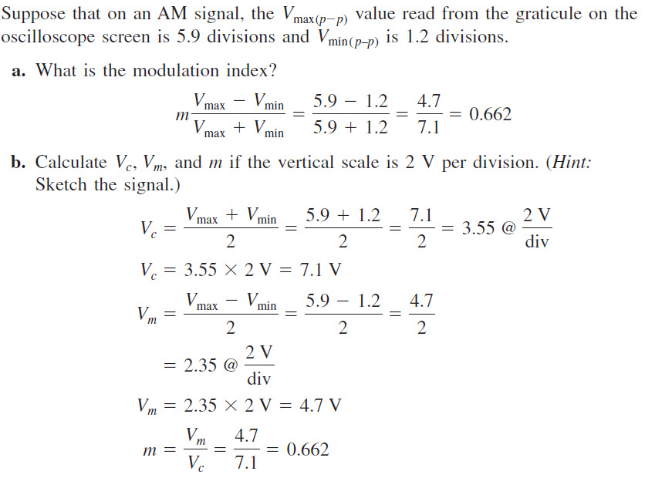
Modulation Index Example

Slide 19
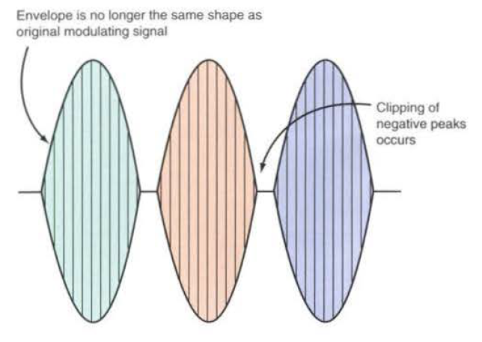
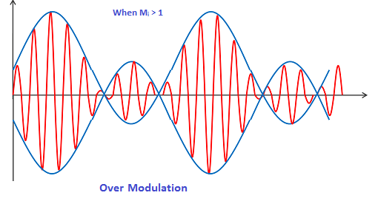
Over modulation and Distortion
The modulation index should be a number between 0 and I. If the amplitude of the modulating voltage is higher than the carrier voltage, m will be greater than 1, causing distortion of the modulated waveform. If the distortion is great enough. The intelligence signal becomes unintelligible
If M>1

Slide 20
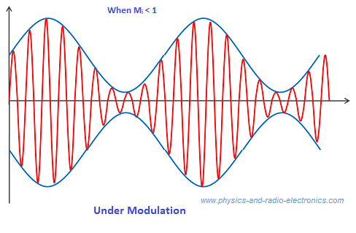
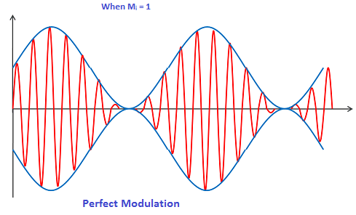
Under modulation and Critical Modulation
Critical Modulation : m=1 ie, 100 % modulation
No Distortion will occur, Greatest output power at Transmitter and Receiver
Under Modulation : M<1 , No Distortion will occur

Slide 21




AM Power
P_{T} = Pc + P_{LSB} + P_{USB}
The AM signal is
The R.M.S carrier and sideband voltages are
The power in the carrier and sidebands can be calculated by using the power formula P =V²/R, where P is the output power, V is the rms output voltage, and R is the resistive part of the load impedance, which is usually an antenna.
The modulation index m= Vm /Vc

Slide 22



AM Power
P_{T} = Pc + P_{LSB} + P_{USB}
Since the term Vc ²/2R is equal to the rms carrier power Pc,
For example, if the carrier of an AM transmitter is 1000 W and it is modulated 100 percent
(m = 1), the total AM power is

Slide 23
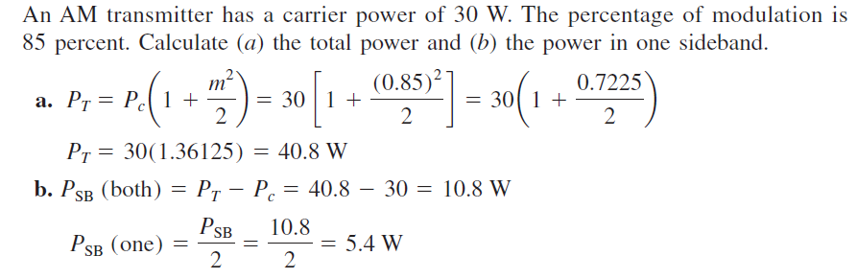
AM Power-Example

Slide 24
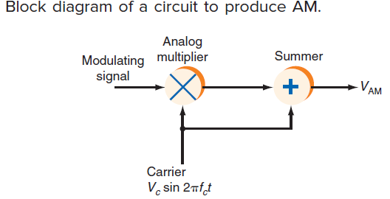
Amplitude Modulator Circuits
The basic equation for an AM signal
where the First term is the sine wave carrier and second term is the product of the sine wave carrier and modulating signals. (Remember that AM is the instantaneous value of the amplitude modulation voltage.)

Slide 25
Amplitude Modulator Circuits
Amplitude modulators are generally one of two types: low level or high level.
Low-level modulators generate AM with small signals and thus must be amplified considerably if they are to be transmitted.
High-level modulators produce AM at high power levels, usually in the final amplifier stage of a transmitter.
Low level Modulators
Diode Modulators
Transistor Modulators
Differential Amplifier Modulators

Slide 26
Amplitude Modulator Circuits
Low level Modulators
Diode Modulators
Transistor Modulators
Differential Amplifier Modulators
High level Modulators
Collector Modulator
Series Modulator

Slide 27
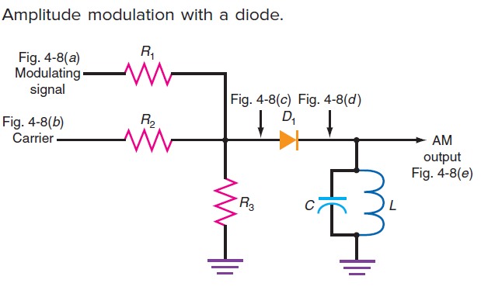
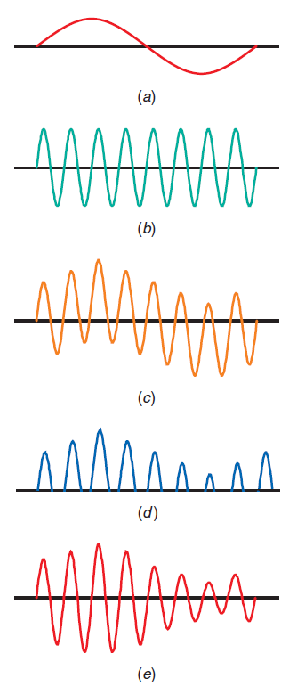
Amplitude Modulator Circuits- Low Level
The circuit works
best with mill volt-level signals.
The circuit consists of a resistive mixing network, a diode rectifier, and an LC tuned circuit.
Each time the diode conducts, a pulse of current flows through the tuned circuit. The coil and capacitor repeatedly exchange energy, causing an oscillation, or “ringing,” at the resonant frequency.
The oscillation of the tuned circuit creates one negative half-cycle for every positive input pulse. High amplitude positive pulses cause the tuned circuit to produce high- amplitude negative pulses. Low-amplitude positive pulses produce corresponding low-amplitude negative pulses. The resulting waveform across the tuned circuit is an AM signal, as Fig. (e) illustrates. The Q of the tuned circuit should be high enough to eliminate the harmonics and produce a clean sine wave and to filter out the modulating signal, and low enough that its bandwidth accommodates the sidebands generated.

Slide 28
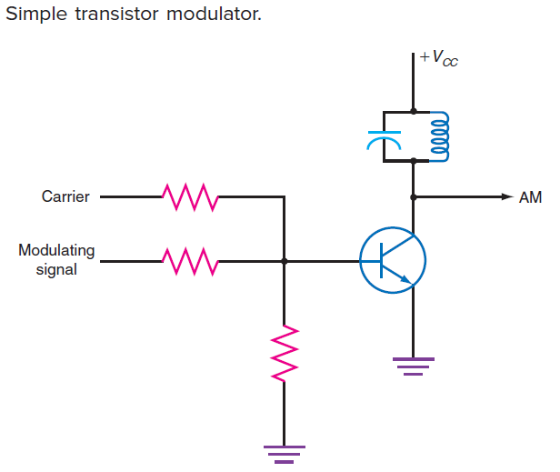
Amplitude Modulator Circuits
The emitter-base junction is a diode and a nonlinear device.
The base current controls a larger collector current, and therefore the circuit amplifies.
Rectification occurs because of the emitter-base junction.
This causes larger half-sine pulses of current in the tuned circuit.
The tuned circuit oscillates (rings) to generate the missing half-cycle.
The output is a classic AM wave.

Slide 29
Advantages and Disadvantages of Amplitude Modulation
Advantages | Disadvantages
Amplitude Modulation is easier to implement. | When it comes to power usage it is not efficient.
Demodulation can be done using few components and a circuit. | It requires a very high bandwidth that is equivalent to that of the highest audio frequency.
The receiver used for AM is very cheap. | Noise interference is highly noticeable.

Slide 30
Applications of Amplitude Modulation
Broadcast Transmissions: AM is used in broadcasting transmission over the short, medium and long wavebands. Since AM is easy to demodulate, radio receivers for amplitude modulation are therefore easier and cheaper to manufacture.
Air-band radio: AM is used in the VHF transmissions for many airborne applications such as ground-to-air radio communications or two-way radio links for ground staff personnel.
Single sideband: Amplitude modulation in this form is used for HF radio links or point-to-point HF links. AM uses a lower bandwidth and provides more effective use of the transmitted power.
Quadrature amplitude modulation: AM is used extensively in transmitting data in several ways, including short-range wireless links such as Wi-Fi to cellular telecommunications and others.

Slide 31
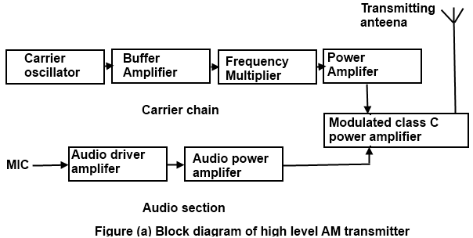
High-Level AM Transmitters

Slide 32
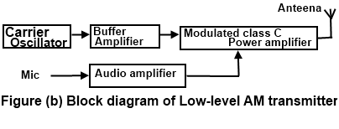
LOW-Level AM Transmitters

Slide 33
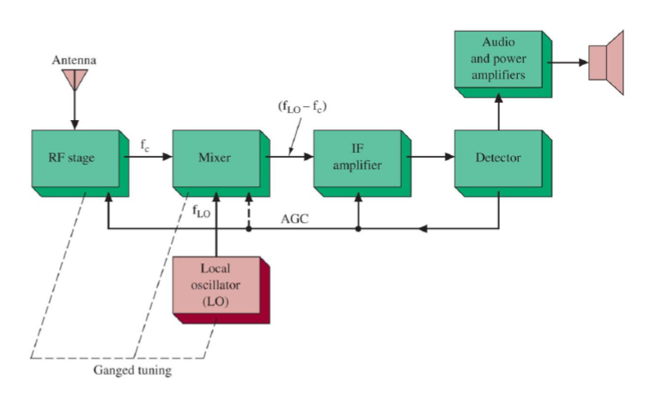
AM Receiver
Block diagram of a basic super heterodyne radio receiver

Slide 34
References
BOOK: Principles of Electronic Communication Systems (Louis E. Frenzel Jr.)
https://byjus.com/jee/amplitude-modulation/
https://www.physics-and-radio-electronics.com/blog/amplitude-modulation/
http://cpassignments.blogspot.com/2015/04/block-diagram-of-am-transmitter-and.html

