Slide 1
FTP
S. Varadhaganapathy
Professor/IT
KEC

Slide 2
Introduction
File Transfer Protocol (FTP) is the standard protocol provided by TCP/IP for copying a file from one host to another.
Problems
Two systems may use different file name conventions.
Two systems may have different ways to represent data.
Two systems may have different directory structures.
All of these problems have been solved by FTP in a very simple and elegant approach.
Although we can transfer files using HTTP, FTP is a better choice to transfer large files or to transfer files using different formats.

Slide 3
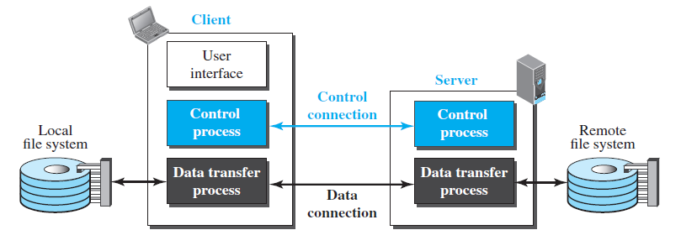
FTP

Slide 4
The client has three components: the user interface, the client control process, and the client data transfer process.
The server has two components: the server control process and the server data transfer process.
The control connection is made between the control processes.
The data connection is made between the data transfer processes.
Separation of commands and data transfer makes FTP more efficient.
The control connection uses very simple rules of communication.
We need to transfer only a line of command or a line of response at a time.
The data connection needs more complex rules due to the variety of data types transferred.

Slide 5
Two Connections
The two connections in FTP have different lifetimes.
The control connection remains connected during the entire interactive FTP session.
The data connection is opened and then closed for each file transfer activity.
It opens each time commands that involve transferring files are used, and it closes when the file is transferred.
In other words, when a user starts an FTP session, the control connection opens.
While the control connection is open, the data connection can be opened and closed multiple times if several files are transferred.
FTP uses two well-known TCP ports: port 21 is used for the controlconnection, and port 20 is used for the data connection.

Slide 6
Control Connection
For control communication, FTP uses the same approach as TELNET
It uses the NVT ASCII character set as used by TELNET. Communication is achieved through commands and responses.
This simple method is adequate for the control connection because we send one command (or response) at a time.
Each line is terminated with a two-character (carriage return and line feed) end-of-line token.
During this control connection, commands are sent from the client to the server and responses are sent from the server to the client.
Commands, which are sent from the FTP client control process, are in the form of ASCII uppercase, which may or may not be followed by an argument.
Some of the most common commands are shown in the following table:

Slide 7
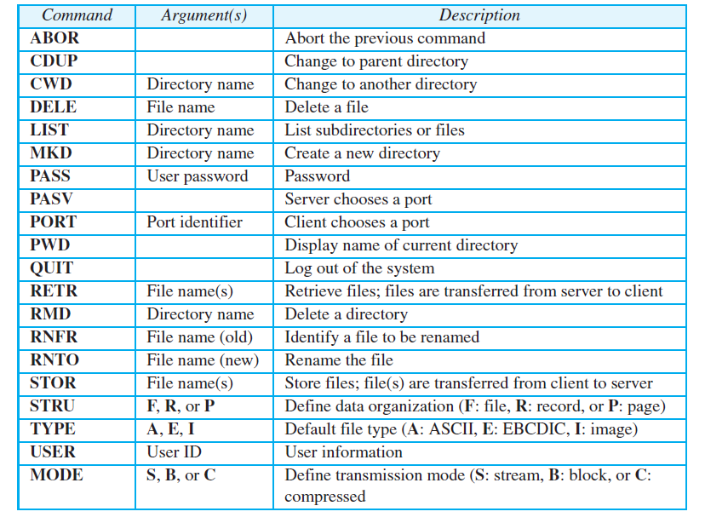
FTP Commands

Slide 8
Responses
Every FTP command generates at least one response.
A response has two parts: a three-digit number followed by text.
The numeric part defines the code; the text part defines needed parameters or further explanations.
The first digit defines the status of the command.
The second digit defines the area in which the status applies.
The third digit provides additional information.
Following Table shows some common responses.

Slide 9
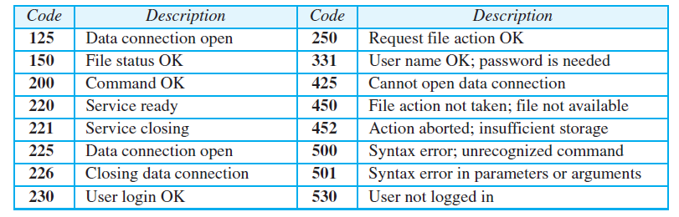
Responses

Slide 10
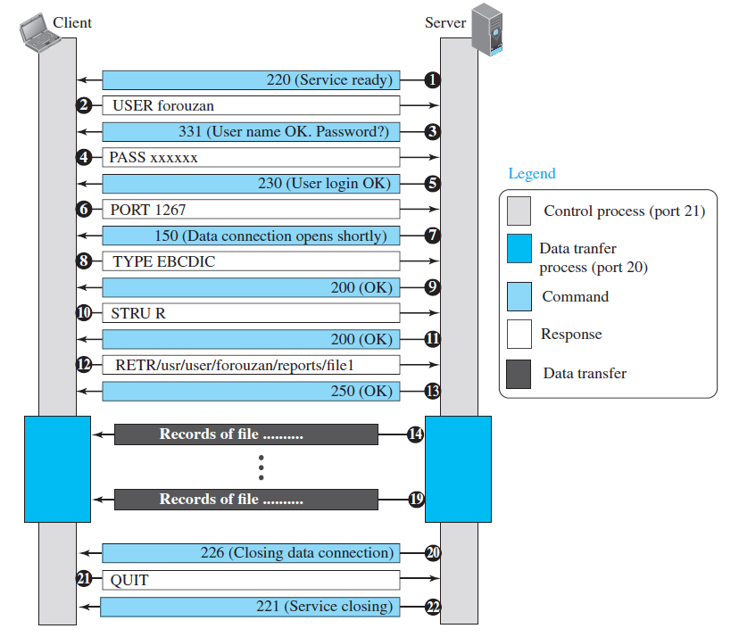
Retrieving a file using FTP

Slide 11
Data Connection
The data connection uses the well-known port 20 at the server site.
However, the creation of a data connection is different from the control connection.
The following shows the steps:
The client, not the server, issues a passive open using an ephemeral port. This must be done by the client because it is the client that issues the commands for transferring files.
Using the PORT command the client sends this port number to the server.
The server receives the port number and issues an active open using the wellknown port 20 and the received ephemeral port number.

Slide 12
Communication over Data Connection
The purpose and implementation of the data connection are different from those of the control connection.
We want to transfer files through the data connection.
The client must define the type of file to be transferred, the structure of the data, and the transmission mode.
Before sending the file through the data connection, we prepare for transmission through the control connection.
The heterogeneity problem is resolved by defining three attributes of communication: file type, data structure, and transmission mode.
File Type
FTP can transfer one of the following file types across the data connection: ASCII file, EBCDIC file, or image file.

Slide 13
Communication over Data Connection
Data Structure
FTP can transfer a file across the data connection using one of the following interpretations of the structure of the data: file structure, record structure, or page structure.
The file structure format has no structure. It is a continuous stream of bytes.
In the record structure, the file is divided into records. This can be used only with text files.
In the page structure, the file is divided into pages, with each page having a page number and a page header. The pages can be stored and accessed randomly or sequentially.

Slide 14
Communication over Data Connection
Transmission Mode
FTP can transfer a file across the data connection using one of the following three transmission modes: stream mode, block mode, or compressed mode.
The stream mode is the default mode; data are delivered from FTP to TCP as a continuous stream of bytes.
In the block mode, data can be delivered from FTP to TCP in blocks. In this case, each block is preceded by a 3-byte header. The first byte is called the block descriptor; the next two bytes define the size of the block in bytes.

Slide 15
Communication over Data Connection
File Transfer
File transfer occurs over the data connection under the control of the commands sent over the control connection.
File transfer in FTP means one of three things: retrieving a file (server to client), storing a file (client to server), and directory listing (server to client).

Slide 16
Security for FTP
Although FTP requires a password, the password is sent in plaintext (unencrypted), which means it can be intercepted and used by an attacker.
The data transfer connection also transfers data in plaintext, which is insecure.
To be secure, one can add a Secure Socket Layer between the FTP application layer and the TCP layer.

