Slide 1
Computer Network Models
OSI MODEL
TCP/IP MODEL

Slide 2
Question 01
What is the process of sending letters through a post office?

Slide 3
Network Model
A method of describing and analyzing data communication networks by breaking the entire set of communication process into a number of layers.
Each layer has a specific function

Slide 4
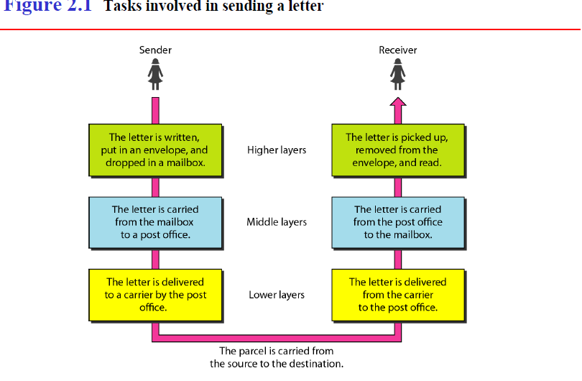
PROTOCOL LAYERING
Protocol layering enables to divide a complex task into several smaller and simpler tasks.

Slide 5
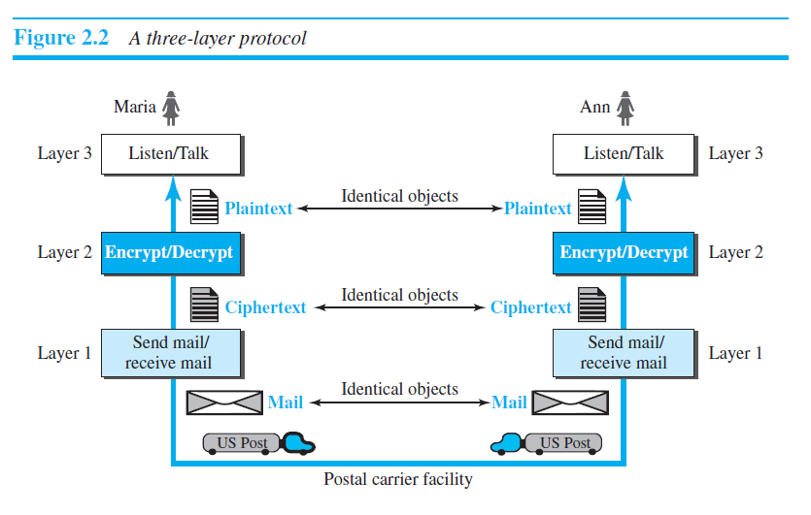
PROTOCOL LAYERING

Slide 6
Applications and layered architectures
Various services: various applications require various services
Flexibility: powerful networks need to be flexible enough to support the current services and future services
Architectures: an overall network architecture is necessary to achieve the flexibility

Slide 7
Layered architectures
Layers: grouping the common functions
Benefits of layers:
  Simplicity: easy to design once layers and their interaction are defined clearly
  Flexibility: easy to modify and develop networks by separate layers modifications
  Incremental changes: add new layers, add new functions to a layer

Slide 8
Three obvious tasks (layers)
Transport of data across the network from one end to the other
Routing/forwarding of packets across multiple hops
Transfer of a frame from one interface to another (i.e., one hop).

Slide 9
Big picture of layered architectures
Web browsing and e-mail examples
OSI reference model (Seven layers)
TCP/IP architecture
Detailed end-to-end examples to complete big picture of layered architectures
Socket API and other utilities

Slide 10
Terminology
Client/Server model: the most typical interaction between two parties within networks
Client: the process making requests
Server (Daemon): the process waiting and receiving requests, processing the requests and returning results
Protocols: a set of rules governing how two communicating parties are to interact.
Service: a protocol will provide a service
Layers’ protocols: each layer carries out a specific set of functions using its own protocol, and builds on the services of the layer below it (provides a service to its upper layer).

Slide 11
Why do we use OSI layer?
to guide technology vendors and developers
Provide a teaching tool to understand the communication process used between networking components. Separate a complex function into simpler components.

Slide 12
The OSI Model:
OSI Model
International standard organization (ISO) established a committee in 1977 to develop an architecture for computer communication.
In 1984, the Open Systems Interconnection (OSI) reference model was approved as an international standard for communications architecture.
It is an architectural model for the inter-computer communications.
OSI model divides the whole task into seven smaller and manageable tasks. Each layer is assigned a particular task.
Each layer is self-contained, so that task assigned to each layer can be performed independently.

Slide 13
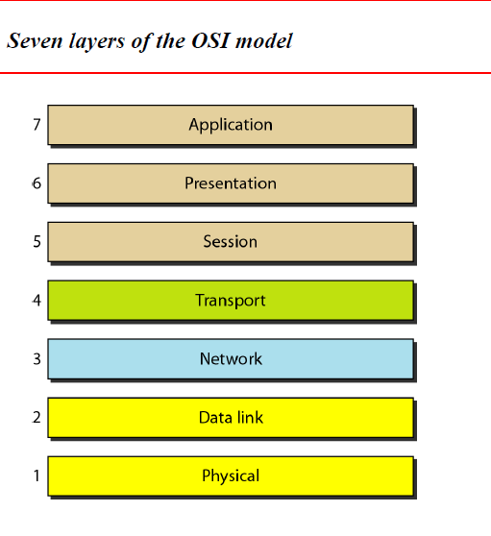
OSI Reference Model
OSI Model

Slide 14
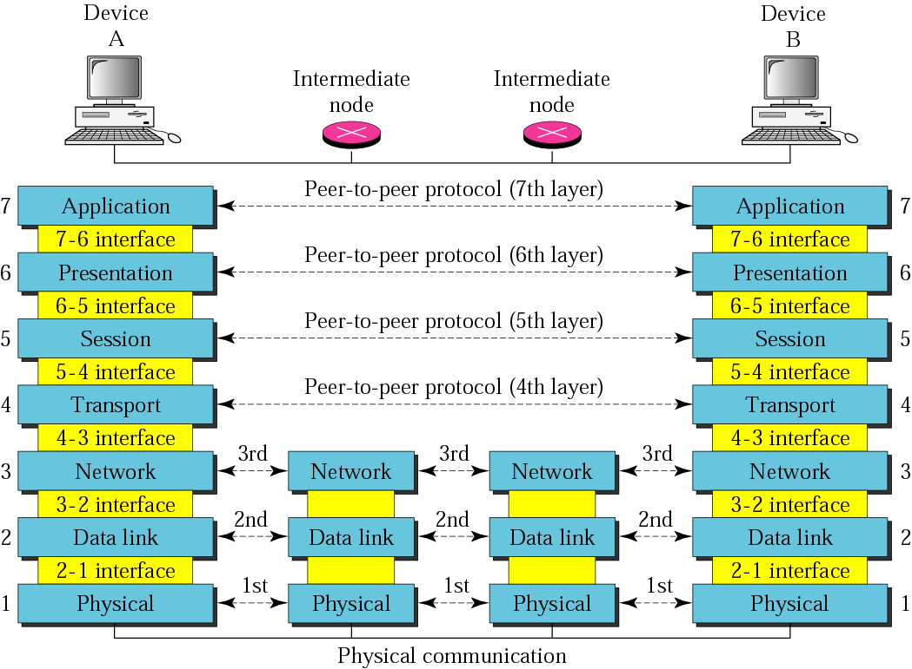
Figure 2.2 OSI layers

Slide 15
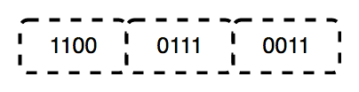
Layer 1: The Physical Layer
The physical layer contains information in the form of bits.
It is responsible for transmitting individual bits from one node to the next.
When receiving data, this layer will get the signal received and convert it into 0s and 1s and send them to the Data Link layer

Slide 16
functions of the physical layer
Bit synchronization: to provides the synchronization of the bits by providing a clock. This clock controls both sender and receiver thus providing synchronization at bit level.
Bit rate control: To defines the transmission rate i.e. the number of bits sent per second.
Hub, Repeater, Modem, Cables are Physical Layer devices.

Slide 17
functions of the physical layer
Physical topologies: It specifies the way in which the different, devices/nodes are arranged in a network i.e. bus, star or mesh topolgy.
Transmission mode: It defines the way in which the data flows between the two connected devices.
The various transmission modes possible are: Simplex, half-duplex and full-duplex.

Slide 18
Data Link Layer (DLL) (Layer 2)
Data link layer converts Packets into frames.
Adds the physical address of the sender in frames.
Data link layer is responsible for error detection and correction.
Responsible for Flow Control.
Data link layer uses ARP, RARP, PPP, Ethernet, WiFi, etc protocols

Slide 19
Data Link Layer (DLL) (Layer 2)
The data link layer is divided into two sublayers:
1)Media access control: Responsible for controlling how devices in a network gain access to a medium
2)Logical link control: Responsible error checking and frame synchronization

Slide 20
NETWORK LAYER
Network layer converts received segment into packets.
Network layer Adds Source and destination IP address to each packet.
Responsible for routing of packets.
Handles network traffic i.e network conjunction.
Network layer adds a sequence number to each packet.
Network layer uses IP, ICMP, IGMP, IPsec.

Slide 21
TRANSPORT LAYER
Transport layer does segmentation.
It uses TCP and UDP protocols.
When transport layer uses the TCP protocol, it gives the guarantee of transmission.
When transport layer uses the UDP protocol, it does not give the guarantee of transmission.
It responsible for retransmission of data if data transmission is failing when transport layer uses TCP protocol.

Slide 22
Transport layer
It sends acknowledgment for successful and unsuccessful message delivery.
Transport layer uses TCP, UDP, SCTP, DCCP, etc protocols.

Slide 23
SESSION LAYER
It is responsible for creating a session between client and server.
Session means any activity performed within start time and stop time is called the session.
It is responsible for establishing a connection, managing the connection and terminating the connection between the client and the server
It is responsible for dialog control means for keeping the track of whose turn it is to transmit.

Slide 24
PRESENTATION LAYER
Translation : It changes the data format depends on the receiver requirement with encryption. for example, ASCII to EBCDIC.
Encryption/ Decryption : Data encryption translates the data into another form or code.
The encrypted data is known as the cipher text and the decrypted data is known as plain text. A key value is used for encrypting as well as decrypting data.

Slide 25
PRESENTATION LAYER
Compression: Reduces the number of bits that need to be transmitted on the network.

Slide 26
Application Layer (Layer 7)
It provides the user to access information on the network through an application.
This layer is the main interface for the user to interact with the application and the network.
the user interact directly with the software application.
This layer interacts with software applications that implement a communicating component

Slide 27
Application Layer (Layer 7)
The various functions of the Application layer are:
Mail services,
Directory services,
File server management, etc.

Slide 28
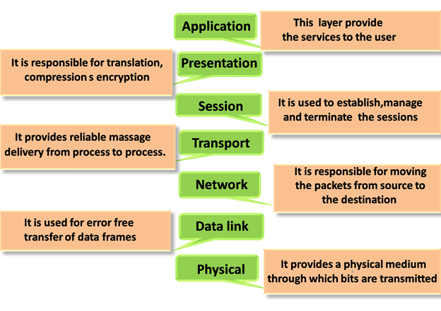

Slide 29
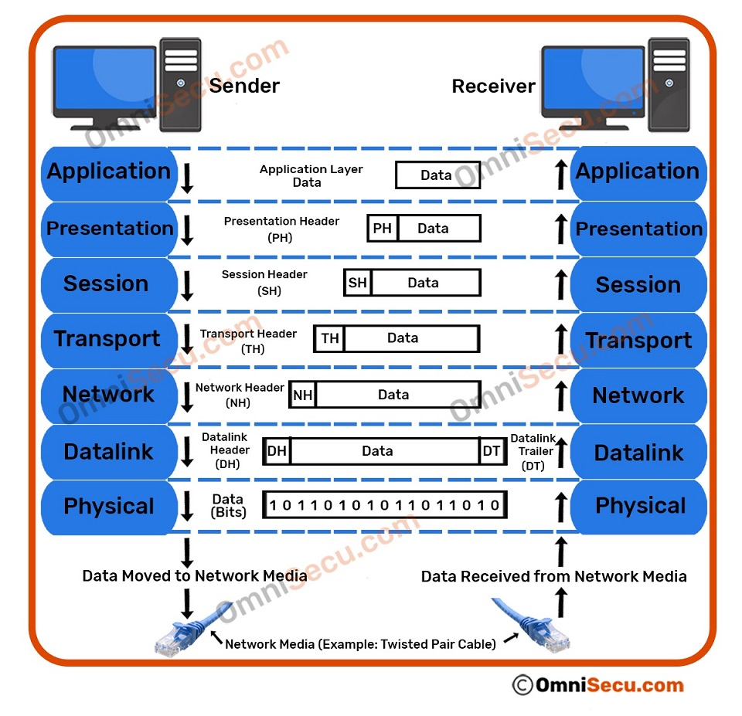

Slide 30
TCP/IP PROTOCOL SUITE
(Transmission
Control Protocol/Internet Protocol)

Slide 31
TCP/IP model development
TCP/IP to interconnect various defense department computer networks.
The Internet, an International Wide Area Network, uses TCP/IP to connect networks across the world.
It is a Internet architecture

Slide 32
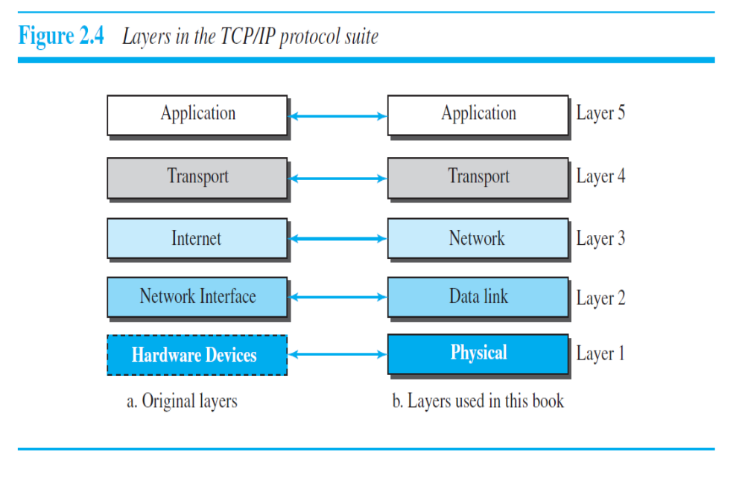

Slide 33
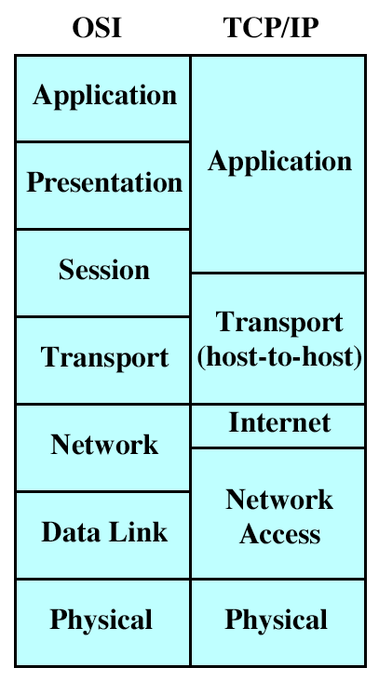
TCP/IP MODEL
TCP/IP Model

Slide 34
Physical Layer
t deals with data in the form of bits. This layer mainly handles the host to host communication in the network.
It defines the transmission medium and mode of communication between two devices.
The medium can be wired or wireless, and the mode can be simplex, half-duplex, or full-duplex.

Slide 35
Data-Link Layer
It deals with data in the form of data frames.
It performs the data framing in which, it adds some header information to the data packets for the successful delivery of data packets to correct destinations.
For this, it performs physical addressing of the data packets by adding the source and the destination address to it.

Slide 36
Internet Layer
It deals with data in the form of datagrams or data packets.
To provide the logical addressing of the data packets by adding the IP(Internet Protocol) address to it.
It performs routing of data packets using the IP addresses.
The data packets can be sent from one network to another using the routers in this layer.

Slide 37
Transport Layer
It deals with data in the form of data segments.
It performs segmentation of the data received from the upper layers.
It is responsible for transporting data and setting up communication between the application layer and the lower layers.
This layer facilitates the end-to-end communication and error-free delivery of the data.

Slide 38
Application Layer
It deals with the communication of the whole data message.
It provides an interface between the network services and the application programs.
It provides services to the end-users to work over the network.
For Example,
file transfer, web browsing, etc. This layer uses all the higher-level protocols like HTTP, HTTPS, FTP, NFS, DHCP, FMTP, SNMP, SMTP, Telnet, etc.

Slide 39
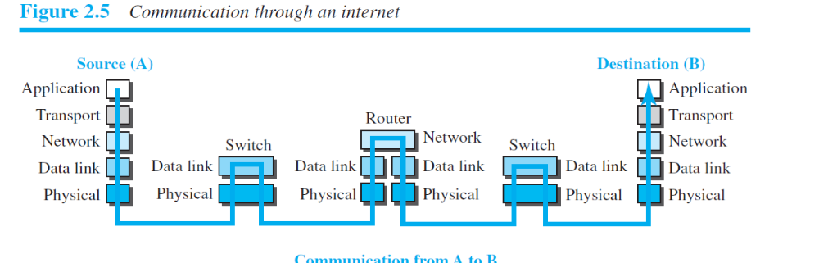
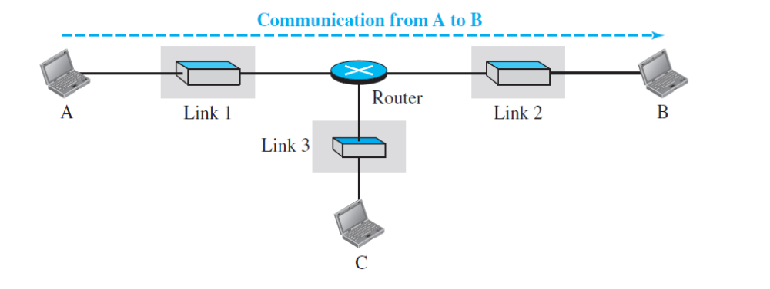

Slide 40
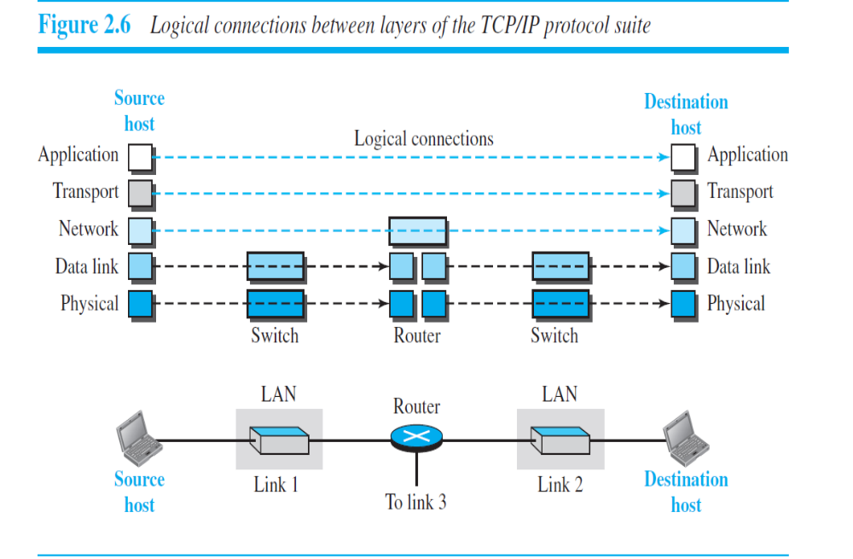

Slide 41
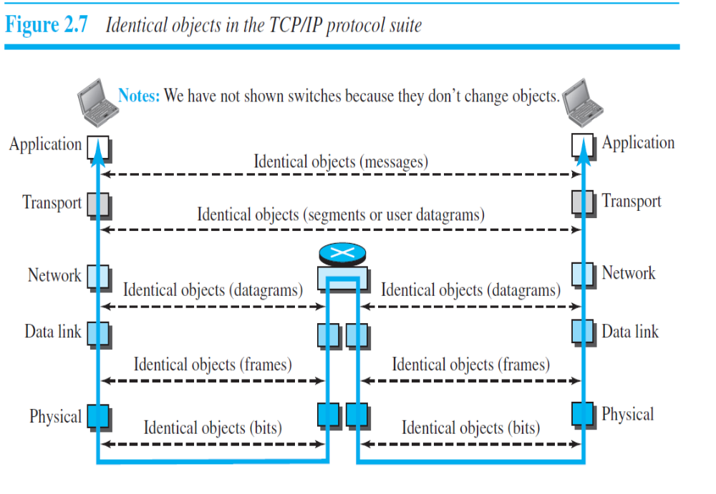

Slide 42
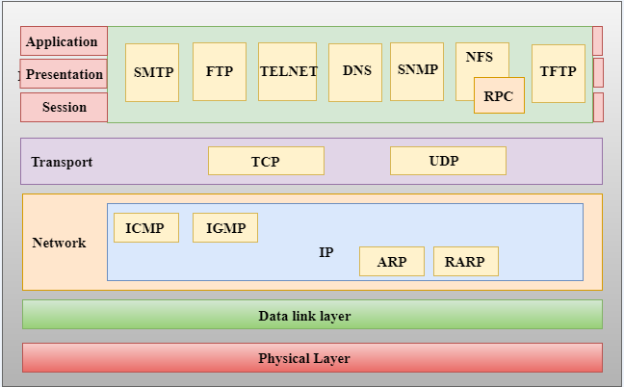

Slide 43
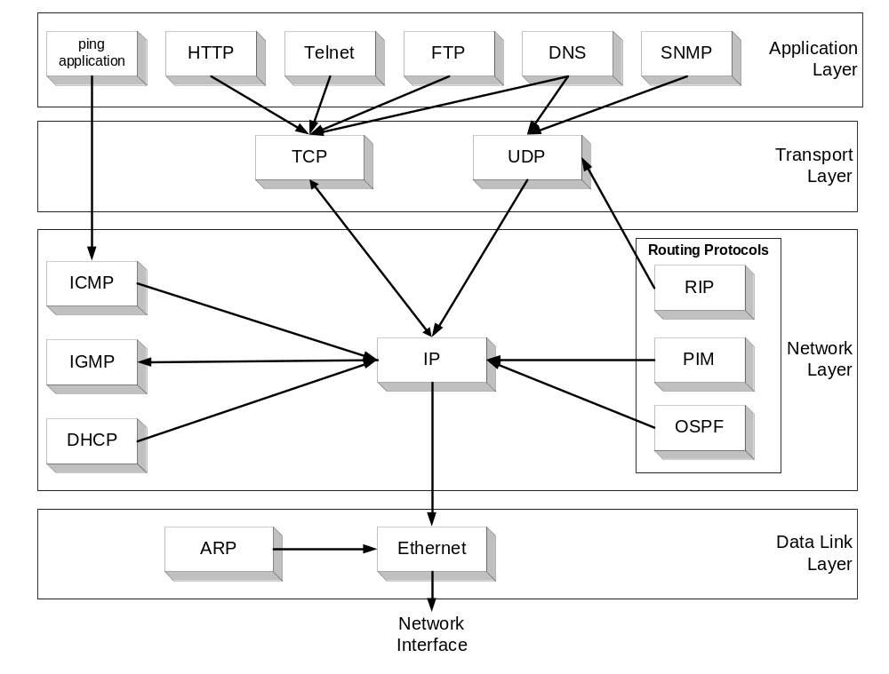

Slide 44
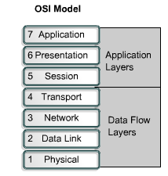
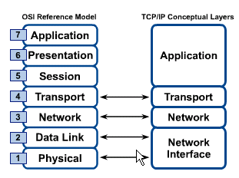
OSI & TCP/IP Models
TCP/IP Model

Slide 45
Encapsulation and Decapsulation
In encapsulation, the data is moving from upper layer to the lower layer, and each layer includes a bundle of information called a header along with the actual data
while in decapsulation, the data is moving from the lower layer to the upper layers, and each layer unpacks the corresponding headers to obtain the actual data.

Slide 46
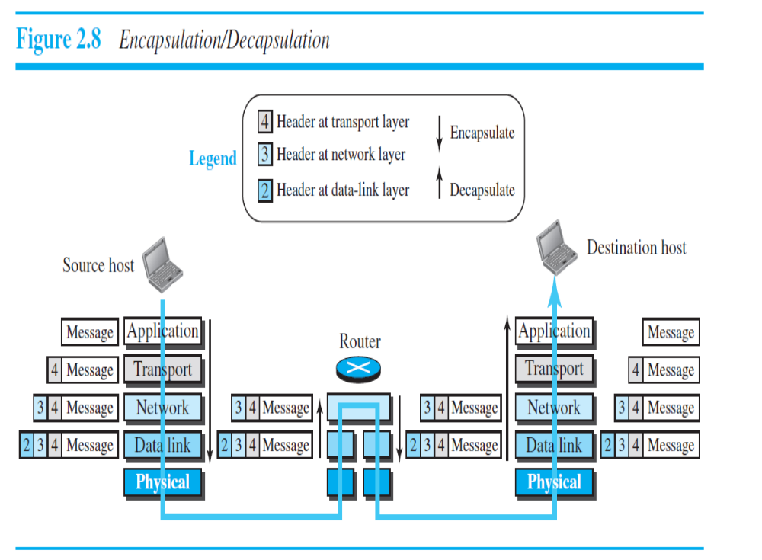

Slide 47
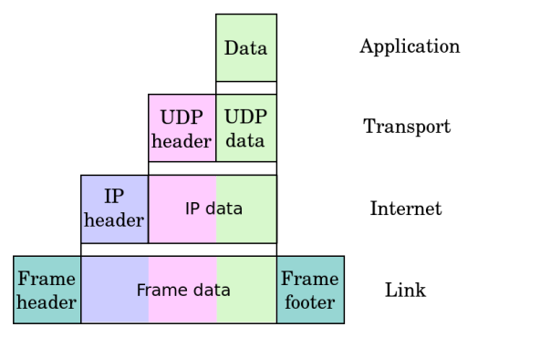

Slide 48
the example of browsing a website using a web browser like Chrome. The OSI model can help us understand the different layers involved in the process:
Application Layer: The web browser resides in the application layer of the OSI model. It interacts with the user and provides an interface to access websites.

Slide 49
Presentation Layer:
The presentation layer takes care of data formatting and encryption.
In this case, it ensures that the website data is presented in a readable format and may handle tasks such as data compression or encryption if necessary.

Slide 50
Session Layer:
The session layer establishes and manages the communication session between the web browser and the web server. It sets up a connection, manages authentication, and maintains the session during the browsing session.

Slide 51
Transport Layer:
The transport layer is responsible for reliable end-to-end delivery of data.
In the case of browsing a website, it uses protocols like TCP (Transmission Control Protocol) to break the website data into smaller segments, ensure their reliable delivery, and establish a connection with the web server.

Slide 52
Network Layer:
The network layer handles the addressing and routing of data packets.
It adds the source and destination IP addresses to the data packets, allowing them to be routed across different networks. It uses protocols like IP (Internet Protocol) to accomplish this.

Slide 53
Data Link Layer:
The data link layer is responsible for the physical transmission of data over the network.
It takes the packets from the network layer and encapsulates them into frames, adding MAC (Media Access Control) addresses for source and destination.
Ethernet is an example of a data link layer protocol commonly used in local area networks (LANs).

Slide 54
Physical Layer:
The physical layer deals with the actual transmission of binary data through physical media such as cables, wireless signals, or fiber optics.
It handles the electrical, mechanical, and timing aspects of data transmission.

