Slide 1
Error Detection and Correction

Slide 2
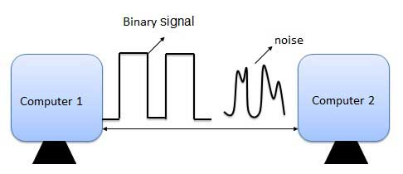
Need of Error detection and correction
Noise or Error is the main problem in the signal, which disturbs the reliability of the communication system.
Error control coding is the coding procedure done to control the occurrences of errors.
These techniques help in Error Detection and Error Correction.

Slide 3
Basic concepts
Networks must be able to transfer data from one device to another with complete accuracy.
Data can be corrupted during transmission.
For reliable communication, errors must be detected and corrected.
Error detection and correction are implemented either at the data link layer or the transport layer of the OSI model.

Slide 4
Error-Detecting codes
use error-detecting codes which are additional data added to a given digital message to help us detect if an error occurred during transmission of the message.
A simple example of error-detecting code is parity check.

Slide 5
Error-Correcting codes
To pass some data to figure out the original message from the corrupt message that we received. This type of code is called an error-correcting code.

Slide 6
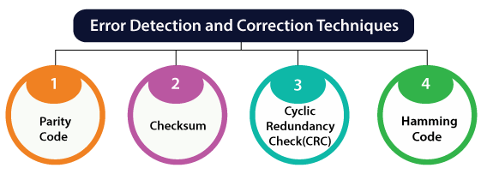

Slide 7
How to Detect and Correct Errors?
To detect and correct the errors, additional bits are added to the data bits at the time of transmission.
The additional bits are called parity bits. They allow detection or correction of the errors.
The data bits along with the parity bits form a code word.

Slide 8
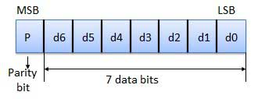
Parity Checking of Error Detection
The MSB of an 8-bits word is used as the parity bit and the remaining 7 bits are used as data or message bits.
The parity of 8-bits transmitted word can be either even parity or odd parity.

Slide 9
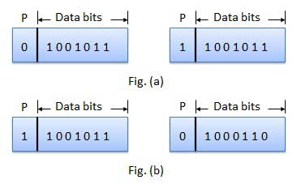
Use of Parity Bit
Even parity -- Even parity means the number of 1's in the given word including the parity bit should be even (2,4,6,....).
Odd parity -- Odd parity means the number of 1's in the given word including the parity bit should be odd (1,3,5,....).

Slide 10
The parity bit can be set to 0 and 1 depending on the type of the parity required.
For even parity, this bit is set to 1 or 0 such that the no. of "1 bits" in the entire word is even. Shown in fig. (a).
For odd parity, this bit is set to 1 or 0 such that the no. of "1 bits" in the entire word is odd. Shown in fig. (b).

Slide 11
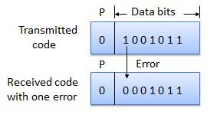
How Does Error Detection Take Place?

Slide 12
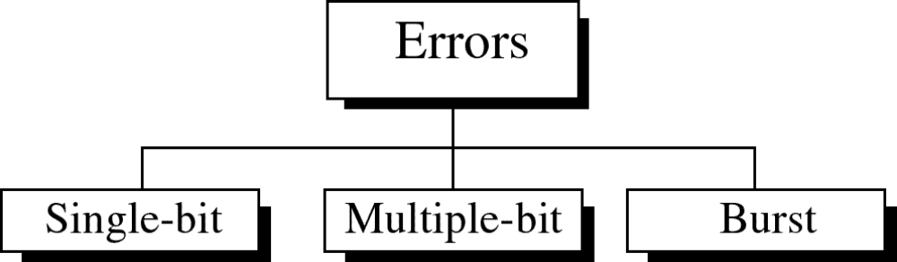
Types of Errors

Slide 13
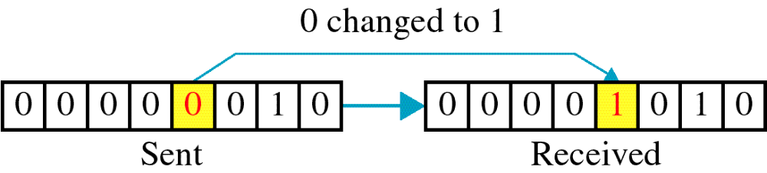
Single-bit error
only 1 bit of a given data unit
(such as a byte, character, or packet) is changed from 1 to 0 or from 0 to 1.
Single bit errors - in serial data transmission

Slide 14
Burst error
The term burst error means that two or more bits in the data unit have changed from 1 to 0 or from 0 to 1.
errors occur in consecutive bits,
Some bits in between may not have been corrupted.

Slide 15
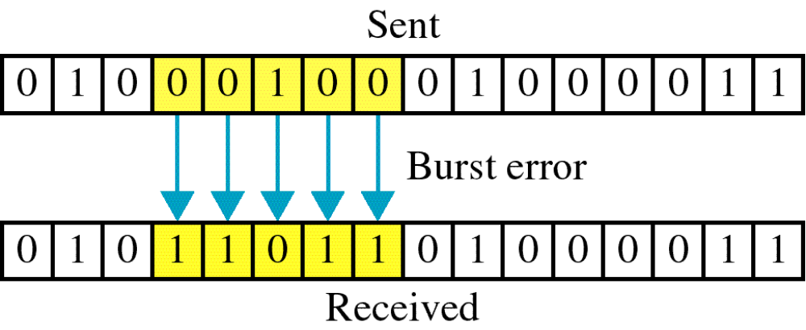
Burst error

Slide 16
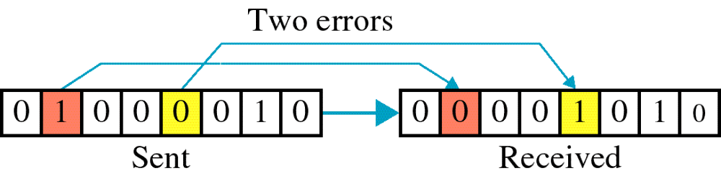

Slide 17
Redundancy
The central concept in detecting or correcting errors is redundancy.
To detect or correct errors, we need to send some extra bits with our data.
These redundant bits are added by the sender and removed by the receiver

Slide 18
Error detection
Error detection means to decide whether the received data is correct or not without having a copy of the original message.
Error detection uses the concept of redundancy, which means adding extra bits for detecting errors at the destination.
Notes:
Make sense of message.
Make sense of message.

Slide 19
Error Correction
Error Correction codes are used to detect and correct the errors when data is transmitted from the sender to the receiver.

Slide 20
Error Correction can be handled in two ways:
Backward error correction: Once the error is discovered, the receiver requests the sender to retransmit the entire data unit.
Forward error correction: In this case, the receiver uses the error-correcting code which automatically corrects the errors.

Slide 21
Coding schemes
Redundancy is achieved through various coding schemes.
The sender adds redundant bits through a process that creates a relationship between the redundant bits and the actual data bits.
The receiver checks the relationships between the two sets of bits to detect errors.

Slide 22
Coding
The ratio of redundant bits to data bits and the robustness of the process are important factors in any coding scheme.
We can divide coding schemes into two broad categories:
block coding and convolution coding

Slide 23
Block codes
In block codes, in fixed-size blocks of bits, the message is contained.
In this, the redundant bits are added for correcting and detecting errors.
In block coding, we divide our message message into blocks, each of k bits, called datawords.
We add r redundant bits to each block to make the length n = k + r.
There resulting n-bit blocks are called codewords

Slide 24
Convolutional codes
The message consists of data streams of random length, and parity symbols are generated by the sliding application of the Boolean function to the data stream.
The hamming code technique is used for error correction

Slide 25
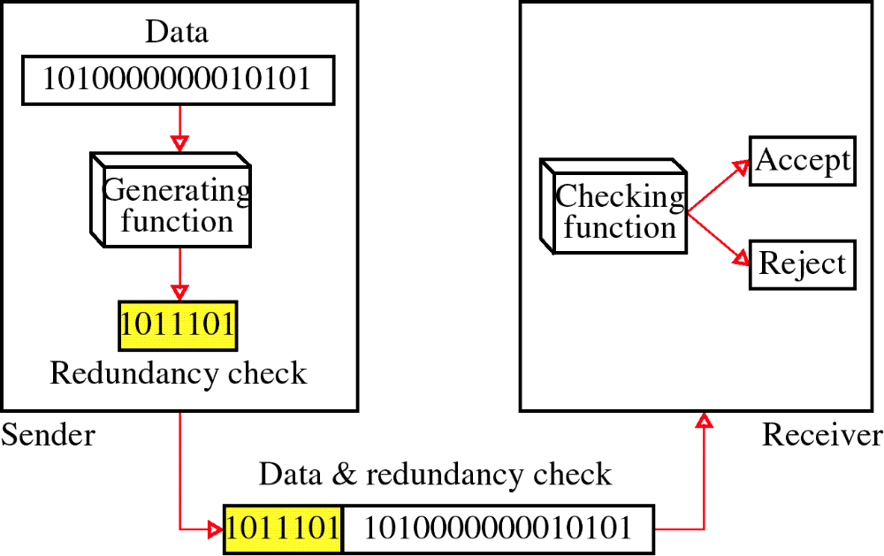
Redundancy

Slide 26
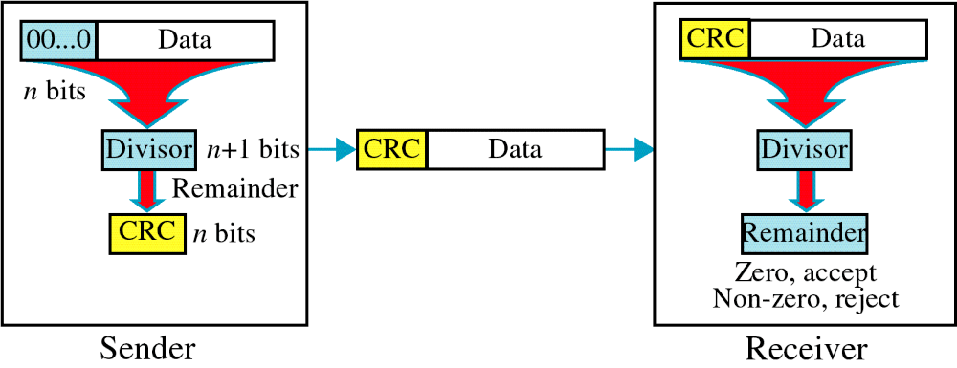
Cyclic Redundancy Check
CRC

Slide 27

XORing of two single bits or two words
10.<number>

Slide 28
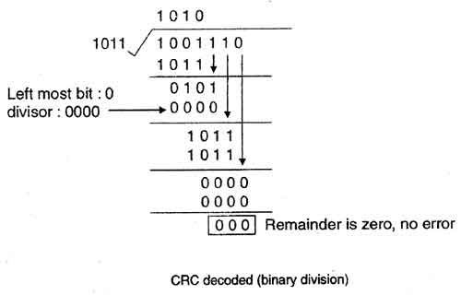
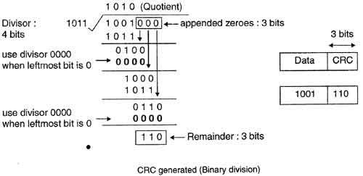
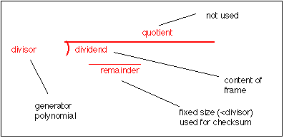
Cyclic Redundancy Check
Receiver Side/decoding
Sender Side / Encoding

Slide 29
At Sender Side
Sender has a generator G(x) polynomial.
Sender appends (n-1) zero bits to the data.
Where n= no of bits in generator
Dividend appends the data with generator G(x) using modulo 2 division (arithmetic).
Remainder of (n-1) bits will be CRC.

Slide 30
Example
Assume that –
(a) data is 10110.
(b) code generator is 1101. (Code generator can also be mentioned in polynomial : ( x^3+x^2+1)
Note – Code generator is always mentioned in the question.

Slide 31
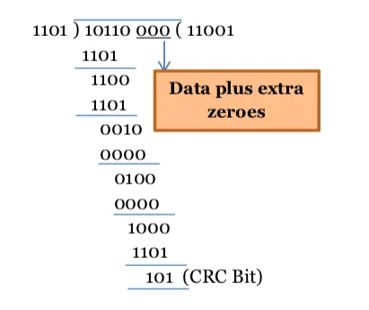
Step 1: In the above code, code generator is 1101. So, there is total 4 bits. So, we will append 000 with the data.
Step 2:
Cyclic redundancy check is 101. Thus, the sender sends 10110101 (codeword) to the receiver.

Slide 32
At Receiver Side
Receiver has same generator G(x).
Receiver divides received data (data + CRC) with generator.
If remainder is zero, data is correctly received.
Else, there is error.

Slide 33
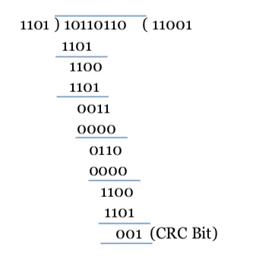
Step 1: the received message is 10110110.
It does not add any padding bits, rather calculates from the entire received code word.
CRC calculation by receiver
The CRC bits are calculated to be different. Thus, there is an error detected.

Slide 34
Cyclic Redundancy Check
Given a k-bit frame or message, the transmitter generates an n-bit sequence, known as a frame check sequence (FCS), so that the resulting frame, consisting of (k+n) bits, is exactly divisible by some predetermined number.
The receiver then divides the incoming frame by the same number and, if there is no remainder, assumes that there was no error.

Slide 35
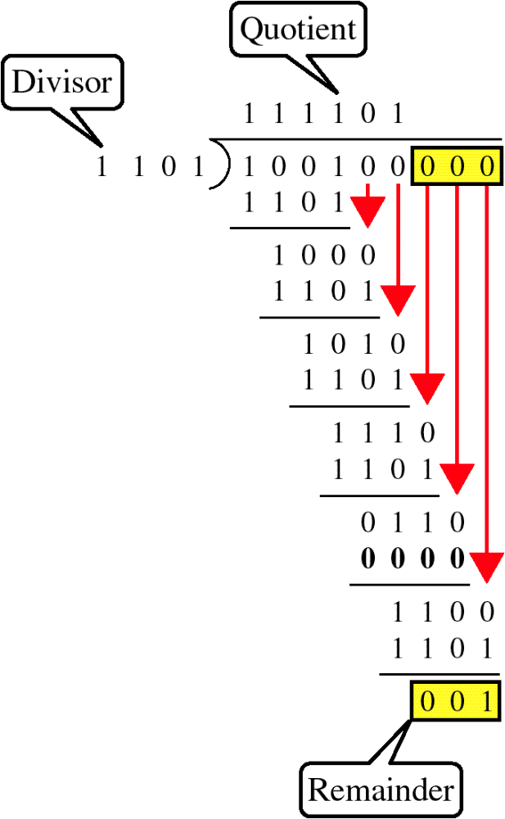
Binary Division

Slide 36
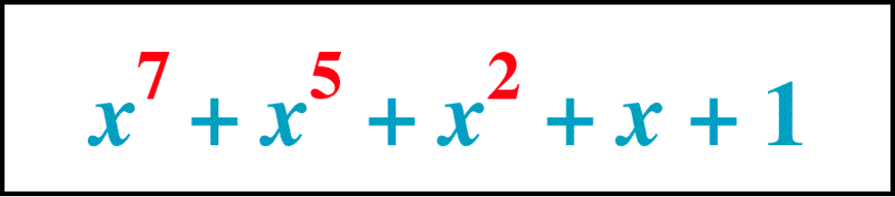
Polynomial

Slide 37
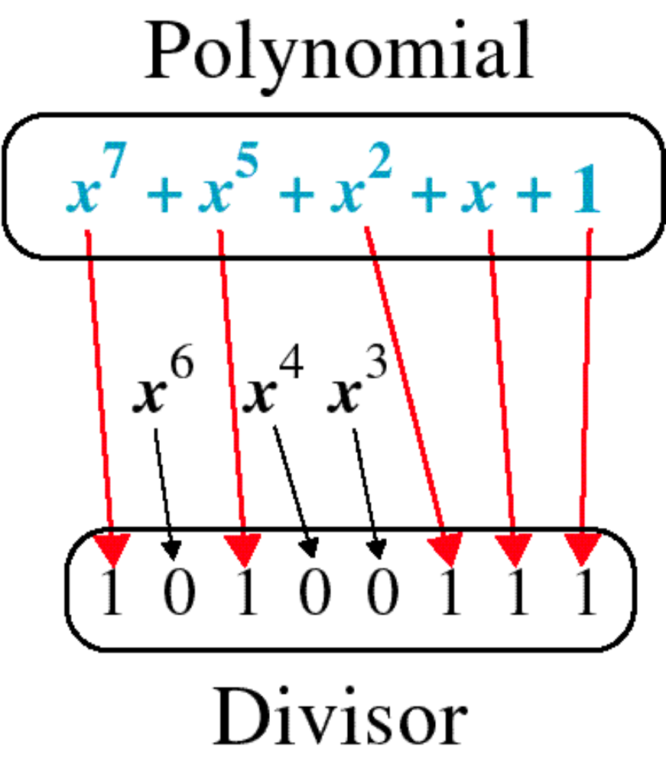
Polynomial and Divisor

Slide 38
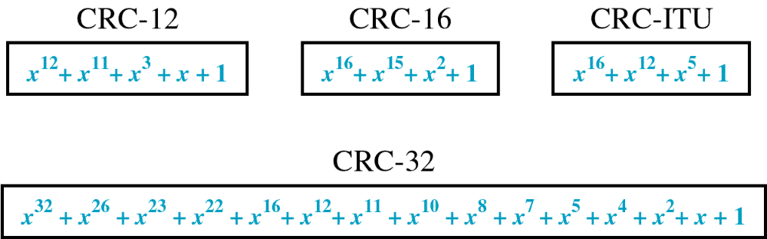
Standard Polynomials

Slide 39
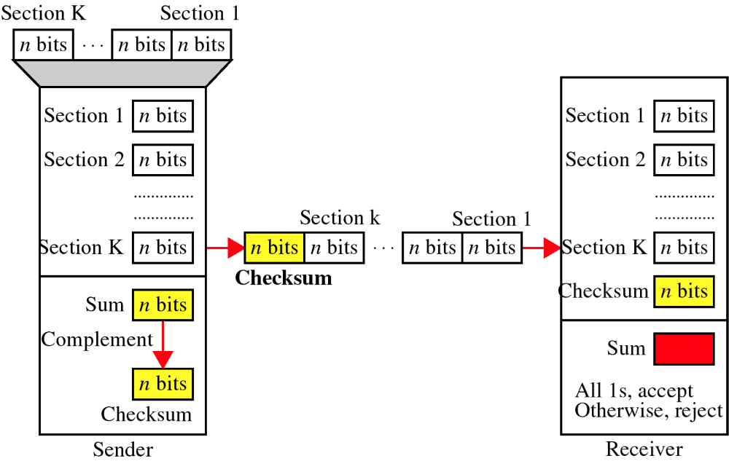
Checksum

Slide 40
At the sender
The unit is divided into k sections, each of n bits.
All sections are added together using one’s complement to get the sum.
The sum is complemented and becomes the checksum.
The checksum is sent with the data

Slide 41
At the receiver
The unit is divided into k sections, each of n bits.
All sections are added together using one’s complement to get the sum.
The sum is complemented.
If the result is zero, the data are accepted: otherwise, they are rejected.

Slide 42
Performance
The checksum detects all errors involving an odd number of bits.
It detects most errors involving an even number of bits.
If one or more bits of a segment are damaged and the corresponding bit or bits of opposite value in a second segment are also damaged, the sums of those columns will not change and the receiver will not detect a problem.

Slide 43
Error Correction
It can be handled in two ways:
receiver can have the sender retransmit the entire data unit.
The receiver can use an error-correcting code, which automatically corrects certain errors.

Slide 44
Single-bit error correction
To correct an error, the receiver reverses the value of the altered bit. To do so, it must know which bit is in error.
Number of redundancy bits needed
Let data bits = m
Redundancy bits = r
∴Total message sent = m+r
The value of r must satisfy the following relation:
2^{r} ≥ m+r+1

Slide 45
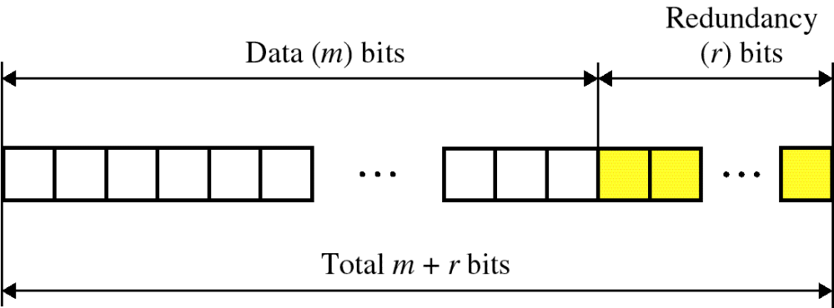
Error Correction

Slide 46
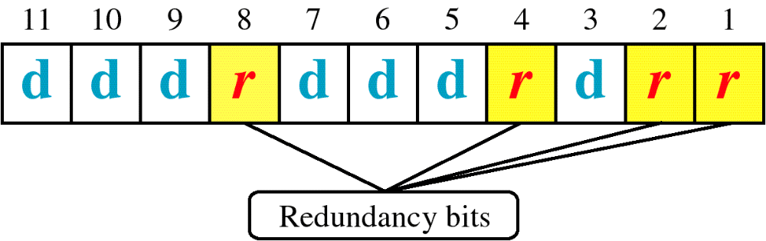
Hamming Code

Slide 47
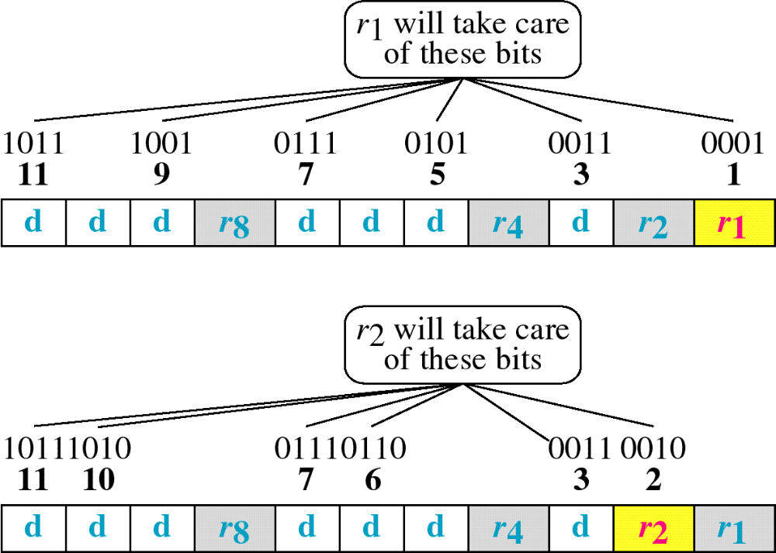
Hamming Code

Slide 48
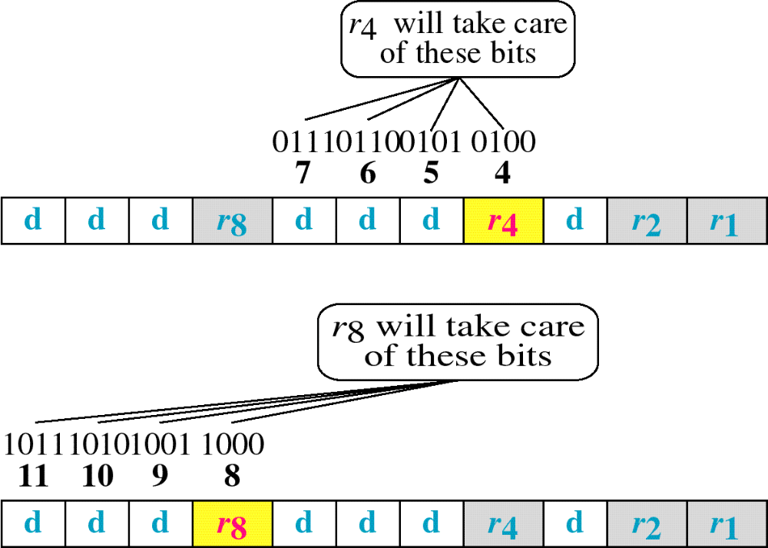
Hamming Code

Slide 49
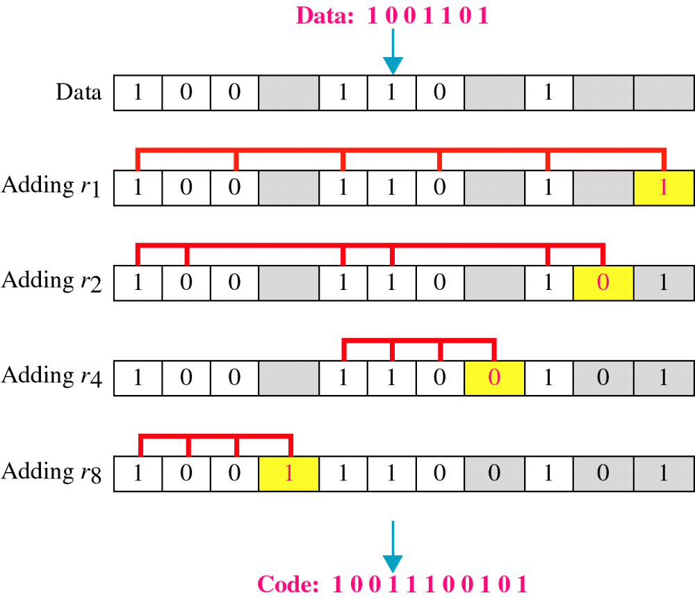
Example of Hamming Code

Slide 50
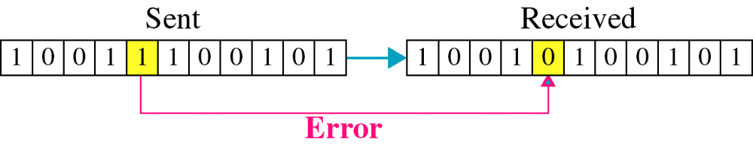
Single-bit error

Slide 51

Error
Detection

