Slide 1
Transmission Media

Slide 2
Transmission media
It is a communication channel that carries the information from the sender to the receiver.
Channel - an electric circuit (= a closed system through which electricity can flow) that allows a signal to travel:

Slide 3
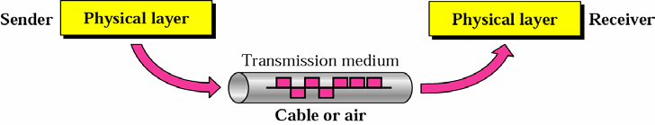
Transmission media
It can carry information fro S to D.
Computers use signals to represent data.
Signals are transmitted in from one device to another in the form of electromagnetic energy.

Slide 4
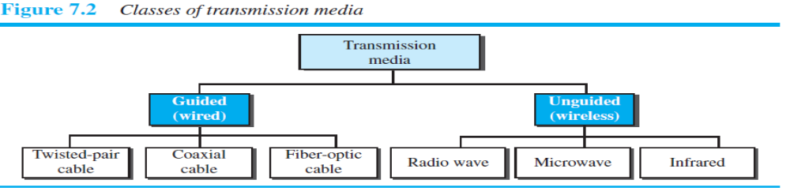
Transmission Media
Guided Media (Wired)
  Twisted-Pair Cable
  Coaxial Cable
  Fiber-Optic Cable
Unguided Media (Wireless)
  Radio Waves
  Microwaves
  Infrared

Slide 5
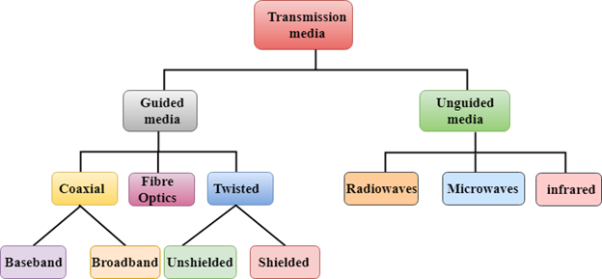

Slide 6
GUIDED MEDIA
It provide a conduit (channel) from one device to another
Twisted-pair and coaxial cable use metallic(copper) conductors that accepts and transports signal in the form of electric current.
Optical fiber is cable that accepts and transports signals in the form of light.

Slide 7
Design Factors
Bandwidth
  higher bandwidth gives higher data rate
Transmission impairments
  eg. Attenuation - to any reduction in the strength of a signal.
Interference - disrupts a signal as it travels along a channel between a source and a receiver.
Number of receivers in guided media
  more receivers introduces more attenuation
Notes:
A number of design factors relating to the transmission medium and the signal determine the data rate and distance:
• Bandwidth: All other factors remaining constant, the greater the bandwidth of a signal, the higher the data rate that can be achieved.
• Transmission impairments: Impairments, such as attenuation, limit the distance. For guided media, twisted pair generally suffers more impairment than coaxial cable, which in turn suffers more than optical fiber.
• Interference: Interference from competing signals in overlapping frequency bands can distort or wipe out a signal. Interference is of particular concern for unguided media, but is also a problem with guided media. For guided media, interference can be caused by emanations from nearby cables. For example, twisted pairs are often bundled together and conduits often carry multiple cables. Interference can also be experienced from unguided transmissions. Proper shielding of a guided medium can minimize this problem.
• Number of receivers: A guided medium can be used to construct a point-to-point link or a shared link with multiple attachments. In the latter case, each attachment introduces some attenuation and distortion on the line, limiting distance and/or data rate.

Slide 8
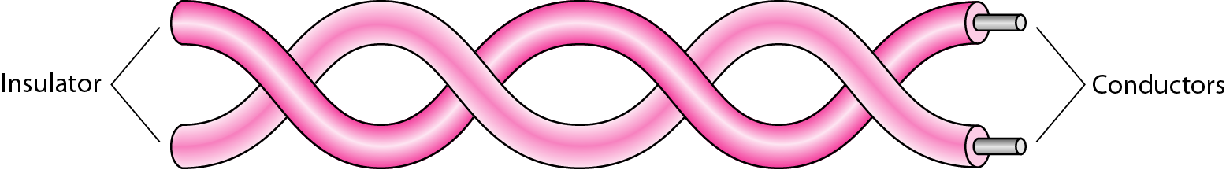
Guided Media – Twisted-pair Cable
A twisted pair consists of two conductors (normally copper), each with its own plastic insulation, twisted together
One of the wires is used to carry signals to the receiver, and the other is used only as a ground reference

Slide 9
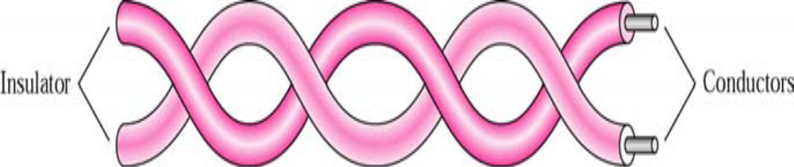
Twisted pair
One of the wires carries signal, the other is used only as a ground reference.
The receiver uses the difference b/w the two levels.
Two wires are parallel, the effect of unwanted signals
number of twists per unit length determines the quality of the cable.

Slide 10
Twisted Pair - Transmission Characteristics
analog
  needs amplifiers every 5km to 6km
digital
  can use either analog or digital signals
  needs a repeater every 2-3km
limited distance
limited bandwidth (1MHz)
limited data rate (100MHz)
susceptible to interference and noise
Notes:
Twisted pair may be used to transmit both analog and digital transmission. For analog signals, amplifiers are required about every 5 to 6 km. For digital transmission (using either analog or digital signals), repeaters are required every 2 or 3 km.
Compared to other commonly used guided transmission media (coaxial cable, optical fiber), twisted pair is limited in distance, bandwidth, and data rate. The attenuation for twisted pair is a very strong function of frequency. Other impairments are also severe for twisted pair. The medium is quite susceptible to interference and noise because of its easy coupling with electromagnetic fields. Several measures are taken to reduce impairments. Shielding the wire with metallic braid or sheathing reduces interference. The twisting of the wire reduces low-frequency interference, and the use of different twist lengths in adjacent pairs reduces crosstalk.
For point-to-point analog signaling, a bandwidth of up to about 1 MHz is possible. For long-distance digital point-to-point signaling, data rates of up to a few Mbps are possible; for very short distances, data rates of up to 10 Gbps have been achieved in commercially available products.

Slide 11

Unshielded Versus Shielded Twisted-Pair Cable
UTP and STP cables

Slide 12
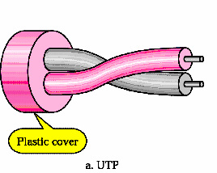
Unshielded Twisted Pair (UTP)
Ordinary telephone wire
Cheapest
Easiest to install
Suffers from external EM interference

Slide 13
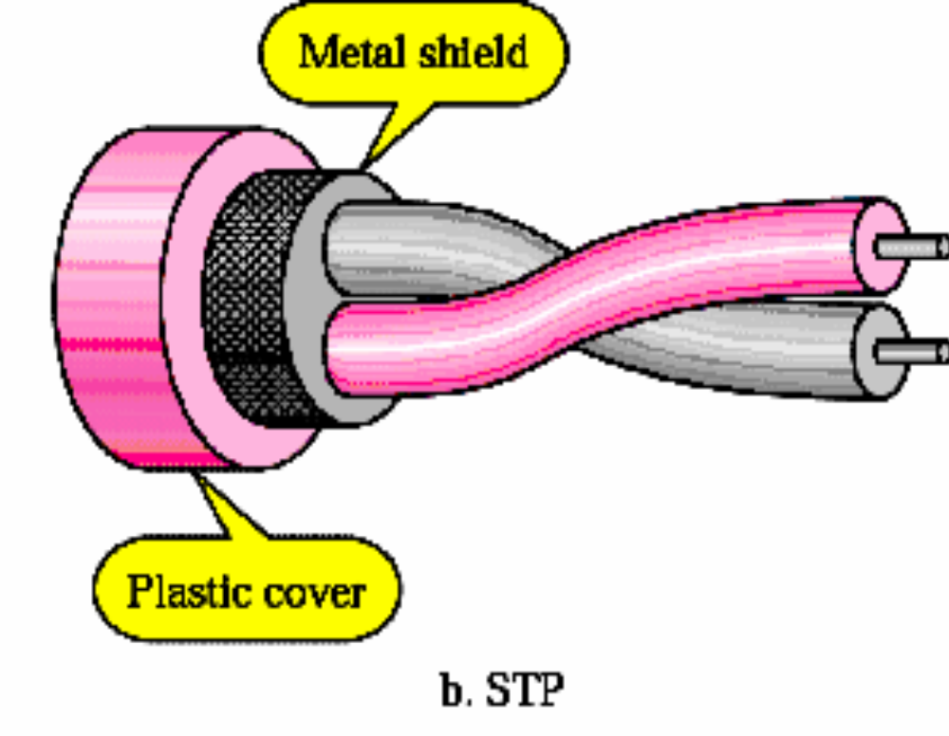
Shielded Twisted Pair (STP)
Metal braid or sheathing that reduces interference
More expensive
Harder to handle (thick, heavy)

Slide 14
Near End Crosstalk
coupling of signal from one pair to another
occurs when transmit signal entering the link couples back to receiving pair
ie. near transmitted signal is picked up by near receiving pair
Notes:
Near-end crosstalk as it applies to twisted pair wiring systems is the coupling of the signal from one pair of conductors to another pair. These conductors may be the metal pins in a connector or wire pairs in a cable. The near end refers to coupling that takes place when the transmit signal entering the link couples back to the receive conductor pair at that same end of the link (ie. the near end transmitted signal is picked up by the near receive pair).

Slide 15

Categories of unshielded twisted-pair cables

Slide 16

Guided Media – UTP
UTP Connector

Slide 17
Guided Media - UTP
Applications:
  Telephone lines connecting subscribers to the central office
  DSL lines
  LAN – 10Base-T and 100Base-T

Slide 18
Twisted Pair - Applications
Most common medium
Telephone network
Within buildings
For local area networks (LAN)

Slide 19
Twisted Pair - Pros and Cons
Cheap
Easy to work with
Low data rate
Short range

Slide 20

Guided Media – Coaxial Cable
Coaxial Cable
Instead of two wires- It has core conductor of solid wire enclosed

Slide 21
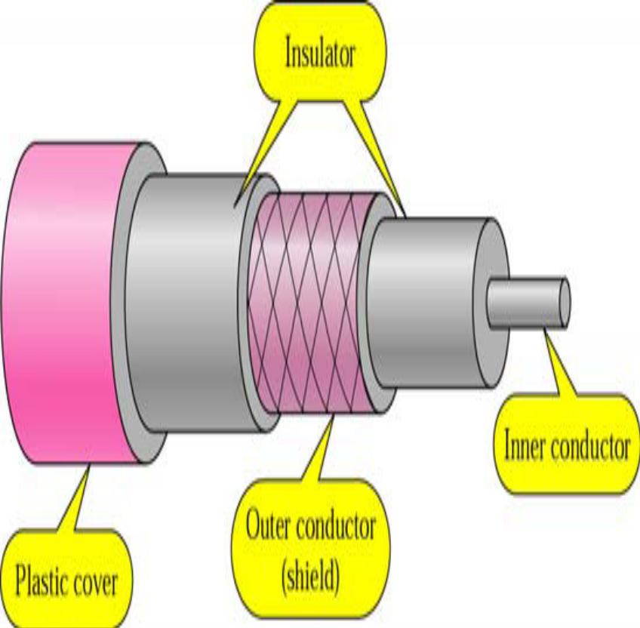
Coaxial cable
Inner conductor is a solid wire outer conductor serves both as a shield
against noise and a second conductor

Slide 22
Coaxial Cable Applications
Most versatile medium
Television distribution
Long distance telephone transmission
Can carry 10,000 voice calls simultaneously
Short distance computer systems links
Local area networks

Slide 23
Coaxial Cable - Transmission Characteristics
superior frequency characteristics to TP
performance limited by attenuation & noise
analog signals
  amplifiers every few km
  closer if higher frequency
  up to 500MHz
digital signals
  repeater every 1km
  closer for higher data rates
Notes:
Coaxial cable is used to transmit both analog and digital signals. It has frequency characteristics that are superior to those of twisted pair and can hence be used effectively at higher frequencies and data rates. Because of its shielded, concentric construction, coaxial cable is much less susceptible to interference and crosstalk than twisted pair. The principal constraints on performance are attenuation, thermal noise, and intermodulation noise. The latter is present only when several channels (FDM) or frequency bands are in use on the cable.
For long-distance transmission of analog signals, amplifiers are needed every few kilometers, with closer spacing required if higher frequencies are used. The usable spectrum for analog signaling extends to about 500 MHz. For digital signaling, repeaters are needed every kilometer or so, with closer spacing needed for higher data rates.

Slide 24

Guided Media – Coaxial Cable
Categories of coaxial cables

Slide 25

Guided Media – Coaxial Cable
BNC Connectors

Slide 26
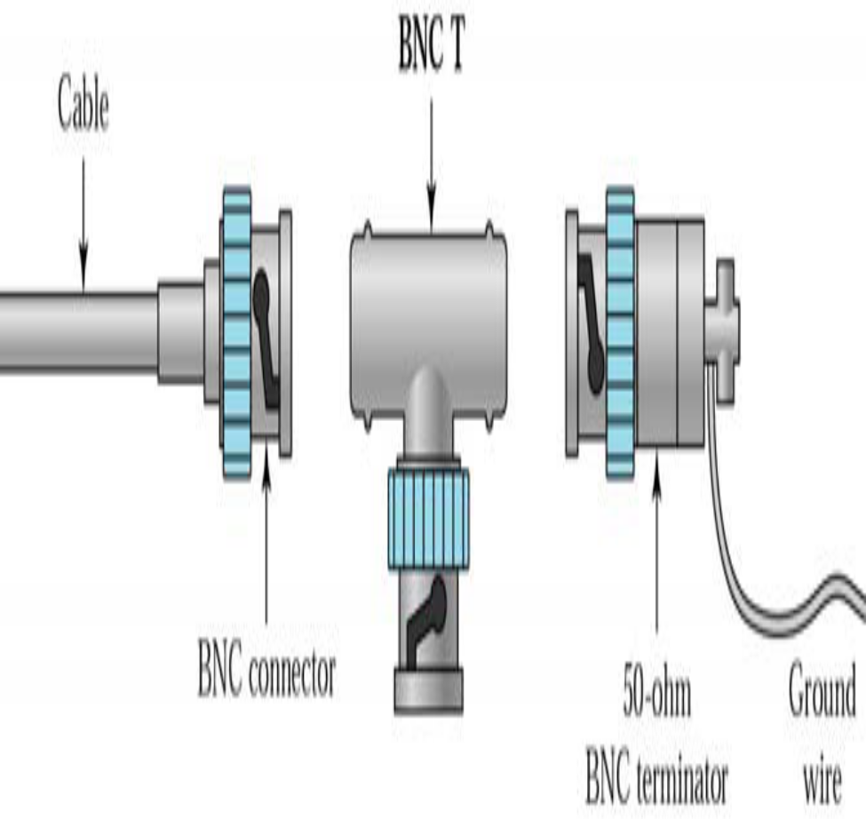
BNC connectors
BNC = Bayone-Neill-Concelman
BNC Connector is used to connect the end of the cable to a device
BNC T is used in networks to branch out a cable for connection to a computer or other device
BNC Terminator is used at the end of the cable to prevent the reflection of signal.

Slide 27
Guided Media – Coaxial Cable
Applications:
  Analog telephone networks
  Cable TV networks
  Traditional Ethernet LAN – 10Base2, 10Base5

Slide 28
Fiber optic cable
It is made of glass or plastic and transmit signals in the form of light .
Light travels in a straight line as long as it is moving through a single uniform
Different density – ray changes direction

Slide 29
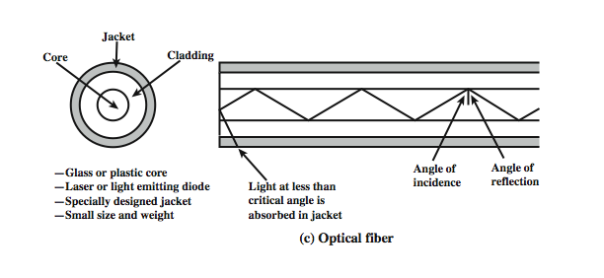
Optical Fiber
Notes:
An optical fiber is a thin (2 to 125 µm), flexible medium capable of guiding an optical ray. Various glasses and plastics can be used to make optical fibers. An optical fiber cable has a cylindrical shape and consists of three concentric sections: the core, the cladding, and the jacket (Stallings DCC8e Figure 4.2c). The core is the innermost section and consists of one or more very thin strands, or fibers, made of glass or plastic; the core has a diameter in the range of 8 to 50 µm. Each fiber is surrounded by its own cladding, a glass or plastic coating that has optical properties different from those of the core and a diameter of 125 µm. The interface between the core and cladding acts as a reflector to confine light that would otherwise escape the core. The outermost layer, surrounding one or a bundle of cladded fibers, is the jacket. The jacket is composed of plastic and other material layered to protect against moisture, abrasion, crushing, and other environmental dangers.
Optical fiber already enjoys considerable use in long-distance telecommunications, and its use in military applications is growing. The continuing improvements in performance and decline in prices, together with the inherent advantages of optical fiber, have made it increasingly attractive for local area networking. Five basic categories of application have become important for optical fiber: Long-haul trunks, Metropolitan trunks, Rural exchange trunks, Subscriber loops & Local area networks.

Slide 30

Guided Media – Fiber-Optic Cable
Optic Fiber
cover is surrounded by a cladding

Slide 31
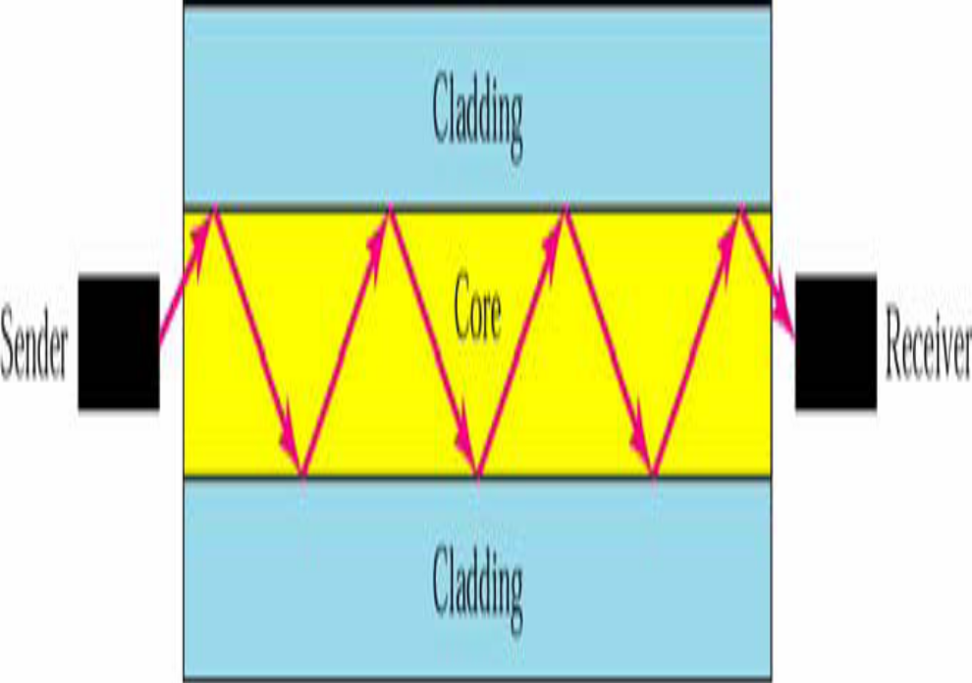
Optical fiber
Uses reflection to guide light through a channel
Core is of glass or plastic surrounded by Cladding
Cladding is of less dense glass or plastic

Slide 32

Guided Media – Fiber-Optic Cable
Fiber-optic cable transmit signals in the form of light.
Bending of light ray

Slide 33
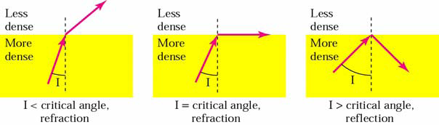
Bending of light ray
Angle of Incidence (I): the angle the ray makes with the line perpendicular to the interface between the two substances
Critical Angle: the angle of incidence which provides an angle of refraction of 90-degrees.

Slide 34
Optical Fiber - Benefits
greater capacity
  data rates of hundreds of Gbps
smaller size & weight
lower attenuation
electromagnetic isolation
greater repeater spacing
  10s of km at least
Notes:
The following characteristics distinguish optical fiber from twisted pair or coaxial cable:
• Greater capacity: The potential bandwidth, and hence data rate, of optical fiber is immense; data rates of hundreds of Gbps over tens of kilometers have been demonstrated. Compare this to the practical maximum of hundreds of Mbps over about 1 km for coaxial cable and just a few Mbps over 1 km or up to 100 Mbps to 10 Gbps over a few tens of meters for twisted pair.
• Smaller size and lighter weight: Optical fibers are considerably thinner than coaxial cable or bundled twisted-pair cable. For cramped conduits in buildings and underground along public rights-of-way, the advantage of small size is considerable. The corresponding reduction in weight reduces structural support requirements.
• Lower attenuation: Attenuation is significantly lower for optical fiber than for coaxial cable or twisted pair, and is constant over a wide range.
• Electromagnetic isolation: Optical fiber systems are not affected by external electromagnetic fields. Thus the system is not vulnerable to interference, impulse noise, or crosstalk. By the same token, fibers do not radiate energy, so there is little interference with other equipment and there is a high degree of security from eavesdropping. In addition, fiber is inherently difficult to tap.
• Greater repeater spacing: Fewer repeaters mean lower cost and fewer sources of error. The performance of optical fiber systems from this point of view has been steadily improving. Repeater spacing in the tens of kilometers for optical fiber is common, and repeater spacings of hundreds of kilometers have been demonstrated.

Slide 35

Guided Media – Fiber-Optic Cable
Propagation Modes - light is a directional projection of light energy radiating from a light source.

Slide 36
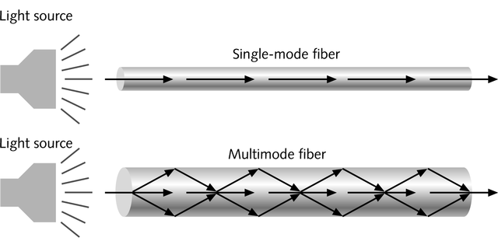
Single and Multimode Fiber
Physical Media
Single-mode fiber
  Carries light pulses along single path
  Uses Laser Light Source
Multimode fiber
  Many pulses of light generated by LED travel at different angles

Slide 37
Multi mode fibers :
More than one path is available
V-number is greater than 2.405
Core diameter is higher
Higher dispersion
Lower bandwidth (50MHz)
Used for short distance communication
Fabrication is less difficult and not costly
The single mode fiber has the following characteristics:
Only one path is available.
V-number is less than 2.405
Core diameter is small
No dispersion
Higher band width (1000 MHz)
Used for long haul communication
Fabrication is difficult and costly

Slide 38
The step index fibers propagate both single and multimode signals within the fiber core.
Graded index fiber – decrease the distortion of the signal the cable

Slide 39

Guided Media – Fiber-Optic Cable
Propagation Modes

Slide 40
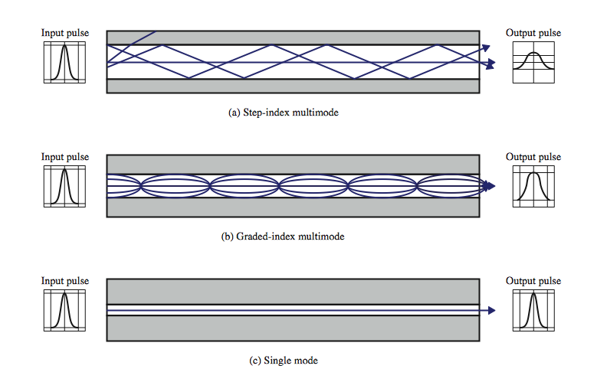
Optical Fiber Transmission Modes
Notes:
Stallings DCC8e Figure 4.4 shows the principle of optical fiber transmission. Light from a source enters the cylindrical glass or plastic core. Rays at shallow angles are reflected and propagated along the fiber; other rays are absorbed by the surrounding material. This form of propagation is called step-index multimode, referring to the variety of angles that will reflect. With multimode transmission, multiple propagation paths exist, each with a different path length and hence time to traverse the fiber. This causes signal elements (light pulses) to spread out in time, which limits the rate at which data can be accurately received. This type of fiber is best suited for transmission over very short distances.
When the fiber core radius is reduced, fewer angles will reflect. By reducing the radius of the core to the order of a wavelength, only a single angle or mode can pass: the axial ray. This single-mode propagation provides superior performance for the following reason. Because there is a single transmission path with single-mode transmission, the distortion found in multimode cannot occur. Single-mode is typically used for long-distance applications, including telephone and cable television.
Finally, by varying the index of refraction of the core, a third type of transmission, known as graded-index multimode, is possible. The higher refractive index (discussed subsequently) at the center makes the light rays moving down the axis advance more slowly than those near the cladding. Rather than zig-zagging off the cladding, light in the core curves helically because of the graded index, reducing its travel distance. The shortened path and higher speed allows light at the periphery to arrive at a receiver at about the same time as the straight rays in the core axis. Graded-index fibers are often used in local area networks.

Slide 41

Guided Media – Fiber-Optic Cable
Fiber Construction

Slide 42

Guided Media – Fiber-Optic Cable
Fiber-optic Cable Connectors

Slide 43
Guided Media – Optical Fiber Cable
Applications:
  Backbone networks – SONET
  Cable TV – backbone
  LAN
    100Base-FX network (Fast Ethernet)
    100Base-X

Slide 44
Unguided Media
Transport electromagnetic waves without using a physical conductor or wire
Signals broadcast through free space
any one who has a device capable of receiving them.

Slide 45
Frequency
the number of waves that pass a fixed point in unit time
describes the number of waves that pass a fixed place in a given amount of time.
The hertz measurement, abbreviated Hz,
Hz is the number of waves that pass by per second.
Hertz (Hz) = One hertz is equal to one cycle per second.
Cycle = One complete wave of alternating current or voltage.
Alternation = One half of a cycle.
Period = The time required to produce one complete cycle of a waveform.

Slide 46
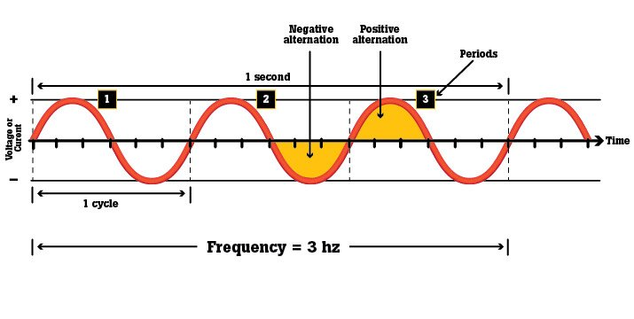
Example
If an alternating current is said to have a frequency of 3 Hz (see diagram below), that indicates its waveform repeats 3 times in 1 second.

Slide 47
Antennas
It converts electrical power into electromagnetic waves and vice versa.
electrical conductor used to radiate or collect electromagnetic energy
transmission antenna
  radio frequency energy from transmitter
  converted to electromagnetic energy byy antenna
  radiated into surrounding environment
reception antenna
  electromagnetic energy impinging on antenna
  converted to radio frequency electrical energy
  fed to receiver
same antenna is often used for both purposes
Notes:
For unguided media, transmission and reception are achieved by means of an antenna. An antenna can be defined as an electrical conductor or system of conductors used either for radiating electromagnetic energy or for collecting electromagnetic energy.
For transmission of a signal, radio-frequency electrical energy from the transmitter is converted into electromagnetic energy by the antenna and radiated into the surrounding environment.
For reception of a signal, electromagnetic energy impinging on the antenna is converted into radio-frequency electrical energy and fed into the receiver.
In two-way communication, the same antenna can be and often is used for both transmission and reception. This is possible because antenna characteristics are essentially the same whether an antenna is sending or receiving electromagnetic energy.

Slide 48
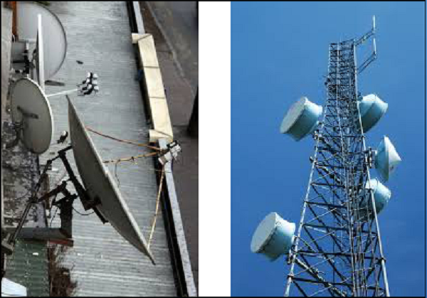
examples of different types of Antennas

Slide 49
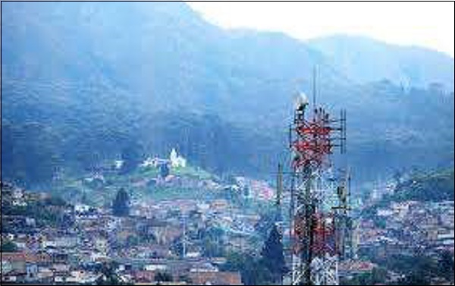

Slide 50
Frequency of operation
Very Low Frequency (VLF)
Low Frequency (LF)
Medium Frequency (MF)
High Frequency (HF)
Very High Frequency (VHF)
Ultra High Frequency (UHF)
Super High Frequency (SHF)
Micro wave
Radio wave

Slide 51
Radiation Pattern
power radiated in all directions
not same performance in all directions
  as seen in a radiation pattern diagram
an isotropic antenna is a (theoretical) point in space
  radiates in all directions equally
  with a spherical radiation pattern
Notes:
An antenna will radiate power in all directions but, typically, does not perform equally well in all directions. A common way to characterize the performance of an antenna is the radiation pattern, which is a graphical representation of the radiation properties of an antenna as a function of space coordinates.
The simplest pattern is produced by an idealized antenna known as the isotropic antenna. An isotropic antenna is a point in space that radiates power in all directions equally. The actual radiation pattern for the isotropic antenna is a sphere with the antenna at the center.

Slide 52
An amplifier
It is an electronic device that increases the voltage, current, or power of a signal

Slide 53
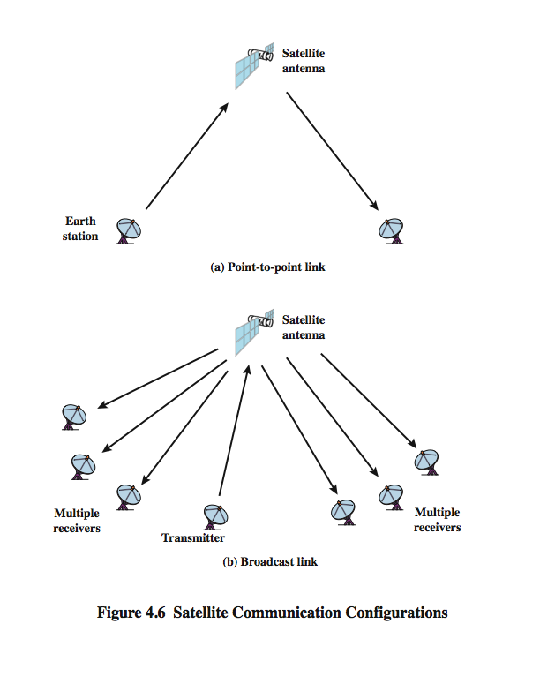
Satellite Point to Point Link
Notes:
Stallings DCC8e Figure 4.6 depicts in a general way two common configurations for satellite communication. In the first, the satellite is being used to provide a point-to-point link between two distant ground-based antennas.

Slide 54
Satellite Broadcast Link
Notes:
Stallings DCC8e Figure 4.6 depicts in a general way two common configurations for satellite communication. In the second, the satellite provides communications between one ground-based transmitter and a number of ground-based receivers.

Slide 55
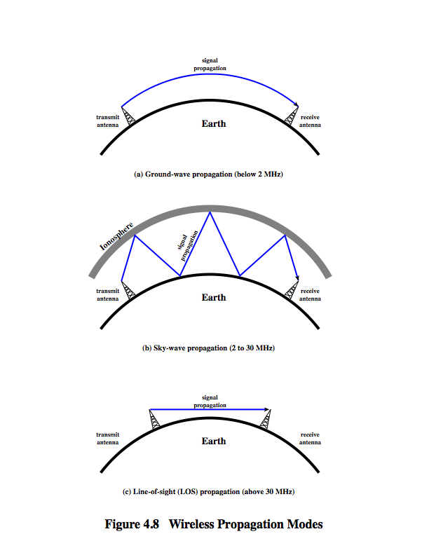
Wireless Propagation
Ground Wave
Notes:
A signal radiated from an antenna travels along one of three routes: ground wave, sky wave, or line of sight (LOS), as shown in Stallings DCC8e Figure 4.8.
Ground wave propagation more or less follows the contour of the earth and can propagate considerable distances, well over the visual horizon. This effect is found in frequencies up to about 2 MHz. Several factors account for the tendency of electromagnetic wave in this frequency band to follow the earth's curvature. One factor is that the electromagnetic wave induces a current in the earth's surface, the result of which is to slow the wavefront near the earth, causing the wavefront to tilt downward and hence follow the earth's curvature. Another factor is diffraction, which is a phenomenon having to do with the behavior of electromagnetic waves in the presence of obstacles. Electromagnetic waves in this frequency range are scattered by the atmosphere in such a way that they do not penetrate the upper atmosphere. The best-known example of ground wave communication is AM radio.

Slide 56
Wireless Propagation
Sky Wave
Notes:
Sky wave propagation is used for amateur radio, CB radio, and international broadcasts such as BBC and Voice of America. With sky wave propagation, a signal from an earth-based antenna is reflected from the ionized layer of the upper atmosphere (ionosphere) back down to earth. Although it appears the wave is reflected from the ionosphere as if the ionosphere were a hard reflecting surface, the effect is in fact caused by refraction. Refraction is described subsequently. A sky wave signal can travel through a number of hops, bouncing back and forth between the ionosphere and the earth's surface, as shown in Stallings DCC8e Figure 4.8b. With this propagation mode, a signal can be picked up thousands of kilometers from the transmitter.

Slide 57
Wireless Propagation
Line of Sight
Notes:
Above 30 MHz, neither ground wave nor sky wave propagation modes operate, and communication must be by line of sight (Stallings DCC8e Figure 4.8c). For satellite communication, a signal above 30 MHz is not reflected by the ionosphere and therefore a signal can be transmitted between an earth station and a satellite overhead that is not beyond the horizon. For ground-based communication, the transmitting and receiving antennas must be within an effective line of sight of each other. The term effective is used because microwaves are bent or refracted by the atmosphere. The amount and even the direction of the bend depends on conditions, but generally microwaves are bent with the curvature of the earth and will therefore propagate farther than the optical line of sight. In this book, we are almost exclusively concerned with LOS communications.

Slide 58

Unguided Media
Electromagnetic spectrum for wireless communication

Slide 59

Unguided Media
Propagation Methods – direction radio waves travel

Slide 60

Bands

Slide 61

Unguided Media
Wireless transmission waves

Slide 62
Broadcast Radio
radio is 3kHz to 300GHz
use broadcast radio, 30MHz - 1GHz, for:
  FM radio
  UHF and VHF television
is omnidirectional – send out signals in all directions.
Antenna transmits radio waves
suffers from multipath interference
  reflections from land, water, other objects
Notes:
Radio is a general term used to encompass frequencies in the range of 3 kHz to 300 GHz. We are using the informal term broadcast radio to cover the VHF and part of the UHF band: 30 MHz to 1 GHz. This range covers FM radio and UHF and VHF television. This range is also used for a number of data networking applications. The principal difference between broadcast radio and microwave is that the former is omnidirectional and the latter is directional. Thus broadcast radio does not require dish-shaped antennas, and the antennas need not be rigidly mounted to a precise alignment.
The range 30 MHz to 1 GHz is an effective one for broadcast communications. Unlike the case for lower-frequency electromagnetic waves, the ionosphere is transparent to radio waves above 30 MHz. Thus transmission is limited to the line of sight, and distant transmitters will not interfere with each other due to reflection from the atmosphere. Unlike the higher frequencies of the microwave region, broadcast radio waves are less sensitive to attenuation from rainfall. A prime source of impairment for broadcast radio waves is multipath interference. Reflection from land, water, and natural or human-made objects can create multiple paths between antennas, eg ghosting on TV pictures.

Slide 63

Unguided Media – Radio Waves
Omnidirectional Antenna
Frequencies between 3 KHz and
1 GHz.
are used for multicasts communications, such as radio and television, and paging system.

Slide 64
Terrestrial Microwave
Unidirectional
Propagation is Line of sight
short point-to-point links
use a parabolic dish to focus a narrow beam onto a receiver antenna
1-300GHz frequencies
higher frequencies give higher data rates
Notes:
The primary use for terrestrial microwave systems is in long haul telecommunications service, as an alternative to coaxial cable or optical fiber. The microwave facility requires far fewer amplifiers or repeaters than coaxial cable over the same distance, (typically every 10-100 km) but requires line-of-sight transmission. Microwave is commonly used for both voice and television transmission. Another increasingly common use of microwave is for short point-to-point links between buildings, for closed-circuit TV or as a data link between local area networks.
The most common type of microwave antenna is the parabolic "dish”, fixed rigidly to focus a narrow beam on a receiving antenna A typical size is about 3 m in diameter. Microwave antennas are usually located at substantial heights above ground level to extend the range between antennas and to be able to transmit over intervening obstacles. To achieve long-distance transmission, a series of microwave relay towers is used, and point-to-point microwave links are strung together over the desired distance.
Microwave transmission covers a substantial portion of the electromagnetic spectrum, typically in the range 1 to 40 GHz, with 4-6GHz and now 11GHz bands the most common. The higher the frequency used, the higher the potential bandwidth and therefore the higher the potential data rate. As with any transmission system, a main source of loss is attenuation, related to the square of distance. The effects of rainfall become especially noticeable above 10 GHz. Another source of impairment is interference.

Slide 65

Unguided Media – Microwaves
Frequencies between 1 and 300 GHz.
Used for unicast communication such as cellular phones, satellite networks and wireless LANs.
Unidirectional Antenna

Slide 66
Satellite Microwave
satellite is relay station
receives on one frequency, amplifies or repeats signal and transmits on another frequency
  eg. uplink 5.925-6.425 GHz & downlink 3.7-4.2 GHz
typically requires geo-stationary orbit
  height of 35,784km
  spaced at least 3-4° apart
typical uses
  television
  long distance telephone
  private business networks
  global positioning
Notes:
A communication satellite is, in effect, a microwave relay station. It is used to link two or more ground-based microwave transmitter/receivers, known as earth stations, or ground stations. The satellite receives transmissions on one frequency band (uplink), amplifies or repeats the signal, and transmits it on another frequency (downlink). A single orbiting satellite will operate on a number of frequency bands, called transponder channels, or simply transponders. The optimum frequency range for satellite transmission is in the range 1 to 10 GHz. Most satellites providing point-to-point service today use a frequency bandwidth in the range 5.925 to 6.425 GHz for transmission from earth to satellite (uplink) and a bandwidth in the range 3.7 to 4.2 GHz for transmission from satellite to earth (downlink). This combination is referred to as the 4/6-GHz band, but has become saturated. So the 12/14-GHz band has been developed (uplink: 14 - 14.5 GHz; downlink: 11.7 - 12.2 GHz).
For a communication satellite to function effectively, it is generally required that it remain stationary with respect to its position over the earth to be within the line of sight of its earth stations at all times. To remain stationary, the satellite must have a period of rotation equal to the earth's period of rotation, which occurs at a height of 35,863 km at the equator. Two satellites using the same frequency band, if close enough together, will interfere with each other. To avoid this, current standards require a 4° spacing in the 4/6-GHz band and a 3° spacing at 12/14 GHz. Thus the number of possible satellites is quite limited.
Among the most important applications for satellites are: Television distribution, Long-distance telephone transmission, Private business networks, and Global positioning.

Slide 67
Unguided Media – Infrared
Frequencies between 300 GHz to 400 THz.
Can not penetrate walls.
Used for short-range communication in a closed area using line-of-sight propagation.

Slide 68
Infrared
modulate noncoherent infrared light
end line of sight (or reflection)
are blocked by walls
no licenses required
typical uses
  TV remote control
  IRD port
Notes:
Infrared communications is achieved using transmitters/receivers (transceivers) that modulate noncoherent infrared light. Transceivers must be within the line of sight of each other either directly or via reflection from a light-colored surface such as the ceiling of a room.
One important difference between infrared and microwave transmission is that the former does not penetrate walls. Thus the security and interference problems encountered in microwave systems are not present. Furthermore, there is no frequency allocation issue with infrared, because no licensing is required.

