Slide 1
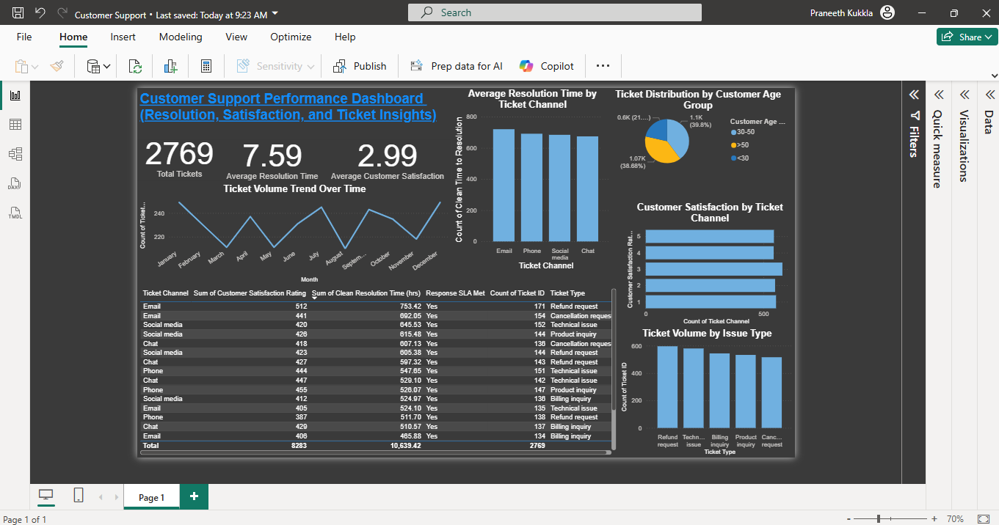
Customer Support Dashboard Presentation

Slide 2
Introduction
Dashboard provides a full view of customer support operations.
Focuses on ticket volume, resolution time, satisfaction, and support trends.
Built using cleaned data from customer support ticket logs.

Slide 3
KPI Cards (Top Row)
Total Tickets: 2769 tickets logged in the dataset.
Avg. Resolution Time: 7.59 hours per ticket on average.
Avg. Customer Satisfaction: 2.99 out of 5 based on customer feedback.

Slide 4
Ticket Volume Trend (Line Chart)
Tracks monthly ticket volume using Date of Purchase.
Helps identify peak support periods or seasonal trends.
Useful for resource planning and volume forecasting.

Slide 5
Resolution Time by Channel (Bar Chart)
Displays average resolution time per support channel.
Reveals which channels are most/least efficient.
Actionable insight for reallocating or improving support efforts.

Slide 6
Ticket Share by Age Group (Pie Chart)
Visualizes customer age segments: <30, 30–50, and >50.
Most tickets come from the 30–50 group.
Helps with user targeting, training design, or channel preference analysis.

Slide 7
Customer Satisfaction by Channel
Compares CSAT scores by ticket channel.
Helps evaluate which channels deliver the best customer experience.
Useful for training and channel optimization.

Slide 8
Ticket Volume by Issue Type
Shows which ticket types are most frequent.
Identifies common pain points.
Supports prioritizing knowledge base content or product fixes.

Slide 9
SLA & CSAT Breakdown Table
Combines Ticket ID, SLA Met, Resolution Time, CSAT, and Ticket Type.
Useful for operational reviews or team coaching.
Easily filtered to highlight SLA violations or low-rated tickets.

Slide 10
Conclusion
Dashboard delivers both high-level monitoring and detailed analysis.
Helps management make data-driven decisions to improve support performance.
Easily extensible for real-time updates or client-specific customization.

