Slide 1
AI Recipe Generator
Using rasa, spacy and groq API
Objective: A chatbot that suggests recipes based on user input (cuisine & ingredients).
Technologies:
Rasa: Conversational AI framework
Groq API: LLM for generating recipes
SpaCy: NLP processing
Flask: Web integration

Slide 2
AI Recipe Generator
Using rasa, spacy and groq API
Intents:
greet: “Hello”
request_recipe: “Give me an Indian recipe with eggs.”
goodbye: “Thanks”
Stories (Chatbot flow):
User greets: Hello! I can generate recipes for you. What ingredients do you have?
User provides cuisine & ingredients: Bot generates a recipe.
User says bye: Bot says Happy Cooking!.
Config File:
Defines NLP pipelines and policies:
Pipeline: Uses SpaCy for intent recognition & entity extraction.
Policies: Rule-based, memory-based, and machine learning-based conversation handling.

Slide 3
AI Recipe Generator
Using rasa, spacy and groq API
Domain (Defines chatbot responses and actions):
Slots: cuisine, ingredient
Actions: action_generate_recipe (calls Groq API)
Responses: utter_greet, utter_goodbye, utter_iamabot
How to run the recipe generator
1. Clone the repository https://github.com/praneeth116/AI-Recipe-Generartor/
2. Install all the requirements in a python environment version >= 3.8
3. Train the chatbot with command rasa train
4. Run Rasa server with command rasa run —enable-api
5.Start actions server with command rasa run actions
6. Start the flask app with python app.py

Slide 4
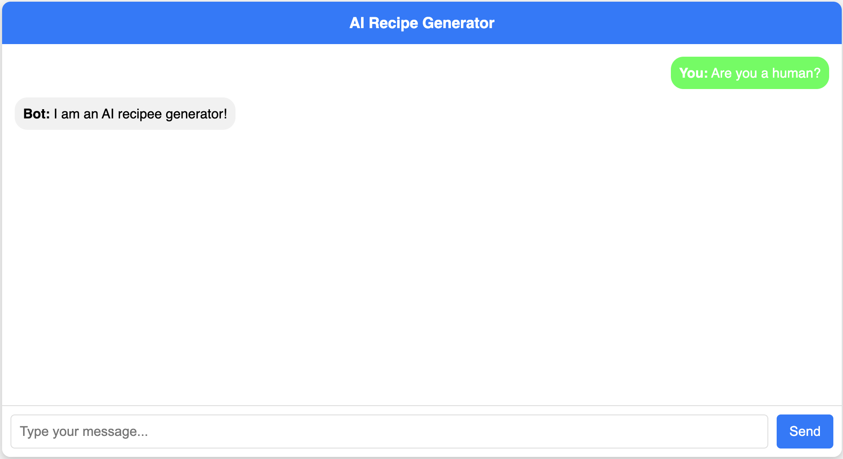
AI Recipe Generator
Example Outputs

Slide 5
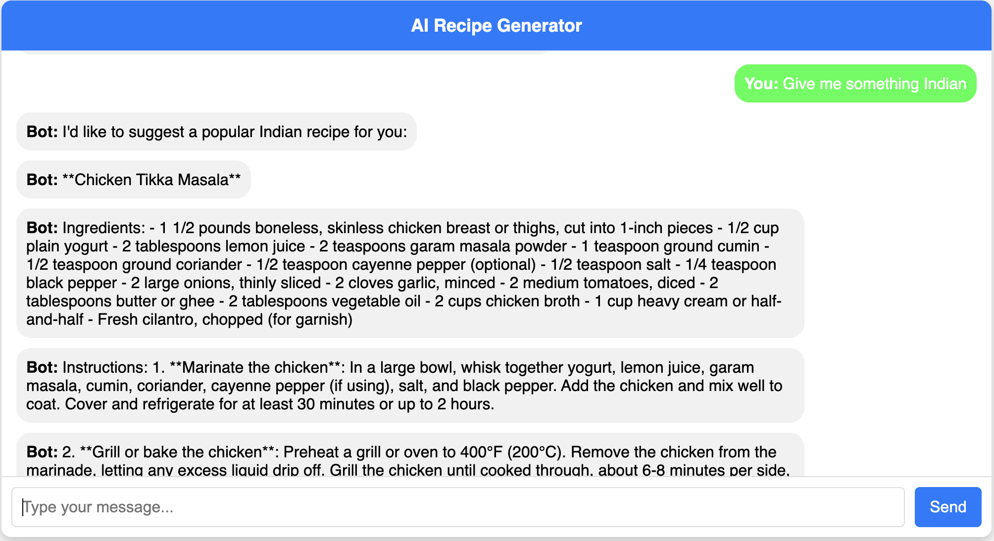
AI Recipe Generator
Example Outputs

Slide 6
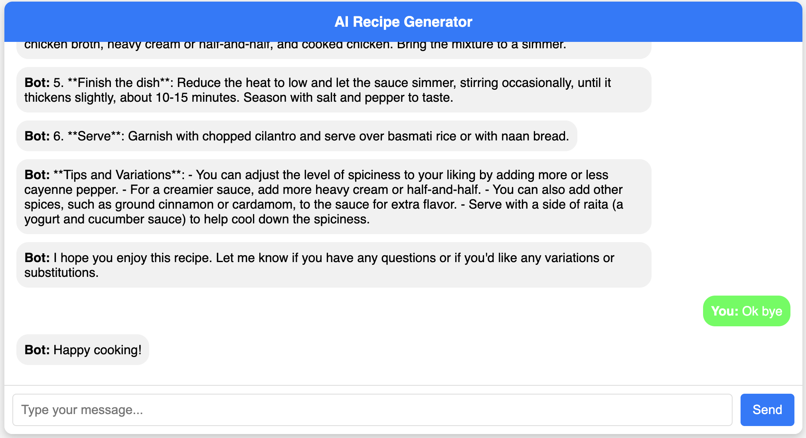
AI Recipe Generator
Example Outputs

