Slide 1
SECURE BOOT
#Usecase 4.3: PKI/KMS
Team Members:
Anoop MP
Darshan MS
Manjunatha D
Praneeth Devadiga
Mohan B

Slide 2
What is PKI/KMS
Cryptographic techniques and protocols used to manage digital certificates and public-private key pairs.
It enables secure communication and authentication over insecure networks, such as the Internet.

Slide 3
PKI in Secure Boot
Ensures authenticity and Integrity of the software and firmware.
Providing a Secure Environment for key storage.

Slide 4
Functions of PKI in Secure Boot
Generates the key for the signing tool.
Managing CA and Generating certificates for the signing tool.
Generating keys in a secure Environment and Maintaining them.
Establishing trust anchors in secure boot.

Slide 5
Overview
Signing Tool
ADAS ECU
Request for Key pairs
Sending Key pairs
Request for certificate
Sending the certificate
Sending the signed data with the certificate
5
1
2
3
4
PKI/KMS

Slide 6
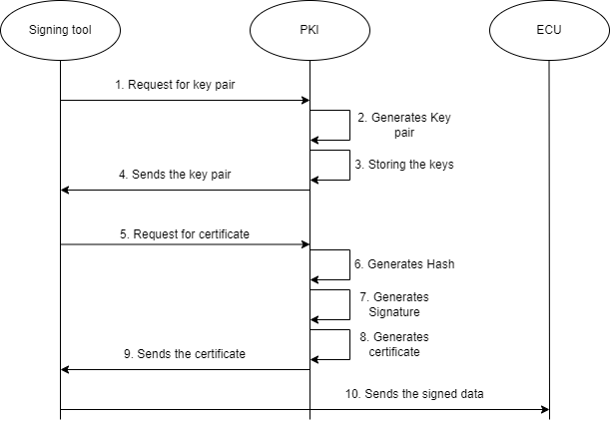
2. FLOW

Slide 7
Requirements:
1. Public Key Infrastructure (PKI) or Key Management System (KMS)
2. Key pair Generation and Storage
3. Key Distribution
4. Certificate Authority
5. Software Requirement

Slide 8
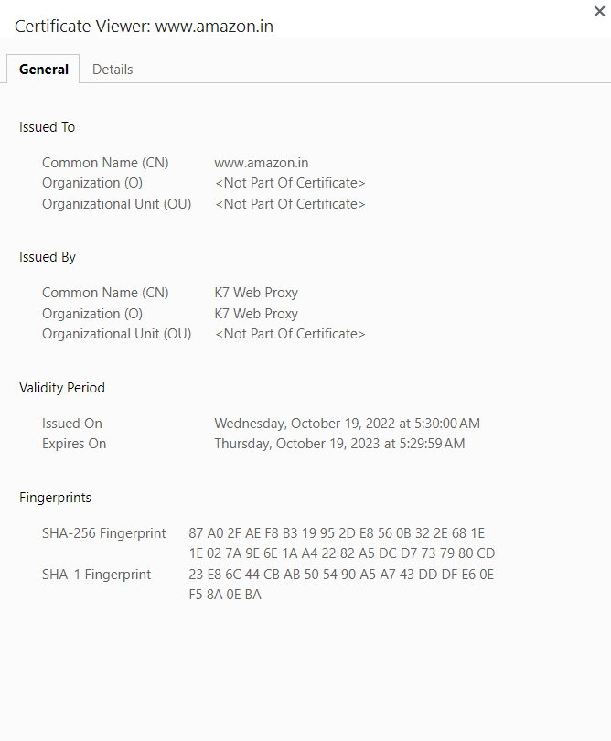
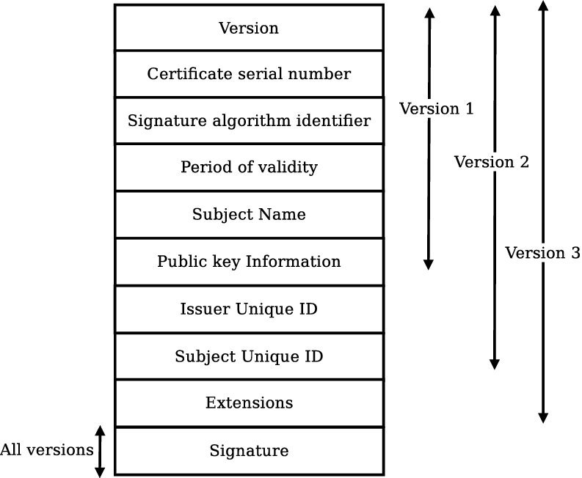
Certificate Used
X.509 certificate

Slide 9
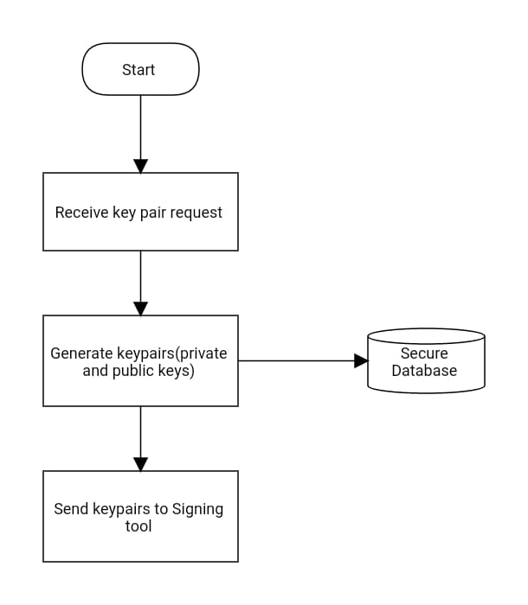
USESCASES:

Slide 10
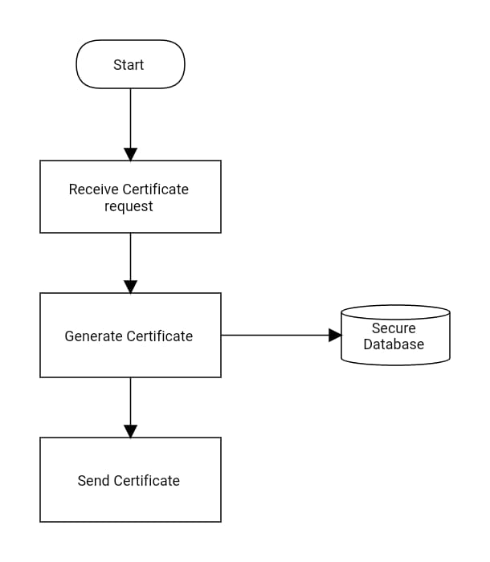

Slide 11
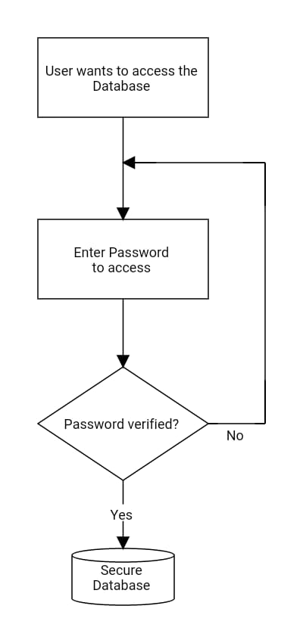

Slide 12
THANK YOU

