Slide 1

Analysis on Rented Properties in Different Location

Slide 2
About me
I have completed my B-tech in year 2024 at GITAM university, Hyderabad
I want to learn Data Science because it is a fascinating field where we can understand and make decision based on the information. It allows you to uncover patterns, make predictions, and solve problems effectively.
I don’t have any experience

Slide 3
Objective of the data and web scraping details
Objective : Analysis on Rented Properties in Different Location using magic bricks website
Web Scraping details:
Analysis for rented properties I have used the magic bricks website
For web scraping the website I have used python libraries like BeautifulSoup to extract the data from the website
Summary of the Data:
I have collected the data of more than 400 rows and 9 columns from more than 10 cities from the website.
Each record includes information such as property type, location, price, tenant-prefernces, and furniture.

Slide 4
Exploratory Data Analysis:
Data Cleaning Steps:
Converting the price, flat, bathrooms, of object datatype to int.
Removing the non-numeric characters in price , flat etc
Data Manipulation Steps:
Extracting floor number from total floors
Extracting location and area from the column

Slide 5
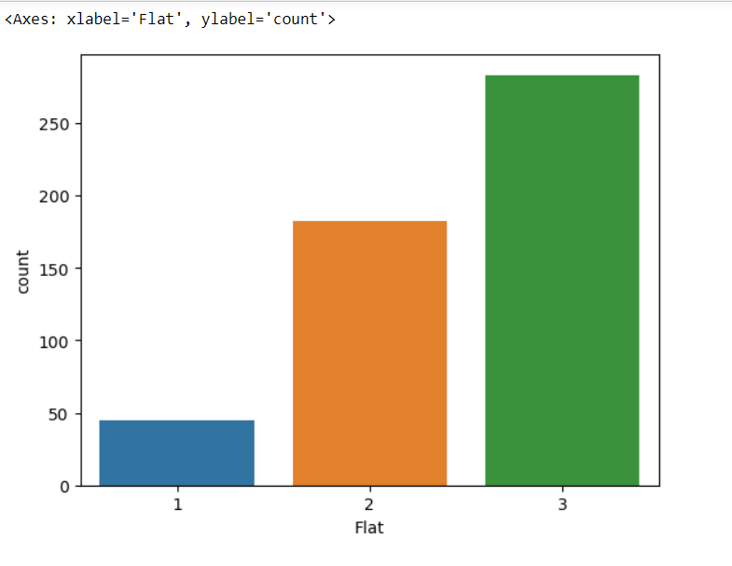
UNIVARIATE ANALYSIS

Slide 6
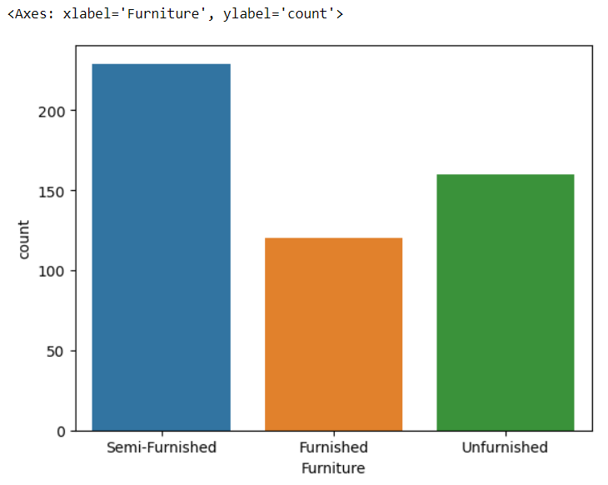
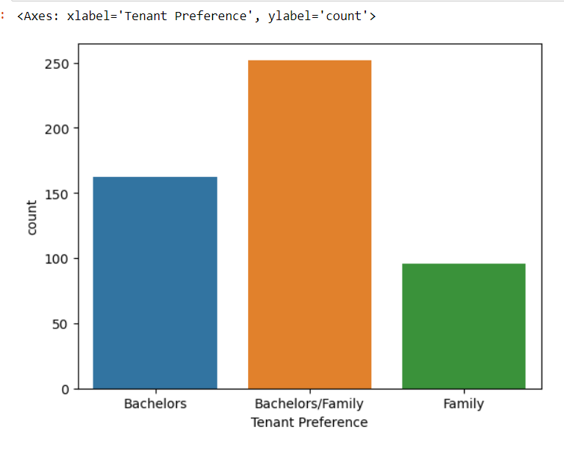

Slide 7
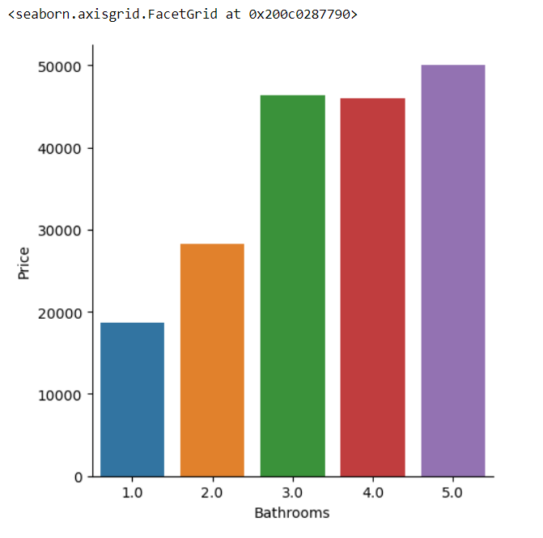
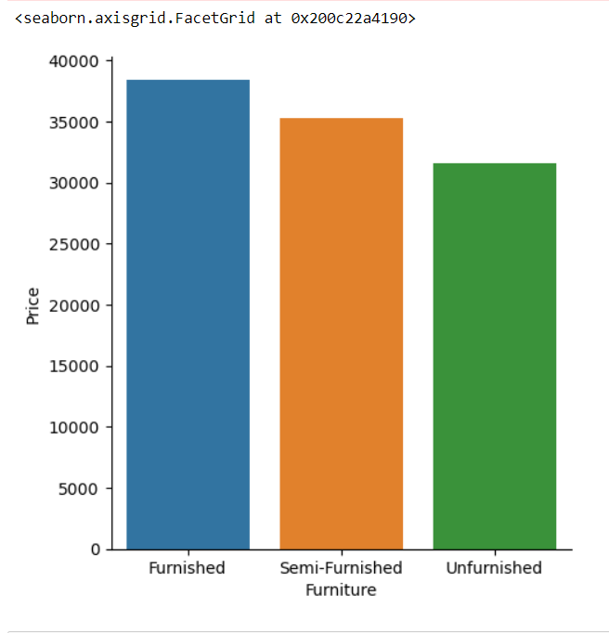
BIVARIATE ANALYSIS

Slide 8
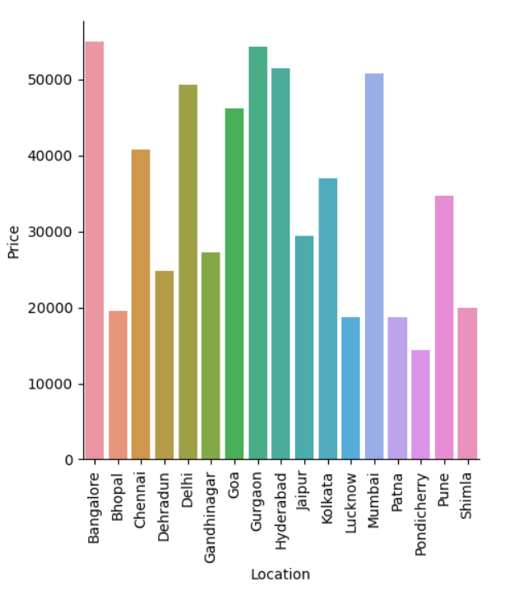
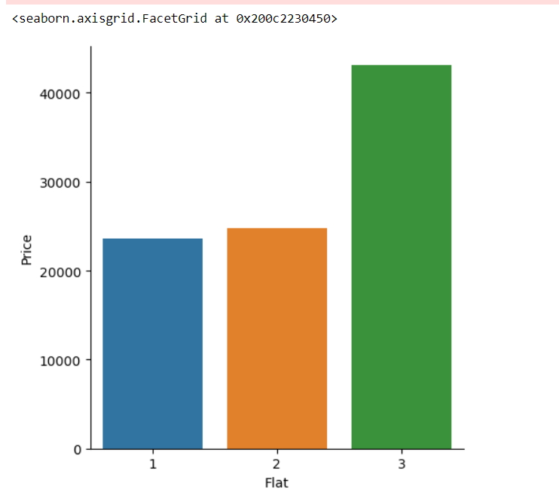

Slide 9
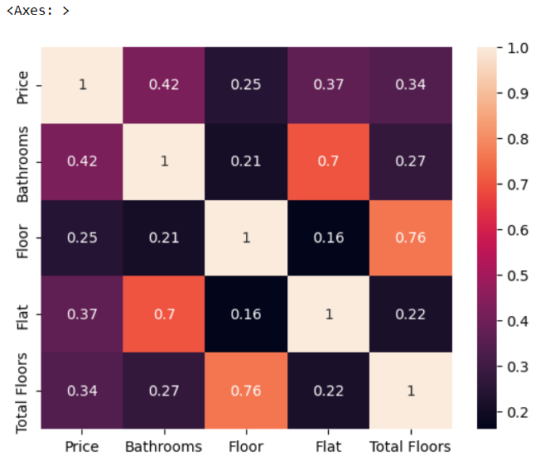

Slide 10
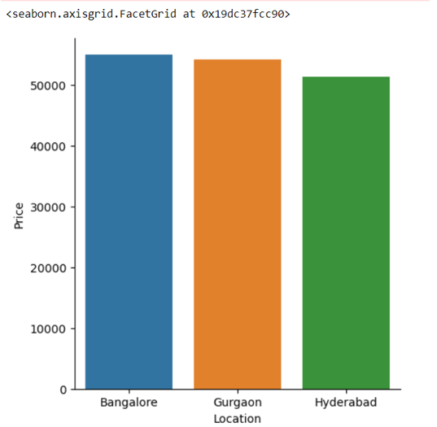
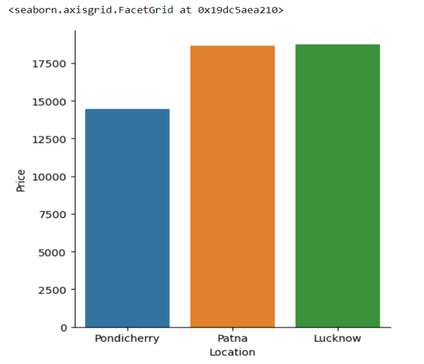
Key business questions Top 3 cities w.r.t price Least 3 cities w.r.t price

Slide 11
Conclusion
The rental analysis on the different locations indicates the rental prices. High demand areas such as Hyderabad , Bangalore , Mumbai, Gurgaon , goa ,Chennai ,Delhi are having higher rental prices based on the features such as type of flat, no.of floors , tenant-preferences than other areas. It indicates that rental properties are lesser available and in these areas the demand is high.

Slide 12
Experience
Working on the web scraping and data analysis project for the Magic Bricks website has been both an enriching and insightful experience. The project involved several key steps, each presenting its own set of challenges and learning opportunities. Utilized tools like BeautifulSoup to scrape data from the Magic Bricks website.

Slide 13
Q&A

Slide 14

THANK YOU

