Slide 1
Department of CSE (AI & ML)
Batch No: C12
Drug Recommendation System based on Sentiment Analysis of Drug Reviews using Machine Learning
Team members:
D. Ragasree – 217R1A66E5
B. Shiva Chaitanya – 217R1A66D7
V. Praneeth Reddy – 217R1A66J7
Under the Esteemed Guidance of U. Saritha
(Assistant Professor)

Slide 2
Table of contents:
Abstract
Existing System
Disadvantages
Proposed System
Advantages
System Architecture
Use Case Diagram
Class Diagram
Sequence Diagram
Algorithms
Dataset
Screenshots and Project
Execution
Performance Metrics
Result Analysis
Conclusion and Future Scope
Any Queries

Slide 3
Abstract
During the times of covid-19,people faced many healthcare problems including Shortage of medical resources, including specialists, leads to distress and increased mortality.
Individuals resort to self-medication due to unavailability of proper consultation.In this we present a drug recommender system that can drastically reduce specialists help.
We built a medicine recommendation system that uses patient reviews to predict the sentiment using various vectorization processes like Bow, TF-IDF,Word2Vec, and Manual Feature Analysis, which can help recommend the top drug for a given disease by different classification algorithms.
The predicted sentiments were evaluated by precision, recall, f1score, accuracy, and AUC score.

Slide 4
Existing System
GalenOWL Framework: Online tool for doctors to prescribe medications considering patient specifics like illness, allergies, and drug interactions.
Similar Treatments Comparison: Analyzed extensive treatment records to identify optimal options.Implemented an intelligent system to categorize and compare similar treatments, evaluating their effectiveness.
Considering Patient Health for Medication: Emphasizes prescribing medicines based on patient health status.Developed a system to assess the strength of a patient's immunity.
Picking the Best Treatment Algorithm: Explored decision tree, SVM, and neural network algorithms for treatment suggestions.Selected SVM due to its accuracy, speed, and effectiveness across a diverse range of patients.
CADRE Cloud-Assisted Drug Suggestions: Introduces a novel system for doctors to select medicines using the internet.Recommends medications based on what similar patients have taken.

Slide 5
Disadvantages
In the existing work, the system did not implement an exact sentiment analysis for large data sets.
This system is less performance due to lack Data Classification and Data Fragmentation technique.

Slide 6
Proposed System
Recommends medicines based on user interests and needs, employing sentiment analysis on patient reviews.
Focuses on understanding patient sentiments and opinions for personalized drug recommendations.
In the drug recommender system, medicine is offered on a specific condition dependent on patient reviews using sentiment analysis and feature engineering.
Sentiment analysis is a progression of strategies, methods, and tools for distinguishing and extracting emotional data, such as opinion and attitudes, from language .

Slide 7
Advantages:
Proposed algorithm for NLP efficiently counts token frequency in reviews/documents.
Utilizes precise sentiment analysis techniques for data cleaning and visualization.
Enhances system effectiveness by integrating these algorithms.
Improves accuracy through efficient sentiment analysis prediction methods.

Slide 8
System Requirements:
Hardware System Configuration:
➢ Processor - Ryzen 7
➢ RAM - 4 GB (min)
➢ Hard Disk - 20 GB
➢ Key Board - Standard Windows Keyboard
➢ Mouse - Two or Three Button Mouse
➢ Monitor - SVGA

Slide 9
Software Requirements:
Operating system : Windows 11.
Coding Language : Python.
Front-End : Python.
Back-End : Django-ORM
Designing : CSS, JavaScript.
Data Base : MySQL

Slide 10
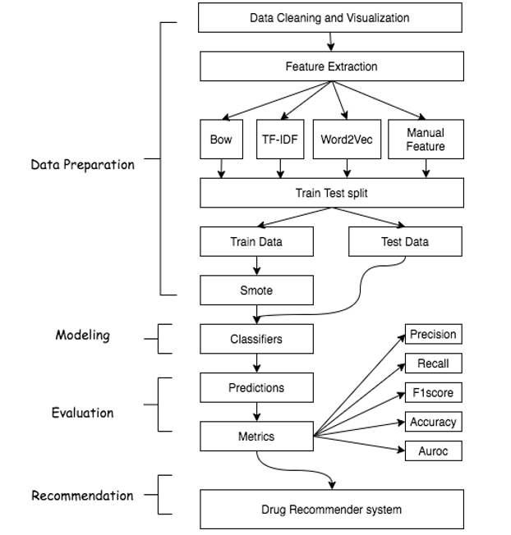
System Architecture:

Slide 11
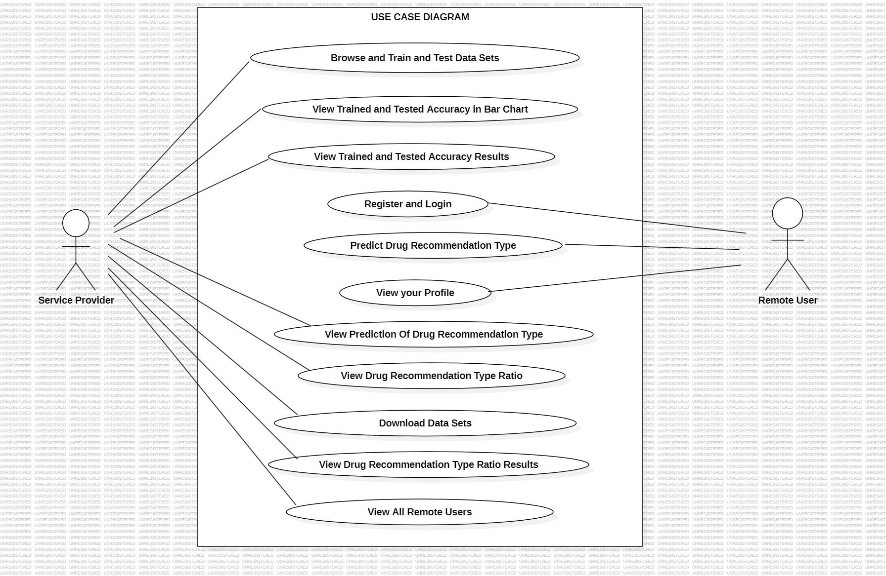
Use Case Diagram:

Slide 12
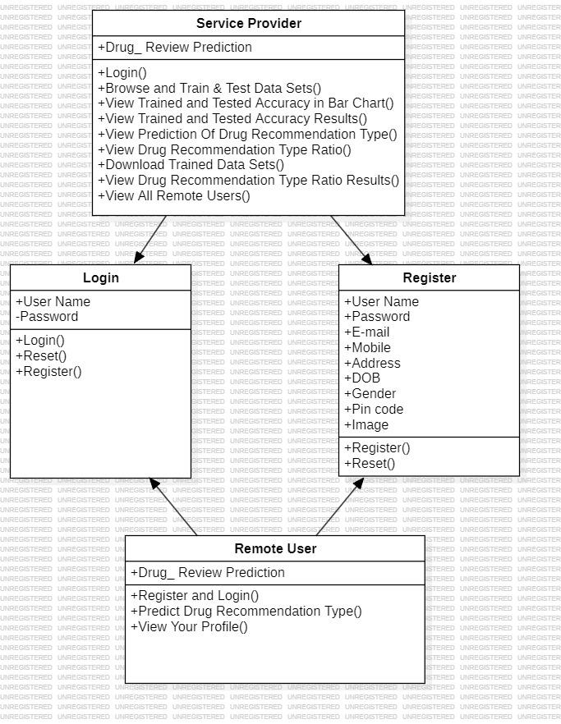
Class Diagram:

Slide 13
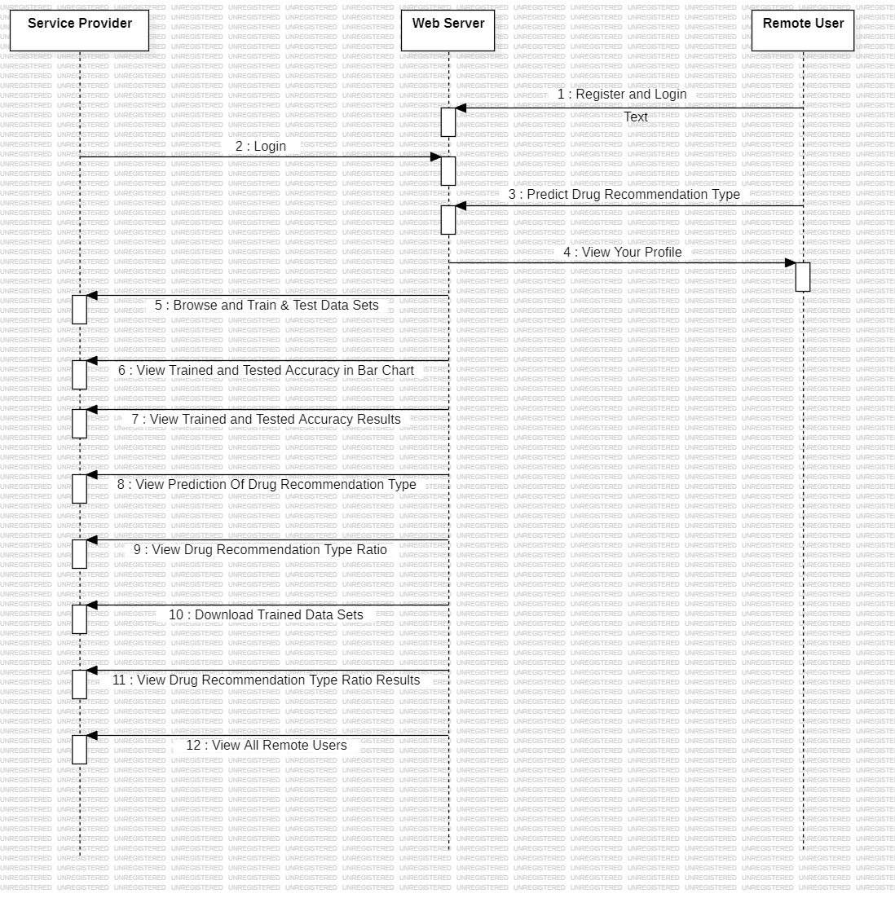
Sequence Diagram

Slide 14
Algorithms:
SVM
Naive Bayes
Logistic Regression
Decision Tree Classifier
SGD Classifier

Slide 15
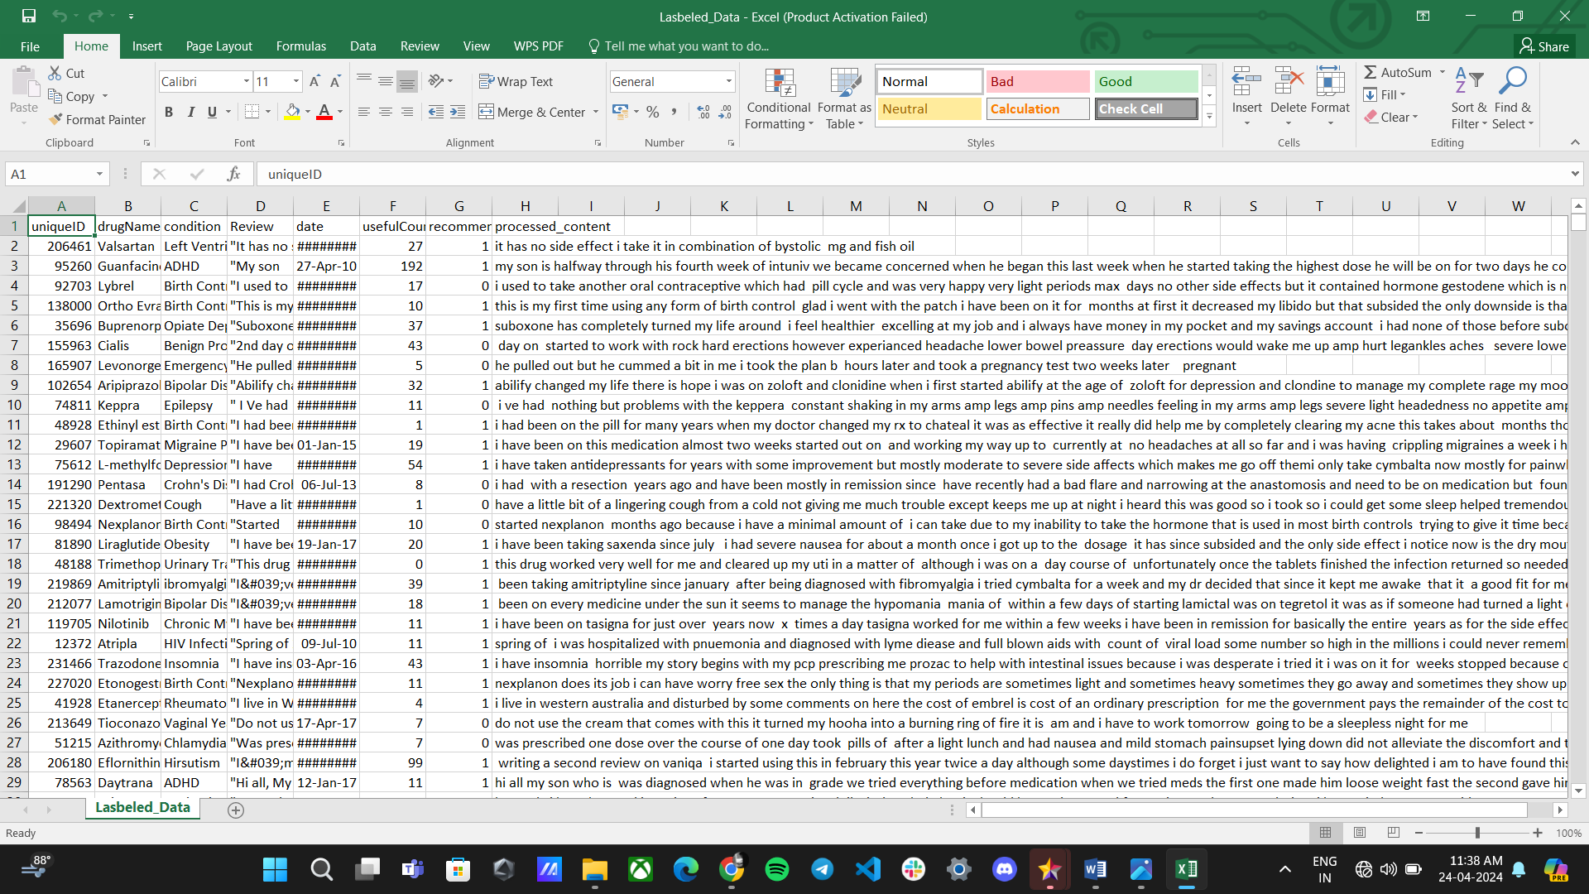
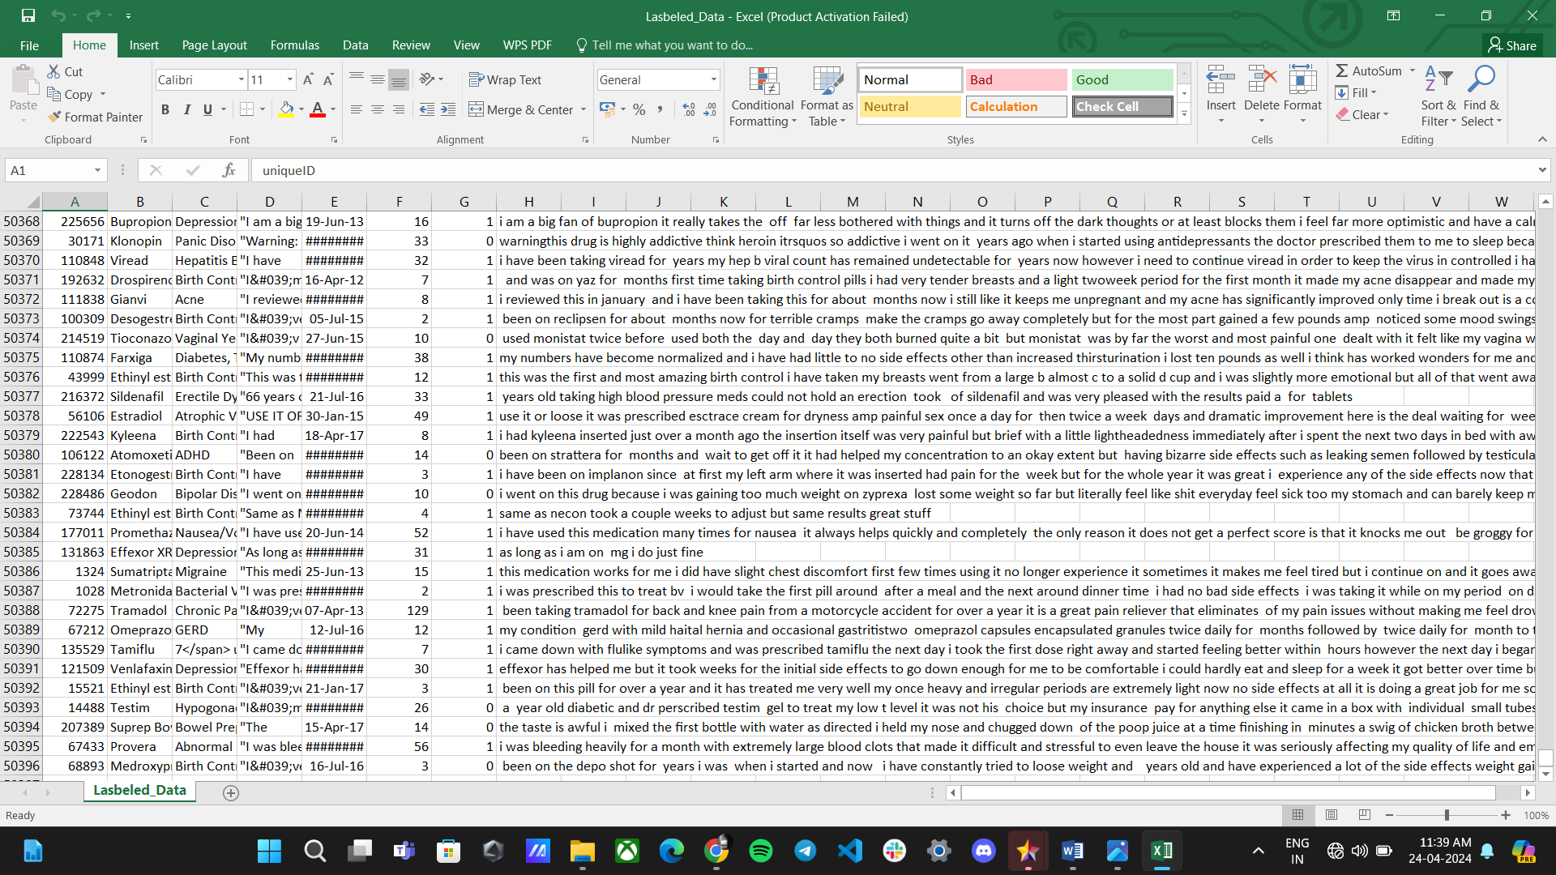
Dataset:
The Datasets are retrieved from Kaggle.
In this there are 8 atttributes.(uniqueID,drugName,Condition,Review,Date,usefulCount,Recommend,Processed_content)
The size of the dataset is more than 50,000.
Link:Dataset

Slide 16
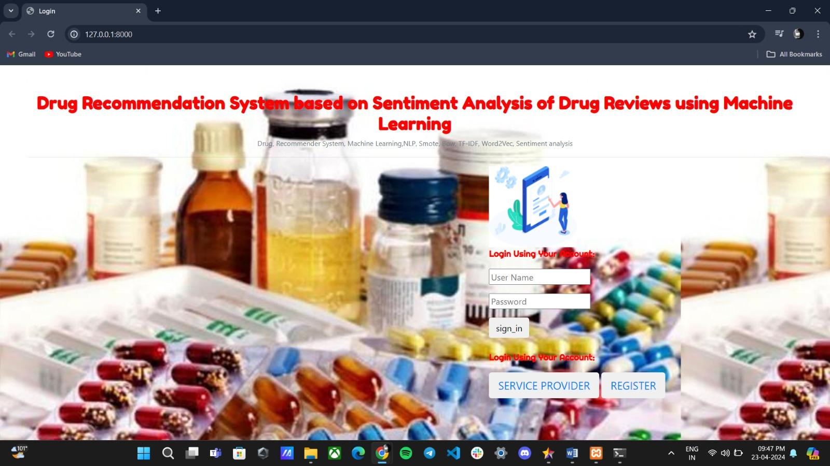
Screenshots and Project Execution:

Slide 17
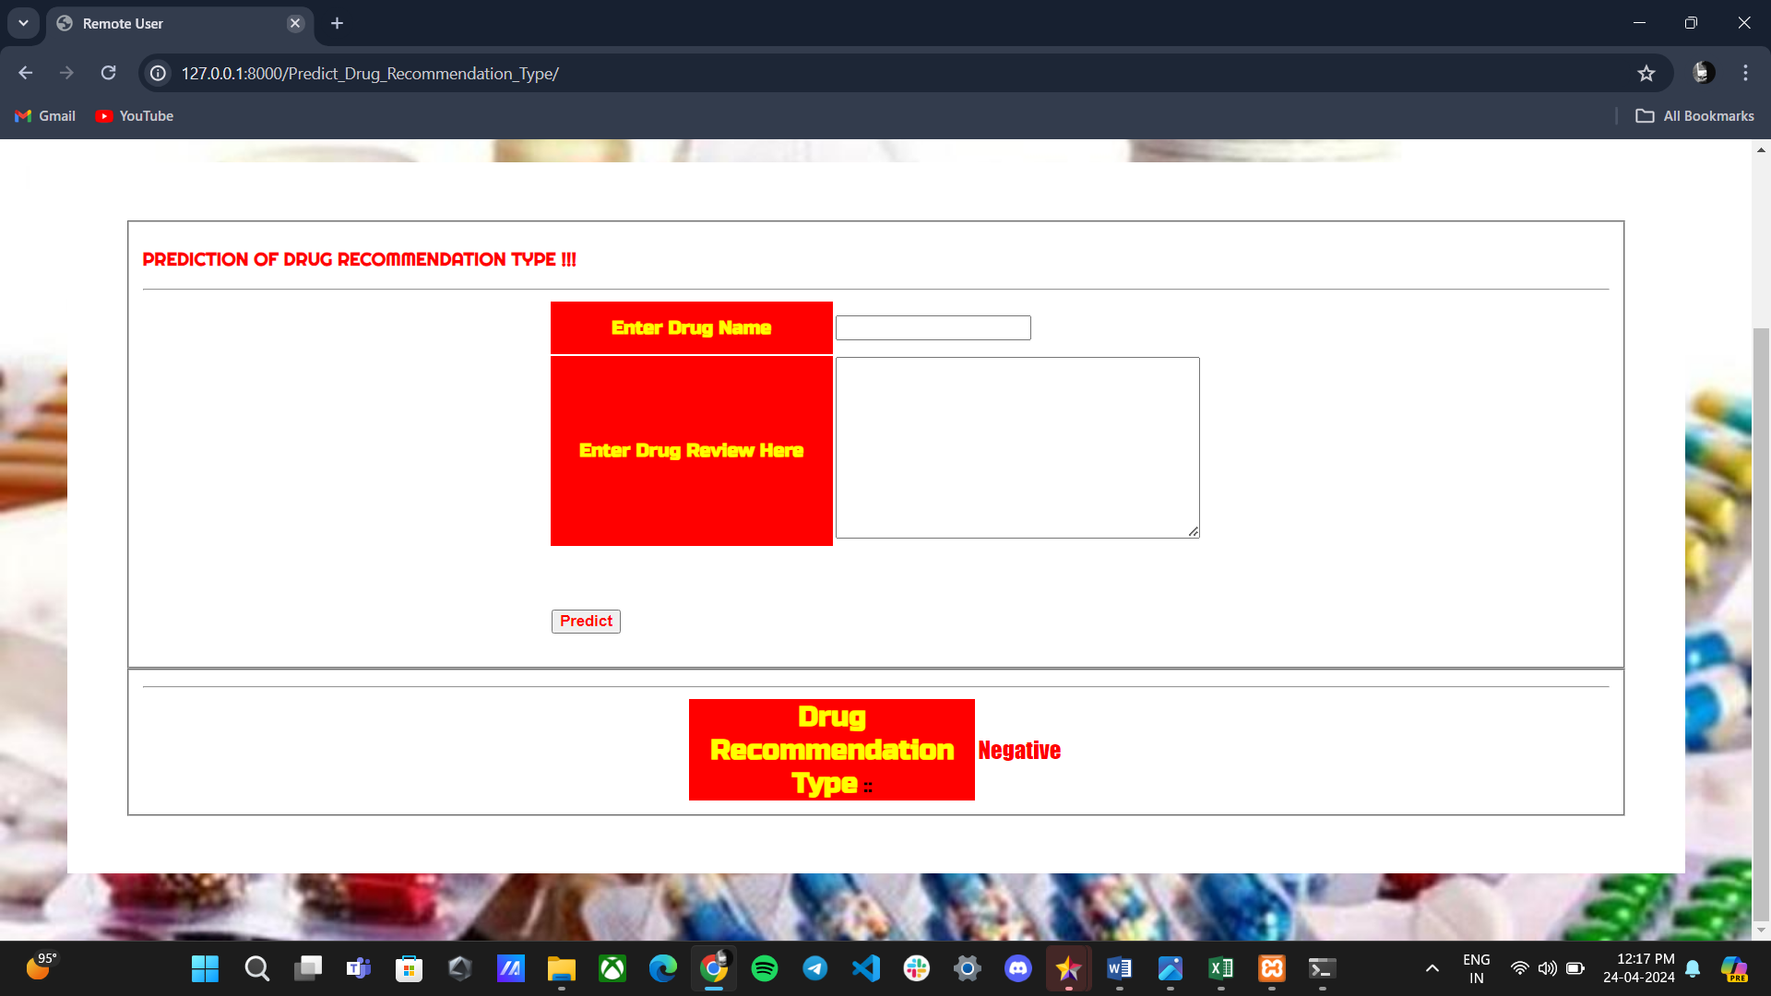
Project Execution:

Slide 18
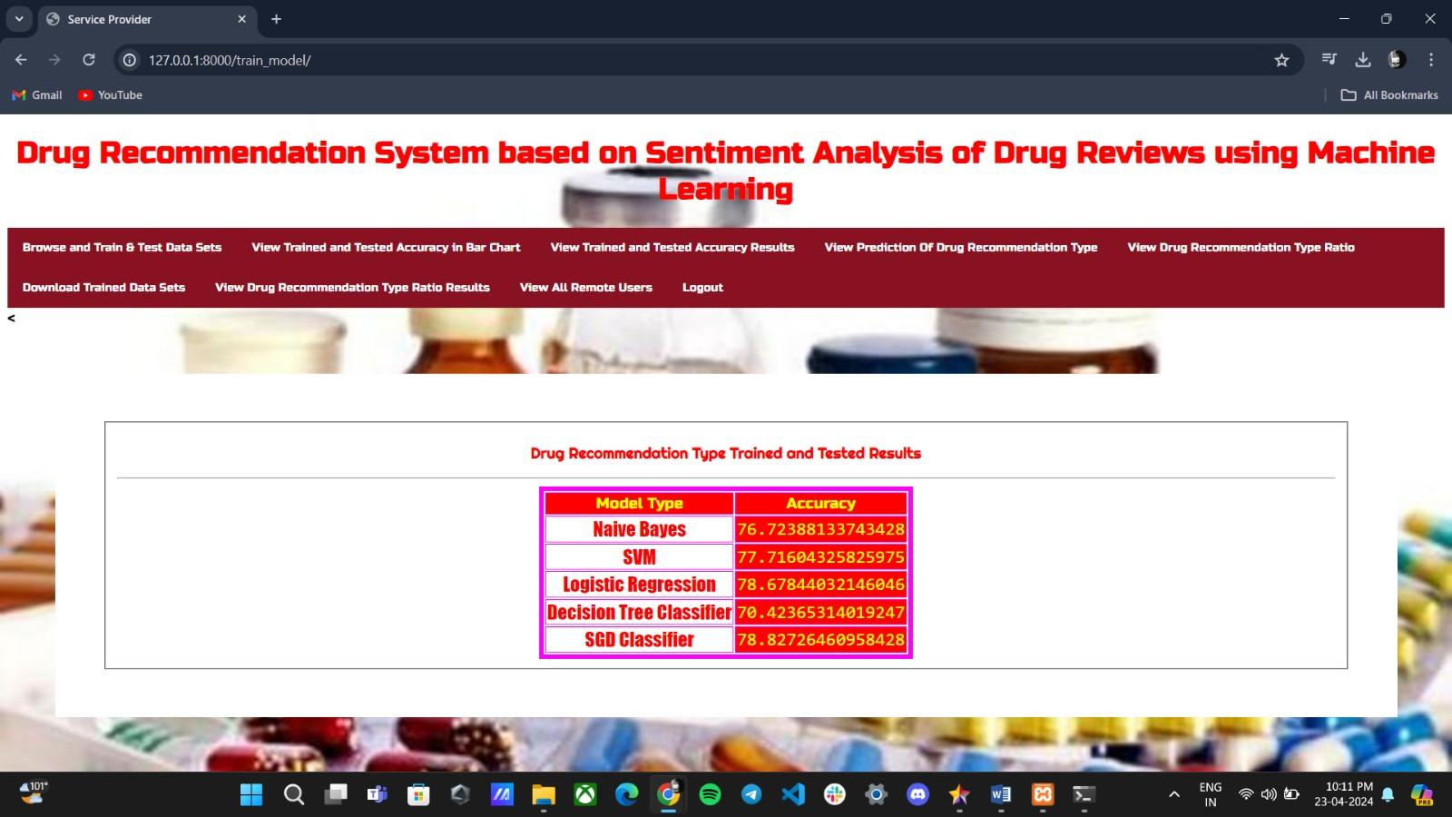
Performance Metrics:

Slide 19
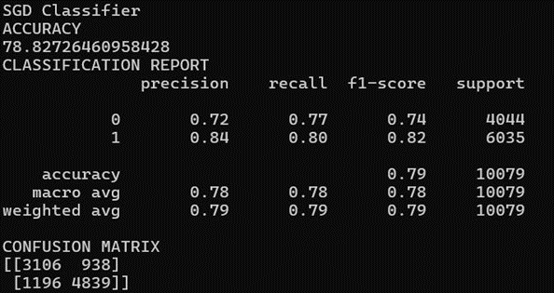
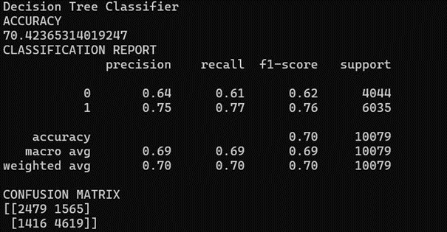
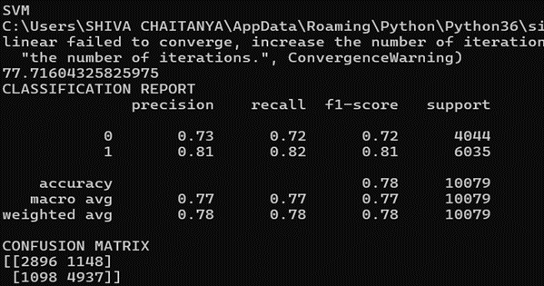
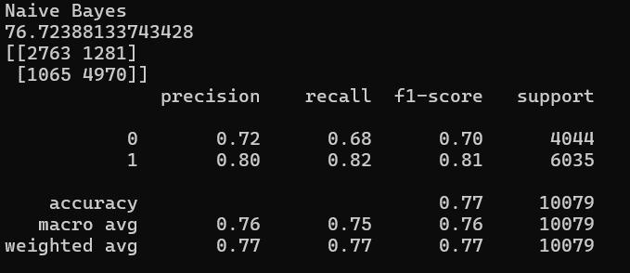
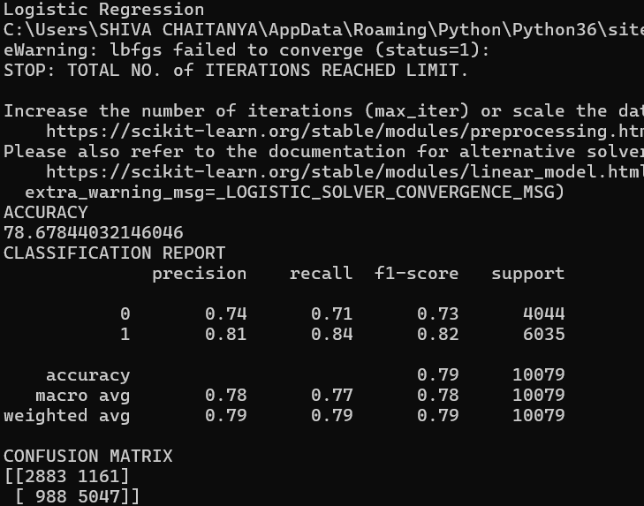
Performance Metrics:

Slide 20
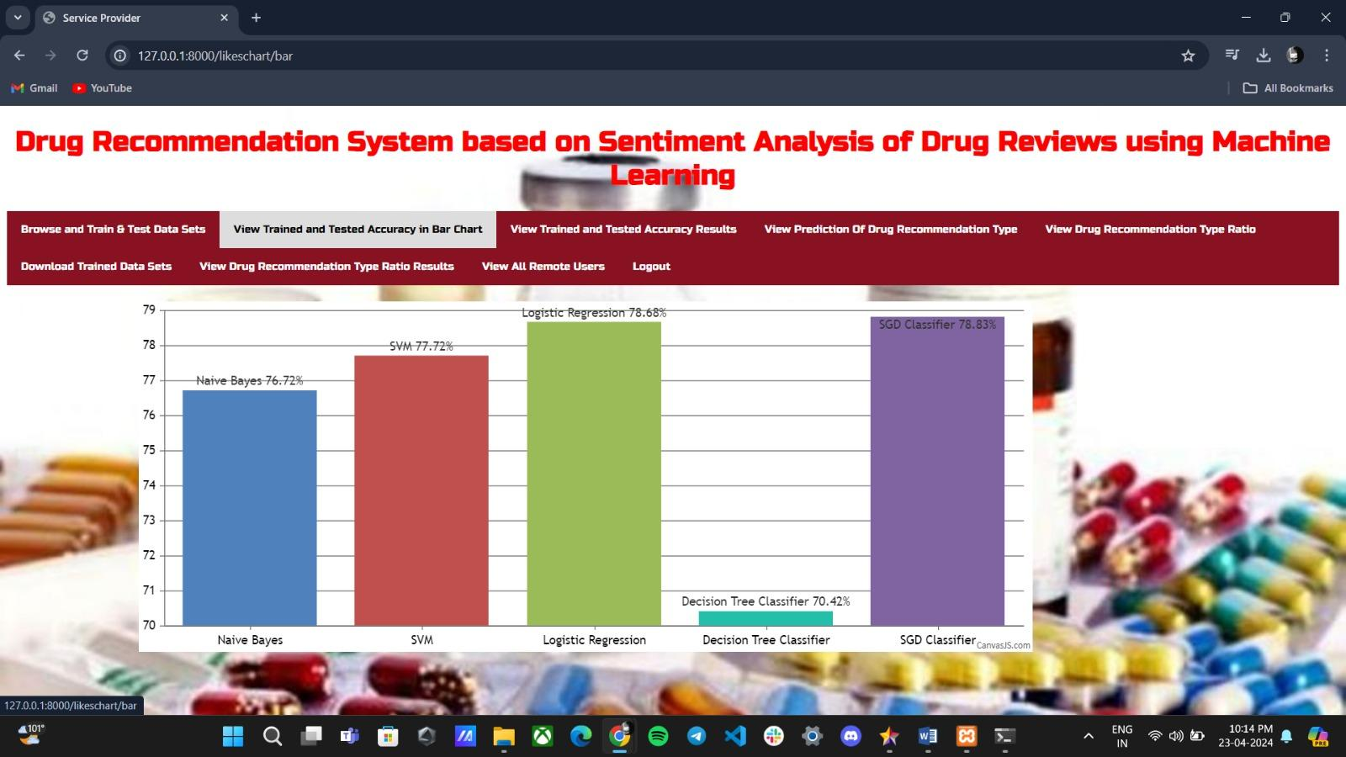
Result Analysis:

Slide 21
Conclusion:
Explored sentiment analysis of drug reviews for a recommender system.
Logistic regression and SGD classifier are more useful as they are giving high accuracy.
Utilized various machine learning classifiers and feature representations.
Integrated predicted emotion values and useful count for overall drug score.
Future work includes investigating oversampling techniques, n-gram adjustments, and algorithm optimization.

Slide 22

Any Queries ?
By Batch C12
CSM – C

