Slide 1
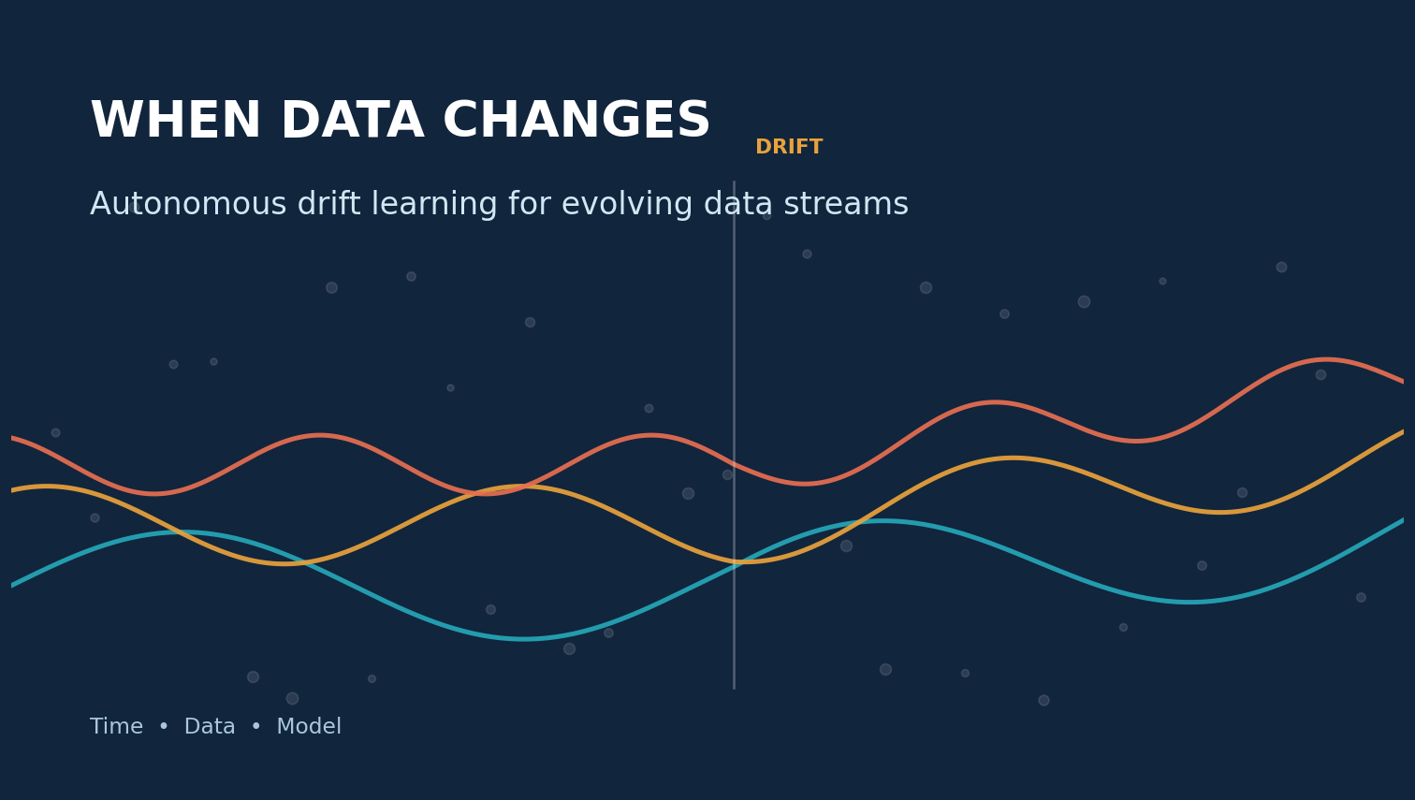
CMPE 255 SHORT STORY
Praneeth Kalangi
Primary survey: Yang, Yu, and Lu (2026)
Notes:
Introduce the short story and explain that the presentation combines the 2026 drift-learning survey with an accepted KDD 2026 benchmark.
Sources:
https://arxiv.org/abs/2605.01295
https://arxiv.org/abs/2606.07789

Slide 2
A production model is a snapshot of a moving process
02
92%
JANUARY
A fraud model learns yesterday's behavior.
offline accuracy
does not guarantee
New payment tools, merchant behavior, and attack strategies arrive after deployment.
future reliability
Pₜ(X,Y) changes while the code stays the same
Notes:
Use a fraud-detection example to show why fixed test-set accuracy cannot guarantee future performance.
Sources:
https://arxiv.org/abs/2605.01295

Slide 3
The research question has expanded
03
From detecting external change to managing an evolving learning system
DETECT
UNDERSTAND
ADAPT
Is the stream statistically different from the recent past?
What changed: timing, representation, meaning, or model state?
Which response restores performance without causing new damage?
+
+
193 studies synthesized into a three-dimensional drift-learning framework
Notes:
Explain the progression from the 2019 detection-understanding-adaptation framework to the broader 2026 operational-state view.
Sources:
https://doi.org/10.1109/TKDE.2018.2876857
https://arxiv.org/abs/2605.01295

Slide 4
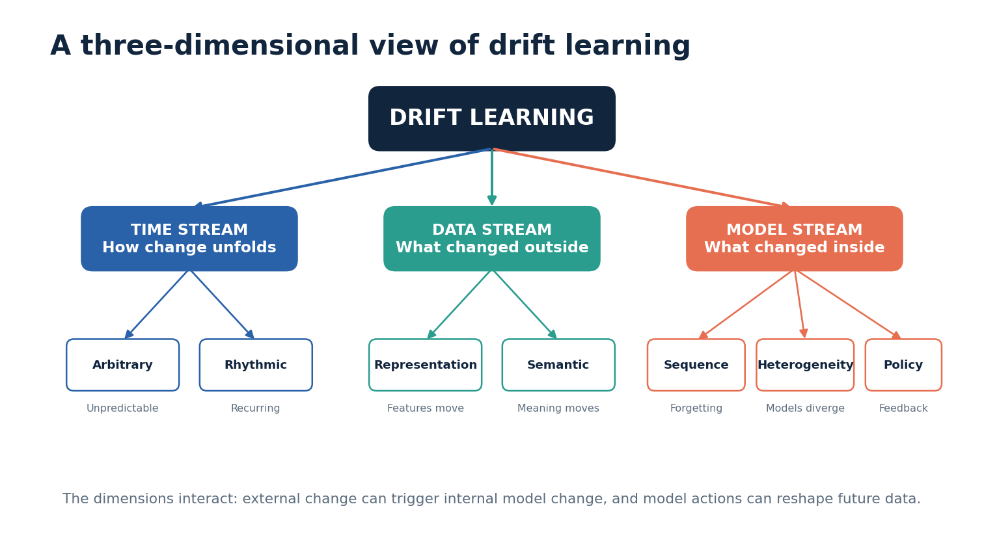
Three dimensions explain where drift originates
04
Notes:
Walk through time-stream, data-stream, and model-stream drift. Emphasize that multiple dimensions can occur together.
Sources:
https://arxiv.org/abs/2605.01295

Slide 5
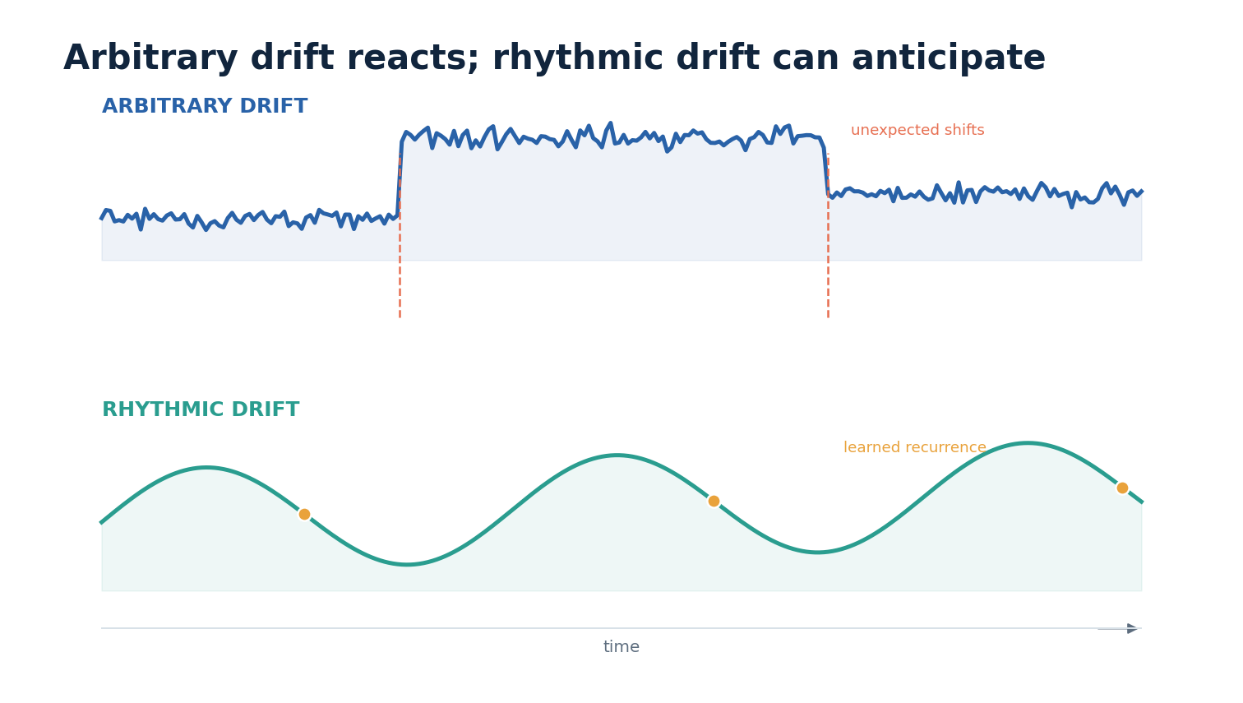
Temporal structure changes the response
05
Arbitrary drift needs fast reaction. Rhythmic drift creates a chance to forecast the next regime.
Notes:
Compare unexpected shifts with recurring or smoothly evolving patterns. Explain why recurring drift can support proactive adaptation.
Sources:
https://arxiv.org/abs/2605.01295

Slide 6
Representation and meaning can move independently
06
REPRESENTATION DRIFT
SEMANTIC DRIFT
The feature space changes
The input-label relationship changes
Examples
Examples
New camera
Sensor recalibration
Network protocol update
Evolving fraud behavior
New label policy
Changing customer intent
Feature-only monitoring can miss a label-only change
Notes:
Explain why representation drift and semantic drift require different monitoring signals and different responses.
Sources:
https://arxiv.org/abs/2605.01295

Slide 7
The learner can drift even when incoming data looks stable
07
SEQUENCE
HETEROGENEITY
POLICY
Continual updates erase earlier knowledge
Distributed models gradually diverge
Model actions reshape future observations
catastrophic forgetting
federated clients
feedback loops
Monitor model state, disagreement, and update behavior, not only input features.
Notes:
Introduce sequence, heterogeneity, and policy drift. Use recommendation systems as an example of a model influencing its own future data.
Sources:
https://arxiv.org/abs/2605.01295

Slide 8
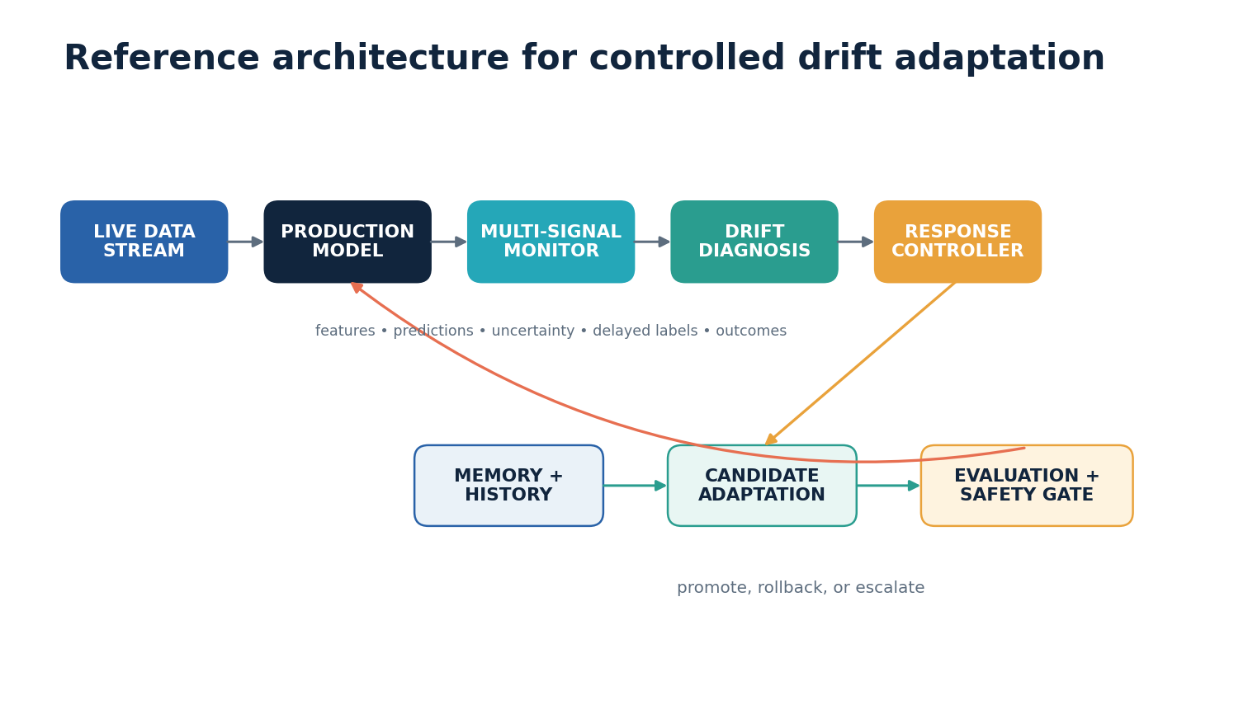
Autonomous adaptation needs diagnosis and a safety gate
08
Notes:
Explain the monitoring, diagnosis, response, memory, candidate adaptation, and evaluation stages. Stress that an alarm should not directly replace a production model.
Sources:
https://arxiv.org/abs/2605.01295

Slide 9
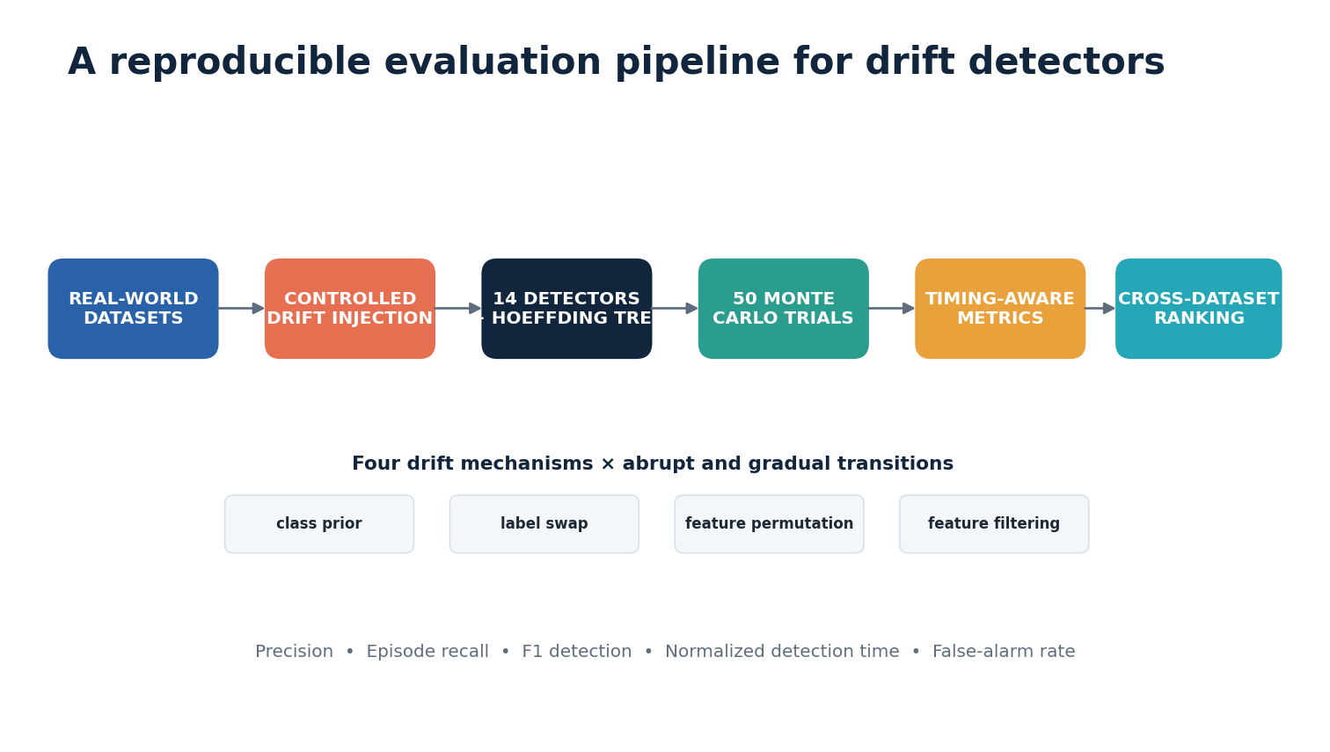
Known drift points make detector evaluation reproducible
09
Notes:
Describe the KDD 2026 setup: 14 detectors, seven datasets, four drift mechanisms, abrupt and gradual transitions, and 50 Monte Carlo trials.
Sources:
https://arxiv.org/abs/2606.07789

Slide 10
A detector must be accurate, timely, and operationally useful
10
PRECISION
EPISODE RECALL
F1 DETECTION
How many alarms were correct?
How many drift episodes were found?
How well are precision and recall balanced?
NORMALIZED DELAY
FALSE-ALARM RATE
How quickly did the correct alarm arrive?
How much unnecessary work did alarms create?
No single number captures detection quality and business cost.
Notes:
Explain why F1 alone is incomplete. Pair timing with episode recall and false-alarm rate.
Sources:
https://arxiv.org/abs/2606.07789

Slide 11
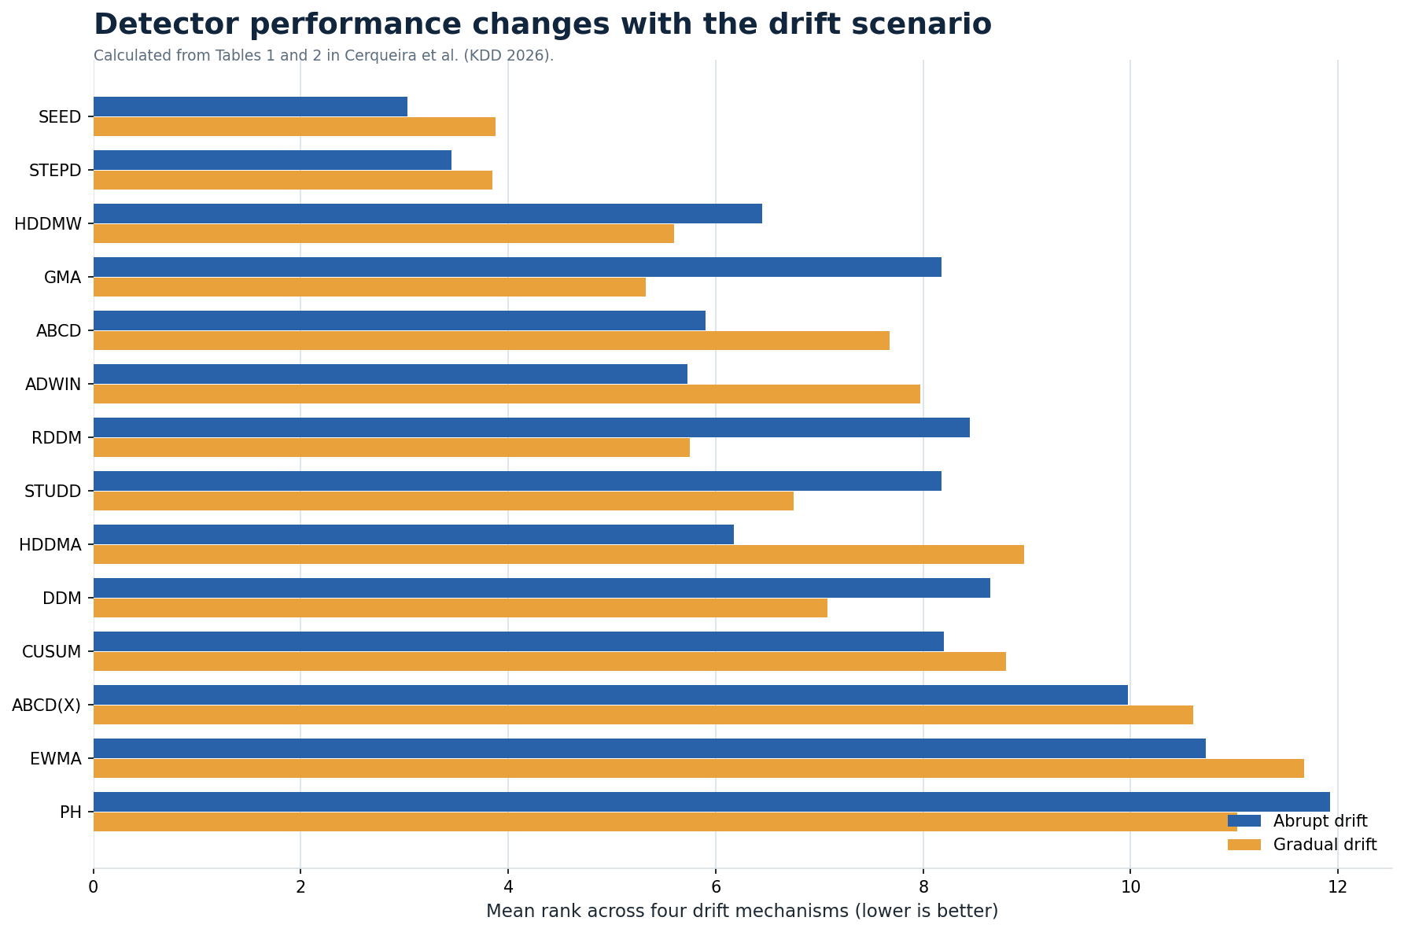
Detector performance depends on the drift mechanism
11
READING THE RESULT
SEED and STEPD stay competitive across many scenarios.
Abrupt drift is usually easier than gradual drift.
Feature-only detectors struggle with label-only change.
No universal winner
Notes:
Interpret the mean ranks calculated from the benchmark tables. Emphasize specialization and the absence of a universal best detector.
Sources:
https://arxiv.org/abs/2606.07789

Slide 12
Cross-dataset tuning changes the benchmark conclusion
12
Ablation: tuned configurations versus defaults
DEFAULT CONFIGURATION
LEAVE-ONE-DATASET-OUT
Parameters may reflect the datasets used when the detector was originally developed.
VS
Tune on six datasets, then evaluate once on the held-out seventh dataset.
Risk: an optimistic or unfair comparison
Result: stronger and more transferable settings
The benchmark reports meaningful gains from optimization over defaults.
Notes:
Explain the leave-one-dataset-out protocol and why comparing tuned methods with defaults can change rankings.
Sources:
https://arxiv.org/abs/2606.07789

Slide 13
The same drift problem creates different risks by domain
13
FRAUD
HEALTHCARE
Attackers adapt to the detector
Population and clinical practice change
RECOMMENDERS
ROBOTICS
Recommendations reshape user behavior
Weather, surfaces, and people change
Notes:
Connect drift learning to fraud, healthcare, recommendations, and robotics. Mention the need for human approval in high-risk adaptation.
Sources:
https://arxiv.org/abs/2605.01295

Slide 14
FINAL TAKEAWAY
The goal is not a model that changes whenever the data moves.
The goal is a system that identifies the type of change, chooses a proportional response, and validates that response before deployment.
TIME
DATA
MODEL
How change unfolds
What changed outside
What changed inside
Praneeth Kalangi | CMPE 255
Notes:
Close by summarizing the taxonomy and the need for proportional, validated adaptation.
Sources:
https://arxiv.org/abs/2605.01295
https://arxiv.org/abs/2606.07789

