Slide 1
Food delivery application
By naga praneeth kumar chinni
12007225
Submitted to : Dr. Balwinder kaur dhaliwal

Slide 2
INTRODUCTION
A food delivery application is a software program that enables users to order their food in real-time. Food delivery applications are Generally used to order food to our location.

Slide 3
Technologies Used
React js : React js is a highly popular library used for developing single-page applications or SPAs, as well as complex and dynamic web applications. React uses a virtual DOM (Document Object Model) which allows it to update only the necessary components of a web page, instead of reloading the entire page each time a change is made.
Axios : Axios is a popular JavaScript library that allows developers to make HTTP requests from their web applications. It provides a simple and easy-to-use API for sending requests to servers, and for handling the responses that are returned. Axios can be used in both browser-based and Node.js applications, and it supports a variety of features such as interceptors, automatic transformation of data, cancellation of requests, and support for Promise-based asynchronous operations.

Slide 4
Technologies used
Swal JS : Bcrypt JS provides a simple and easy-to-use API that allows developers to quickly and easily integrate password hashing and salting into their applications. It supports both synchronous and asynchronous hashing methods, and can be used in a wide variety of JavaScript environments, including Node.js and the browser
Dotenv : Dotenv is a zero-dependency module that loads environment variables from a .env file into process.env . The dotenv package is a great way to keep passwords, API keys, and other sensitive data out of your code. It allows you to create environment variables in a . env file instead of putting them in your code.

Slide 5
Functionalities
User login and register
User logout
Add to cart
Order list

Slide 6
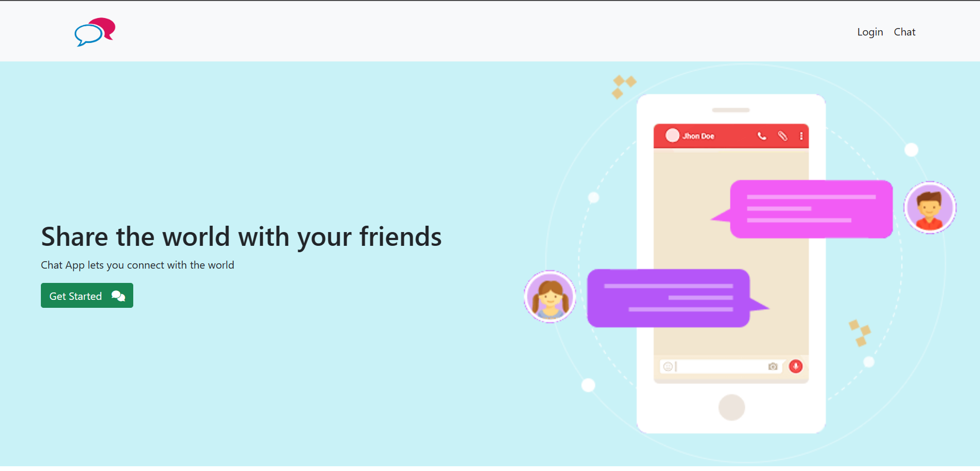
Home page

Slide 7
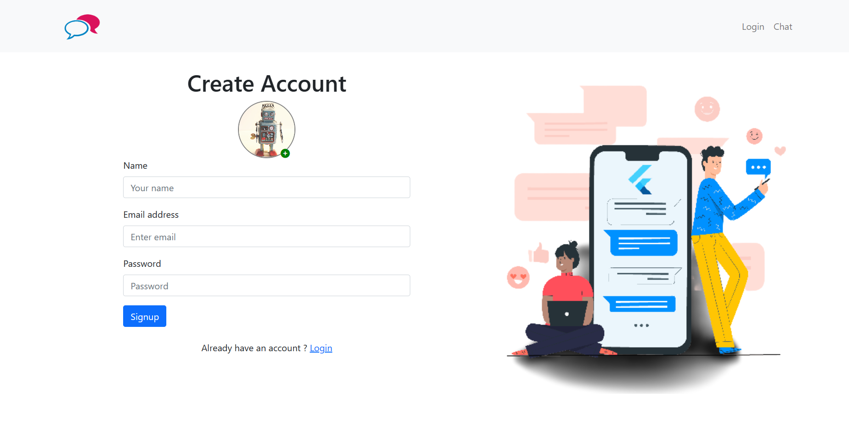
Signup page

Slide 8
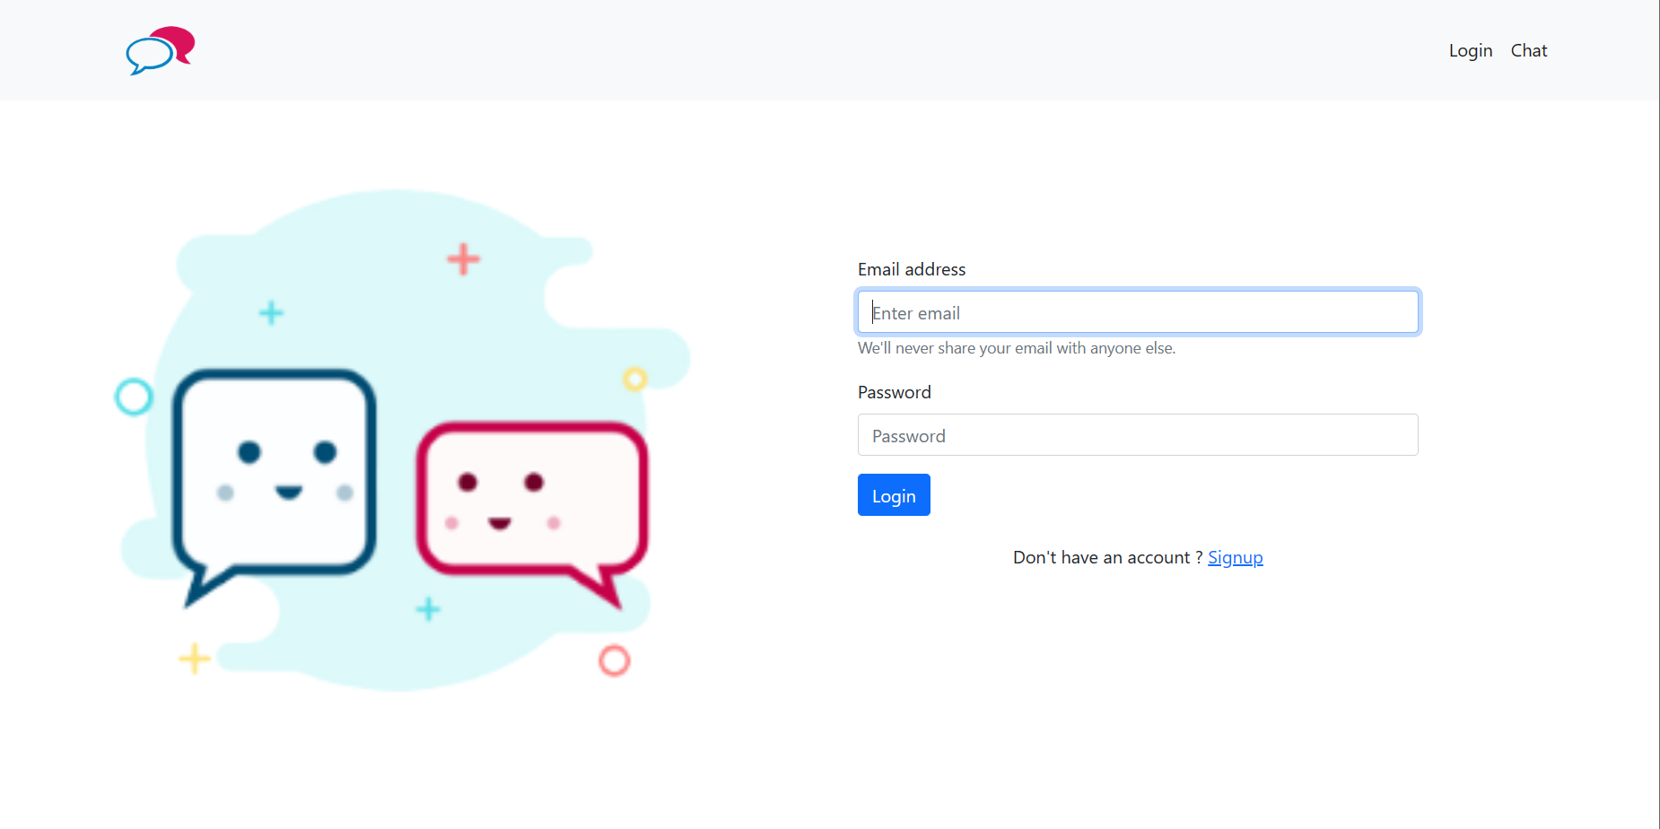
Login page

Slide 9
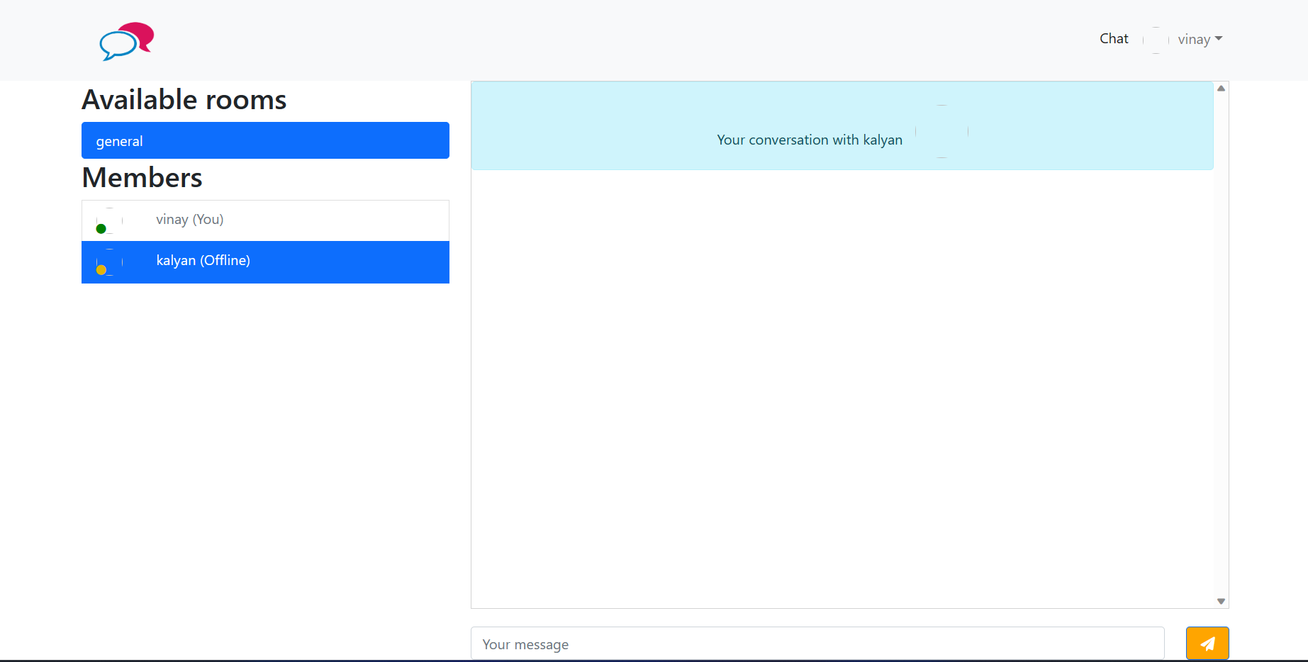
Chat page

Slide 10
Thank you

