Slide 1

SEASONAL AGRICULTURE PERFORMANCE ANALYSIS
Name: Praneetha Vechalapu
College Name: Vignan’s Institute of Engineering for Women
AICTE STU ID : STU65da02e46f6fa1708786404

Slide 2

PROBLEM STATEMENT
Agricultural activities are influenced by seasonal variations in environmental conditions, farming practices, resource availability and market conditions. As a result, agricultural performance may differ from one season to another. However, raw agricultural data does not clearly explain how agricultural performance changes across seasons or what patterns can be observed in different seasonal conditions. The problem is to analyze the given agricultural dataset and investigate seasonal differences in agricultural performance by identifying meaningful patterns, trends, relationships and variations within the available data.

Slide 3
Project Description
This project analyzes a 4,000-record dataset of Indian farm activity spanning the Kharif, Rabi and Zaid seasons across 8 states and 8 crops, covering environmental conditions, farming inputs, yield, and economic outcomes.
The goal was to investigate how agricultural performance differs by season, using Python (Pandas, NumPy, Matplotlib, Seaborn, SciPy) for cleaning, exploratory analysis, statistical testing and visualization.
Key steps: missing-value treatment via season-wise median imputation, outlier assessment with the IQR method, univariate/bivariate/multivariate analysis, a Kruskal-Wallis significance test, and five original investigative questions (farm-size payoff, seed quality impact, crop cost-efficiency, disease-risk vs. profit, and irrigation-method efficiency).

Slide 4

WHO ARE THE END USERS?
Farmers — to plan sowing, resource allocation and crop choice by season.
Agricultural Planners / Policy Makers — to design season-specific support programs.
Agribusiness & Input Suppliers — to time fertilizer, seed and irrigation-equipment supply.
Financial Institutions & Insurers — to assess seasonal risk for loans and crop insurance.
Researchers & Students — as a reference case study in agricultural data analytics.

Slide 5

Technology Used
Python — core language for the entire analysis
Pandas & NumPy — data cleaning, transformation and aggregation
Matplotlib & Seaborn — univariate, bivariate and multivariate visualizations
SciPy (stats) — Kruskal-Wallis significance testing
Jupyter Notebook — documenting the complete, reproducible analysis

Slide 6
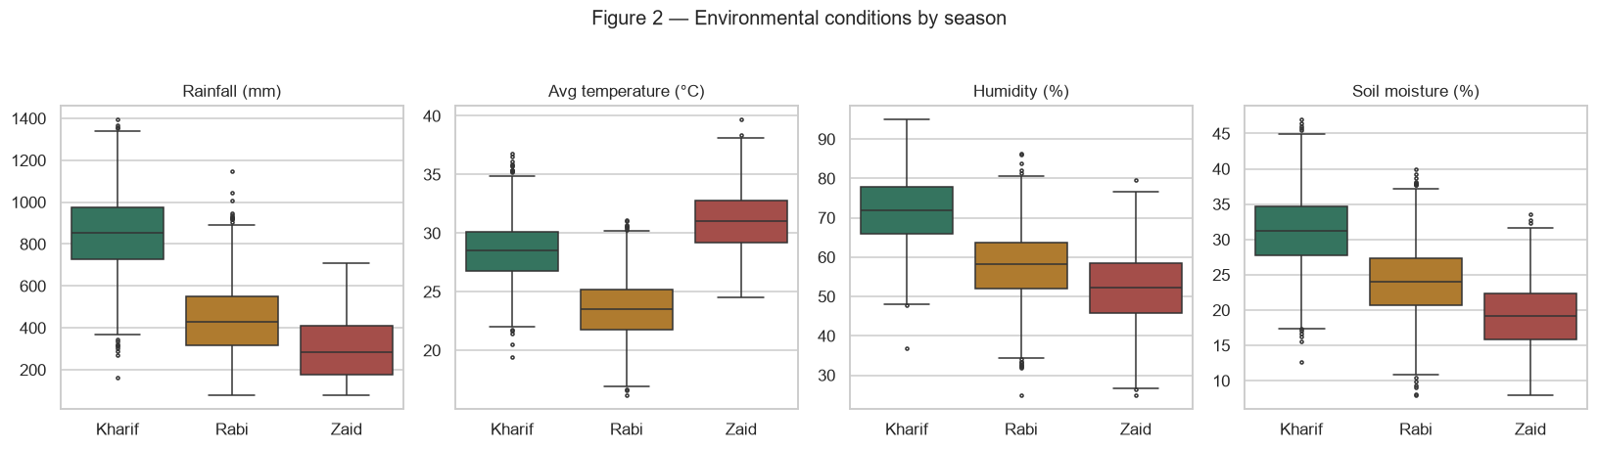
RESULTS
Kharif records the highest rainfall, humidity, and soil moisture among the three seasons.
Zaid has the highest average temperature but the lowest humidity and soil moisture levels.
Rabi generally shows moderate environmental conditions, falling between Kharif and Zaid.

Slide 7
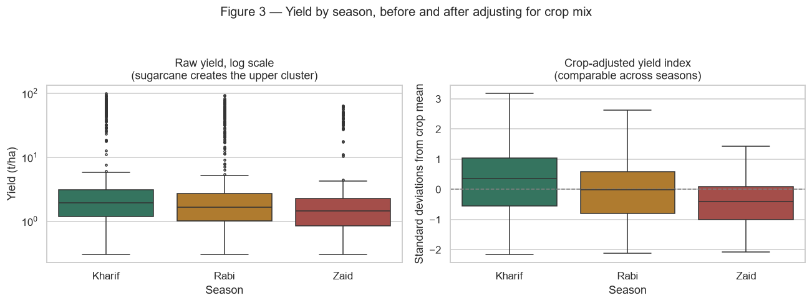
RESULTS
Raw yield varies across seasons, with Kharif showing a slightly higher central yield than Rabi and Zaid.
After adjusting for crop mix, Kharif shows the highest positive yield deviation, while Zaid has the lowest.
This indicates that part of the raw seasonal yield difference is influenced by the types of crops grown in each season.

Slide 8
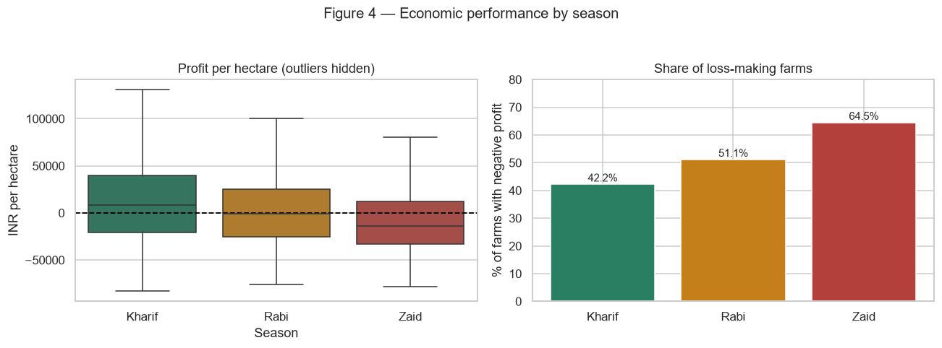
RESULTS
Kharif shows the highest profit per hectare, while Zaid has the lowest overall profitability.
Loss-making farms increase from Kharif (42.2%) to Rabi (51.1%) and reach 64.5% in Zaid.
Overall, Zaid faces the greatest economic risk, while Kharif performs comparatively better.

Slide 9
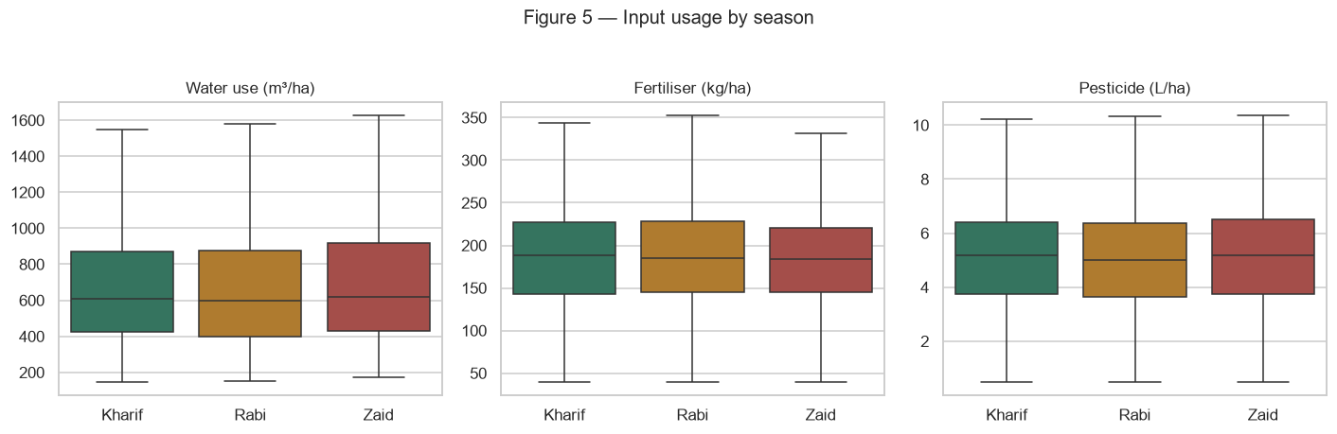
RESULTS
Water use is broadly similar across seasons, with Zaid showing slightly higher typical usage.
Fertilizer and pesticide usage remain relatively consistent across Kharif, Rabi, and Zaid.
Overall, seasonal differences in input usage are smaller than the differences observed in yield and profitability.

Slide 10
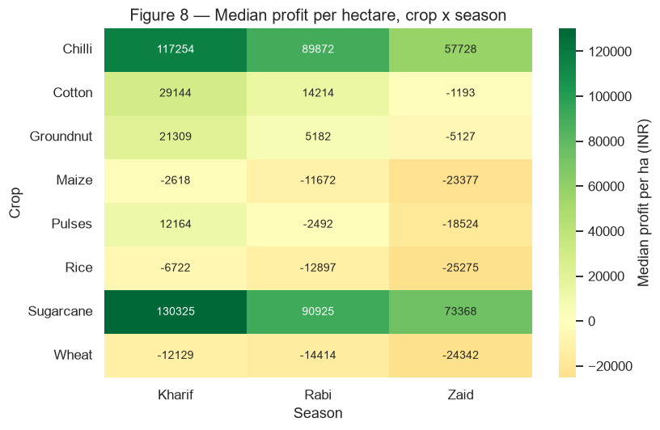
RESULTS
Chilli and Sugarcane are the most profitable crops across all seasons, with the highest median profits in Kharif.
Profit generally declines from Kharif to Rabi and further in Zaid for most crops.
Maize, Rice, and Wheat show negative median profits across all seasons, with the largest losses in Zaid.

Slide 11
Future scope
Extend the dataset across multiple years to capture year-on-year seasonal trends, not just a single-year snapshot.
Incorporate real-time weather and market-price feeds so recommendations adapt to current conditions.
Build a regression or predictive model that controls for crop, state and season simultaneously to isolate each factor's true effect.
Develop an interactive dashboard for farmers and planners to explore seasonal performance by their own region and crop.
Investigate the cost/price assumptions behind the loss-making crops with real market data to validate the recommendations.

Slide 12
GitHub Link
https://github.com/praneetha0125/Seasonal_Agriculture_Performance_Analysis

Slide 13

VOIS Course completion certificate - Course name- Data Visualization

Slide 14
Thank you
.
.

