Slide 1

GOKARAJU RANGARAJU INSTITUTE OF ENGINEERING AND TECHNOLOGY Department of Computer Science and Engineering Realtime Research Project/Societal Related Project
Calorie Counter Application
Under the esteemed Guidance of
Dr.G.R.Sakthi Dharan
(Professor)
Team Members
N.Madhu Samhitha-22241A05H0
N.Praneetha Reddy-22241A05G8
S.Sai Tehya-22241A05J3
P.Divya Sree-22241A05H3

Slide 2
Contents
Abstract
Literature Survey
Gaps in the Existing System
Proposed System
System Architecture
Design – UML Diagrams
Requirements
Implementation (50%)

Slide 3
Abstract
In recent years, there has been an increasing concern regarding dietary habits and their impact on health. With the rise of technology, various applications have emerged to assist individuals in managing their dietary intake.
The system serves as a personalized dietary assistant, capable of conversing with users in natural language to track their calorie consumption. Utilizing Web application, the system employs a rule-based approach to understand user queries and provide relevant responses. Through a combination of predefined rules and machine learning algorithms, the system can adapt to users' preferences and dietary requirements over time.
Key features of the web application-based calorie counter include the ability to:
1. Interpret user input in natural language, including queries related to food items.
2. Retrieve nutritional information from database of food items.
3. Calculate calorie intake based on user input and provide real-time feedback.
4. Offer personalized recommendations and tips for maintaining a balanced diet.
The system aims to empower users with a convenient and intelligent tool for managing their dietary goals. The calorie counter provides a user-friendly interface that simplifies the process of monitoring calorie intake and making informed dietary choices. Web application-based calorie counter represents a promising approach to dietary assistance, offering a versatile and adaptive solution for individuals seeking to improve their nutritional habits and overall well-being.

Slide 4
Literature Survey
S.No. | Title of The Paper & Year | Authors | Methodology & Metrics | Datasets Used | Observed Shortcomings/ Gaps in The Paper
1. | Calorie Estimation in Adults Differing in Body Weight Class and Weight Loss Status. Year-Feb 16,2024 | Ruth E Brown Karissa L Canning Michael Fung Dishay Jiandani Michael C Riddell Alison K Macpherson Jennifer L Kuk | SQLite is used for the database development. Software applications operating system, Eclipse,Android SDK are used. | Mean error in estimating exercise energy expenditure and calories in food by BMI and weight loss status | The groups were not balanced, the repeated measures ANOVA were conducted with the PROC MIXED procedure, which has the capacity to handle unbalanced data.
2. | Calorie counting smart phone apps: Effectiveness in nutritional awareness, lifestyle modification and weight management amoung young Indian adults. Year- Jan 13,2024. | Paromita Banerjee Vishnu vardhan Rao Mendu Damayanthi Korrapati SubbaRao M Gavaravarapu | Sample app collection: chosen based on the keywords used in searching for certain apps such as 'Calorie countig' and 'weight loss'. | The data were entered in excel sheet, checked for consistency and analysed using SPSS. | The sample size of the survey was limited. Continued Improvement and further research is necessary
3. | Developing a Calorie Counter Fitness App for Smartphones. Year- Jan 2023 | Adewole Adewumi Godwin Olatunde Sanjay Misra Rytis Maskeliūnas Robertas Damaševičius | The mobile application was developed using PHP programming language, (HTML) ,CSS | No datasets used. | Continued Improvement and further research is necessary
4.. | Calorie Counter Information System Development for Weight Loss Program based on Android | Nenny Anggraeni Nashrul Hakiem Gerry Widya Ganesha | Features of the user to store the required information, such as weight, height, and age. The authors use SQLite as a database | Information has been taken from the user | Applications can be developed so that it has an online update system. System update function to add food database and data on the number of calories contained.

Slide 5
Literature Survey
S.No. | Title of The Paper & Year | Authors | Methodology & Metrics | Datasets Used | Observed Shortcomings/ Gaps in The Paper
5. | Indian Food Recognition and calorie estimation using YOLOV8 Year-2023 | V.Gayatri, M.Thanuja | A novel CNN-based model to recognize food items with more accuracy and speed. YOLO divides the input image into a grid and predicts bounding boxes and class probabilities directly from the grid cells. | A novel dataset of 5446 food item images of 30 different classes of food, the training and testing of the model takes place. | It achieves a highest accuracy of 93.1%.
6. | Calorie counter smartphone apps Year-2019 | Paromita Banerjee, Vishnu Vardhan rao Mendu, Damayanthi korrapdi , Subba Rao M Gavaravarapu | Comparison of The Internal Food Database(FDB) with Indian Standard count was considered. | No datasets used | The sample size of the survey was limited.
7. | Designing a Calorie Counter smartphone app for Effective Weight loss. | Sharlin Tamara, Janine Milliard | Having a two part approach Having Behavior Treatment Interventions | No datasets used | Continued Improvement and further research is necessary. Cannot be effective alone.
8. | User Perspective of Diet Tracking apps Research content analysis and topic modelling | Mila Zecemic, Dejan Mijatonic, Matija Koskotali | Used two text mining techniques. Topical n-grams identification and Topic modelling | Reviews were collected from users to understand user’s perspectives. The total collected reviews were 72,084 for 15 calorie counter apps. | The sample size of the survey was limited.

Slide 6
Literature Survey
S.No. | Title of The Paper & Year | Authors | Methodology & Metrics | Datasets Used | Observed Shortcomings/ Gaps in The Paper
9. | ACCURATE CALORIE COUNTING ALGORITHM FOR CAREFULY PLATED DISHES Year-2020 | WOON ZHENG LI | The Methodology it used are XP Programming, Prototyping methodology | Images with different light intensity and background Non-mixed food type | This will lead to inaccurate result since the portion itself is selected by the users
10. | Calorie Counter using Django framework Year-2021 | Saritha Niranjanrai | Calculate the calorie required . Calorie consumed . Display the left out calorie | No datasets used. | Researchers may unintentionally skew results Setting up controlled environments takes time. Mistakes during data collection or analysis
11. | Semantics based Calorie calculator-year-2019 | Sravan Raghu Kumar Narra | The core idea contains 2 steps: Entity extraction Unit Conversion | 150 total recipes were considered These recipes were combined into one dataset and experiments were performed on it. | The research does not address the need for a lightweight, fast, and reliable food calorie estimation system² While the study compares results with existing applications, a more comprehensive evaluation could enhance its credibility

Slide 7
Literature Survey
S.No. | Title of The Paper & Year | Authors | Methodology & Metrics | Datasets Used | Observed Shortcomings/ Gaps in The Paper
12. | The utilization of Machine Learning for the identification and computation of calories Year-2023 | S.Dhanush Hariharan, P.Dinesh, Vivek Chidambaram, G.T Shakila Devi | i) It is a smart watch based food tracking and monitoring system. ii) It precisely determines a user’s calorie consumption from their meals using Machine Learning | The dataset of different foods was used to evaluate the system. | It achieves a highest accuracy of 90%.
13. | A study of calorie estimation in pictures of food Year-2019 | Jun Zhou, Dane Bell, Sabrina Nusrat, Melanine Hingle, Mahai Surdeanu | It is a study to determine the accurary of crowdsourced annotations of calorie content in food images. | Foods were chosen for the study and the study covers the maximum food types encountered in daily life. | Cannot be effective alone.
14. | Deciphering calorie counts to make smarter food choices Year-2023 | Santos Lima | Provides a clear picture of how much energy a person is taking in and how much he is burning through physical activity. | No datasets used | Continued Improvement and further research is necessary. Cannot be effective alone.
15. | An analysis of calorie estimation accuracy. | Hannah Mixon, Matthew E.Davis. | Undergraduates are sampled and ascertained their propensity for cognitive reflection through their numeracy abilities, restrained eating behavior and their ability to accurately estimate calories. | No specific datasets mentioned. | It achieves a highest accuracy of 80%.

Slide 8
Gaps in Existing System
Validation: The code lacks robust input validation. While it checks if the user inputs are empty, it doesn't thoroughly validate whether the input values are within reasonable ranges (e.g., age should be a positive integer, weight and height should be positive numbers).
Gender Selection: The calorie calculation relies on the user selecting their gender, but there's no indication of the gender selection in the HTML code. Without this information, the calculation won't work properly.
Activity Level: Although the code provides a dropdown for selecting activity level, it doesn't explain the options or their corresponding activity levels. Users may not understand the implications of selecting different activity levels, leading to inaccurate calorie estimates.

Slide 9
Proposed System
User Interface (UI):
The user interface should consist of a clean and intuitive design that allows users to input their age, weight, height, gender, and activity level easily.
Input Validation:
Implement robust input validation to ensure that users provide valid data. Validate each input field to ensure it contains the expected type of data (e.g., age as a positive integer, weight as a positive number).
Calorie Calculation:
Use an appropriate formula to calculate the user's Basal Metabolic Rate (BMR), which represents the number of calories required to maintain basic bodily functions at rest.
User Feedback and Guidance:
Provide clear explanations for each input field and the purpose of the calorie counter application as a whole. Offer tooltips or information icons to explain terms like "activity level" or provide links to additional resources for users who want more information
Accessibility:
Ensure that the web application is accessible to users with disabilities by following best practices for web accessibility

Slide 10
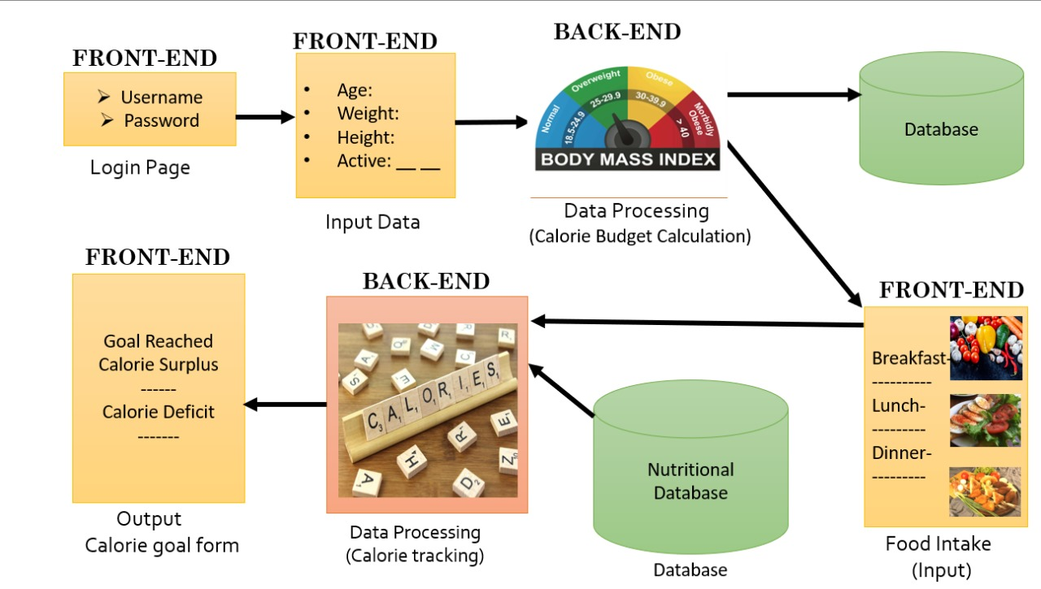
System Architecture

Slide 11
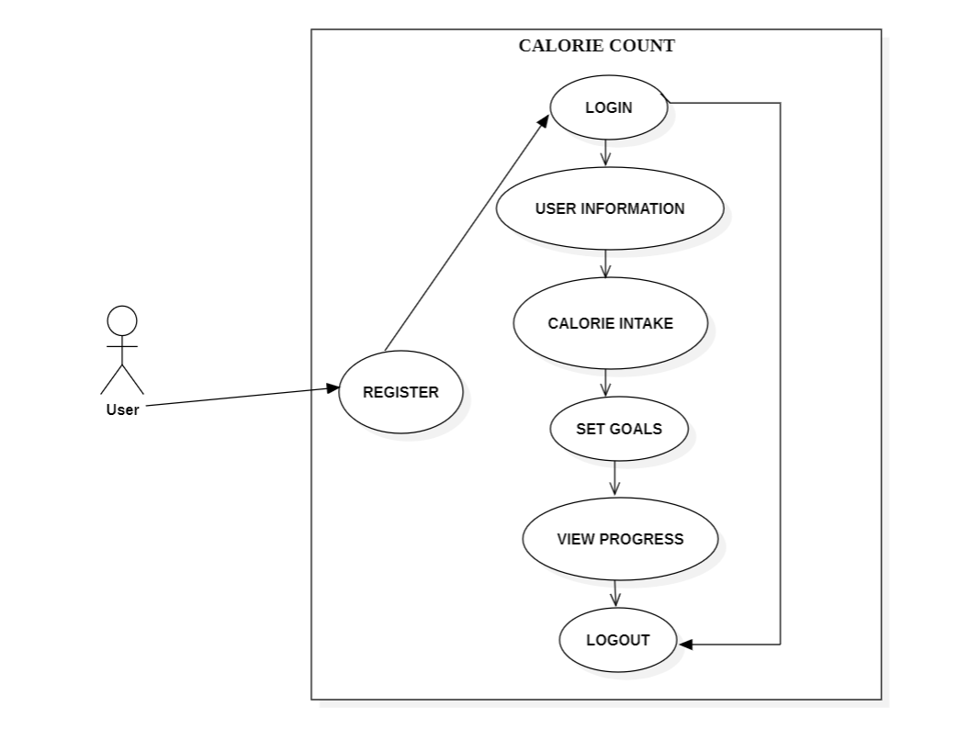
Design – UML Diagrams
Use Case Diagram

Slide 12
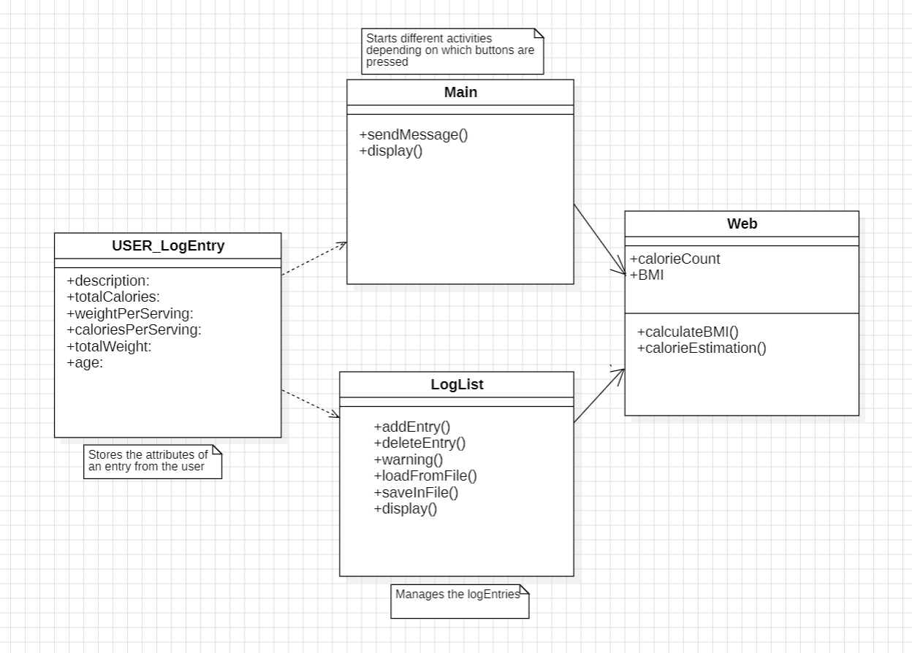
Design – UML Diagrams
Class Diagram

Slide 13
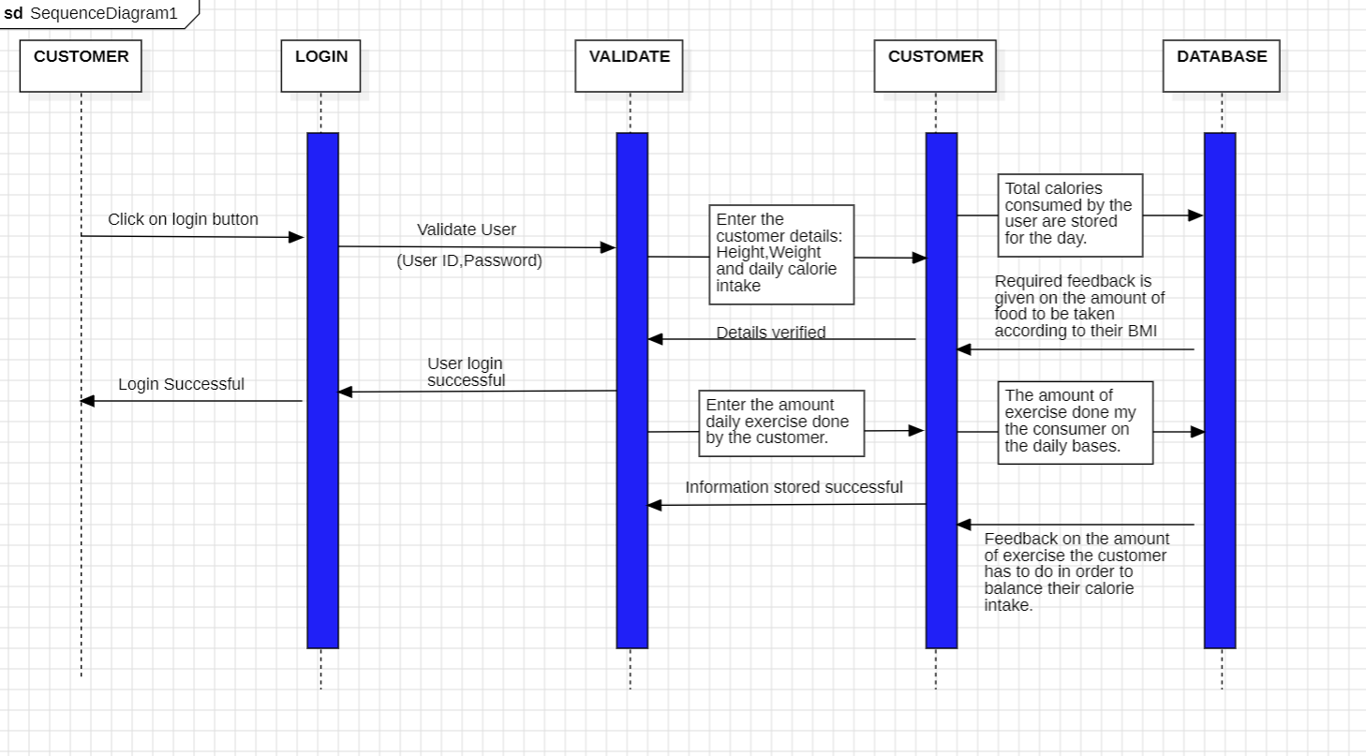
Design – UML Diagrams
Sequence Diagram – Full Stack/ Web Applications

Slide 14
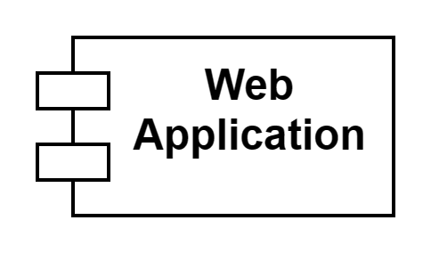
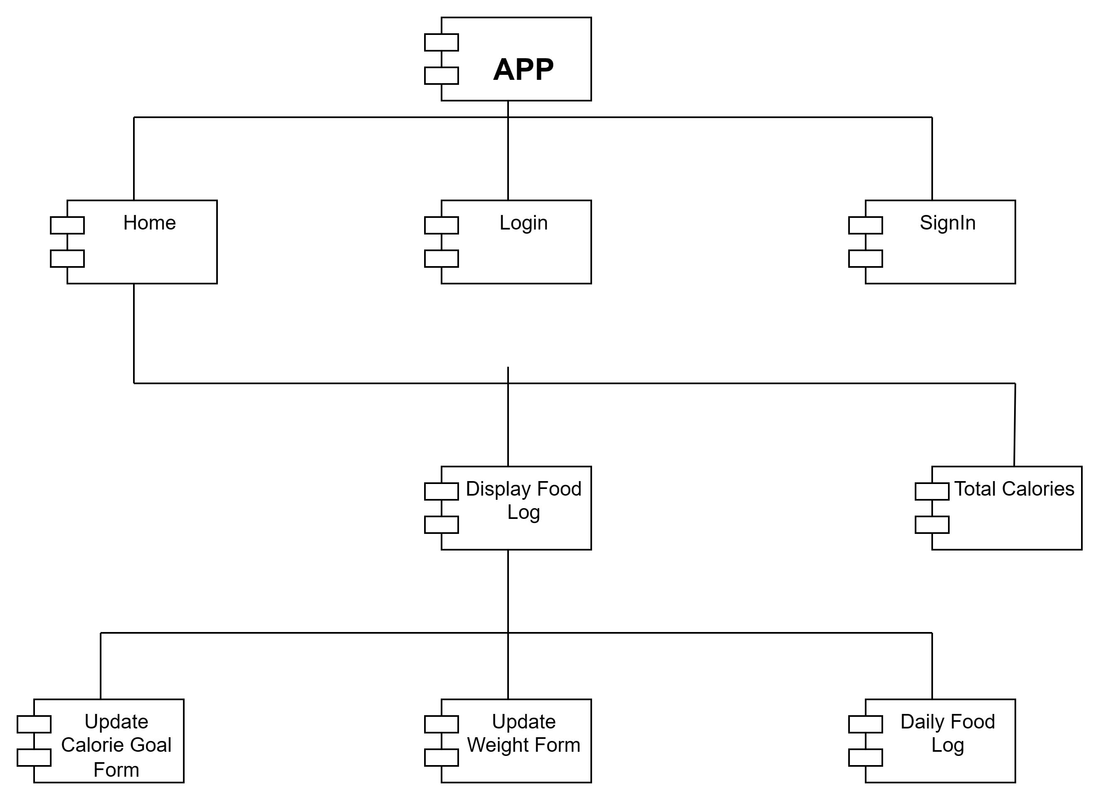
Design – UML Diagrams
Component Diagram

Slide 15
Requirements
Software Requirements:
JavaScript
HTML
CSS
Hardware Requirements:
Server – host
webserver :
userMySQL
Public database

Slide 16
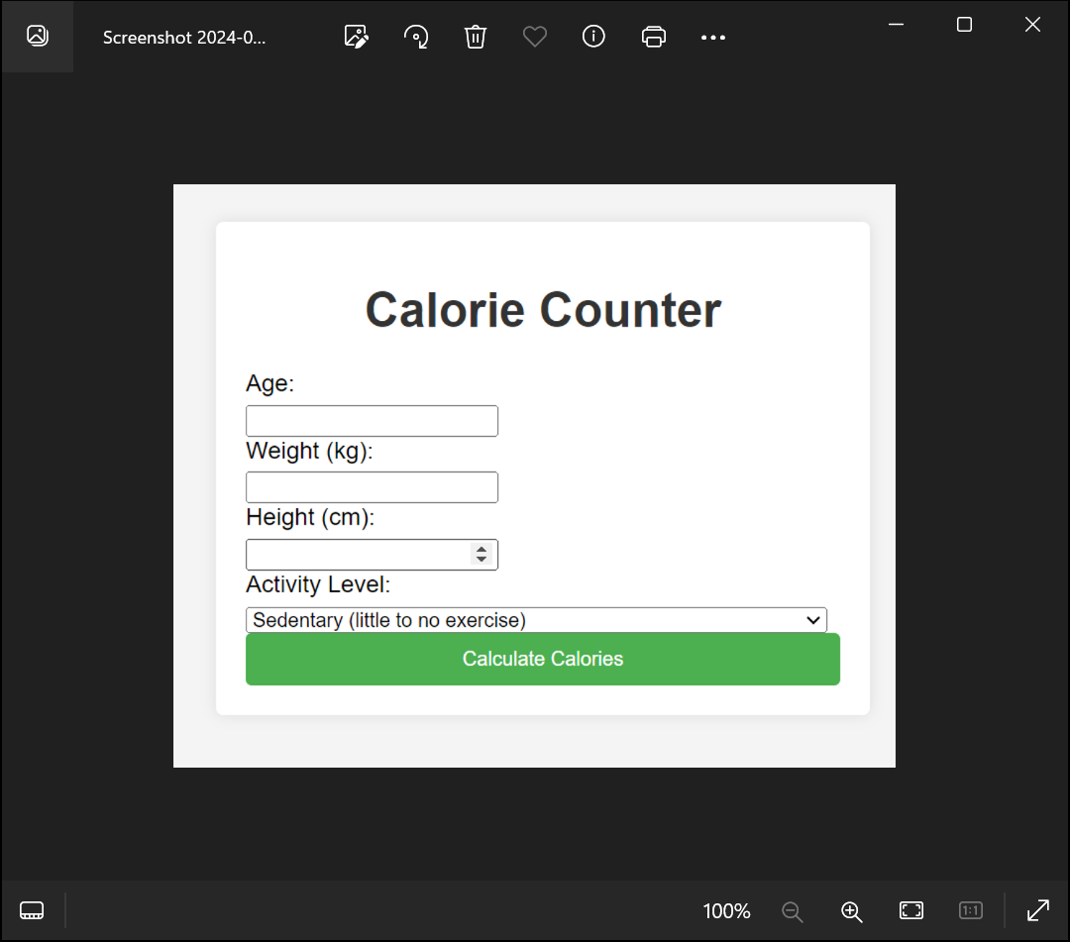
Implementation
Execution of Program

Slide 17

THANK YOU
Any Queries

