Slide 1
Topic : Retail Sales Online
Group 9
Darshan Reddy Chilakala Krishna Reddy
Surya Chandra Phani Santhosh Dulam
Sai Praneetha Jaladanki

Slide 2
Online Retail Sales
Online retail industry has been on the grow at an exponential rate for the past decade
Online retail gives the buyer a similar experience of an offline retail except that the buyer can have many more advantages
It also provides the buyer to make a decision based on the other customers’ review on the same product they wish to buy
The main purpose of the retail domain analysis is to better understand the customers, purchase pattern of the customers and sales trends that helps in getting to know about the customers

Slide 3
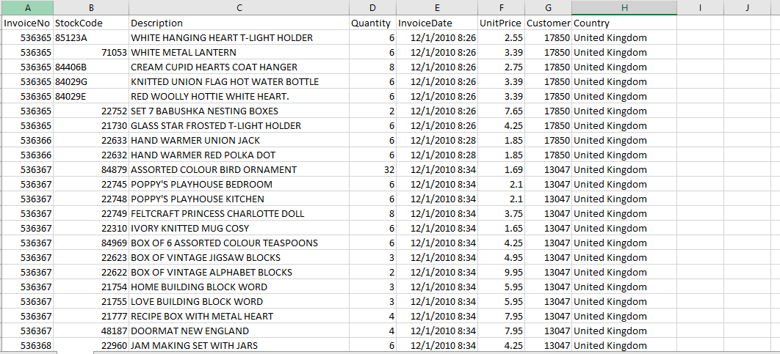
Raw Data
The data features transactions occurring between 01/12/2010 and 09/12/2011 for a UK-based and registered non-store online retail
The raw data has 8 Attributes and 5,81,587 Rows

Slide 4
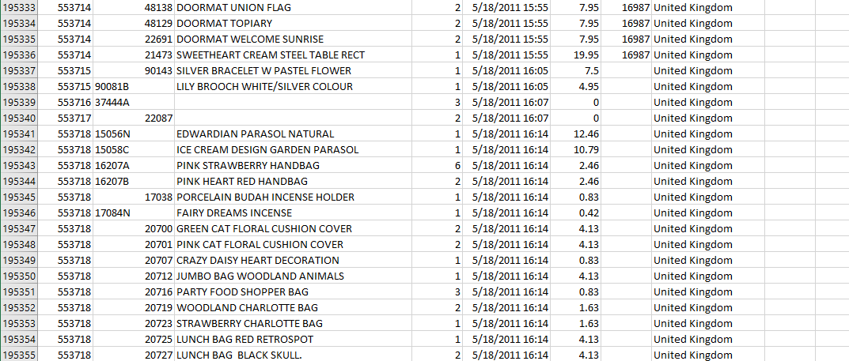
Raw Data

Slide 5
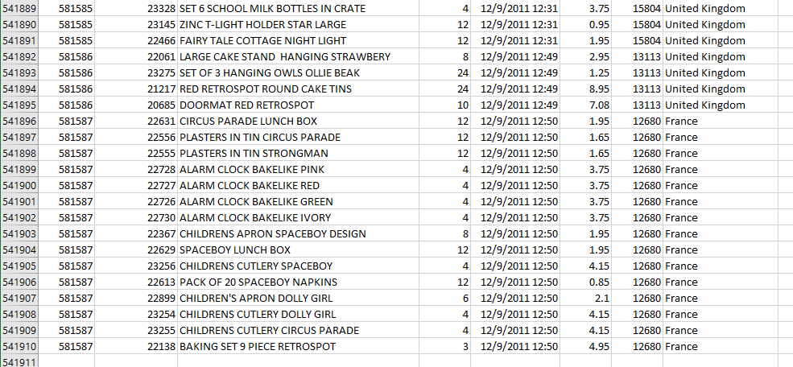
Raw Data

Slide 6
Dimensions and Data Types
Dimension | Data Type | Description
Invoice | Nominal | Invoice Number
Stockcode | Nominal | Code of the product
Description | Nominal | Describes the item
Quantity | Numeric | Count of the items purchased
unitPrice | Numeric | Cost of each unit
InvoiceDate | Numeric | Date of the invoice
CustomerID | Nominal | Unique ID assigned to the customer
Country | Nominal | Location of the item purchased

Slide 7
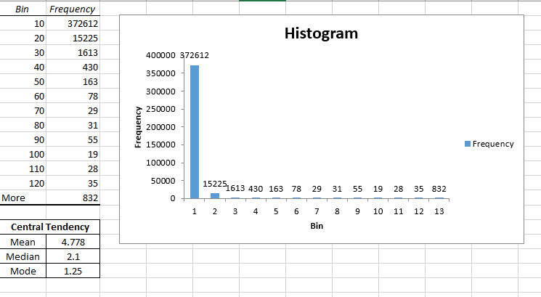
Central Tendency and Histogram of the dimensions
Unit Price

Slide 8
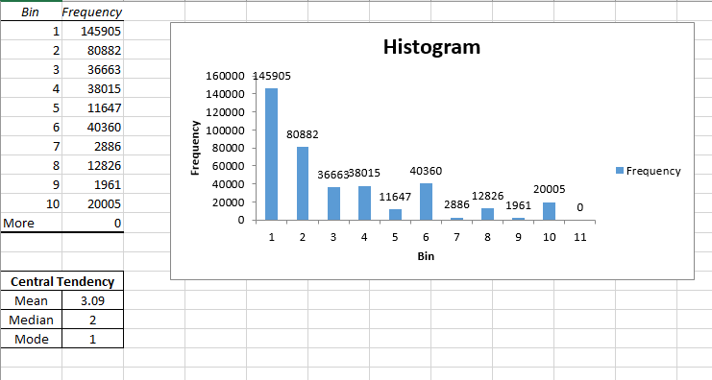
Central Tendency and Histogram of the dimensions
Quantity

Slide 9
Data Preprocessing
Software Used: R Studio
Size of the data before preprocessing:
8 Attributes and 5,81,587 Rows
Size of the data after preprocessing:
9 Attributes and 4,06,829 Rows

Slide 10
Data Preprocessing
Incomplete Data: Null values from the data have been removed
Noisy Data: Noisy data has been identified and the data is removed
Inconsistent Data: Data format has been changed
A new dimension ‘Total Price’ has been added as the product of unitprice and quantity to analyze the data further

Slide 11
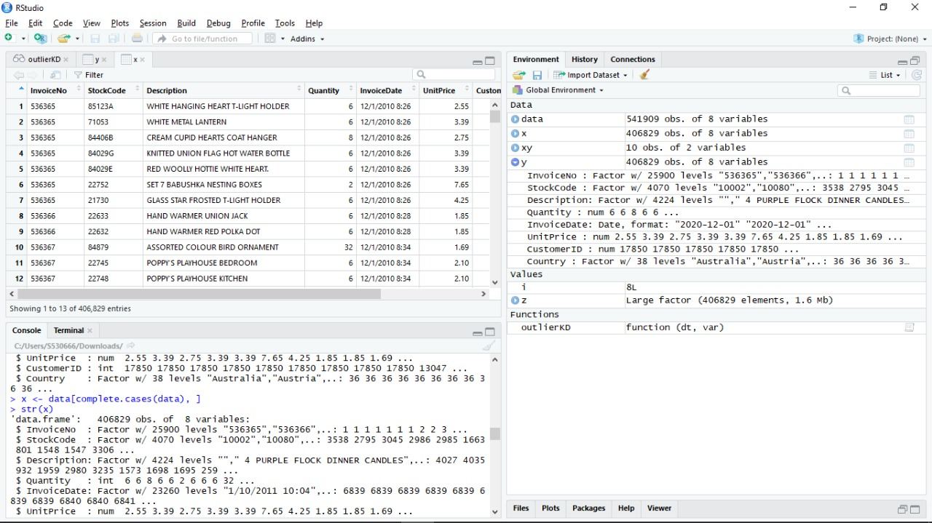
Data Preprocessing Steps

Slide 12
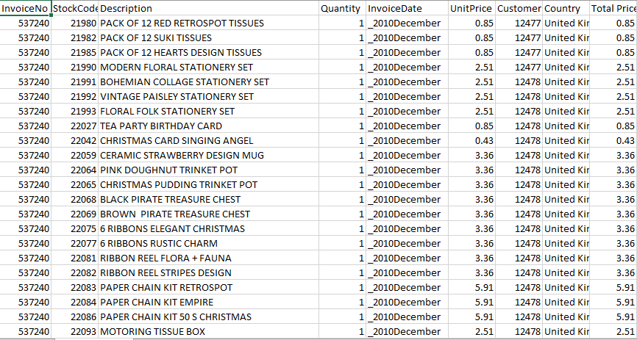
Processed data

Slide 13
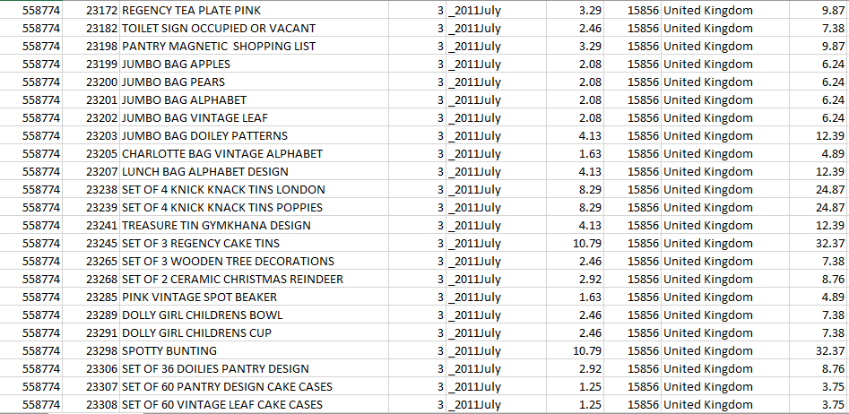
Processed data

Slide 14
Outcomes
1) Who are the most loyal customers?
2) Percentage change in total sales over a period of time
3) Which item was widely sold in which country?
4) Highest sales in a particular month.
5) Items customers have purchased together frequently
6) Prediction of sales for the next two months.

Slide 15
Outcome - 1
The customer with most purchases
Relevant Data : UnitPrice, Quantity and CustomerID
Total amount = UnitPrice * Quantity
To analyze the most profitable customer to the sales, we have taken into the consideration the customer who spent the most money
The output has been visualized through Tableau.
Each block represents an individual customer.
The customers with the ID 17841 has the largest block and hence is the customer with the most number of purchases.
This analysis helps in finding out the least and the most profitable customers for the sales

Slide 16
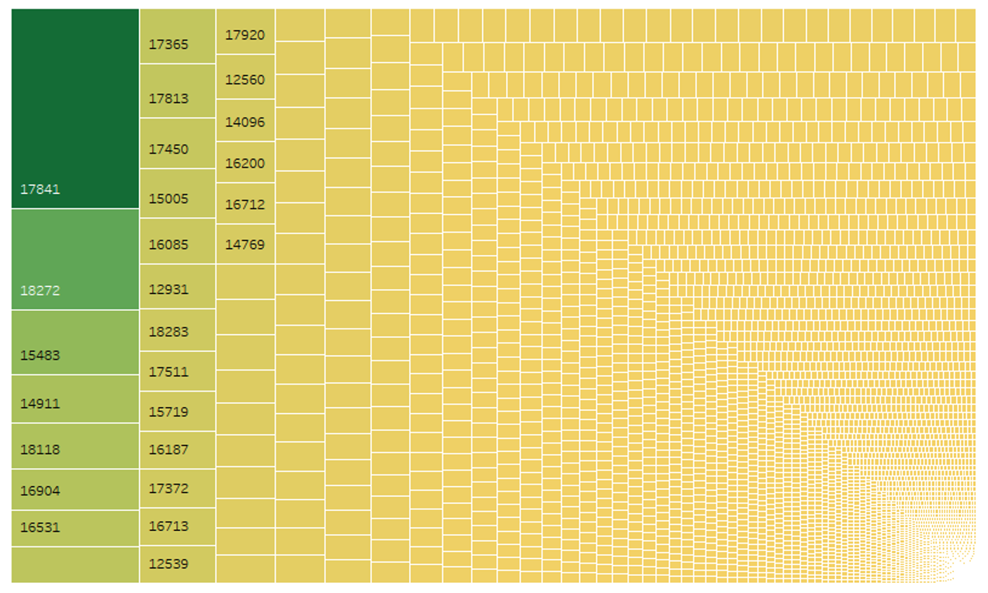
Outcome - 1
The customer with most purchases

Slide 17
Outcome - 2
Percentage change in the total sale over a period of 11 months
Relevant Data : Invoice Date, UnitPrice, Quantity
Total amount = UnitPrice * Quantity
To study the percentage in sales, we have taken the total amount spent every month
The output has been visualized through Tableau
It can be interpreted that there was some decline in sales for the first three months from Dec 2010 to Feb 2011.
The sales increased by 541 percent from Dec 2010 to Oct 2011.
After a brief downfall, there is increase in the sales

Slide 18
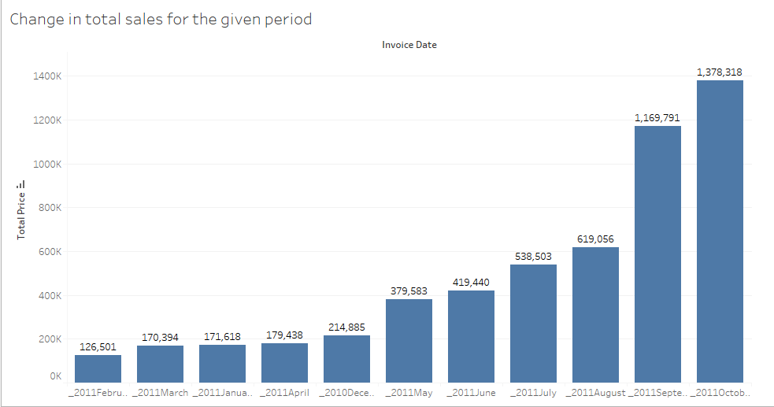
Outcome - 2
Percentage change in the total sale over a period of 11 months

Slide 19
Outcome - 3
Highest stock sold in which country
Relevant Data : Country, Stock code
The output has been visualized through Tableau
It can be interpreted that the highest sales and stock is in the United Kingdom
The least number of sales can be taken as Sweden

Slide 20
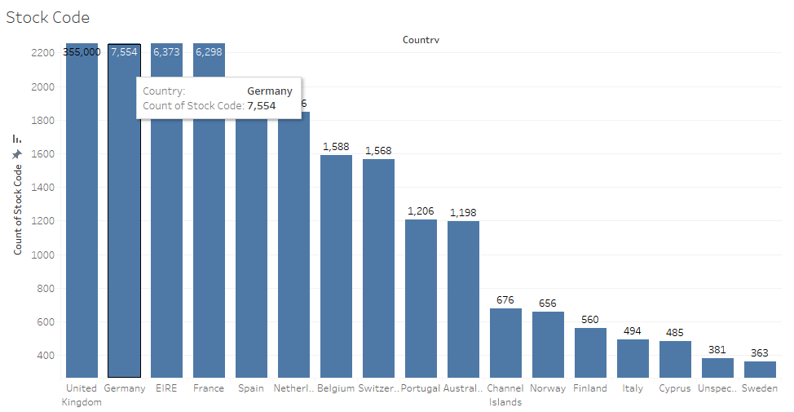
Outcome - 3
Highest stock sold in which country

Slide 21
Outcome - 4
Highest number of units sold in which month
Relevant Data : Stock code, Invoice Date
The output has been visualized through Tableau
It can be interpreted that the highest sales amongst the time period is observed in the month of September 2011
The least stock can be visualized in the month of February for the year 2011.

Slide 22
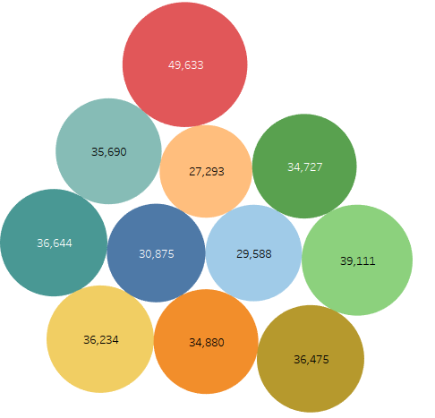
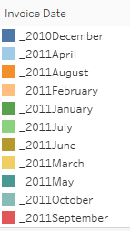
Outcome - 4
Highest number of units sold in which month

Slide 23
Outcome - 5
Items purchased together frequently
Relevant Data : Description
To analyze which of the items have been frequently brought by the customers, we have used Apriori Algorithm
The outcome has been obtained by using Weka
The product is divided into number of columns based on customer ID and considered the product only which had the highest count
We have taken into consideration the 5 products because there are 4000 unique products available

Slide 24
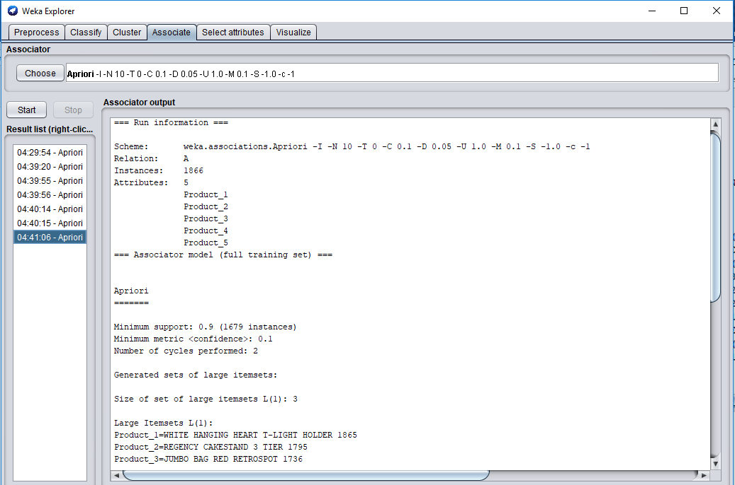
Outcome - 5
Items purchased together frequently

Slide 25
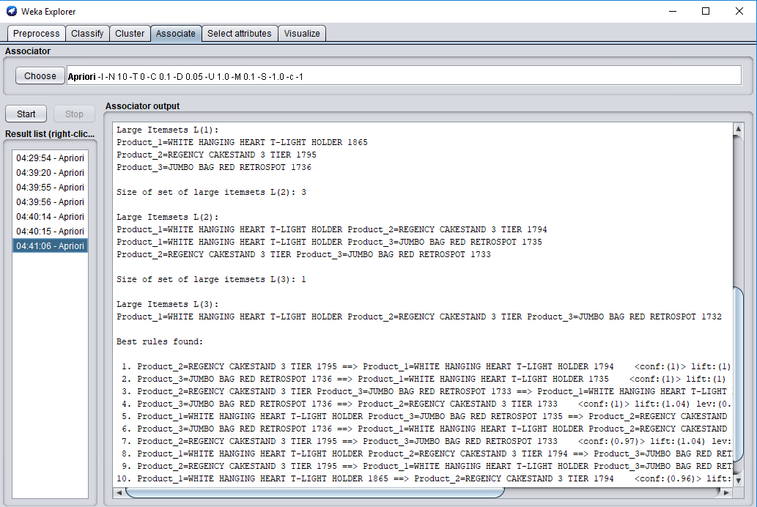
Outcome - 5
Items purchased together frequently

Slide 26
Outcome - 5
Items purchased together frequently
Observations:
WHITE HANGING HEART T-LIGHT HOLDER and REGENCY CAKESTAND
3 TIERJUMBO BAG RED RETROSPOT and WHITE HANGING HEART T-LIGHT HOLDER
REGENCY CAKESTAND 3 TIER and JUMBO BAG RED RETROSPOT

Slide 27
What’s Left
One of our outcomes is to predict the sales for the next two months with the given analysis

Slide 28
References
http://archive.ics.uci.edu/ml/datasets/Online+Retail
http://link.springer.com/article/10.1057/dbm.2012.17
http://www.cs.waikato.ac.nz/ml/weka/downloading.html
https://www.rstudio.com/products/rstudio2/
https://www.tableau.com/

Slide 29
Questions?

Slide 30
Thank You!

