Slide 1

ART Nest
Shri Vishnu Engineering College For Women
Department of CSE
~ Art Gallery Management System
Team Members:
22B01A0570
22B01A0572
22B01A05A3
22B01A05B1
23B05A0509
Guided By:
Dr P. Kiran Sree
HOD - CSE Department

Slide 2
INTRODUCTION
Art nest is a digital platform designed to facilitate the showcasing, selling, and management of artworks.
It’s a virtual gallery for artists, curators, and art enthusiasts to interact and engage with art easily.

Slide 3
Literature survey
Existing Solution:
Art Net, Artsy, Artfinder
Limitations:
Limited customization
Insufficient interaction with the artist
No Artist ratings
Proposed Solution:
.
Art Reviews
Artist Connect
Verified Artists
Address unique needs of art galleries
Customizable, user-friendly, and integrated platform

Slide 4
TECH STACK
Frontend - HTML, CSS, JavaScript, Bootstrap
Backend - PHP
Data Base - MySQL

Slide 5
overview
User Roles and Permissions
Artist Registration and Approval
Art Upload and Management
User Browsing and Ordering
Order Management and Ratings
Live Chat Between Users and Artists
Admin Dashboard and Analytics
Data Management

Slide 6
Bibliography
w3schools
Stack Overflow
php.net
You Tube
ChatGPT

Slide 7
demo

Slide 8
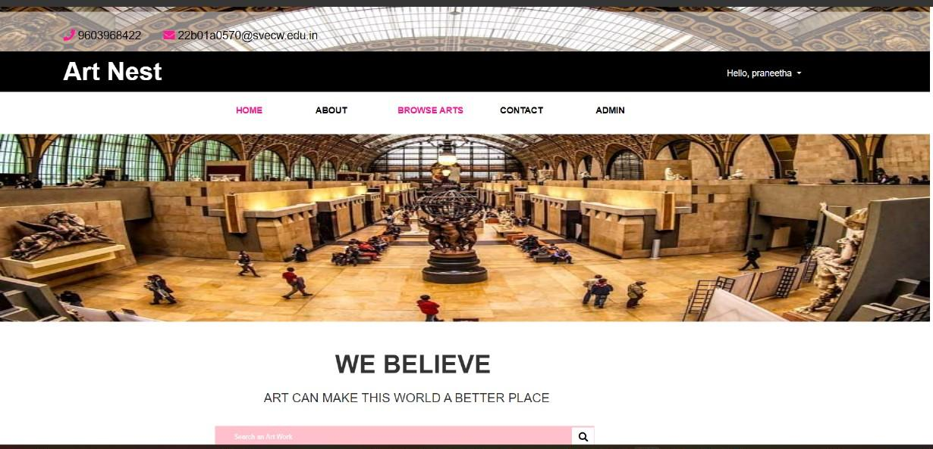
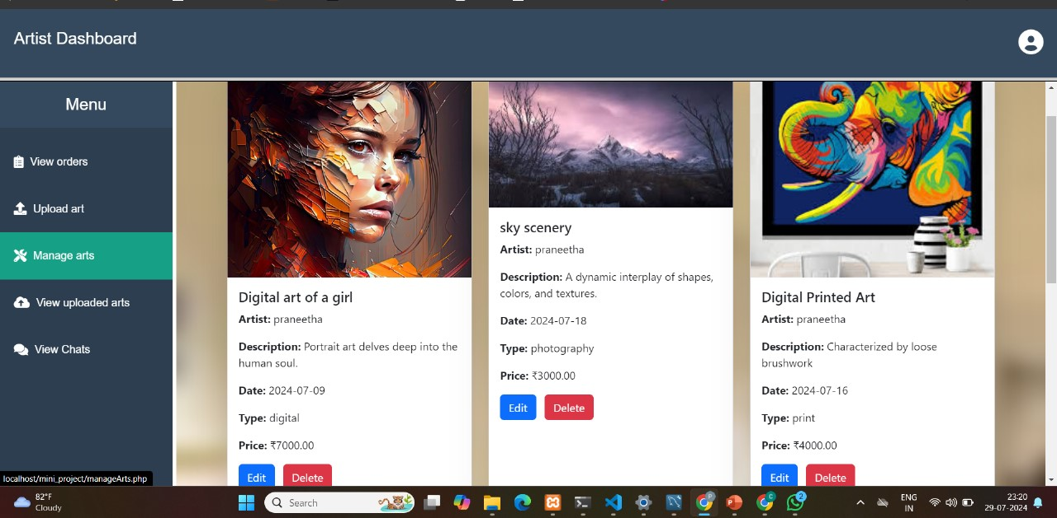
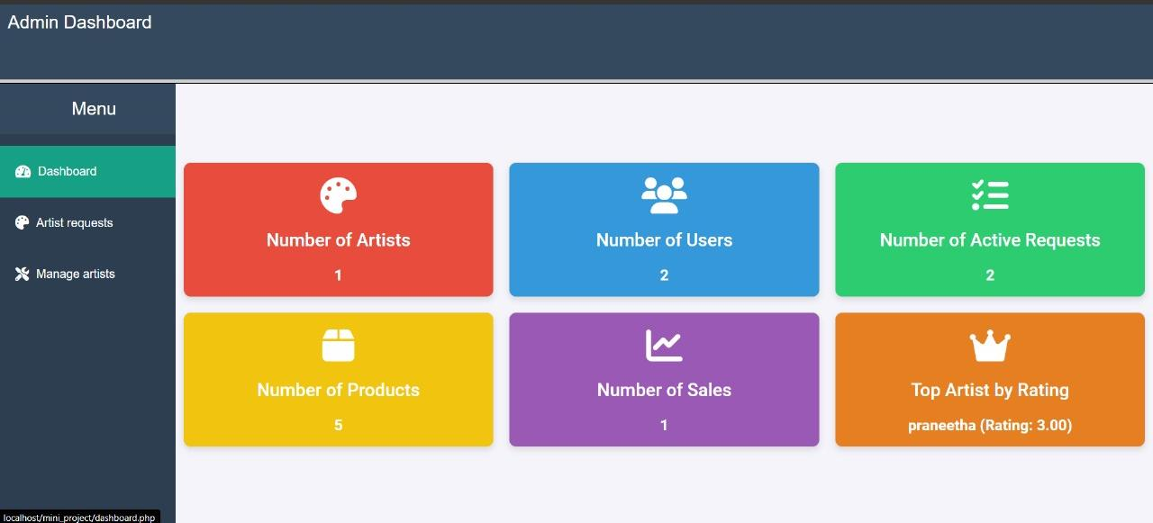
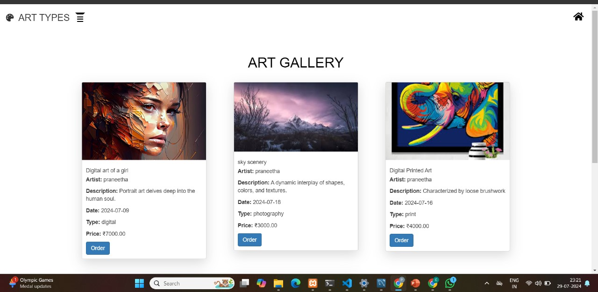

Slide 9
Conclusion
Art Nest revolutionize art curation and sales by leveraging digital technologies.
They enhance accessibility, engage a global audience, and support artists with features like virtual exhibitions and secure e-commerce.
It reduce the need for physical galleries, offering a modern, cost-effective solution that bridges traditional art with innovation.

Slide 10
THANK YOU

