Slide 1
CampusCrate
Campus equipment lending
DevOps Final Capstone
Praneeth Budati
praneethb7
Notes:
CampusCrate manages equipment inventory, lending, returns and overdue tracking. This presentation explains the application and the delivery system that tests, packages, deploys and observes it. The demonstrated infrastructure runs locally. Terraform describes an AWS deployment, but I did not provision AWS resources. Estimated presentation duration: eight minutes.
Evidence recorded on 16 October 2026. Presentation prepared on 26 October 2026.
Sources:
https://github.com/praneethb7/CampusCrate/blob/main/README.md
https://github.com/praneethb7/CampusCrate/blob/main/docs/VALIDATION.md

Slide 2
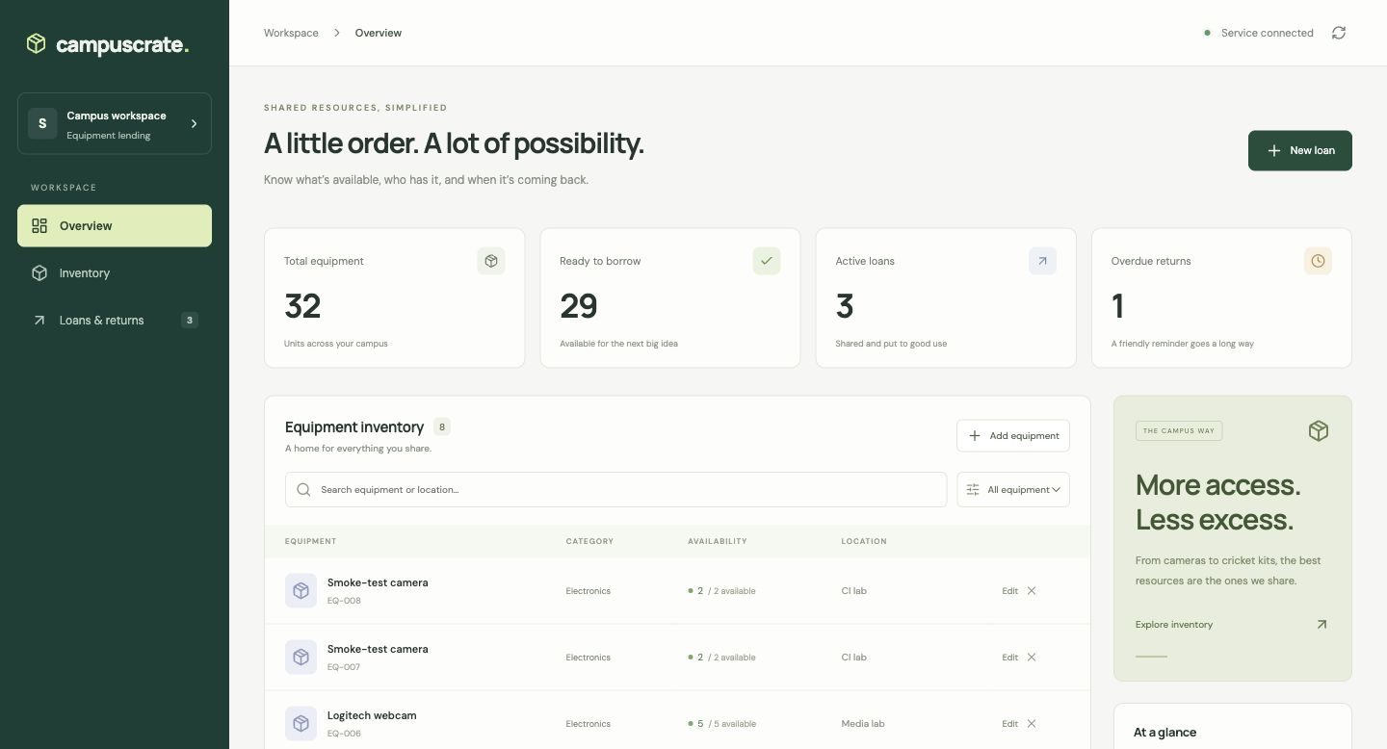
Equipment inventory in one workspace
Availability, loans and due dates stay connected
Inventory
Search equipment and filter by category.
Loans and returns
Track who has an item and when it is due.
Recorded Kubernetes view, overview detail
CampusCrate
02
Notes:
The inventory page shows total units, available units, active loans and overdue returns. Each equipment record has a category, location and quantity. Search and category filters help find resources. The screenshot is a recorded view through the Kubernetes Ingress, rather than a claim that the laptop cluster is running today.
Evidence recorded on 16 October 2026. Presentation prepared on 26 October 2026.
Sources:
https://github.com/praneethb7/CampusCrate/blob/main/evidence/02-kubernetes-ingress.jpg
https://github.com/praneethb7/CampusCrate/blob/main/frontend/src/main.jsx

Slide 3
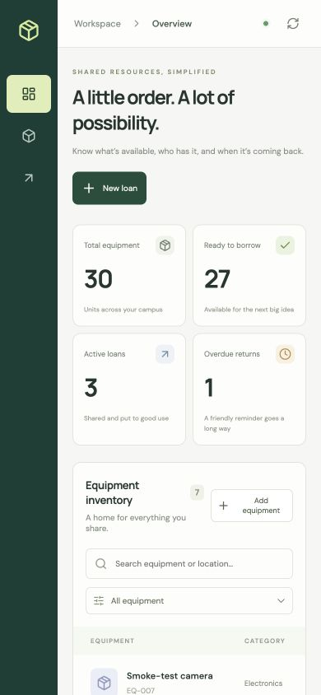
Loan lifecycle and stock protection
The database enforces availability inside a transaction
01
Borrow
Lock the equipment row, check stock, then record one loan.
02
Return
Mark the loan returned once and restore availability.
03
Preserve history
Reject duplicate returns and preserve equipment loan history.
CampusCrate
03
Notes:
A loan allocates one unit of equipment. The backend locks the equipment row so concurrent requests cannot both claim the last unit. A completed return increases availability once. Invalid requests receive validation errors, and conflicts use HTTP 409. The application retains the loan ledger. It also rejects inventory reductions below outstanding loans. The mobile capture shows the responsive interface.
Evidence recorded on 16 October 2026. Presentation prepared on 26 October 2026.
Sources:
https://github.com/praneethb7/CampusCrate/blob/main/backend/app/main.py
https://github.com/praneethb7/CampusCrate/blob/main/backend/tests/test_concurrency.py
https://github.com/praneethb7/CampusCrate/blob/main/evidence/04-mobile-browser.jpg

Slide 4
Application architecture
Same-origin API routing keeps the browser and backend connected
Layer | Technology | Responsibility
Browser | React and Vite | Inventory and loan interface
Routing | NGINX Ingress | / to frontend, /api to backend
Application | FastAPI and SQLAlchemy | REST APIs and stock transactions
Persistence | PostgreSQL and Alembic | Loan ledger and versioned schema
Telemetry | Prometheus and Grafana | Scraping, dashboards and alerts
CampusCrate
04
Notes:
The browser renders the React application. NGINX Ingress routes the root path to the frontend and API paths to FastAPI. PostgreSQL persists the inventory and loan ledger, while Alembic versions the schema. The backend exposes application metrics for Prometheus and Grafana. The database is internal to the deployment.
Evidence recorded on 16 October 2026. Presentation prepared on 26 October 2026.
Sources:
https://github.com/praneethb7/CampusCrate/blob/main/README.md
https://github.com/praneethb7/CampusCrate/blob/main/helm/campuscrate/templates/ingress.yaml
https://github.com/praneethb7/CampusCrate/blob/main/backend/app/models.py

Slide 5
Docker packaging and startup
One Compose command starts the application and its database
docker compose up -d --build
01
Database becomes healthy
PostgreSQL passes its readiness check before migration.
02
Migration completes
Alembic upgrades the schema before the API starts.
03
Application becomes ready
The frontend waits for the backend readiness check.
CampusCrate
05
Notes:
The frontend uses a Node build stage and serves static assets from unprivileged NGINX. The backend separates build and runtime stages and runs as UID 10001. Compose gates startup on database health, migration completion and backend readiness. A named volume preserves PostgreSQL data between restarts. Removing that volume deletes the local data, so routine shutdown preserves it.
Evidence recorded on 16 October 2026. Presentation prepared on 26 October 2026.
Sources:
https://github.com/praneethb7/CampusCrate/blob/main/docker-compose.yml
https://github.com/praneethb7/CampusCrate/blob/main/backend/Dockerfile
https://github.com/praneethb7/CampusCrate/blob/main/frontend/Dockerfile

Slide 6
Tests include database concurrency
Recorded isolated PostgreSQL run
18
Business rules
CRUD, validation, overdue status,
loan history and readiness failure
tests passed
Race conditions
90.22%
Six borrowers compete for two units.
Two requests return the same loan.
overall statement coverage
CampusCrate
06
Notes:
The recorded test run passed all 18 tests against a separate PostgreSQL database with 90.22 percent overall statement coverage. The total includes the optional sample-data module. CI runs the tests on a disposable PostgreSQL service. Two tests exercise simultaneous borrowing and duplicate returns. Test setup requires a non-SQLite database name ending in _test to protect application data. CI also checks migration upgrade, schema drift, downgrade and upgrade again.
Evidence recorded on 16 October 2026. Presentation prepared on 26 October 2026.
Sources:
https://github.com/praneethb7/CampusCrate/blob/main/evidence/pytest.txt
https://github.com/praneethb7/CampusCrate/blob/main/backend/tests/conftest.py
https://github.com/praneethb7/CampusCrate/blob/main/.github/workflows/campuscrate.yml

Slide 7
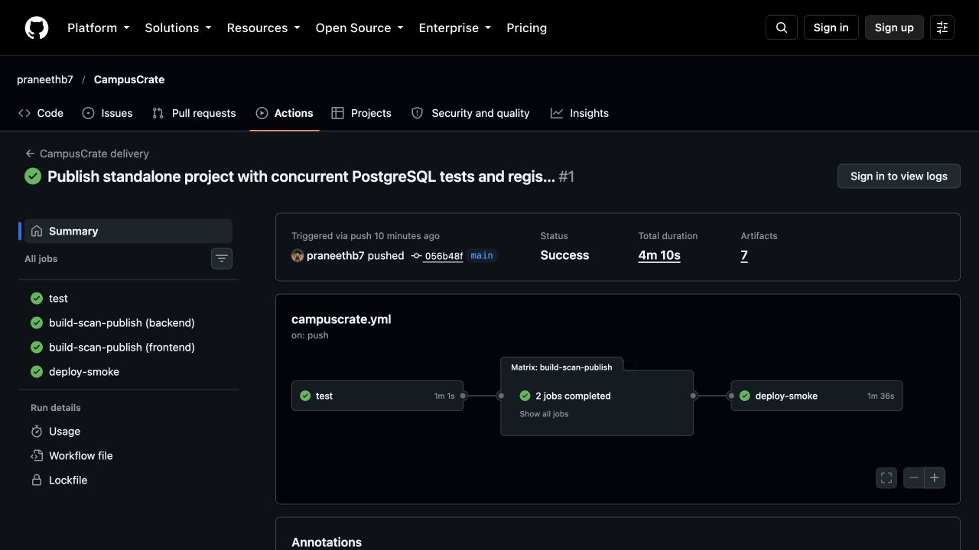
GitHub Actions delivery
Source revisions identify the published and deployed images
01
Validate
Lint, tests and migration checks
02
Build and scan
Both images pass the Trivy gate
03
Publish and deploy
GHCR SHA tags, Helm and smoke test
CampusCrate
07
Notes:
Every push to main runs the root GitHub Actions workflow. Validation gates the image builds. Both images must pass Trivy before publication. The main branch publishes commit-SHA tags to GHCR. A temporary kind cluster pulls those images, deploys the Helm chart and exercises the application through the frontend proxy. CI then removes its cluster. Laptop Minikube updates use an explicit local rollout script. The screenshot records the successful run linked in the repository evidence.
Evidence recorded on 16 October 2026. Presentation prepared on 26 October 2026.
Sources:
https://github.com/praneethb7/CampusCrate/blob/main/.github/workflows/campuscrate.yml
https://github.com/praneethb7/CampusCrate/blob/main/evidence/pipeline.json
https://github.com/praneethb7/CampusCrate/blob/main/evidence/06-actions-success.jpg

Slide 8
Container security gate
Both recorded image scans passed HIGH and CRITICAL checks
0
Remediation
The earlier Debian backend image
triggered 44 OS-package findings.
HIGH or CRITICAL findings
in the final recorded scans
Rebuild on Python Alpine.
Keep the gate and include unfixed CVEs.
Scan results describe the packages and scanner database at that run.
CampusCrate
08
Notes:
An earlier Debian backend build failed the gate with 44 HIGH or CRITICAL operating-system package findings. Rebuilding on Python Alpine produced clean recorded reports for the configured severities. I kept the same non-root runtime and tests. The workflow did not add a CVE allowlist or ignore unfixed findings. Zero findings describes the recorded scanner database, not a guarantee of ongoing or complete security.
Evidence recorded on 16 October 2026. Presentation prepared on 26 October 2026.
Sources:
https://github.com/praneethb7/CampusCrate/blob/main/docs/SECURITY.md
https://github.com/praneethb7/CampusCrate/blob/main/evidence/security-backend/trivy-backend.txt
https://github.com/praneethb7/CampusCrate/blob/main/evidence/security-frontend/trivy-frontend.txt

Slide 9
Kubernetes deployment with Helm
The persistent demonstration runs on local Minikube
Component | Deployment behavior
Frontend | Two replicas with an internal ClusterIP Service
Backend | Two to five replicas, CPU autoscaling and probes
Database | PostgreSQL StatefulSet with persistent storage
Migration | Release-specific Alembic Job
Routing | NGINX Ingress for / and /api
Helm rollback restores workload manifests. Database recovery needs its own plan.
CampusCrate
09
Notes:
Helm packages the application in the campuscrate namespace. The frontend runs two replicas. The backend starts at two and can scale to five. PostgreSQL uses a StatefulSet and persistent volume. A release-specific migration Job avoids having multiple API replicas change the schema at startup. Liveness checks the process, while readiness checks database and schema availability. A Helm rollback restores Kubernetes manifests and does not undo data changes.
Evidence recorded on 16 October 2026. Presentation prepared on 26 October 2026.
Sources:
https://github.com/praneethb7/CampusCrate/blob/main/helm/campuscrate/templates
https://github.com/praneethb7/CampusCrate/blob/main/evidence/kubernetes.txt
https://github.com/praneethb7/CampusCrate/blob/main/evidence/helm.txt
https://github.com/praneethb7/CampusCrate/blob/main/docs/DEMO.md

Slide 10
Autoscaling under demonstration load
Recorded HPA event confirms scaling from two to five replicas
2
5
60%
minimum replicas
scaled replicas
CPU target
SuccessfulRescale: New size: 5
Demo CPU request: 20m. Chart default: 100m.
18,952 successful responses and 4 request errors in 180 seconds.
CampusCrate
10
Notes:
The HPA uses CPU utilization as a percentage of the configured CPU request. For a bounded laptop demonstration, the request was 20 millicores, while the chart default is 100 millicores. The recorded SuccessfulRescale event confirms a change to five replicas. The 180-second workload recorded 18,952 successful responses and four request errors. This demonstrates scaling behavior rather than establishing a production capacity or zero-error benchmark. Metrics Server supplies the HPA resource metrics.
Evidence recorded on 16 October 2026. Presentation prepared on 26 October 2026.
Sources:
https://github.com/praneethb7/CampusCrate/blob/main/evidence/hpa-scale-up.txt
https://github.com/praneethb7/CampusCrate/blob/main/evidence/hpa-events.txt
https://github.com/praneethb7/CampusCrate/blob/main/docs/VALIDATION.md
https://github.com/praneethb7/CampusCrate/blob/main/helm/campuscrate/values-demo.yaml

Slide 11
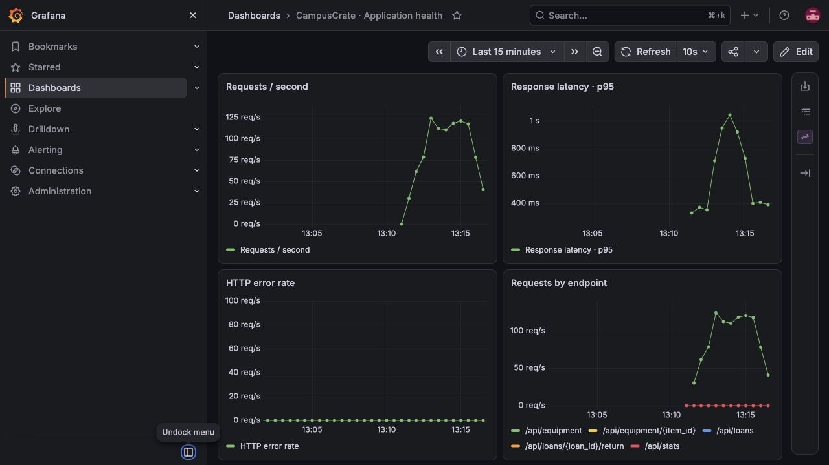
Application monitoring
Prometheus scrapes the API and Grafana shows the recorded workload
Request rate, p95 latency, HTTP errors and requests by endpoint
CampusCrate
11
Notes:
The API exposes Prometheus metrics. ServiceMonitor selects the backend scrape targets, and Grafana shows request rate, p95 latency, HTTP errors and per-route traffic. The screenshot contains actual data from the recorded demonstration. Prometheus stores application time series, while Metrics Server provides the resource API for HPA. Demo monitoring storage is ephemeral.
Evidence recorded on 16 October 2026. Presentation prepared on 26 October 2026.
Sources:
https://github.com/praneethb7/CampusCrate/blob/main/evidence/03-grafana-dashboard.jpg
https://github.com/praneethb7/CampusCrate/blob/main/evidence/05-prometheus-targets.jpg
https://github.com/praneethb7/CampusCrate/blob/main/monitoring/README.md
https://github.com/praneethb7/CampusCrate/blob/main/monitoring/dashboard.json

Slide 12
AWS infrastructure as code
Terraform validation and mock tests completed. AWS provisioning remains pending
Area | Prepared configuration | Executed verification
Network | VPC, 2 public + 2 private subnets, NAT | Terraform init and validate
Compute | EKS and two managed workers | Mock-provider plan assertions
Access | Restricted API, IAM and OIDC | Configuration and test review
Storage | EBS CSI and encrypted gp3 | Configuration and test review
No real AWS plan, apply, Console capture or destroy run.
CampusCrate
12
Notes:
Terraform prepares the requested AWS network and EKS architecture. It includes public and private subnets, NAT, managed workers, restricted cluster API access and EBS CSI storage. Terraform initialized and validated, and mocked-provider plan tests passed. Those tests do not create AWS resources or prove a cloud deployment. I did not run a real AWS plan, apply or destroy, so I do not claim those grading items.
Evidence recorded on 16 October 2026. Presentation prepared on 26 October 2026.
Sources:
https://github.com/praneethb7/CampusCrate/blob/main/terraform/README.md
https://github.com/praneethb7/CampusCrate/blob/main/evidence/terraform-validate.txt
https://github.com/praneethb7/CampusCrate/blob/main/evidence/terraform-mock-tests.txt
https://github.com/praneethb7/CampusCrate/blob/main/docs/RUBRIC-AUDIT.md

Slide 13
Troubleshooting and recovery
Separate lab objects keep fault exercises away from the working application
Fault | Diagnostic evidence | Recovery
Missing image tag | Image pull failure in pod events | Correct the image reference
Wrong Service selector | Empty EndpointSlices despite healthy pods | Match selector to pod labels
Probe distinction
A database outage fails readiness with HTTP 503.
Liveness checks the process without depending on the database.
CampusCrate
13
Notes:
The troubleshooting exercises used isolated objects. A missing image tag caused an image pull failure, visible in pod events. A wrong Service selector produced empty endpoints despite healthy pods. Comparing selectors to pod labels explained the failure and patching the selector restored endpoints. The lab objects were removed afterward. Readiness returns HTTP 503 when the database fails. Process liveness stays independent so a database outage does not cause repeated process restarts.
Evidence recorded on 16 October 2026. Presentation prepared on 26 October 2026.
Sources:
https://github.com/praneethb7/CampusCrate/blob/main/troubleshooting/README.md
https://github.com/praneethb7/CampusCrate/blob/main/evidence/broken-image.txt
https://github.com/praneethb7/CampusCrate/blob/main/evidence/service-before.txt
https://github.com/praneethb7/CampusCrate/blob/main/evidence/service-after.txt
https://github.com/praneethb7/CampusCrate/blob/main/backend/tests/test_api.py

Slide 14
Demonstration sequence
The video will follow the application and its delivery evidence
01
Equipment workflow
Create equipment, borrow a unit, return it and inspect the ledger.
02
Delivery and runtime
Show Actions, published images, Helm release and running workloads.
03
Operations
Explain the HPA event, dashboard, fault diagnosis and AWS scope.
CampusCrate
14
Notes:
For the recorded walkthrough I will first demonstrate the user workflow. I will create an equipment record, borrow one unit, show the availability change, then return it. Next I will show the successful pipeline, image tags and Kubernetes resources. I will close with the recorded autoscaling event, Grafana dashboard, troubleshooting evidence and the Terraform code-only boundary. The presentation itself does not replace a recording of the working application.
Evidence recorded on 16 October 2026. Presentation prepared on 26 October 2026.
Sources:
https://github.com/praneethb7/CampusCrate/blob/main/docs/DEMO.md
https://github.com/praneethb7/CampusCrate/blob/main/scripts/smoke.py
https://github.com/praneethb7/CampusCrate/blob/main/README.md

Slide 15
Delivery scope and next steps
The local classroom demonstration has documented production limits
Demonstrated | Further work
Application, tests and local deployment | Add login, authorization and public TLS
CI scans and SHA-tagged images | Add production secrets and backups
Metrics, dashboard and HPA event | Persist monitoring data and tune capacity
Terraform validation and mock tests | Provision, verify and destroy real AWS resources
Video recording remains pending.
CampusCrate
15
Notes:
The repository includes a working application, automated tests, container packaging, CI publication and Kubernetes smoke deployment. The local demonstration includes monitoring and autoscaling evidence. It is a classroom administrator application, with no authentication, public TLS or production backup policy. These are necessary before public production use. AWS execution and the video recording remain separate outstanding steps.
Evidence recorded on 16 October 2026. Presentation prepared on 26 October 2026.
Sources:
https://github.com/praneethb7/CampusCrate/blob/main/docs/SECURITY.md
https://github.com/praneethb7/CampusCrate/blob/main/docs/VALIDATION.md
https://github.com/praneethb7/CampusCrate/blob/main/docs/SUBMISSION.md

Slide 16
CampusCrate
Source code and demonstration evidence
github.com/praneethb7/CampusCrate
Praneeth Budati
Questions
Notes:
The public repository contains application code, deployment configuration, monitoring setup and the supporting evidence. The demo folder contains this deck and its PDF. I can explain why row locking matters, how readiness differs from liveness, how an image maps to a source revision and which steps remain before production.
Evidence recorded on 16 October 2026. Presentation prepared on 26 October 2026.
Sources:
https://github.com/praneethb7/CampusCrate

