Slide 1

ARAGON
COMPUTER GRAPHICS | FINAL PROJECT
Roopasri Vemula | RXV170002
Praneeth Baru | PXB170006

Slide 2

Summary
This project is a third-person view 2D side- scrolling adventure game that tells the story of a wolf that is lost in the jungle, away from its pack.
So, it must face all the challenges and get through all the levels to reunite with its pack.

Slide 3
Project Environment
Unity Game Engine
Scene Management
Tilemaps
Audio management
Enemy and player animations
Character control
Cinemachine

Slide 4



Goals
To capture the user actions on the screens and to perform relevant actions.
To develop the basic game environment and generate defined arenas.
Associate the user input controller to the player object.
Add animations to the player for every user input action

Slide 5


Goals
Implement the levels in the Play-screen.
Enemy Animations and movement and their animations relevant stimuli.
Enemy animations on colliding with player and killing the player
Enemy animations when player jumps on the enemy’s head and destroy the enemy.

Slide 6
Goals
Implementing Lives, Gems for display on the Play Screen.
Cherries make the score for the game, score increases as more gems collected
Gems are collected to be able to play the next level. A total of 10 gems are required to open the door at the end of the level and navigate to next level.

Slide 7

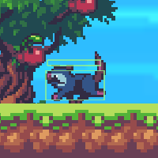
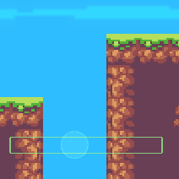
Challenges
Level design
CineMachine
Killing Enemy on jumping on its head
Enemy detection and collision
Game over net
Prop animations

Slide 8
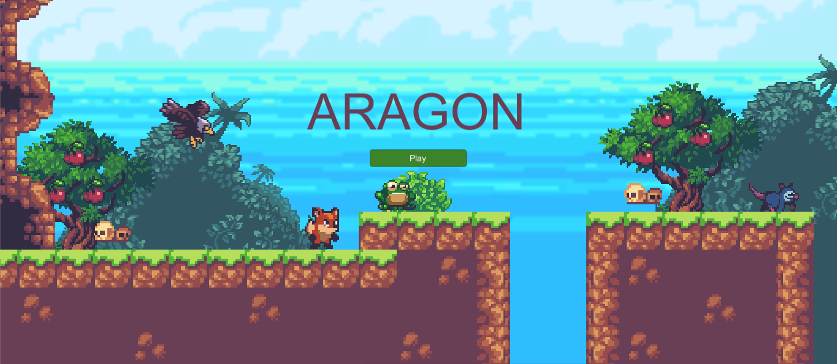
Results

Slide 9
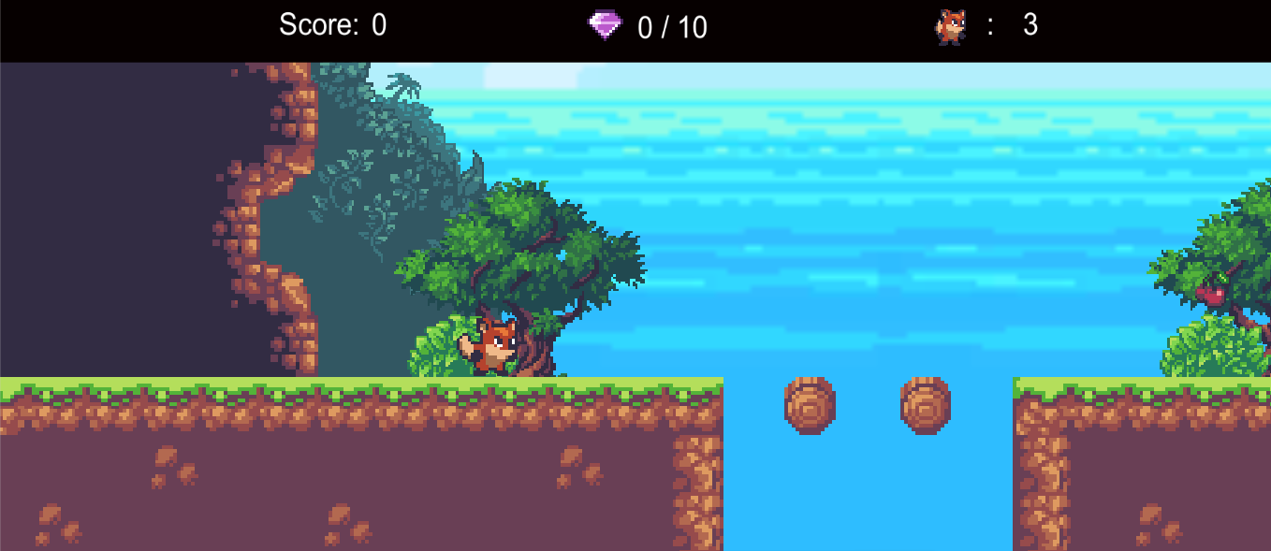
Results

Slide 10
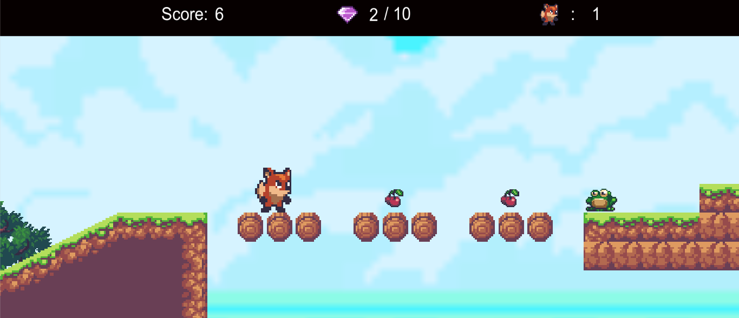
Results

Slide 11
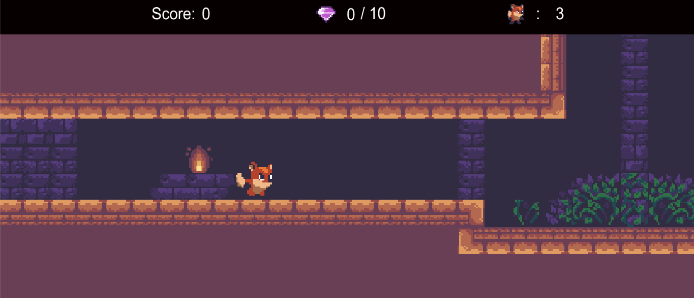
Results

Slide 12
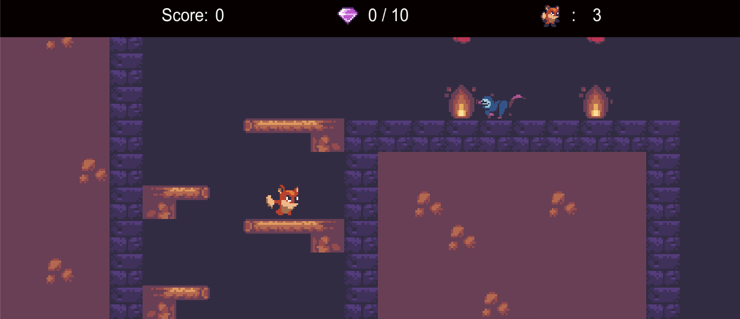
Results

Slide 13
THANK YOU

