Slide 1

Analyzing Airbnb Listings
Team members:
Sai Praneeth Chagiri
K.V.S. Naveen Reddy
Manideep Kotha

Slide 2
Contents
Abstract
Introduction
Airbnb Data Sources Overview
Listings Dataset Cleaning Overview
Related Work
Exploratory Data Analysis
The distribution analysis of the listings and reviews
Correlation and Trend Analysis - Listings Dataset
Airbnb Listing Geographic Distribution
Airbnb Review Analysis
Advanced Statistical Analysis for Airbnb
Interpretation for T-statistic
Conclusion
Further Investigations
References

Slide 3
Abstract
Examining local ubiquity, cost room types, and buyer preferences.
Gathering data for effective posting strategies and guiding travelers.
Identifying trends and market changes in the temporary rental market.
Gaining insights into popular areas, room types' impact on pricing, and enhancing buyer patterns.
Providing valuable insights to hosts and travelers.
Unpacking Airbnb's complexities for a comprehensive understanding of market elements.

Slide 4
Introduction
Understanding Airbnb's Unpredictable Elements:
Examines Airbnb's diverse scene, focusing on neighborhood prevalence, relationship between evaluation and room types, and evolving customer preferences.
Aims to equip hosts with valuable information to improve their listings.
Provides travelers with informed guidance to make informed choices based on value, area, and convenience type.
Contributes to understanding market patterns influencing the future of temporary rentals.

Slide 5
Airbnb Data Sources Overview
From Inside Airbnb: Comprehensive and up-to-date information.
Listings Dataset: Detailed property information including host details, location, amenities, and pricing.
Calendar Dataset: Availability and pricing trends over time.
Reviews Dataset: Customer reviews providing insights into satisfaction and preferences.
Quality Assurance: Data cleaning, correction, and verification for accuracy.
Comprehensive Analysis Approach: Covering all dimensions of the Airbnb market.

Slide 6
Listings Dataset Cleaning Overview
Initial approach: Removed rows with missing values, resulting in 0 records.
Adjusted approach: Removed columns with >50% missing values, computed numerical missing values, filled categorical missing values with 'Unknown', cleaned and converted 'price' to float.
Adjusted result: Retained all records, maintaining 18 attributes.
Next steps: Validation, Data Transformation, and Visuals comparison.

Slide 7
Related Work
Airbnb's evolution within the sharing economy and its impact on various sectors highlight its role as a platform and sharing economy, showcasing diverse accommodation offerings.
"A global-scale analysis of the sharing economy model – an AirBnB case study" from EPJ Data Science explores the nuances of Airbnb within the sharing and platform economies, discussing its growth and impact across different disciplines.
Another important paper, available on SSRN, focuses on "The Rise of the Sharing Economy: Estimating the Impact of Airbnb on the Hotel Industry." This research delves into the economic impact of Airbnb on traditional accommodation providers.

Slide 8
Exploratory Data Analysis Overview
Analyzes basic statistics like mean, median, mode, range, and standard deviation for key variables.
Examines the distribution of key variables to understand their spread and common values.
Investigates correlations between different variables like price and location, room type, or review number.
Identifies trends over time, especially in pricing and availability, to understand market dynamics.
Maps listings to visualize geographical patterns and neighborhood popularity.
Performs basic analysis of review texts to gain insights into consumer satisfaction and preferences.
Detects outliers or anomalies in the data to indicate data entry errors or unique cases.

Slide 9
Listings Dataset (Price)
Count: 11,393 listings
Mean Price: Approximately $68.87
Standard Deviation: $265.30, indicating a wide range in prices
Minimum Price: $0.00 (which could indicate free listings or data entry errors)
25th Percentile: $33.00
50th Percentile (Median): $48.00
75th Percentile: $70.00
Maximum Price: $23,102.00 (suggesting some extremely high-priced listings)
Reviews Dataset (Number of Reviews per Listing)
Count: 8,834 unique listings reviewed
Mean Number of Reviews: Approximately 45.77 per listing
Standard Deviation: 66.07, showing variability in the number of reviews
Minimum Number of Reviews: 1 (minimum engagement)
25th Percentile: 5 reviews
50th Percentile (Median): 19 reviews
75th Percentile: 60 reviews
Maximum Number of Reviews: 711 (indicating some listings are highly reviewed)

Slide 10
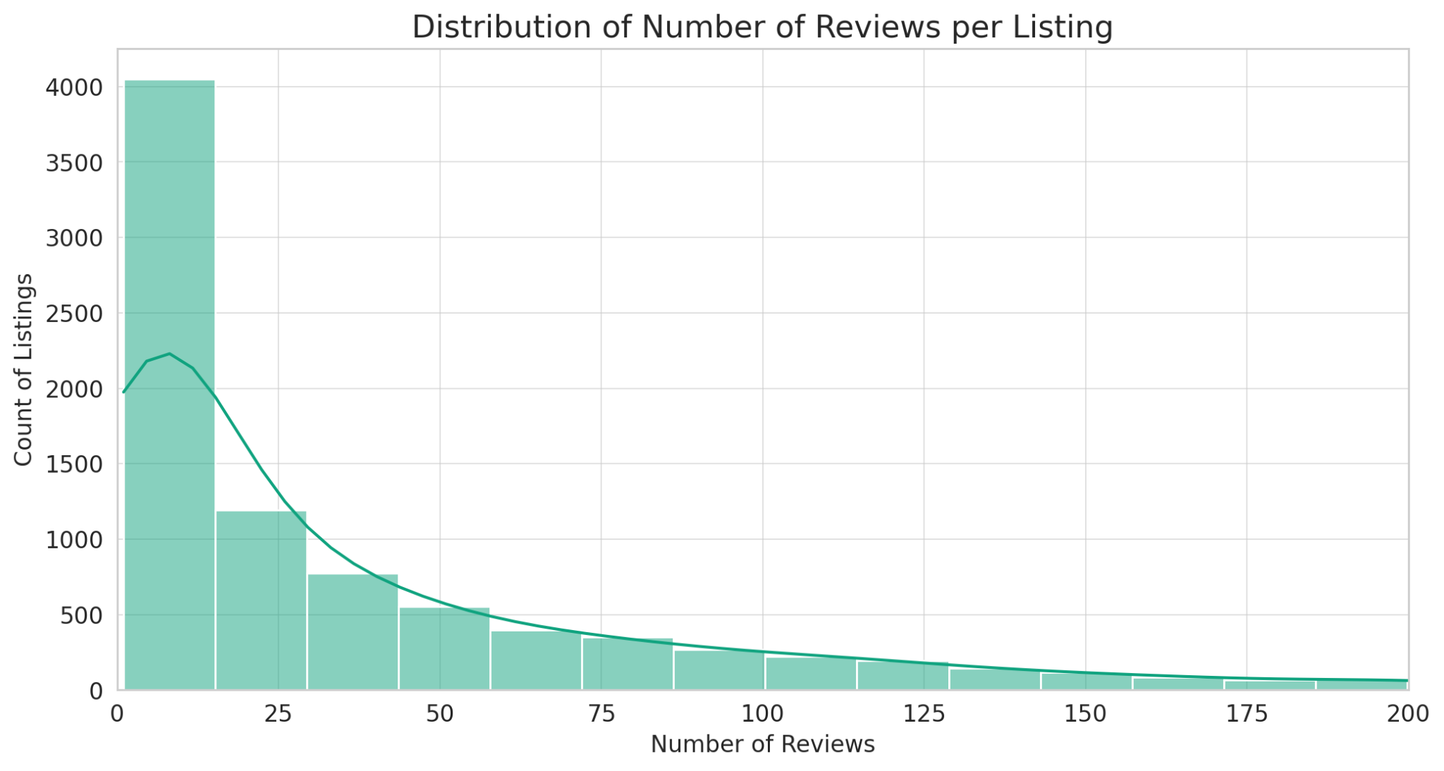
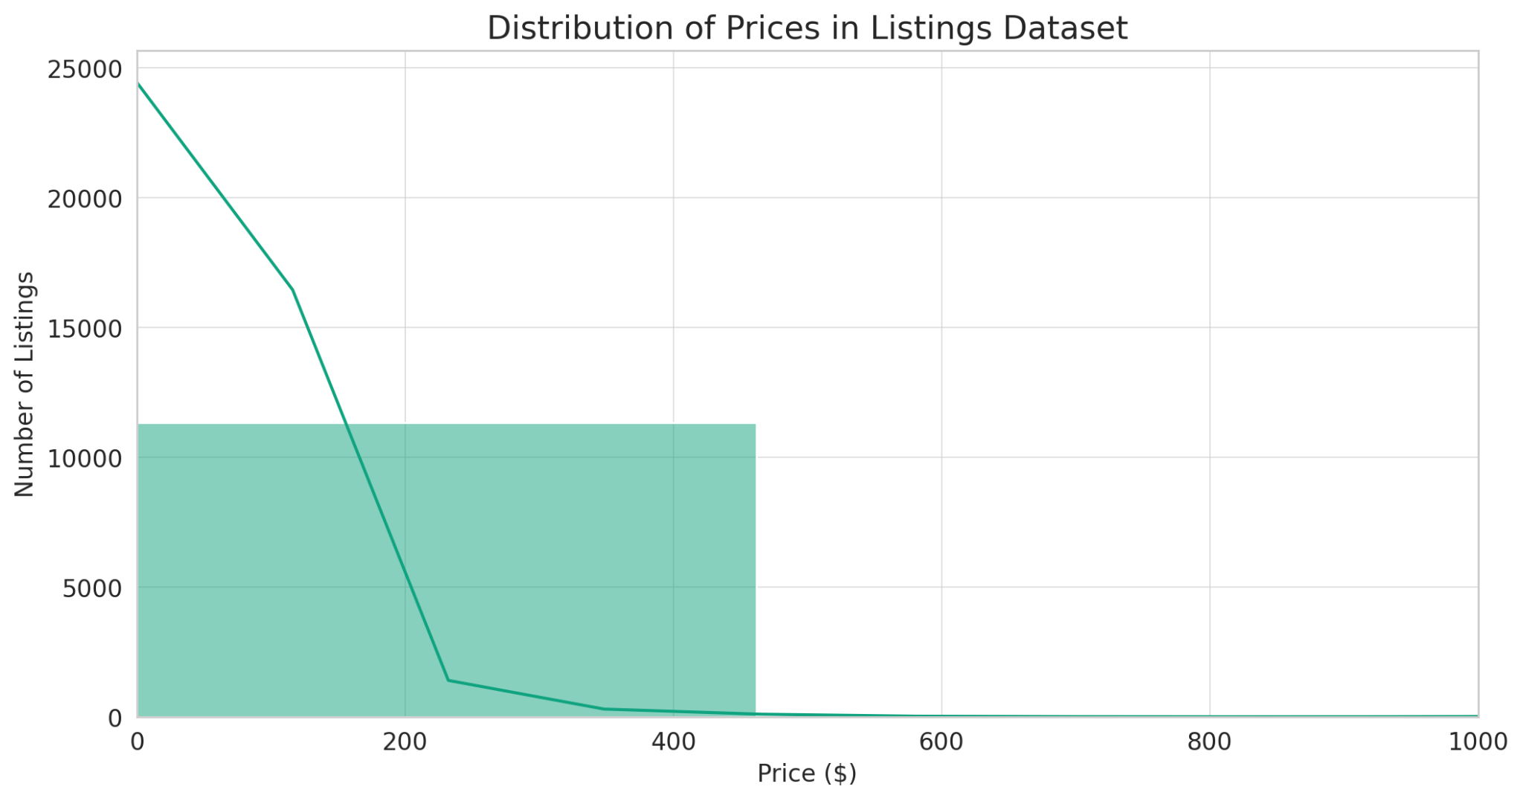
The distribution analysis of the listings and reviews

Slide 11
Listing Dataset Analysis
Right-skewed distribution with most listings priced below $200.
Observations: Majority of prices below $200, concentration in $30-$70 range.
Outliers with high prices present.
Typical pricing concentrated in lower to mid-range.
Majority of listings have fewer than 50 reviews.
Key Takeaways: Majority follow lower to mid-range pricing.
Engagement Level: Most listings have moderate reviews.
Implications for Further Analysis: Correlation Analysis, Review Text Analysis, and Anomaly Detection.

Slide 12
Correlation and Trend Analysis - Listings Dataset
Correlation Analysis:
Heatmap Overview: Shows weak correlations among key variables: price, number of reviews, and room type.
Room type has a low correlation with price and review counts.
Room type does not strongly influence pricing.
Trend Analysis of Prices Over Time:
Line Plot Insights: Shows average daily price trend in Airbnb listings over time.
Observations: Visible price fluctuation and potential indications of seasonality or event-driven pricing.
Importance: Helps hosts optimize pricing strategies and guests plan bookings based on pricing trends.

Slide 13
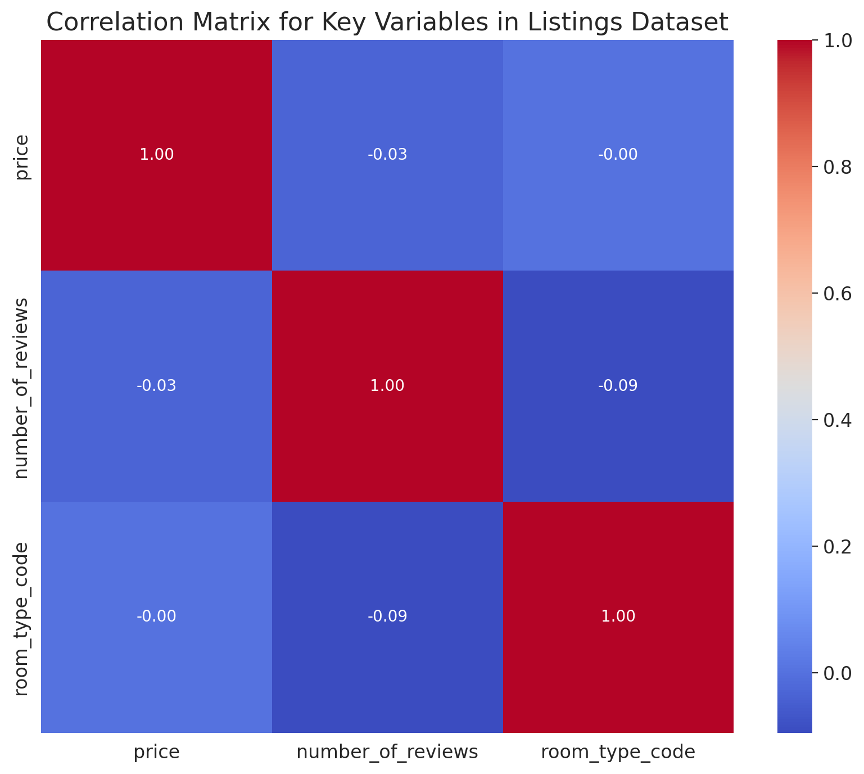
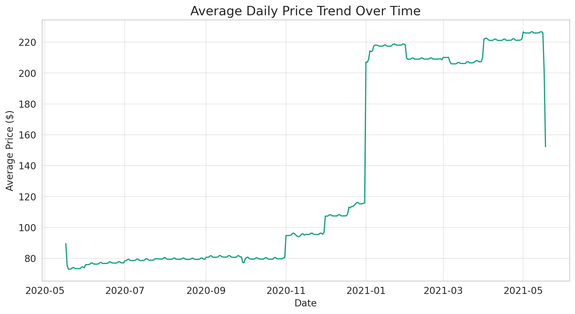
The analysis provides insights into the relationships between key variables in the listings dataset and trends over time in pricing.

Slide 14
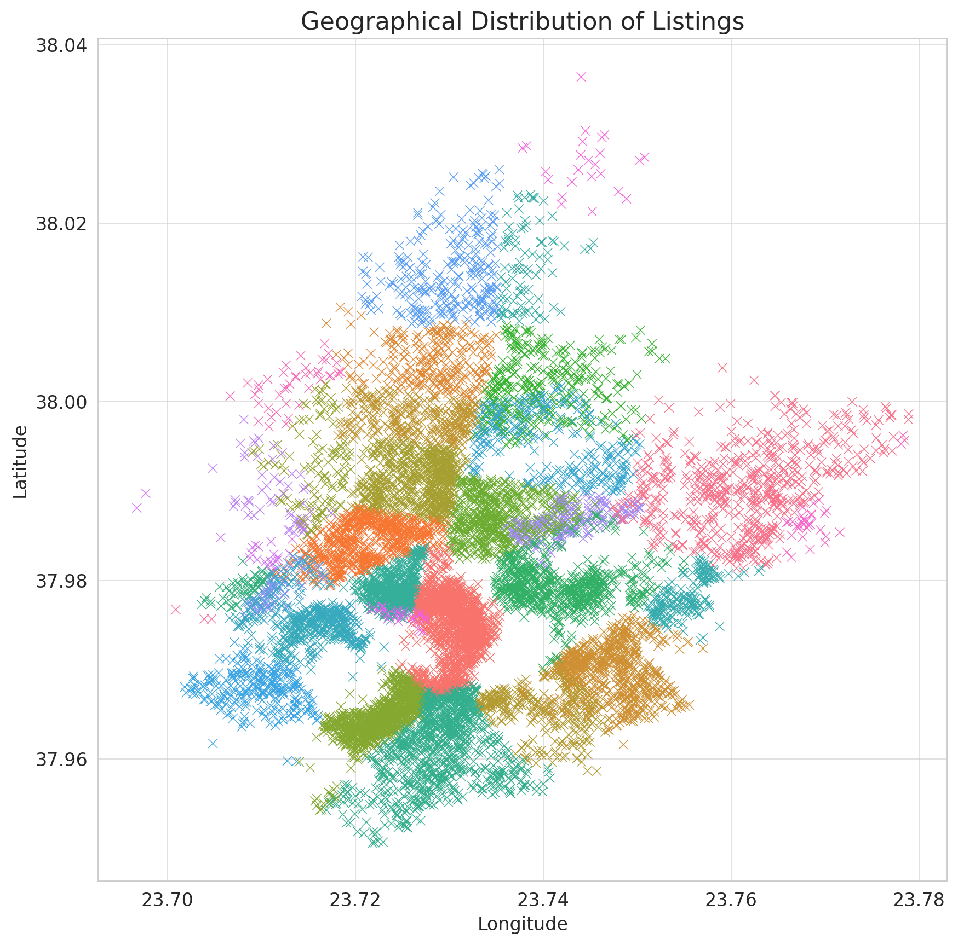
Airbnb Listing Geographic Distribution
Scatter plot shows Airbnb listings' geographical coordinates.
Listings spread across neighborhoods, colored differently.
Helps identify popular neighborhoods or tourist hotspots.

Slide 15
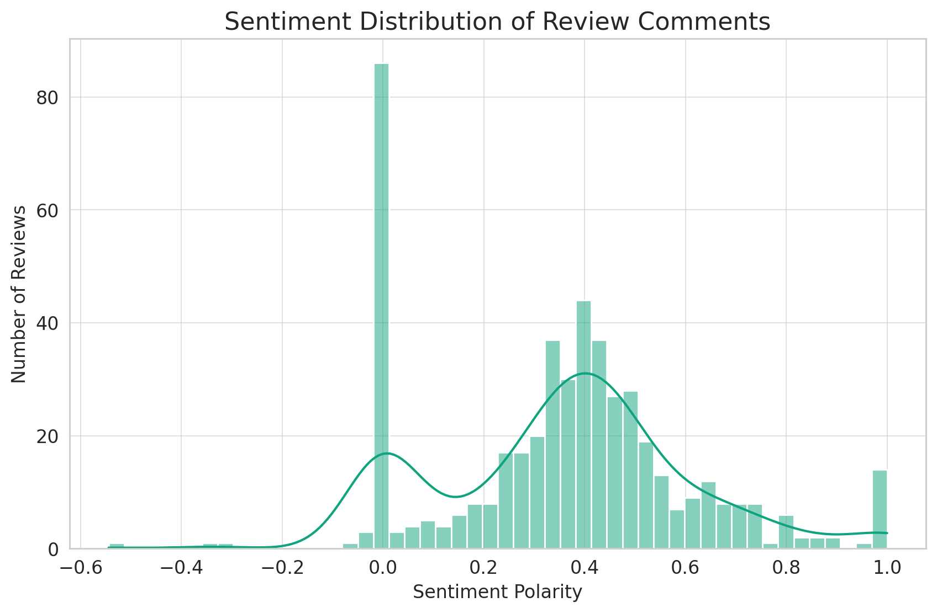
Airbnb Review Analysis
Histogram shows sentiment polarity distribution of Airbnb review comments.
Most reviews have positive sentiment, indicating positive guest experiences.
Fewer reviews have neutral or negative sentiment, indicating overall satisfaction.
Analysis provides insights into Airbnb market dynamics, including geographical preferences and customer satisfaction.

Slide 16
Advanced Statistical Analysis for Airbnb
Hypothesis Testing: Investigates significant differences in pricing across neighborhoods.
Time Series Analysis: Analyzes pricing or booking trends over time if the calendar dataset includes a time component.
Predictive Modeling: Builds a model to predict listing prices based on location, room type, and amenities.
Review Sentiment Prediction: Implements a model to predict review sentiment, gauging overall guest satisfaction.
These analyses demonstrate technical proficiency and provide actionable insights for hosts and guests in the Airbnb ecosystem.

Slide 17
Interpretation of T-Statistic
Measures difference between two groups in standard error units.
Negative t-statistic indicates significantly lower average prices in first neighborhood.
Small p-value suggests statistically significant difference in average prices.

Slide 18
Conclusion
The analysis rejects the null hypothesis that there is no difference in average prices between two neighborhoods, indicating significantly different pricing dynamics.
This advanced statistical analysis demonstrates a thorough understanding of data analysis techniques and offers valuable insights into Airbnb pricing.

Slide 19
Further Investigations
Extend Hypothesis Testing: Conduct broader neighborhood-specific tests to understand pricing dynamics.
Time Series Analysis: Examine temporal trends in pricing and booking patterns.
Predictive Modeling: Develop a Price Prediction Model using machine learning techniques.
Review Sentiment Prediction Model: Use advanced sentiment analysis to predict review sentiment.
Geospatial Analysis: Visualize spatial pricing patterns and identify hotspots.
Segmentation Analysis: Segment listings based on key features.
Dynamic Pricing Strategy: Implement dynamic pricing strategies based on demand and seasonality.

Slide 20
References
[1] Guttentag, D. (2015). "Airbnb: disruptive innovation and the rise of an informal tourism accommodation sector." Current Issues in Tourism, 18(12), 1192-1217.
[2] Quattrone, G., Proserpio, D., Quercia, D., Capra, L., & Musolesi, M. (2016). "Who Benefits from the 'Sharing' Economy of Airbnb?" Proceedings of the 25th International Conference on World Wide Web, 1385-1394.
[3] Xie, K. L., & Mao, Z. (2017). "The impacts of quality and quantity attributes of Airbnb hosts on listing performance." International Journal of Hospitality Management, 67, 11-20.
[4] Dogru, T., Mody, M., & Suess, C. (2019). "Adding evidence to the debate: Quantifying Airbnb's disruptive impact on ten key hotel markets." Tourism Management, 72, 27-38.
[5] Zervas, G., Proserpio, D., & Byers, J. W. (2017). "The rise of the sharing economy: Estimating the impact of Airbnb on the hotel industry." Journal of Marketing Research, 54(5), 687-705.

