Slide 1
Git

Slide 2
What is Git?
Git is a Version Control System (VCS) designed to make it easier to have multiple versions of a code base, sometimes across multiple developers or teams.
It allows you to see changes you make to your code and easily revert them.
VC, also known as source control, is a software that tracks and manages changes to files over time. Allows revisit earlier versions of the files, compare changes between versions, undo changes, etc.

Slide 3
Main features:
Track changes across multiple files
Compare versions of a project
“Time travel” back to old versions
Revert to a previous version
Collaborate and share changes • Combine changes

Slide 4
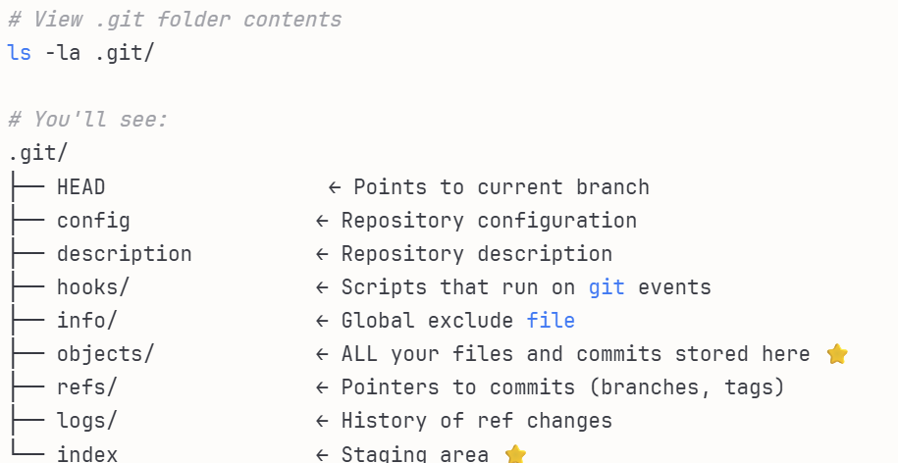

Slide 5
What is Github?
Github.com is a website that hosts git repositories on a remote server
Hosting repositories on Github facilitates the sharing of codebases among teams by providing a GUI to easily fork or clone repos to a local machine
By pushing your repositories to Github, you will pretty much automatically create your own developer portfolio as well!

Slide 6
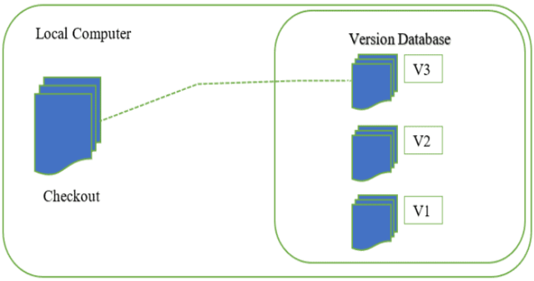
LOCAL VERSION CONTROL SYSTEM
A local version control system is a local database located on your local computer, that keeps all the changes to files under revision control. One of the most popular VCS tools was a system called RCS, which is still distributed with many computers today.
RCS works by keeping patch sets (that is, the differences between files) in a special format on disk; it can then re -create what any file looked like at any point in time by adding up all the patches.

Slide 7
Disadvantages:
If anything were to happen to the local database, all the patches would be lost.
If anything were to happen to a single version, all the changes made after that version would be lost.
Collaborating with other developers or a team is very hard or nearly impossible.

Slide 8
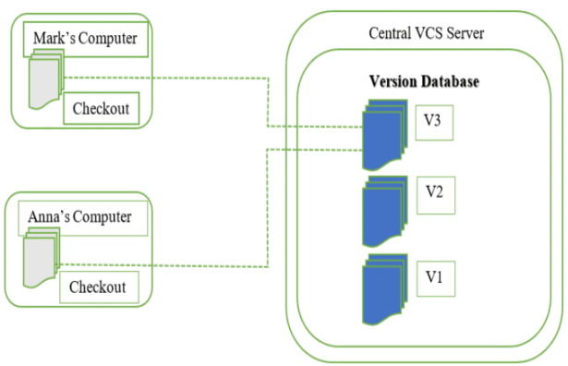
CENTRALIZED VERSION CONTROL SYSTEM
A centralized version control system has a single server that contains all the file versions. This enables multiple clients to simultaneously access files on the server, pull them to their local computer or push them onto the server from their local computer. This way, everyone usually knows what everyone else on the project is doing. Administrators have control over who can do what. Examples of CVCS are TFS (Microsoft Team Foundation) and SVN.

Slide 9
Disadvantages
If the main server goes down, developers can’t save versioned changes
If the central database is corrupted, the entire history could be lost (security issues)
Slow speed delays development

Slide 10
Feature | SCCS (1972) | RCS (1982) | CVS (1986)
Developer | Marc Rochkind (Bell Labs) | Walter F. Tichy | Dick Grune (built on RCS)
Scope | Individual files | Individual files | Entire projects/directories
Architecture | Local only | Local only | Client-server
Concurrency Model | Exclusive locking | Exclusive locking (one user at a time) | Concurrent editing with merging
Storage Location | Same directory (s. prefix) | Same directory (,v files) | Central repository
Branching Support | Limited branching | Basic branches | Better branch support
Merging | Manual merge required | Manual merge required | Semi-automatic merge
Network Support | No | No | Yes (remote repositories)
Key Commands | get, delta, admin, prs | ci, co, rlog, rcs | cvs commit, cvs update, cvs checkout
File Naming | s.filename | filename,v | Hidden in CVS directory
Atomic Commits | No (file-by-file) | No (file-by-file) | Yes (multiple files together)
Platform | Unix/POSIX primarily | Unix/POSIX primarily | Cross-platform
Still in Use? | Very rare | Rarely (legacy systems) | Declining but some legacy use
Typical Use Case | Historical/legacy only | System config files | Multi-developer software projects

Slide 11
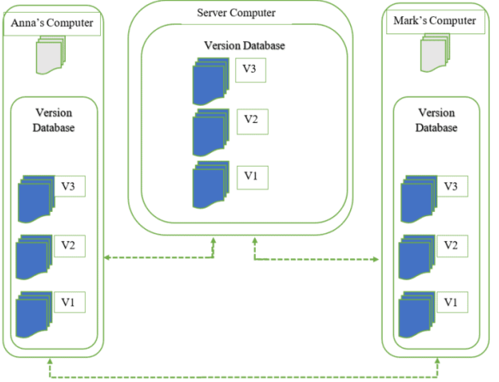
DISTRIBUTED VERSION CONTROL SYSTEM
With distributed version control systems, clients don’t just check out the latest snapshot of the files from the server, they fully mirror the repository, including its full history. Thus, everyone collaborating on a project owns a local copy of the whole project, i.e. owns their own local database with their own complete history. Git is the most well-known example of distributed version control systems.

Slide 12
Advantages
Reliable backup copies: if the server dies, any of the client repositories can send a copy of the project’s version
Fast merging and flexible branching
Rapid feedback and fewer merge conflicts
Flexibility to work offline

Slide 13
HOW GIT STORES INFORMATION ABOUT CHANGES
Repository is used to contain a project. Git allows users to store several different repositories and track each one independently. Throughout development, the project has several save points, called commits. The commit history contains all the commits, i.e., changes implemented in the project during development. A commit allows you to roll back or fast forward the code to any commit in the commit history.
Git uses SHA-1 hashes to refer to the commits. Each unique hash points to a particular commit in the repository. Using hashes, Git creates a tree-like structure to store and retrieve data easily.

Slide 14
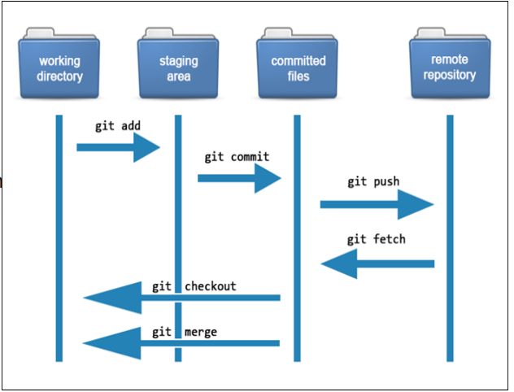
The files in each Git project go through several stages:
Working directory. Modified files,
but untracked and not yet ready for
commit.
Staging directory. Adding modified files
to the staging environment means they
are ready for commit.
Committed. Snapshots of files from the
staging area saved in the commit history.

Slide 15
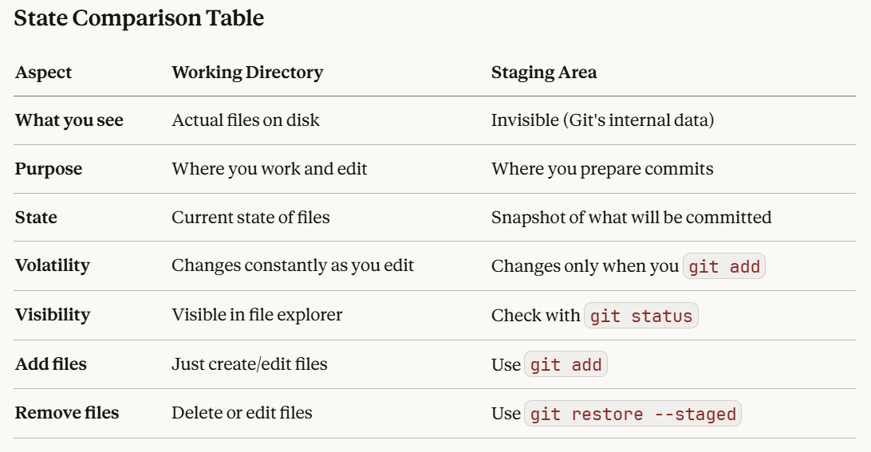

Slide 16
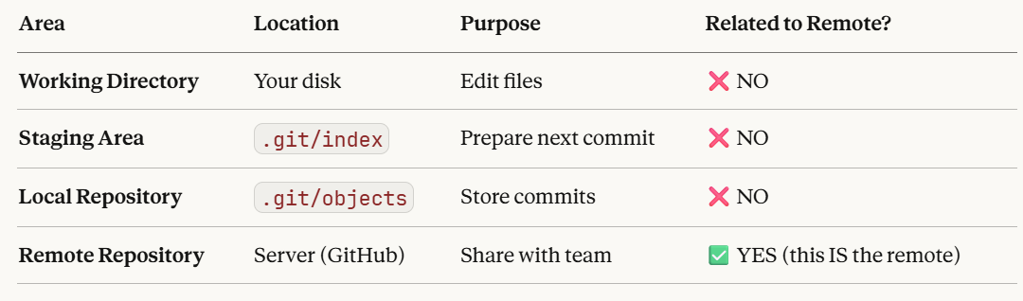

Slide 17
Files
Git sees every file in your working copy as one of three things:
tracked - a file which has been previously staged or committed;
untracked - a file which has not been staged or committed;
ignored - a file which Git has been explicitly told to ignore.

Slide 18
Connecting git with GitHub
In order to prevent having to enter your password each time you push up to Github, you must configure git and Github to recognize Secured Shell (SSH) keys that you generate.
To check and see if you have any recognized SSH keys active on Github, go to https://github.com/settings/keys
If you do not see any SSH keys listed, you do not have SSH configured with Github.

Slide 19
Creating a Git repo
2 Ways
To create a new local Git repo in your current directory:
– git init
• This will create a .git directory in your current directory.
• Then you can commit files in that directory into the repo.
– git add filename
– git commit –m "commit message"

Slide 20
2. To clone a remote repo to your current directory:
– git clone url localDirectoryName
• This will create the given local directory, containing a working copy of the files from the repo, and a .git directory (used to hold the staging area and your actual local repo)

Slide 21
Git Commands
command | description
git clone url [dir] | copy a Git repository so you can add to it
git add file | adds file contents to the staging area
git commit | records a snapshot of the staging area
git status | view the status of your files in the working directory and staging area
git diff | shows diff of what is staged and what is modified but unstaged
git help [command] | get help info about a particular command
git pull | fetch from a remote repo and try to merge into the current branch
git push | push your new branches and data to a remote repository
others: init, reset, branch, checkout, merge, log, tag

Slide 22
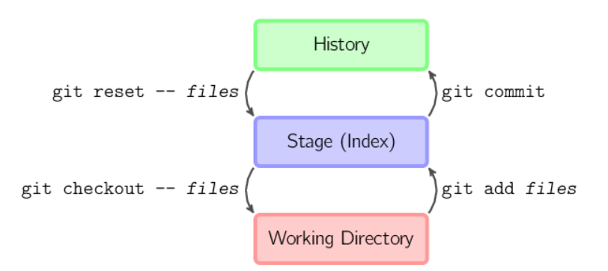

Slide 23
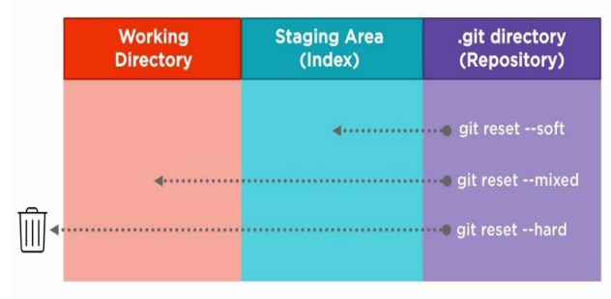
GIT RESET
The git reset command is a complex and versatile tool for undoing changes. It has three primary forms of invocation. These forms correspond to command line arguments --soft, - -mixed, --hard. The three arguments each correspond to Git's three internal state management mechanism's, The Commit Tree (HEAD), The Staging Index, and The Working Directory

Slide 24
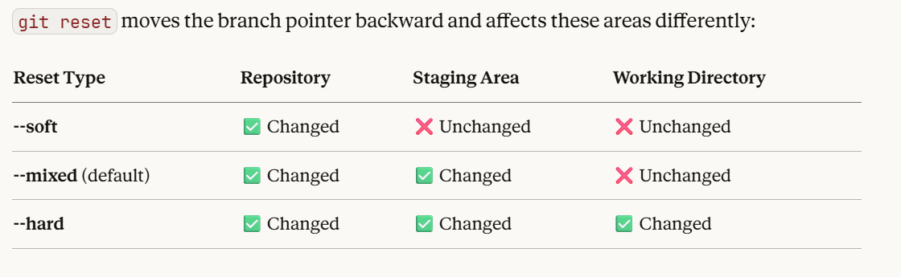

Slide 25
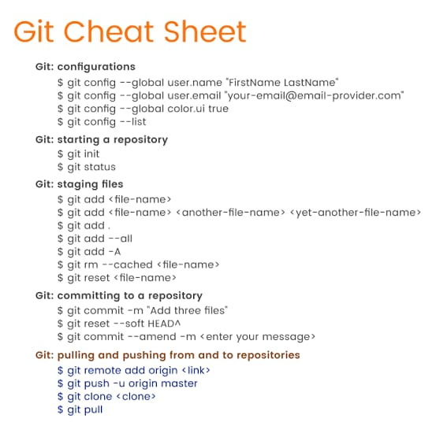

Slide 26
Getting Data from .git folder
$ git ls-files -s 100644 edae7743ce801366a9338a3e1ad0f2cdc633c34c 0 Git.pptx 100644 bdd166a5c1e0b6cbd34fcc5a22171ce26754412b 0 git installation.txt
$git cat-file -p bdd166a5c1e0b6cbd34fcc5a22171ce26754412b

Slide 28
Resources
https://git-scm.com/book/en/v2/Getting-StartedAbout-Version-Control
https://about.gitlab.com/topics/version-control/
https://www.atlassian.com/git/tutorials/learn-gitwith-bitbucket-cloud
https://serengetitech.com/tech/introduction-to-gitand-types-of-version-control-systems/
https://learngitbranching.js.org/

