Slide 1

Integrated Approach for Medical Image Classification and Text Extraction
Combining Computer Vision, OCR, and NLP
-Praneeth kumar

Slide 2

Introduction
Objective: To demonstrate an integrated approach for analyzing medical images and extracting information from prescriptions.
Components:
Computer Vision (CV): Classify chest X-ray images.
Optical Character Recognition (OCR): Extract text from images.
Natural Language Processing (NLP): Identify medical entities from text.

Slide 3
Convolutional Neural Network (CNN)
Purpose: Classify medical images using a Convolutional Neural Network (CNN), such as chest X-rays.
Method: Use a Convolutional Neural Network (CNN) model.
Model Architecture:
Convolutional layers
Max pooling layers
Fully connected layers
Binary classification output
Example Output: Positive or Negative (disease presence).

Slide 4
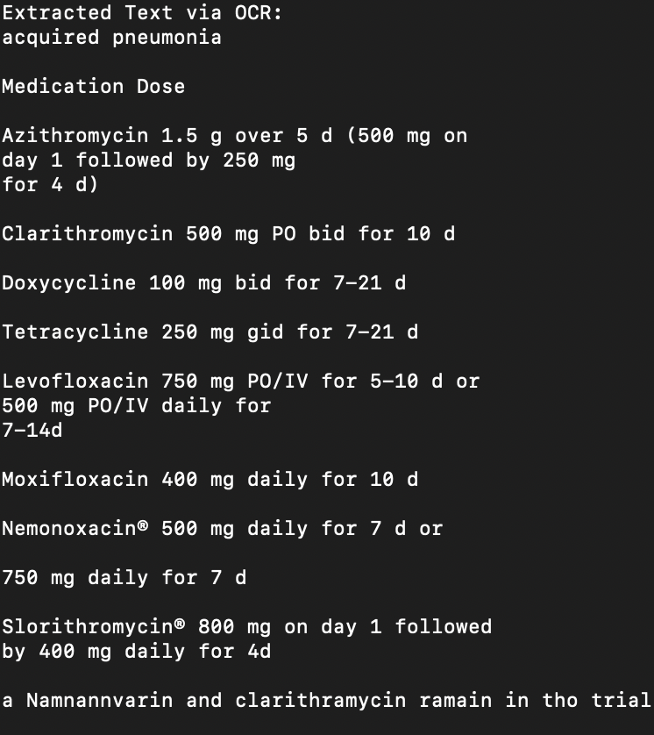
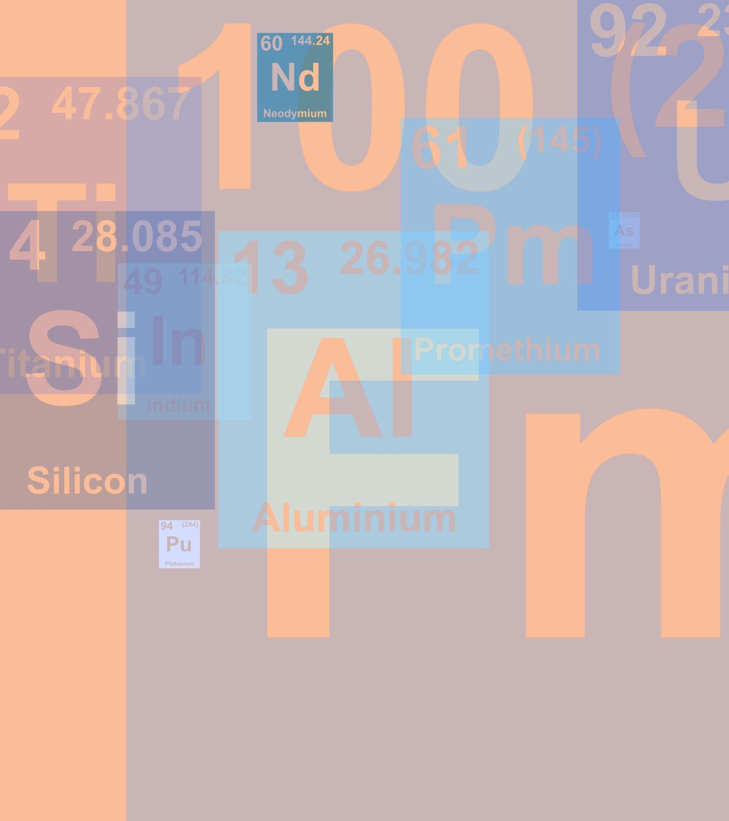
Optical Character Recognition (OCR)
Digitize text from scanned prescriptions and medical documents.
Process:
Input: Scanned prescription or medical document
Tool: OCR (e.g., Tesseract)
Output: Digital text including patient’s name and medication information

Slide 5

Natural Language Processing (NLP)
Objectivdigitized text using NLP techniques.
Process:
Input: Digitized text from prescriptions
Tool: Pre-trained NLP e: Extract relevant information from models (e.g., SpaCy)
Output: Identified entities such as patient’s name and prescribed medications, including dosage indicators like "mg"

Slide 6
Main Execution Flow
Steps:Classify Chest X-Ray: Determine if the image shows a positive or negative condition.
Extract Text from Prescription: Convert the prescription image to text.
Extract Medical Entities: Identify and categorize medical information from the text.

Slide 7
Opportunities
Enhanced Decision Support: Combines NLP, LLMs, and CV for real-time support, reducing errors and aligning treatments.
Automated Documentation: NLP systems generate clinical documentation, easing administrative tasks.
Personalized Care: LMMs analyze multi-source data for personalized treatment plans, improving outcomes and satisfaction.
Improved Efficiency: Automates billing, coding, and data extraction, streamlining operations and cutting costs.

Slide 8

Threats
Data Security: Ensuring patient data privacy and compliance with regulations is crucial for secure AI models.
Bias in Models: AI can reflect biases from training data, potentially leading to unequal care.
Regulatory Challenges: AI in healthcare must meet stringent standards for transparency and compliance, including laws like HIPAA.

Slide 9
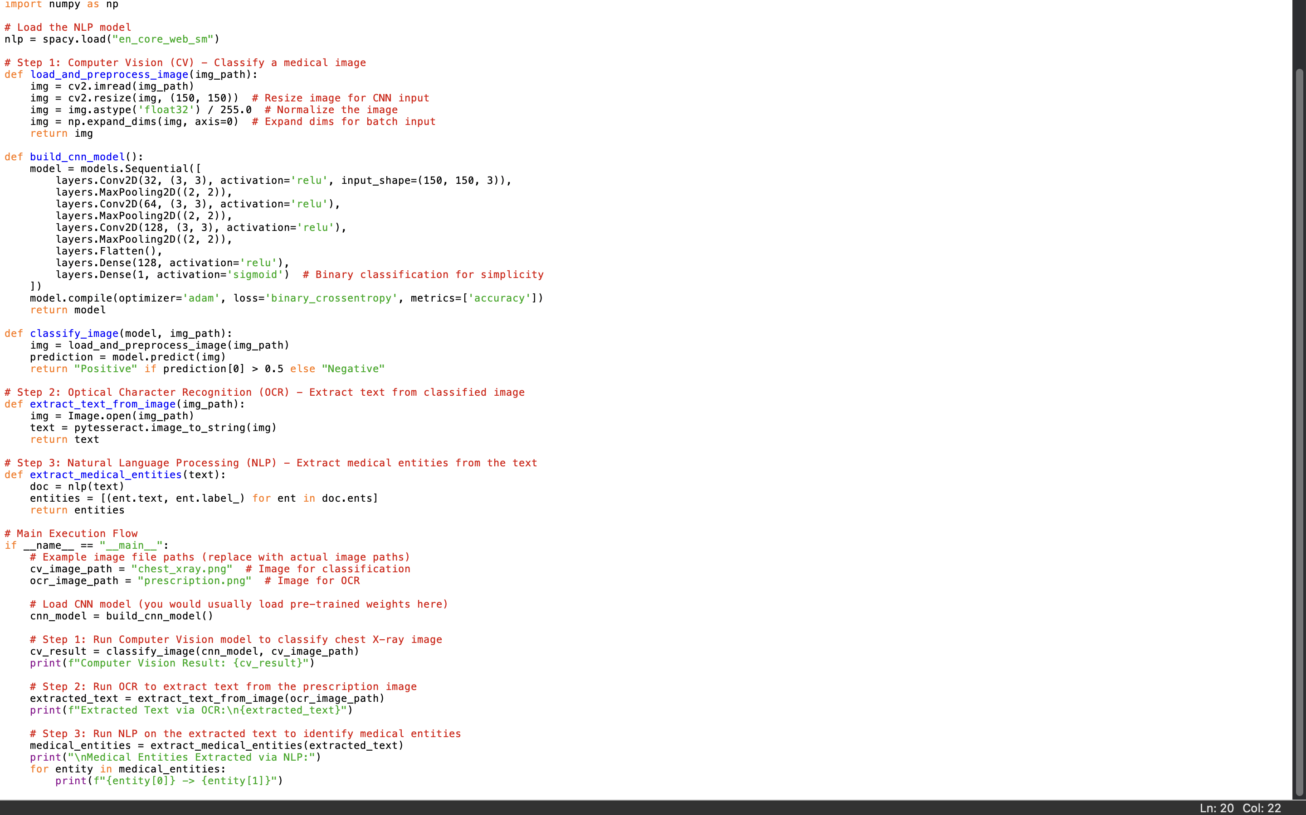
Code:

Slide 10

Conclusion
Summary: The integrated approach demonstrates how to use CV for image classification, OCR for text extraction, and NLP for entity recognition.
Benefits: Improved accuracy in medical diagnostics and streamlined information extraction.
Future Work: Enhancements can include training models with more data and handling multiple disease categories

