Slide 1



MarketHub
ABHEDYA
ALPHA Q

Slide 2
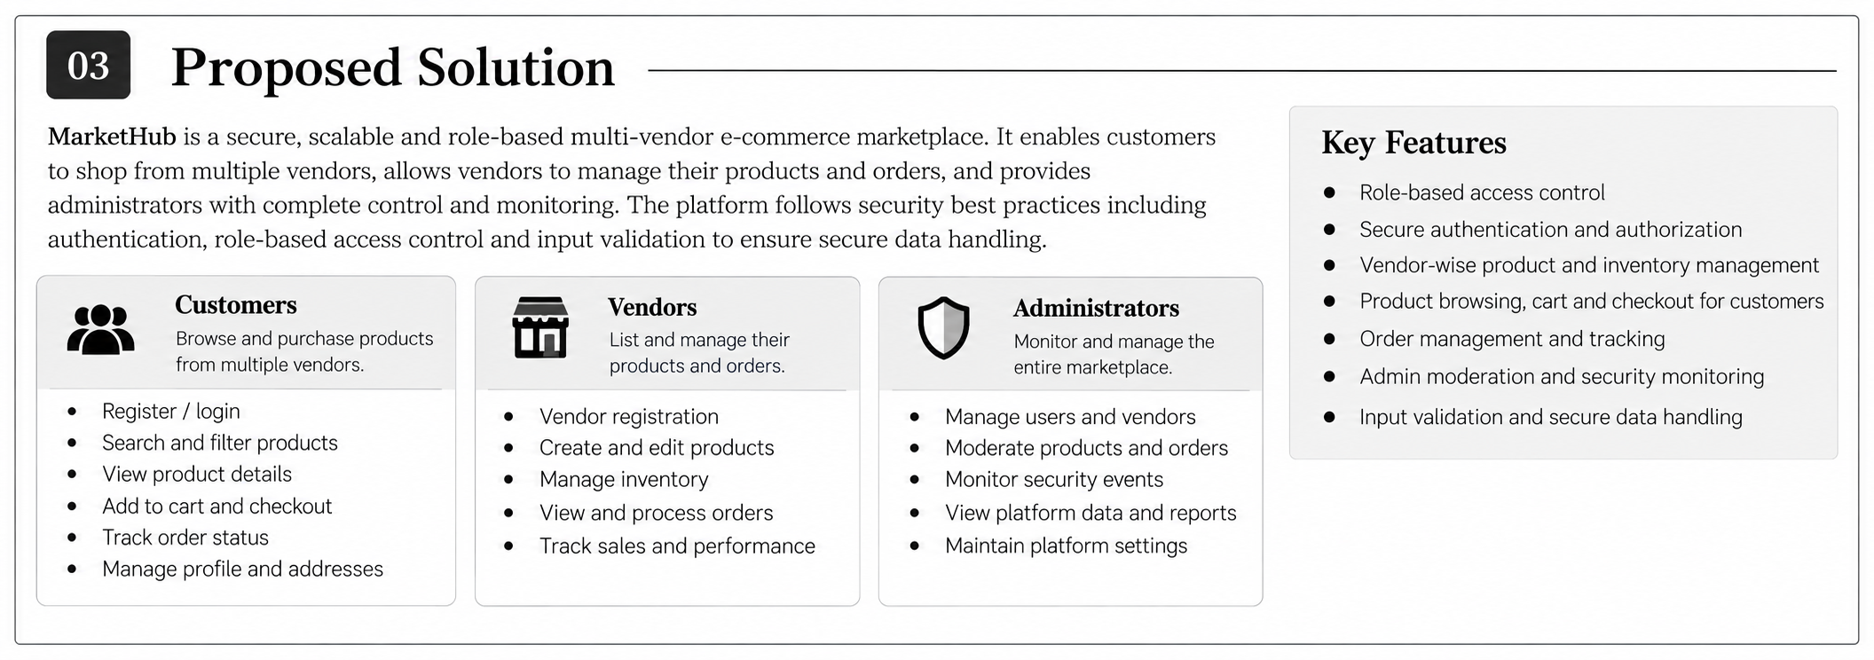
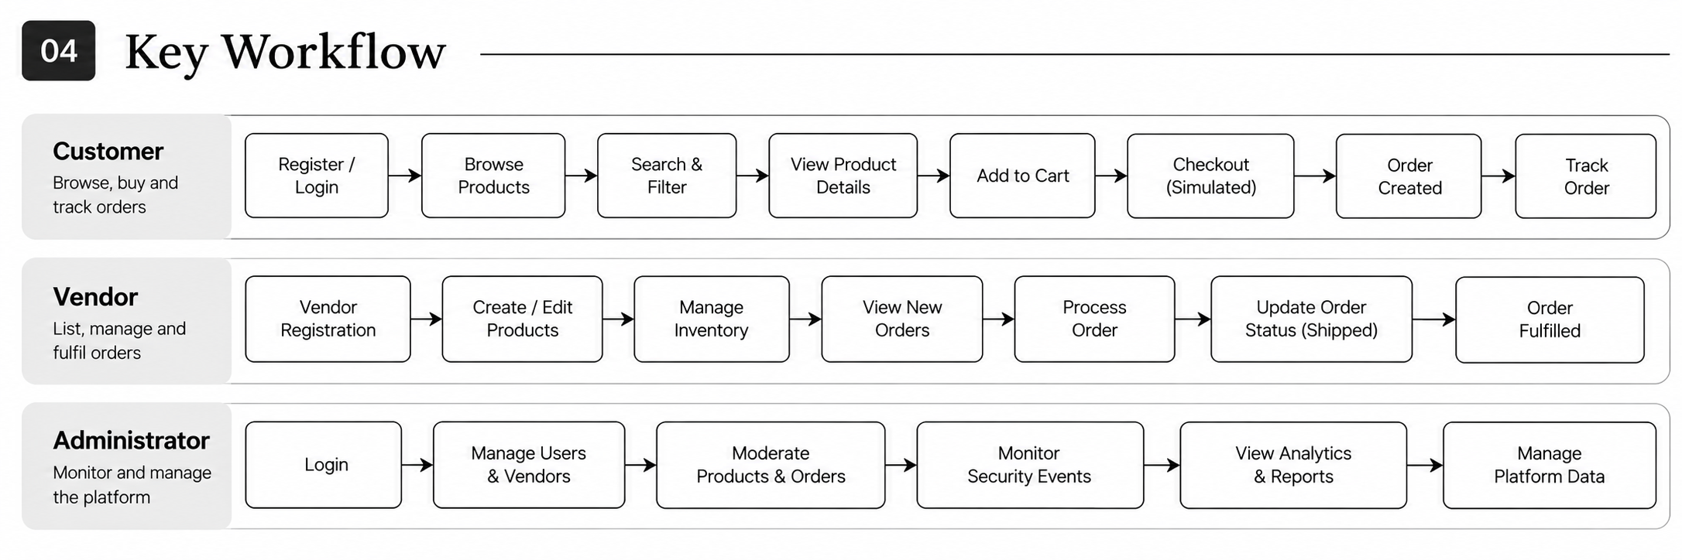
Problem → Our Approach
ABHEDYA

Slide 3
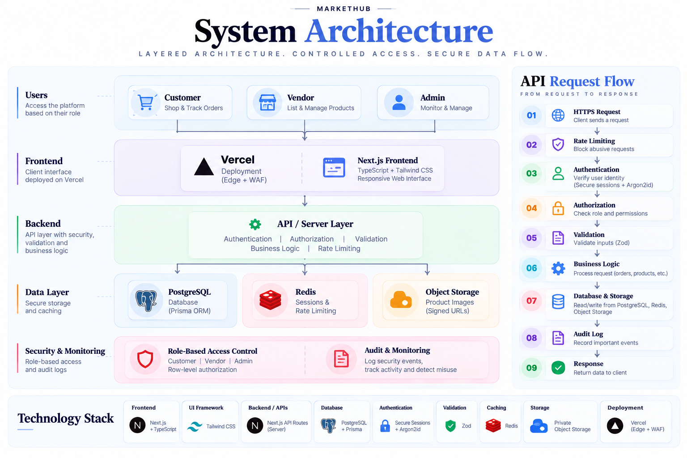
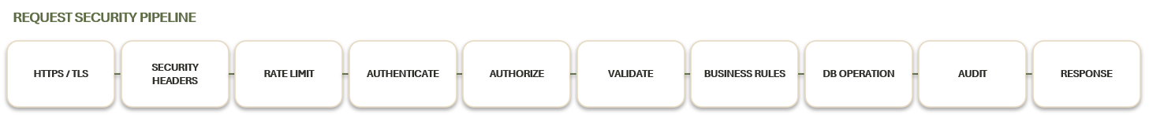
How We Built It
ABHEDYA

Slide 4
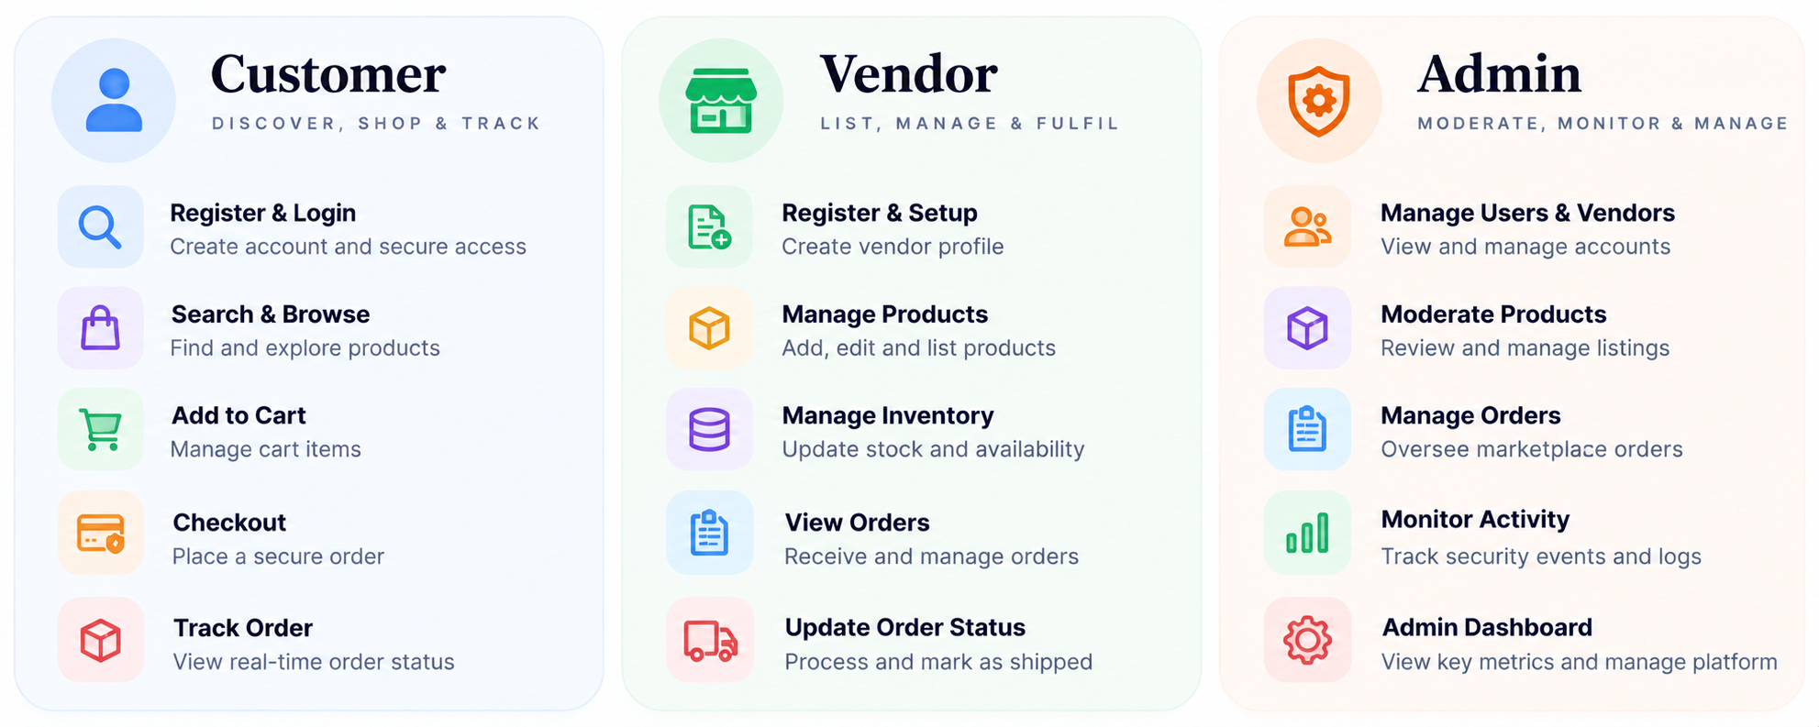
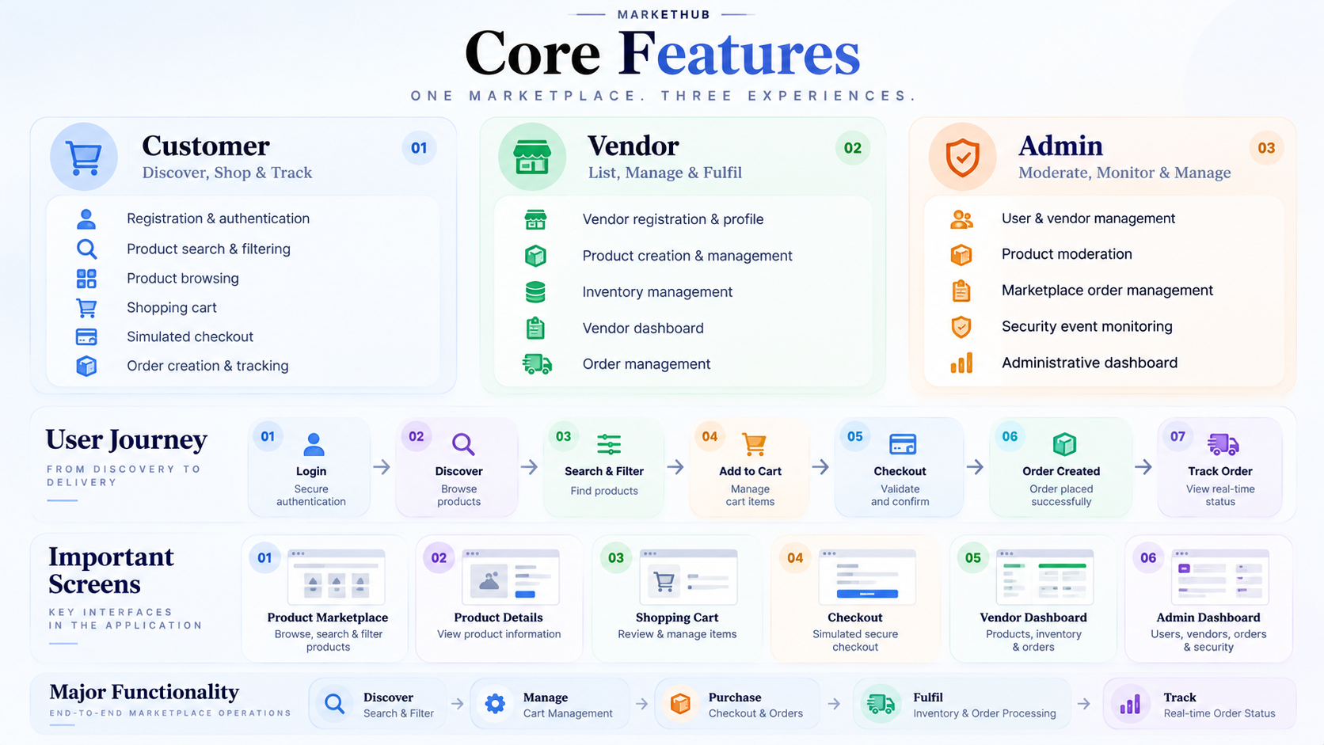
What We Built
ABHEDYA

Slide 5

How We Secured It
ABHEDYA

Slide 6
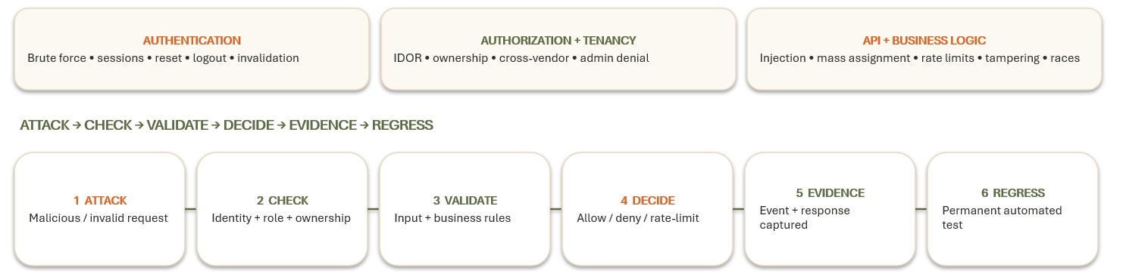


How We Tested It
ABHEDYA

Slide 7
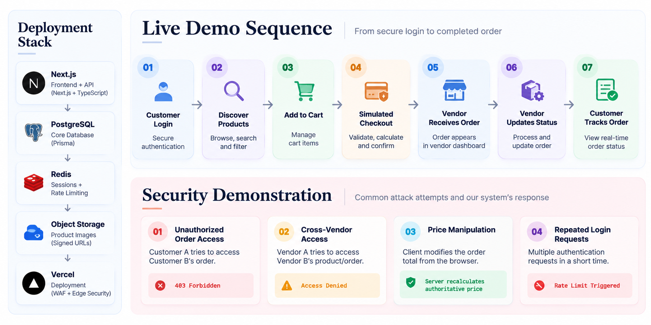
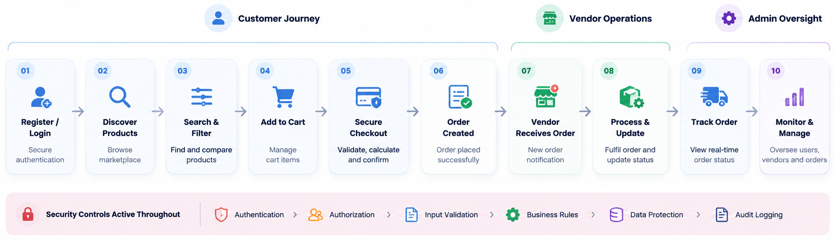
Working Solution
ABHEDYA

Slide 8

Why It Matters
ABHEDYA

