Slide 1
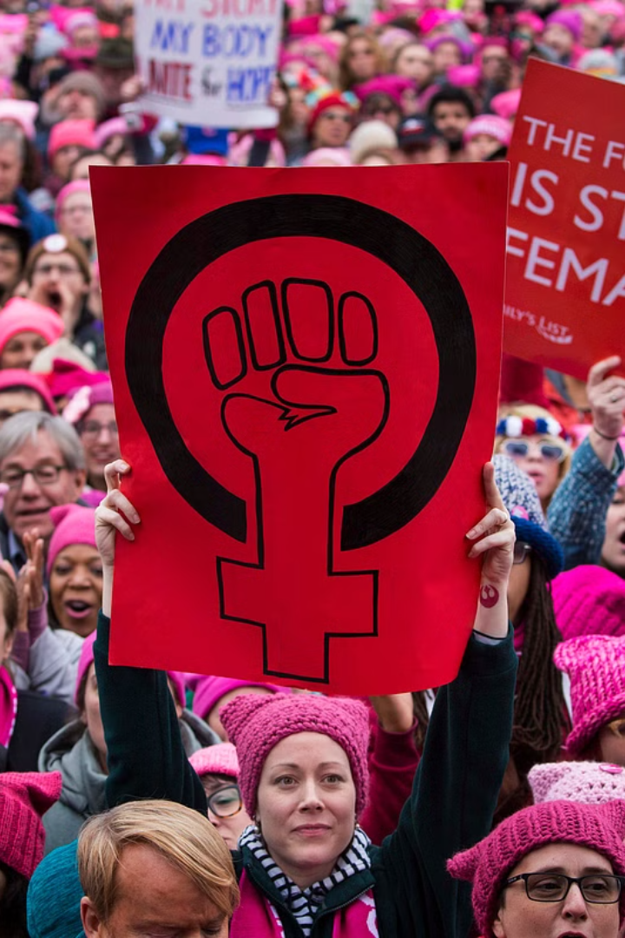

Gender Inequality: A Barrier to Progress
Gender Inequality pt outline
Gender inequality is a problem worldwide, rooted in the social, economic, and political structures of various countries. In simple terms, inequalities caused by gender affect women and girls in many ways, such as being deprived of education, healthcare, and job opportunities and the honour to be in actual leadership. This presentation tries to unpack the complicated issue of gender inequality, its implications, and the current efforts toward addressing it.
by Manoj,suprit,somesh,sowyamraj

Slide 2
Understanding the Gender Inequality Index (GII)
Measuring Inequality
Global Context
The Gender Inequality Index (GII) assesses gender inequality along three dimensions: reproductive health, empowerment, and labor market participation. It provides a comprehensive indication of the relative status of women and men in a particular society. The GII ranges between 0 (with complete equality) and 1 (with complete inequality).
Ending gender inequality has certainly made some advance; however, considerable differences remain worldwide. Prompted by the GII to target interferences and policy changes so as to stimulate gender equality.

Slide 3

Disparities in Education and Health Outcomes
Education Gaps
Health Disparities
There is still a gap in the gender gap in education. Girls and women face some obstacles such as fewer opportunities for school, violence, and other cultural aspects that focus more on the boys. Such inequalities will have effects on future income generation and well-being
Women experience poorer health outcomes than men. Such factors as a lesser access to health care, maternal mortality, and gender-based violence contribute to the disparities. Investing in women's health and empowerment is the need of the hour to address such issues.

Slide 4


The Impact of Gender Discrimination on Opportunities
Economic Inequality
Political Underrepresentation
t leads to less pay, fewer possibilities of growth, and underrepresentation in leadership roles. This thus impacts economic independence, leading to the gender wage gap.
Women are underrepresented in political decision-making bodies, limiting their influence on policies that affect their lives. Addressing this requires promoting women's participation in politics and ensuring their voices are heard.
Social Exclusion
Gender stereotypes and social norms can limit women's participation in social and economic activities, hindering their opportunities and potential. Challenging these norms is crucial for promoting inclusion and equality.

Slide 5
Forms of Gender Inequality
1
Gender-Based Violence
Violence against women and girls is a widespread problem, encompassing physical, sexual, and psychological abuse. It undermines women's safety, well-being, and ability to fully participate in society.
2
Discrimination in Employment
Women face discrimination in hiring, promotion, and pay. They often hold lower-paying jobs with limited opportunities for advancement. This contributes to the gender wage gap and perpetuates economic inequality.
3
Reproductive Health
Unequal access to reproductive healthcare services limits women's control over their bodies and reproductive choices. This includes access to contraception, safe abortion, and maternal healthcare.

Slide 6




Causes of Gender Inequality
Patriarchal Structures
Traditional patriarchal systems often reinforce gender roles and power dynamics, limiting women's opportunities and autonomy. These systems perpetuate inequalities in education, employment, and decision-making.
Cultural Norms and Beliefs
Deeply ingrained cultural norms and beliefs about gender can reinforce gender stereotypes and limit women's roles in society. These norms often restrict women's access to resources and opportunities.
Lack of Education and Awareness
Limited access to education and awareness about gender equality can perpetuate harmful stereotypes and discriminatory practices. Educating individuals about gender issues is crucial for promoting understanding and challenging inequalities.
Economic Factors
Economic factors, such as poverty and limited access to resources, can exacerbate gender inequality. Women in disadvantaged communities often face greater barriers to education, healthcare, and employment.

Slide 7



Impact of Gender Inequality
Economic Loss
1
Gender inequality results in economic losses for societies. Women's untapped potential and talents contribute to lower productivity and GDP growth.
Social Instability
2
Gender inequality can lead to social instability and conflict. It undermines social cohesion and perpetuates violence and discrimination.
Reduced Well-being
3
Gender inequality negatively impacts women's well-being, limiting their access to healthcare, education, and other essential services. It perpetuates poverty and marginalization.

Slide 8
Current Efforts to Address Gender Inequality
International Law
1
International law, such as the Convention on the Elimination of All Forms of Discrimination against Women (CEDAW), provides a framework for promoting gender equality and addressing discriminatory practices.
National Policies
2
Many countries have adopted national policies and programs to promote gender equality, addressing areas like education, employment, and healthcare. These initiatives aim to create a more equitable society.
Civil Society Organizations
3
Civil society organizations play a crucial role in advocating for women's rights, raising awareness about gender inequality, and providing support services to women and girls.
Empowerment Initiatives
4
Empowerment initiatives aim to enhance women's economic independence, leadership skills, and decision-making power. These programs promote women's participation in all aspects of society.

Slide 9

Challenges in Achieving Gender Equality
1
2
Cultural Barriers
Political Will
Overcoming deeply ingrained cultural norms and beliefs that perpetuate gender stereotypes and discrimination remains a significant challenge.
Lack of political will and commitment to gender equality can hinder progress. Governments need to prioritize policies and initiatives that address gender disparities.
3
Resource Allocation
Adequate funding and resources are crucial for implementing gender equality initiatives effectively. Lack of funding can limit the reach and impact of these programs.

