Slide 1
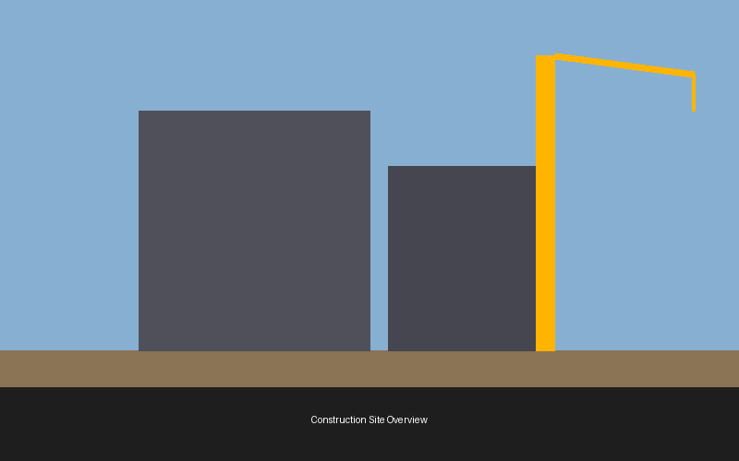
SKYLINE TOWER
Construction Project Report — Phase 2 Update
Q2 2026 | Presented by: Site Engineering Team
Notes:
Welcome to the Q2 Phase 2 update for Skyline Tower. This deck covers structural progress, budget status, timeline milestones, safety compliance, and material procurement. All figures are as of end of May 2026. Questions at the end.

Slide 2
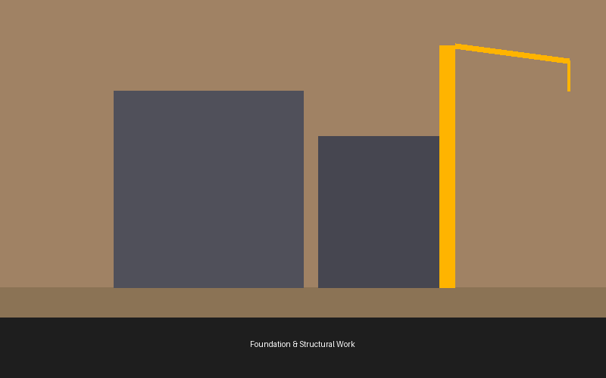
Project Overview
Project: Skyline Tower, Hyderabad Client: Horizon Realty Group Contractor: BuildCore Engineering Ltd. Start Date: March 15, 2025 Completion: December 31, 2026 (est.) Budget: ₹ 142 Crore (approved) Floors: 38 floors + 4 basement levels Scope: Mixed-use commercial + residential
Notes:
Skyline Tower is a flagship mixed-use development in Hyderabad's financial district. Phase 1 (foundation and basement) completed in January 2026. Phase 2 covers floors 1–20 and is currently on track. The client has requested an additional floor for mechanical systems — change order under review.

Slide 3
Budget Breakdown — Q2 2026
Category | Allocated (₹ Cr) | Spent (₹ Cr) | Remaining (₹ Cr) | % Used
Civil & Structural | 52.00 | 38.40 | 13.60 | 73.8%
MEP Services | 28.50 | 12.20 | 16.30 | 42.8%
Finishing Works | 22.00 | 4.10 | 17.90 | 18.6%
Equipment & Machinery | 18.00 | 15.60 | 2.40 | 86.7%
Safety & Compliance | 6.50 | 4.80 | 1.70 | 73.8%
Contingency Reserve | 15.00 | 2.30 | 12.70 | 15.3%
TOTAL | 142.00 | 77.40 | 64.60 | 54.5%
Notes:
Total approved budget is ₹142 crore. As of end of Q2, 54.5% has been spent. Equipment and machinery is the highest burn at 86.7% — two cranes and a concrete pump were purchased outright in Phase 1. MEP spend is low because subcontractor mobilisation begins in Q3. Contingency is largely intact — good sign at the halfway mark.

Slide 4
Construction Progress by Phase
Notes:
The bar chart compares planned vs actual completion percentages across all project phases. Foundation and basement are fully done. Floors 1–10 are at 98% — minor snagging remains. Floors 11–20 are 7 points behind plan — delayed by a rebar delivery shortage in April. MEP rough-in is significantly behind; the team is adding a night shift from July 1. Facade and finishing work has not meaningfully started yet — on schedule.

Slide 5
Monthly Expenditure vs Budget Curve
Notes:
Cumulative monthly spend tracking Oct 2025 through May 2026. Actual spend has tracked slightly below budget in most months — this is a positive sign. The gap widened in April due to the deferred rebar procurement. Finance projects a spend catch-up in Q3 once MEP subcontractors mobilise. Overall the project remains within the approved ₹142 Cr envelope.

Slide 6

Safety & Compliance Report — Q2 2026
Metric | Q1 2026 | Q2 2026 | Target
Lost Time Incidents | 2 | 1 | 0
Near Misses Reported | 11 | 7 | < 5
Safety Audits Passed | 3/4 | 4/4 | 4/4
PPE Compliance (%) | 88% | 96% | ≥ 95%
Training Hours / Worker | 6.2 | 8.1 | 8.0
All Q2 safety targets met or exceeded. PPE compliance reached 96%, surpassing the 95% threshold for the first time. Training hours per worker are up 30% QoQ following the April toolbox talk mandate.
Notes:
Safety performance improved significantly this quarter. The one lost-time incident in Q2 was a sprained ankle on the 12th floor — the worker returned to site after 4 days. Root cause was an unmarked wet floor; corrective action implemented immediately. Near-miss reporting culture is improving — the rise is good, not bad; workers are reporting rather than hiding incidents.

Slide 7
Material Procurement Status
Material | Required (MT / units) | Delivered | On Order | Lead Time | Status
Structural Steel | 1,820 MT | 1,440 MT | 380 MT | 3 weeks | ON TRACK
Ready-Mix Concrete | 42,000 m³ | 28,600 m³ | On-demand | 24 hrs | ON TRACK
TMT Rebar (Fe500) | 3,200 MT | 2,100 MT | 600 MT | 5 weeks | DELAYED
AAC Blocks | 180,000 units | 62,000 units | 118,000 units | 8 weeks | WATCH
Aluminium Facade | 8,400 m² | 0 m² | 8,400 m² | 12 weeks | ON TRACK
Glass Curtain Wall | 5,200 m² | 0 m² | 5,200 m² | 14 weeks | ON TRACK
Notes:
TMT Rebar is the critical risk item — the April shortage pushed delivery back 5 weeks. Mitigation: sourced 200 MT from a secondary supplier at a 4% premium; approved by PM. AAC Blocks on watch because the 8-week lead time is tight against the masonry start date for floors 21–30. Facade and curtain wall are ordered, contracts signed — no delivery risk at this stage.

Slide 8
Workforce Distribution — June 2026
645
Total Workers on Site
38
Subcontractor Firms
12
Nationalities
94%
Attendance Rate (May)
Notes:
645 workers currently on site — up from 480 in Q1 due to MEP subcontractor onboarding. Civil and structural trades remain the largest group. Attendance rate of 94% in May is above the 90% contract threshold. Night shift starting July 1 will add approximately 80 MEP workers to the headcount.

Slide 9
Q3 2026 — Next Steps
Complete floors 11–20 structural work by July 31
Mobilise MEP night shift from July 1
Resolve TMT Rebar shortfall — secondary supplier delivery by June 20
Award AAC Block masonry subcontract by June 25
Submit change order for additional mechanical floor to client by June 30
Q3 safety target: zero lost-time incidents
Next review: July 15, 2026
Notes:
Close the deck by confirming the six Q3 commitments. Emphasise the rebar mitigation is already in motion — delivery confirmed for June 20. The change order for the mechanical floor is a potential budget impact; client meeting scheduled for June 28. Next full project review is July 15 — same format, same attendees.

