Slide 1
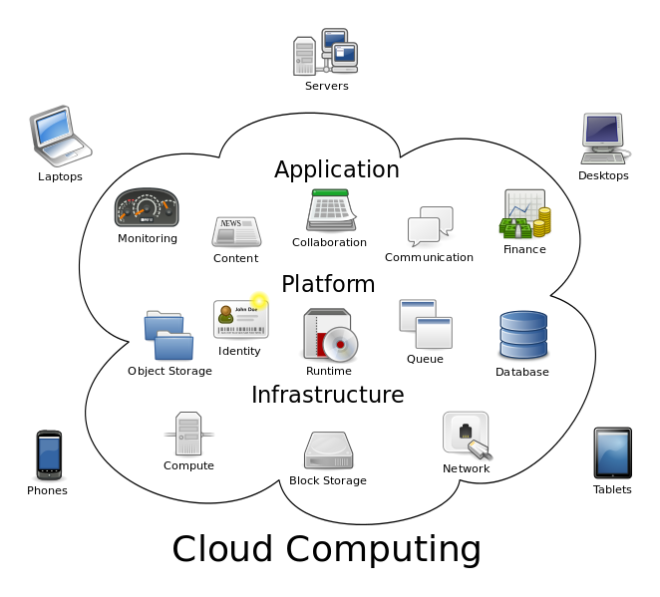
CLOUD

Slide 2
My project is on security protect pin to contacts and other files which we saved in Gmail

Slide 3
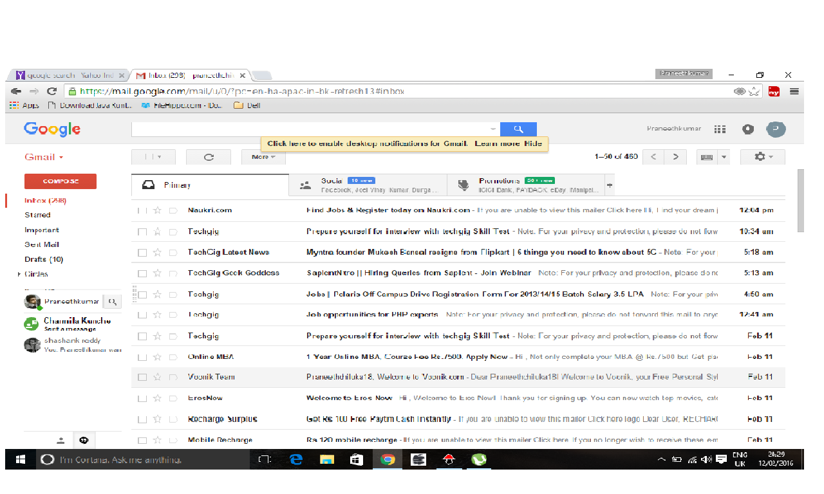
First you have to login to your accout

Slide 4
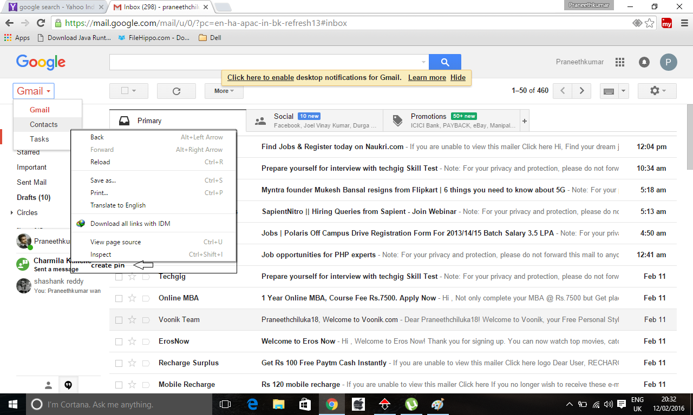
Open contacts then right click on it and click on create pin

Slide 5
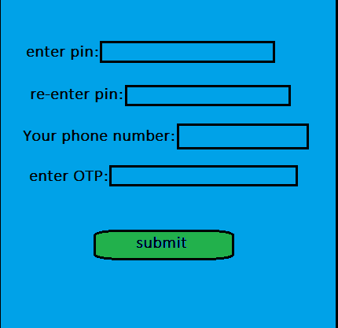
To create pin you have to enter your pin and mobile number(for verification) then click on submit button.

Slide 6
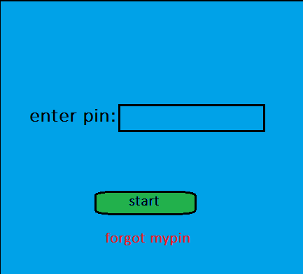
Successfully you have created security pin to your contacts. Now when you click on contacts it will ask u security pin you have enter pin and click on start button

Slide 7
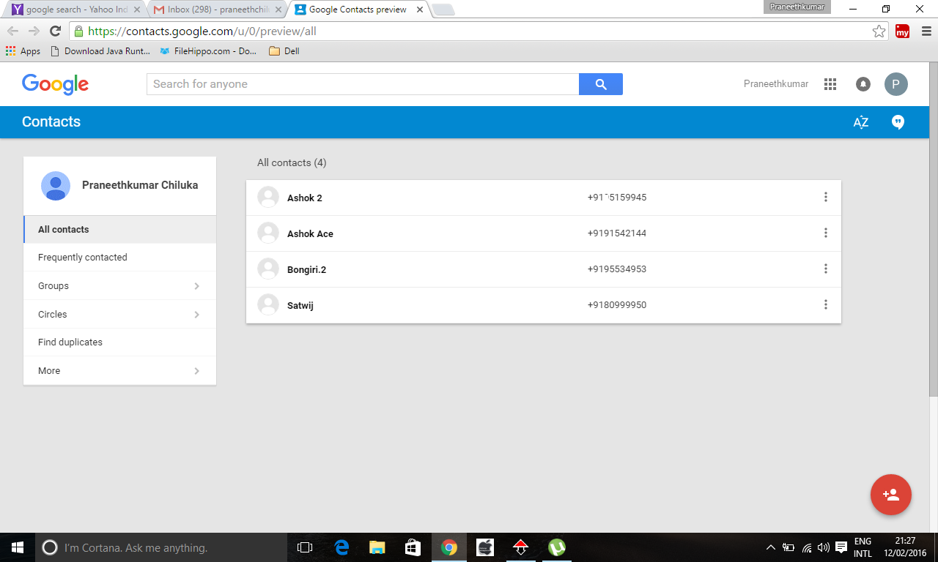
Now you can see your contacts

Slide 8
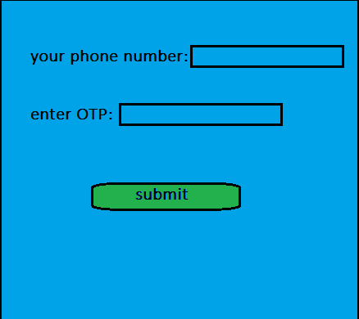
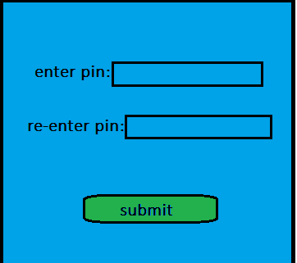
If you forgot your pin then click on forgot my pin just enter the mobile number and enter the OTP click on submit button now you can change your pin

Slide 9
THANKING YOU

