Slide 1
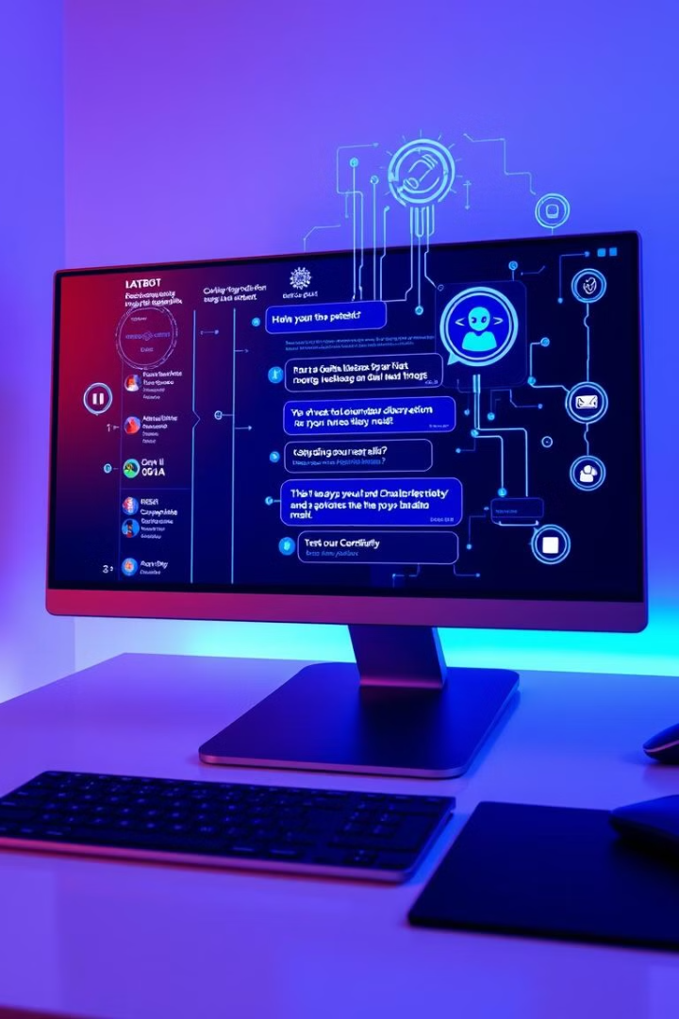

GENAI_CONFIGGENERATOR Chatbot Progress
Innovative chatbot solution for template suggestions
Developing AI-driven recommendations based on user queries
by MAREDDY D V S PRANEETH

Slide 2

Internship Journey: Week 1-2
1
AI Foundations
Studied RAG, Llama, Mistral models
2
Prototype Development
Created ReactJS chatbot UI
3
Dark/Light Mode
Implemented theme switching

Slide 3




Initial Implementation
LLM Integration
Direct response generation
Accuracy Challenges
Relevance issues identified
RAG Transition
Shift to knowledge-based approach

Slide 4
Current Optimization Focus
Knowledge Retrieval
Template Matching
Testing vector databases: FAISS, ChromaDB
Evaluating embedding models

Slide 5
Future Roadmap
1
Unstructured Data Handling
2
Learning Different RAG to handle unstructured diverse Data

