Slide 1

Mini Project Review
Batch No: 17
Project Title: Video Steganography
S.No | Regd.No | Student Name
1 | 20A81A0632 | MATURU PRANEETH
Project Guide:
Mr.M.BHANU RANGA RAO

Slide 2
ABSTRACT
The project entitled Secure Data Transfer through video using the concept of Steganography simply as Video Steganography is the application developed to embed an video file. It is concerned with embedding information in an innocuous cover Speech in a secure and robust manner. This system makes the Files more secure by using the concepts Steganography and Cryptography.

Slide 3
INTRODUCTION
The Video Steganography , which alter the originality of the file into some encrypted form and embed the file into a video file. The major task of the Video Steganography is to provide the user the flexibility of passing the information implementing the encryption standards as per the specification and algorithms proposed and store the information in a form that is unreadable.

Slide 4
Literature Survey
Sno | Authors | Title | Advantages | Disadvantages
1 | Abhinav Thakur | Secure Video Steganography based on DWT(2015) | Better performance in terms of encryption | initially all signals are generally represented in time domain.
2 | Ahmed Salem | Data hiding for Unmanned video based on digital(2016) | saving the storage as well as increasing the data safety from a potential loss | There is less accuracy

Slide 5
Sno | Authors | Title | Advantages | Disadvantages
3 | Said E | A security enhanced robust video embedding(2015) | Provides large capacity of Steganography due to trailing coefficients and high robustness | It occupies more amount of space to store the embedded file
4 | Wong M | A secure video steganography based on LSB technique(2018) | easy and computationally | There is no authentication

Slide 6
Problem Statement in Existing System
A special problem for steganography is the conversion of digital files to different formats or with different compression levels. Both can affect the embedded information, and the technology needs to be robust against this type of attack and signal modification.

Slide 7
Proposed System
In this project, we have proposed Enhanced TEA(Tiny Encryption Algorithm) with embedding(ETEA) text into video. Enhanced TEA provides security during transmission of data transfer. In TEA, only encryption was possible. But in our proposed algorithm ETEA, encryption and embedding both are combined to provide high-level of security to the data so that it couldn’t be hacked.
In this technology, the end user identifies an video file, which is going to act as the carrier of data. The data file is also has the authentication for the encrypted file. The video if hacked or interpreted by a third party user will open up in any video player but not displaying the data.

Slide 8
Objectives
To provide high security for the valuable information
The main objective of steganography is to hide a secret message inside harmless cover media in such a way that the secret message is not visible to the observer
To abstract technique of getting secret data using decryption

Slide 9
Modules
1) Tiny Encryption Algorithm Implementation Module
2) Steganography Module
3) GUI Module

Slide 10
Project domain
We use Java Development kit as project domain

Slide 11
Requirements analysis
Functional Requirements :
Security: In this, we make the data encrypt or decrypt
Encrypt: In this, we provide password for the data file and change into human unreadable format.
Decrypt: In this, we need to enter password for the data file and change into human unreadable to readable format.
Stegnography
Embed: In this, we need to attach video file and encrypted file.
Dembed : In this, we to provide video file then it separates the video file and encrypted file.

Slide 12
Cont…
Non-Functional Requirements :
This project is intended to meet the following non functional requirements:
Program should be free from errors
This should provide high security for the secret data
Extensibility
Reusability
Software Requirements :
Operating System
Windows NT/2000 or Above(Client/Server).
Java (jdk-18)

Slide 13
Hardware Requirements :
Processor(intel i3 Processor or above)
RAM: 4GB
ROM:128GB

Slide 14
System architecture
Sender
Secret Message
Encryption
Algorithm
Embedding
Video file
Receiver
stego
key

Slide 15
Receiver
Dembedding video file
Decryption
Algorithm
Secret Message
stego
key

Slide 16
Methodology
ALGORITHM IMPLEMENTATION
The Tiny Encryption Algorithm (TEA) is a steganographic algorithm designed to minimize memory footprint and maximize speed. It is a Feistel type cipher that uses operations from mixed (orthogonal) algebraic groups. This research presents the cryptanalysis of the Tiny Encryption Algorithm.
Enhanced TEA(Tiny Encryption Algorithm) with embedding(ETEA) text into video.In TEA, only encryption was possible. But in our proposed algorithm ETEA, encryption and embedding both are combined to provide high-level of security to the data so that it couldn’t be hacked.

Slide 17
Project plan
sno | process | weeks
1 | Abstract making | ½ week
2 | Literature survey | 1 week
3 | Project discussion | 1 week
4 | Requirements gathering | 1 week
5 | Implementation of code | 5 week
6 | Testing | 1 week

Slide 18
DESIGN
Use Case Diagram
Sender:

Slide 19
Receiver:

Slide 20
Sequence Diagrams
Sender :

Slide 21
Receiver:

Slide 22
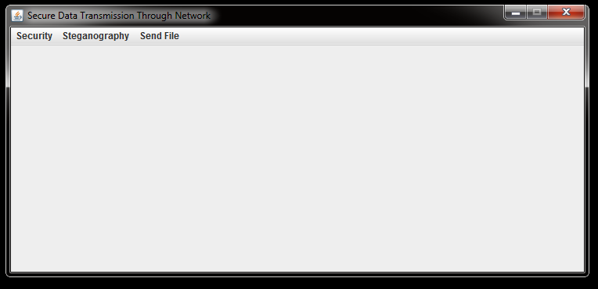
IMPLEMENTATION
When you run the code, It displays a screen as shown in the following image.

Slide 23
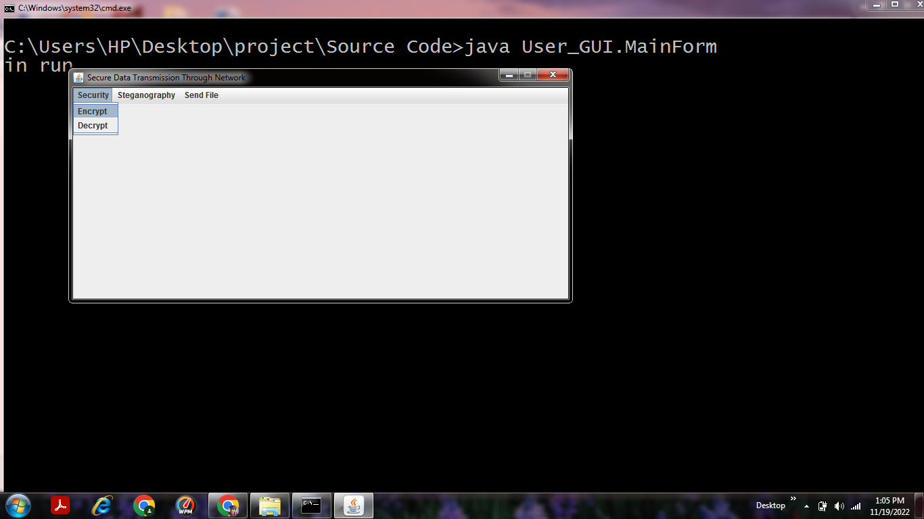
Encrypting:
Now you have to select the “Security” menu and select the “Encrypt” option as shown in the following image.

Slide 24
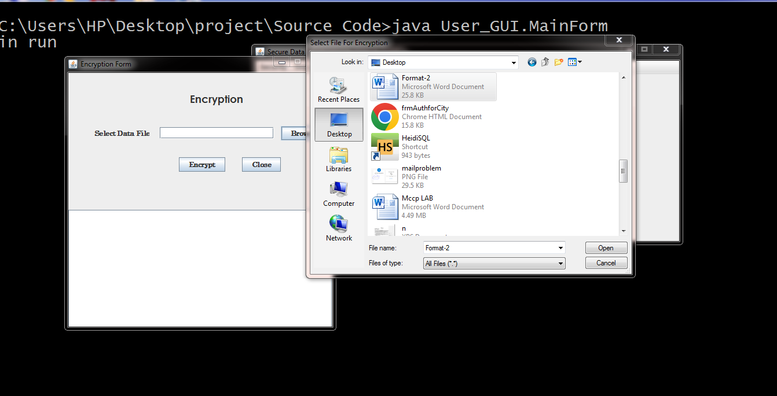
Selecting File to Encrypt:
Now you have to select a file which you want to encrypt from your device.

Slide 25
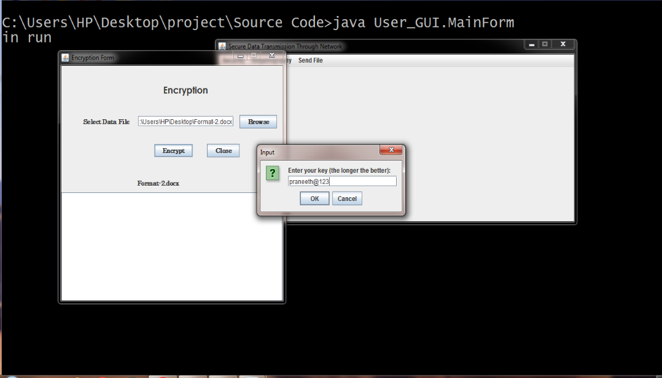
Setting password to File:
Here you have to set a password to your selected file.

Slide 26
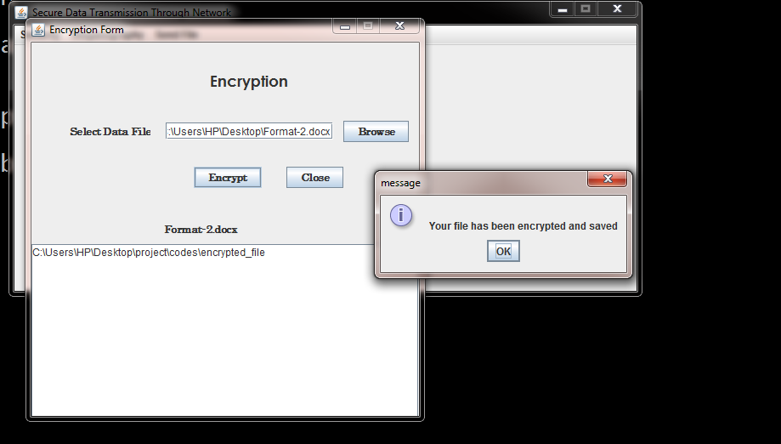
Save the Encrypted File:
Now click on the Encrypt button, It shows a message saying that your file has been encrypted and saved as shown in the following image.

Slide 27
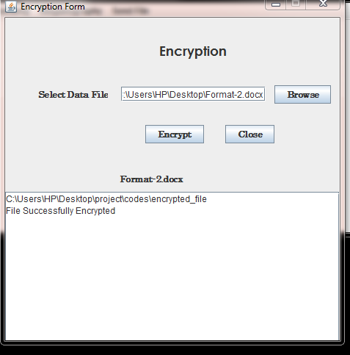
File Encrypted:
Now as shown in the image below, your file will be Encrypted .

Slide 28
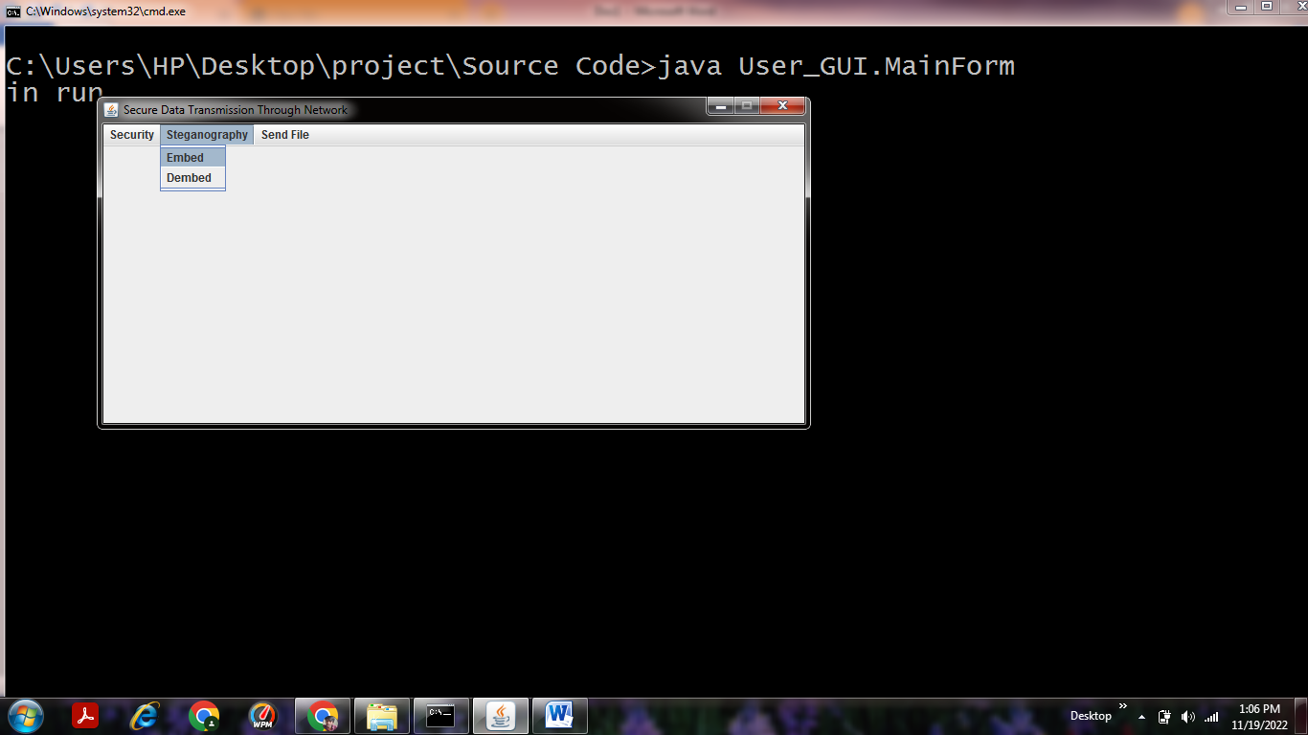
Embedding:
Now in the “Steganography” menu click on “Embed” option.

Slide 29
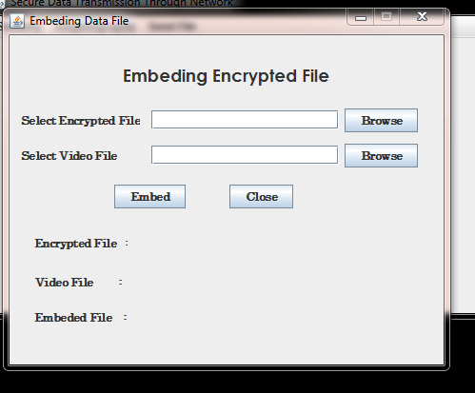
Now as shown in the image below select your Encrypted file from your device. And also select video file.

Slide 30
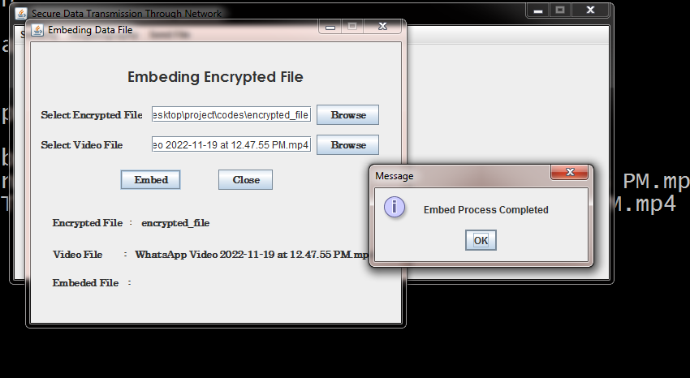
Now click on the “Embed” button to Embed your file, It displays a message that the Embed Process has been completed.

Slide 31

De-embedding:
Now to De-embed your file you have to select “Dembed” option.

Slide 32
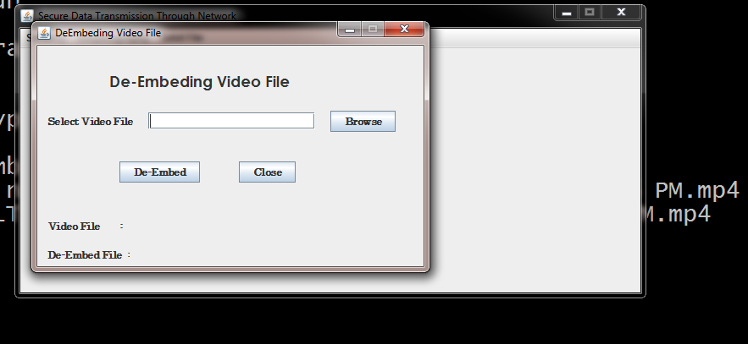
Now select the video which you have selected previously to encrypt your file.

Slide 33
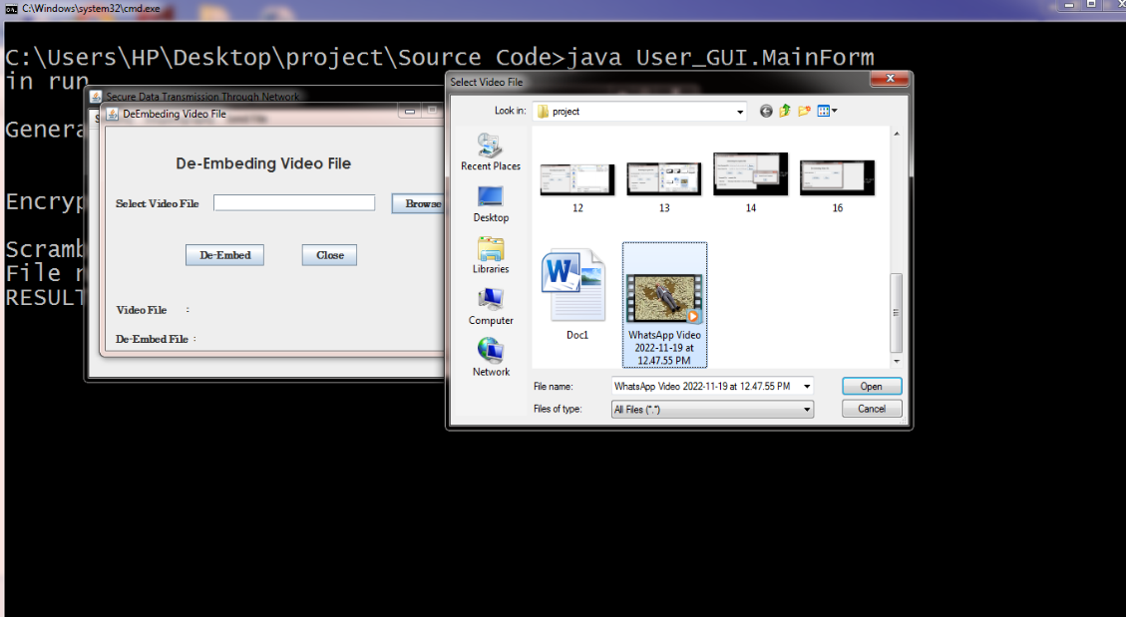
As shown in the image below select the Video file.

Slide 34
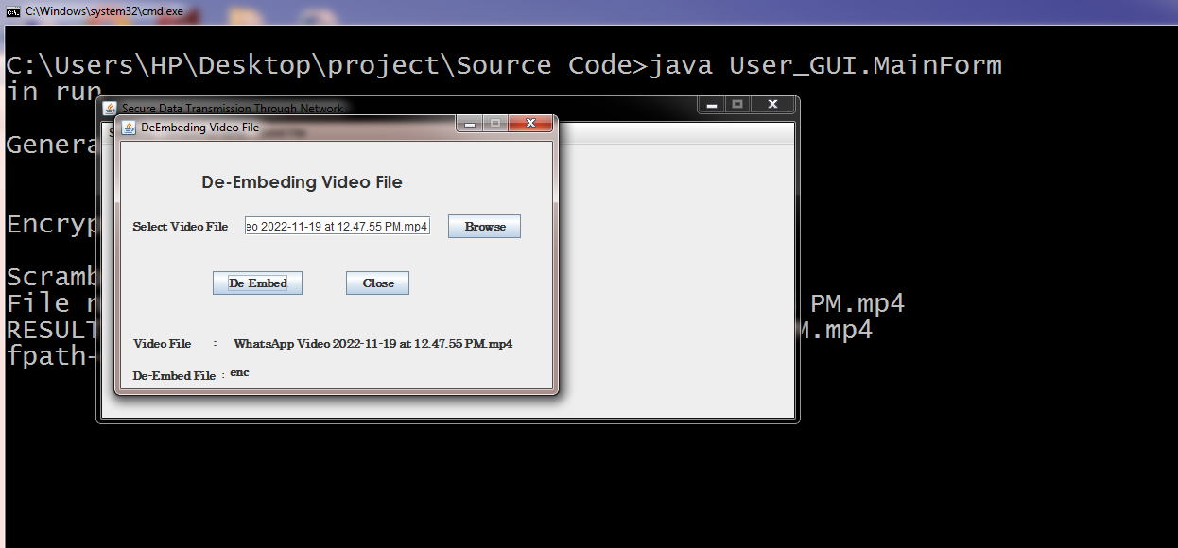
Now as shown in the image below you have to click on “De-Embed” after the video has been selected.

Slide 35
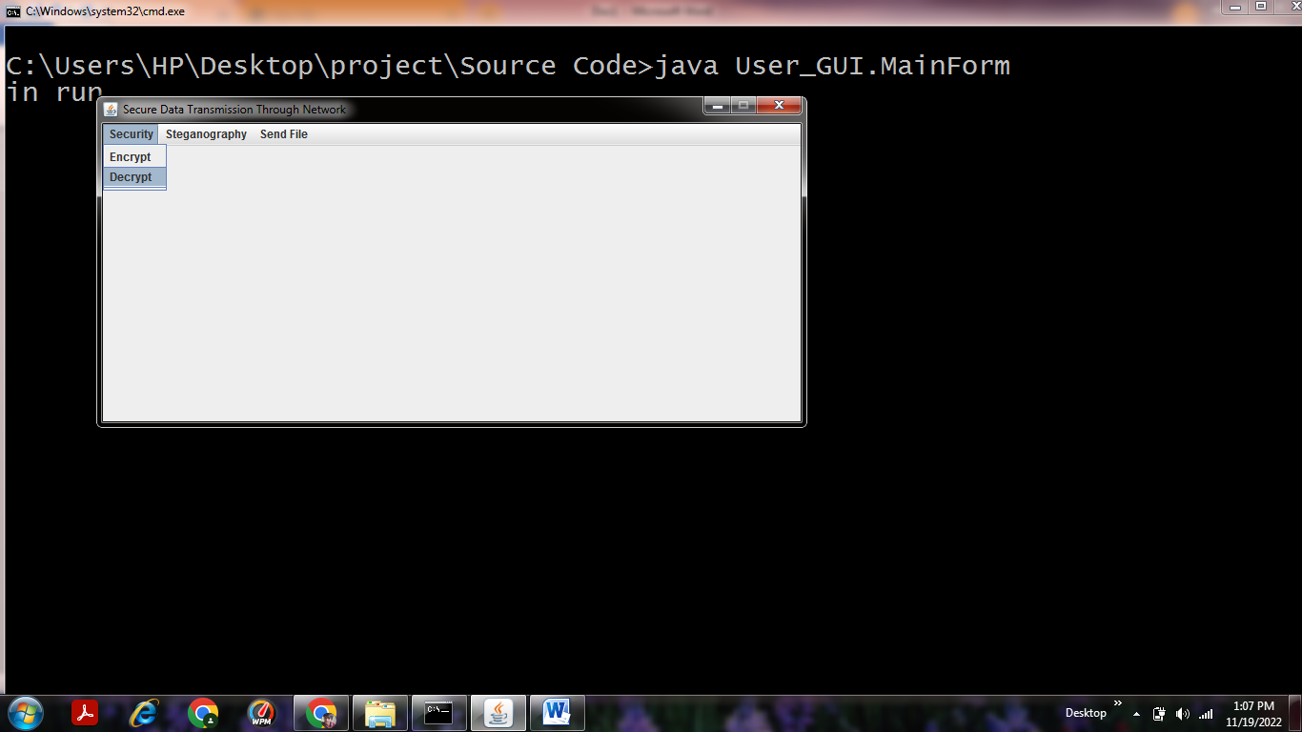
Decrypting:
Now you have to select the “Decrypt” option as shown in the image below.

Slide 36
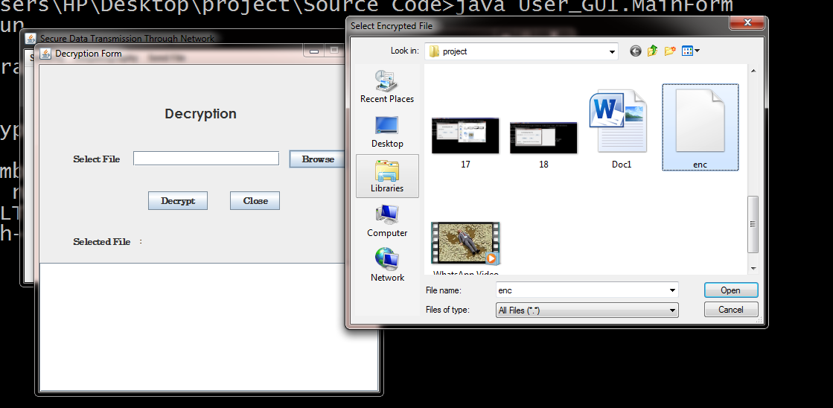
Now select the Encrypted file in your device which was Encrypted previously.

Slide 37
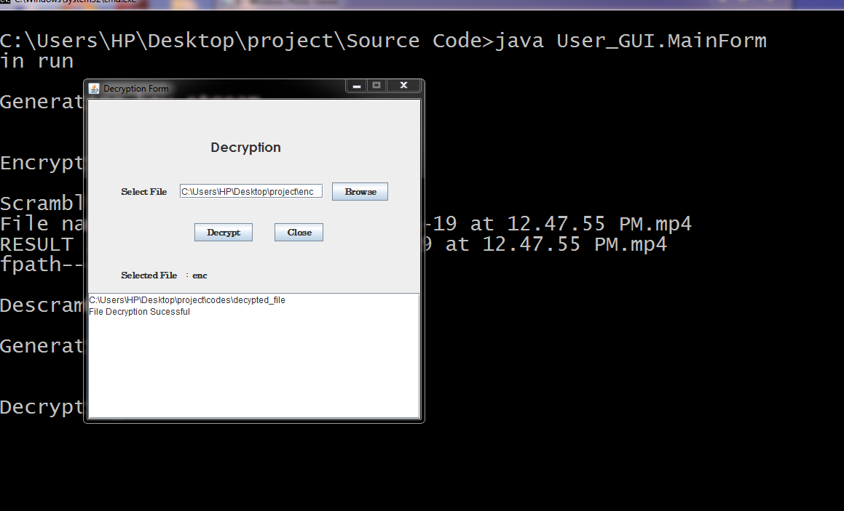
Now, When you have selected the Encypted file, click on the Decrypt option.
It would show your hidden file.

Slide 38
RESULT ANALYSIS
People for long time have tried to sort out the problems faced in the general digital communication system.
But as these problems exist even now, a secured and easy transfer system evolved and came to be known as the Encryption and Decryption of the data.
Converting the file to video format to be transferred using the cryptographic standards and Steganography.
The advantages of Video Steganography are: High level Security and Cost Effective Transfer.

Slide 39
ATTAINMENT OF OBJECTIVE
To provide high security for the valuable information.
The main objective of steganography is to hide a secret message inside harmless cover media in such a way that the secret message is not visible to the observer.
To abstract technique of getting secret data using decryption.

Slide 40
FUTURE SCOPE
There is a lot of scope for future work in the implementation, the functionality of the GUI is rather limited
This would also require a more structured backend, such as a database storing all important information about the feature files or possibly the features directly.
It would be interesting to see if an actual detector confirms the distance measurements we have found.
This detector can be an SVM or a simpler classifier such as an averaged perceptron.

Slide 41


