Slide 1
Burger Builder
Venkata Praneeth Mummaneni

Slide 2
Technology Stack
ReactJS
Redux
Google Firebase

Slide 3
Packages Used
Axios
React-router
React-redux

Slide 4
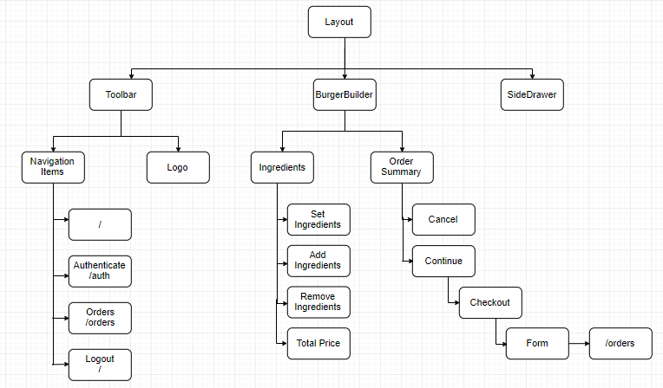

Slide 5
Demo
https://react-my-burger-4d77a.firebaseapp.com/

Slide 6
Any Questions?

Slide 7
Thank You

