Slide 1
Textual & Sentiment Analysis of Movie Reviews
GROUP -6
S.K.H.Praneeth Nooli
Yousef Fadila
Rahul Ghadge

Slide 2
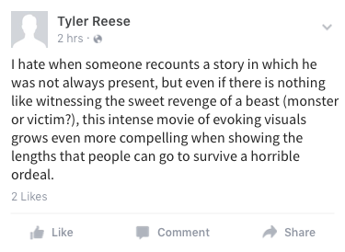
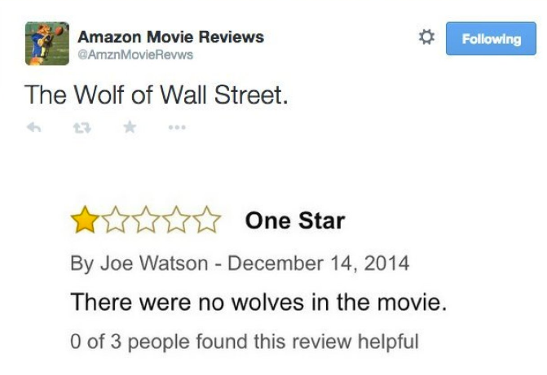
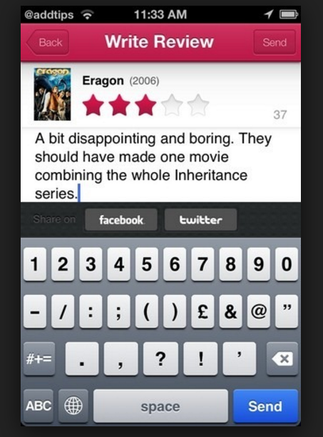
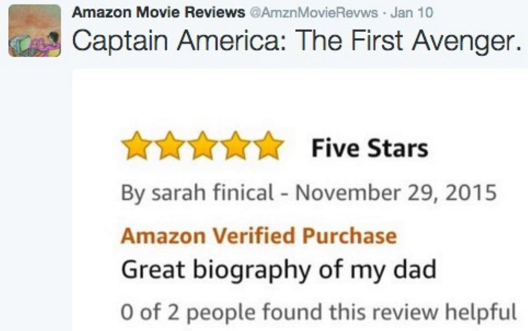
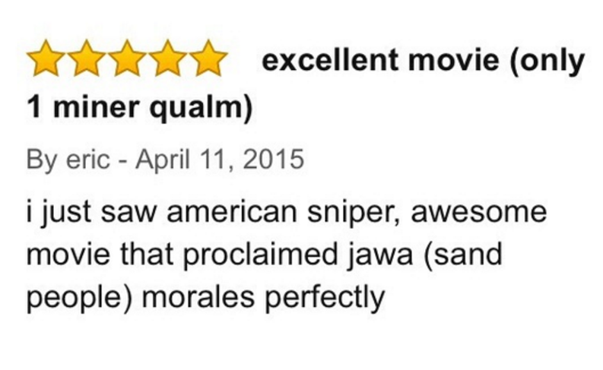
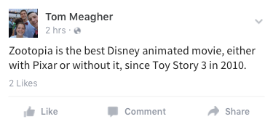
motivation

Slide 3
motivation
Movie Review- What do you think?
Definition- an article published in a newspaper or magazine that describes and evaluates a movie. Reviews are typically written by journalists giving their opinion of the movie.
For many of us, reviews are like one written by our friends on facebook, are important in making our decision to watch a movie.

Slide 4
motivation
Similarly, these reviews are available to movie production companies which helps them-
To understand sentiment and check the popularity of their films
To figure out new marketing strategies and future directions.
Human mind can read and understand whether a review is positive but for movie studios it is difficult to hire employees to simply read and judge movie opinions.
So here comes Machine Learning to rescue - to process, reliably extract and classify the sentiment of unstructured movie reviews.

Slide 5
Data
2k
Movie Reviews
1k
1k
positive
negative
Data downloaded from http://www.cs.cornell.edu/people/pabo/movie-review-data

Slide 6
Objectives
Preliminary Sentiment Analysis on Movie Reviews
Explore sci-kit – TfidfVectorizer Class
Machine Learning Algorithms
Finding the right plot

Slide 7
Preliminary Sentiment Analysis
Methodology
Randomly split movie reviews into 2 parts(75%-25%)
Build Vectorizer Classifier Pipeline (TfidfVectorizer)
Eliminate rare and most frequent tokens
Fit Linear Support Classifier with relatively high frequency
Determine grid search token set for text files
Words (1gram) or words and pairs (2 gram)
Perform Grid Search Cross Vaidation

Slide 8
Preliminary Sentiment Analysis
Grid Search CV scores
On training data, the linear SVC pipeline is more accurate when it considers both words and pairs of words.
ngram_range | score
(1 , 1) | 0.83
(1 , 2) | 0.84
Classification Report
Class | Precision | Recall | f1-score | Support
Negative | 0.85 | 0.86 | 0.86 | 251
Positive | 0.86 | 0.85 | 0.85 | 249
Notes:
The precision is the ratio tp / (tp + fp), recall is the ratio tp / (tp + fn), The F-beta score can be interpreted as a weighted harmonic mean of the precision and recall, The support is the number of occurrences of each class in y_true

Slide 9
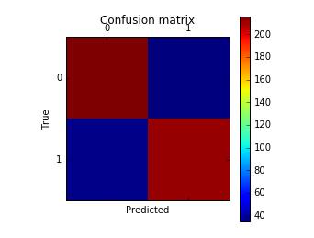

Preliminary Sentiment Analysis
Number of false negatives and false positives are both small compared to the number of true positives and negatives.
Model performed quite well on our test data set.
Test accuracy ~86%
Confusion matrix -- $\left[\begin{matrix}216 & 35 \\ 37 & 212\end{matrix}\right]$

Slide 10
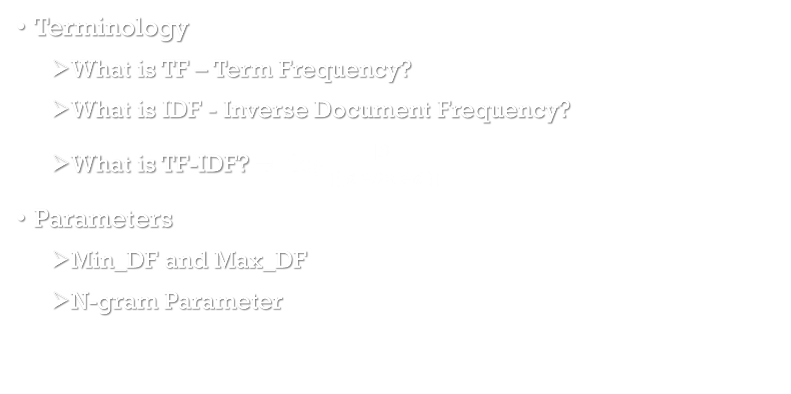
Explore sci-kit TfidfVectorizer Class
Terminology
What is TF – Term Frequency?
What is IDF - Inverse Document Frequency?
What is TF-IDF? → $\log{\frac{|D|}{|\left\{ d ∈D :t ∈d \right\}|}}$
Parameters
Min_DF and Max_DF
N-gram Parameter

Slide 11
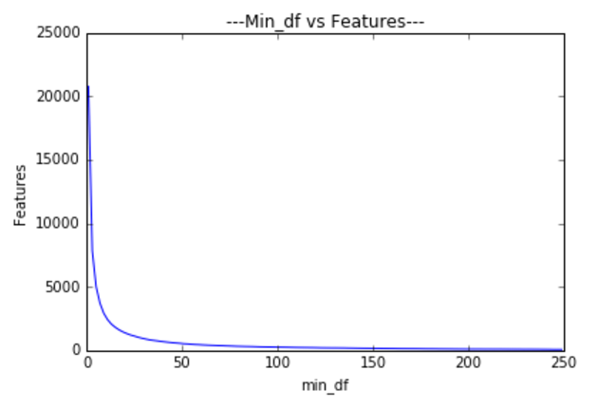
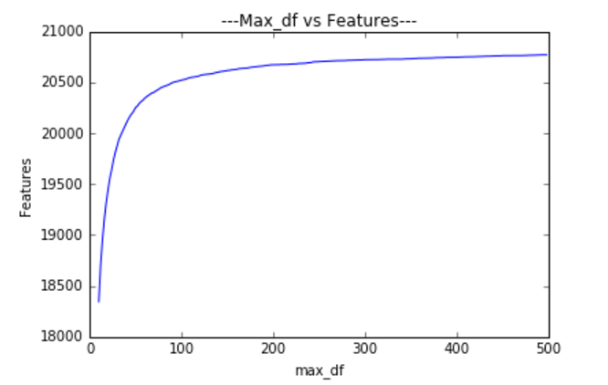
Explore sci-kit TfidfVectorizer Class
Min_df vs Features of TfidfVectorizer
Max_df vs Features of TfidfVectorizer

Slide 12
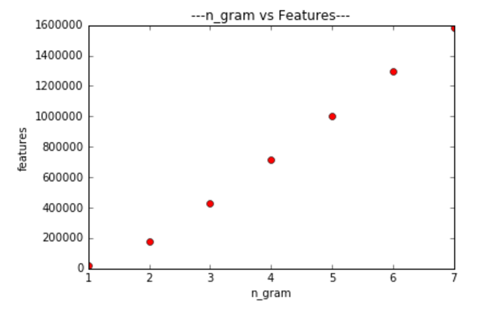
Explore sci-kit TfidfVectorizer Class
The number of features in the TdifVectorizer vocabulary increases linearly as n-gram is increased in ngram_range tuples of the form (1, n-gram).
ngram_range = (1,ngram)
vs.
Features of TfidVectorizer

Slide 13
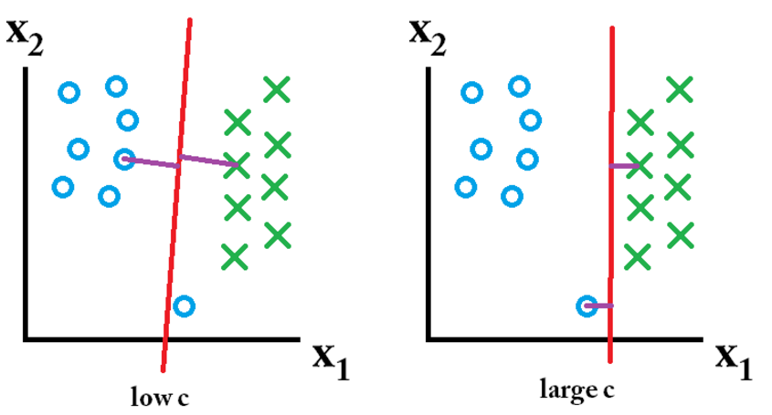
Machine Learning Algorithms
LINEAR SUPPORT VECTOR CLASSIFIER
penalty parameter ({0.01,0.1, 0.5, 1 ,10, 100})
Tolerance ({0.0001, 0.1, 1, 10}
Parameter C →
Notes:
The underlying C implementation uses a random number generator to select features when fitting the model. It is thus not uncommon to have slightly different results for the same input data. If that happens, try with a smaller tolparameter.
In a SVM you are searching for two things: a hyperplane with the largest minimum margin, and a hyperplane that correctly separates as many instances as possible. The problem is that you will not always be able to get both things.

Slide 14
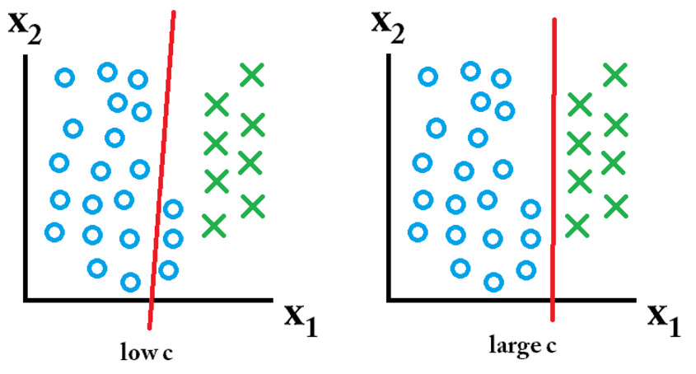
Machine Learning Algorithms

Slide 15
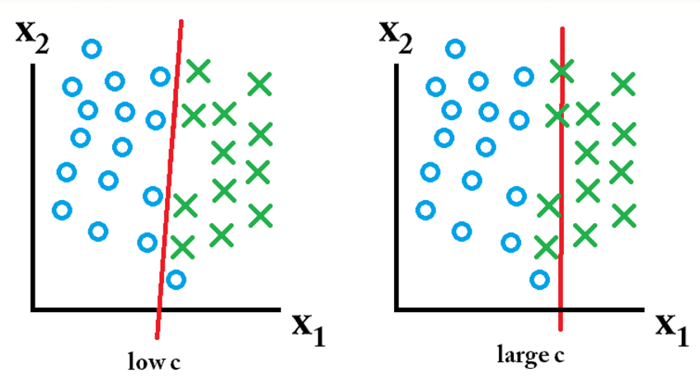
Machine Learning Algorithms

Slide 16
Machine Learning Algorithms
C | Tolerance | Mean_test_score
0.01 | 0.0001 | 0.61
0.01 | 0.01 | 0.61
0.01 | 1 | 0.51
0.01 | 10 | 0.59
0.1 | 0.0001 | 0.81
0.1 | 0.01 | 0.81
0.1 | 1 | 0.81
0.1 | 10 | 0.55
0.5 | 0.0001 | 0.83
1 | 0.0001 | 0.83
10 | 0.0001 | 0.83
100 | 0.0001 | 0.84

Slide 17
Machine Learning Algorithms
K-Nearest Neighbors
neighbor parameter, k({1, 2, 3, 4, 5, 6, 7})
Power parameter for the Minkowski metric, P ({ 1, 2})

Slide 18
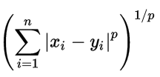
Machine Learning Algorithms
The Minkowski distance of order p between two points
is defined as:
P = 1 corresponds to Manhattan or Rectilinear distance and
P = 2 corresponds to Euclidian distance
Notes:
Manhattan distance is the sum of the absolute differences of their Cartesian coordinates

Slide 19
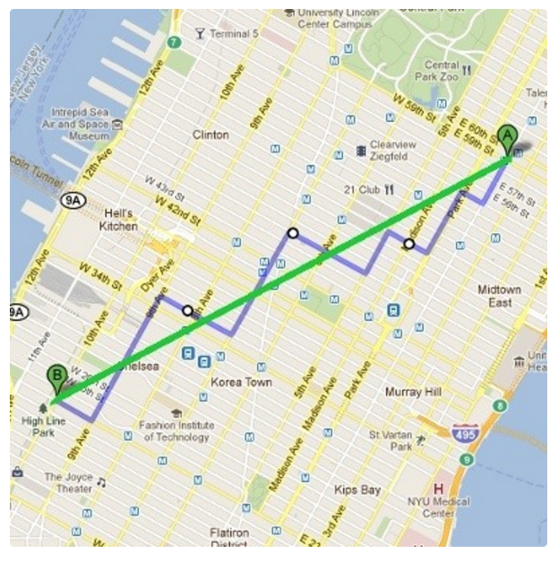
Machine Learning Algorithms
Illustration of Euclidean VS Manhattan distance

Slide 20
Machine Learning Algorithms
K | P | Mean_test_score
1 | 1 | 0.50
1 | 2 | 0.66
2 | 1 | 0.50
2 | 2 | 0.65
3 | 1 | 0.51
3 | 2 | 0.67
4 | 1 | 0.52
4 | 2 | 0.67
5 | 1 | 0.50
5 | 2 | 0.65
6 | 1 | 0.52
6 | 2 | 0.67
7 | 1 | 0.52
7 | 2 | 0.66

Slide 21
Machine Learning Algorithms
Testing Set: neg = 255 pos = 245 | Unique Parameter Set |  | Best Score | Confusion Matrix of Testing Set
Linear SVC | C | Tolerance | 0.84 | [[221 24] [ 27 228]]
 | 100 | 0.0001
KNeighbors Classifier | n_neighbors | Power | 0.693 | [[168 80] [ 92 160]]
 | 4 | 2 (Euclidian)

Slide 22
Machine Learning Algorithms
Finding False Positive (Actual Value is -ve, Predicted Value is +ve)
“i read the new yorker magazine and i enjoy some of their really in-depth articles about some incident frequently i get the feeling that the article sounded exciting for even so good an actor as plummer to play him convincingly have been enthralling”

Slide 23
Machine Learning Algorithms
Finding False Negative(Actual Value is +ve, Predicted Value is -ve)
“When king is screwed out of his title by a corrupt promoter, gordie and sean take it upon themselves to find their fallen hero and restore his glory. The hook of the movie is that gordie and sean are just too stupid to realize that. none casting complaint however : rose mcgowan as a sexy dancer ? ”

Slide 24
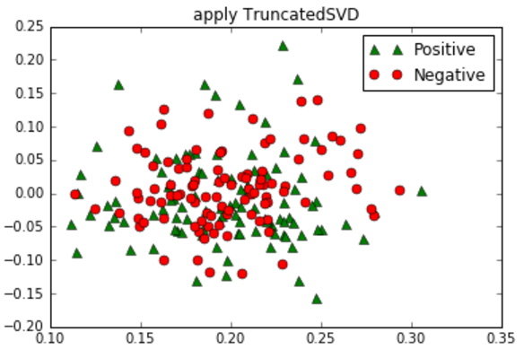
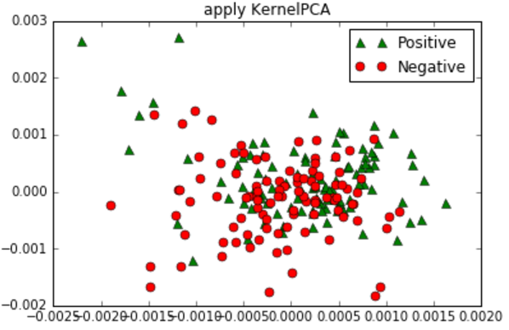
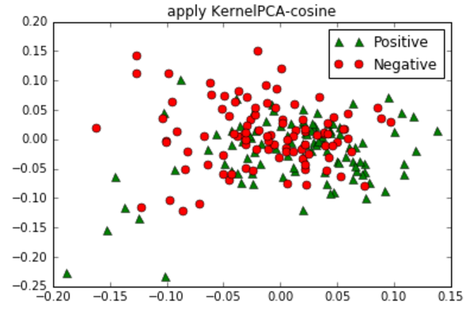
Finding the right plot
Truncated SVD
Default Linear
Polynomial Kernal
Cosine Kernel
Notes:
truncated SVD does not center the data before computing the singular value decomposition. It works on term count/tf-idf matrices as returned by the vectorizers in sklearn.feature_extraction.text. In that context, it is known as latent semantic analysis (LSA)

Slide 25
Finding the right plot
Features-
No. of characters i.e. Length of a review
Count of Question marks “?”
Positive and Negative word patterns (regular expressions) which are not preceded by “not”
Positive – good, awesome, appealing, exciting etc.
Negative- ?, bad, awful, frustrating etc.
Difference between ratio of positive words and negative words
Positive Ratio = Count of occurrence of positive words in a review / Length of review
Negative Ratio = Count of occurrence of negative words in a review / Length of review
Positive Ratio - Negative Ratio

Slide 26
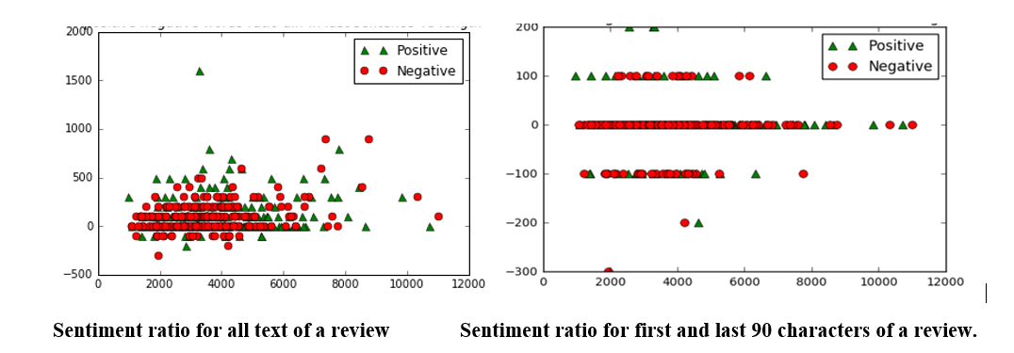
Finding the right plot
Conclusion- we need to identify more features which would help in clearly distinguishing positive and negative review in each of those clusters for which we may have some common feature or different set features per cluster.

Slide 27
Business intelligence &
Decision Making
By understanding sentiments after the analysis identify popularity of films
Use this information in implanting new marketing strategies and future movie directions and productions.

Slide 28



