Slide 1
Case Study -4 Spot-It Detecting fake reviews Group#6
Yousef Fadila
Rahul Ghadge
Praneeth Nooli

Slide 2
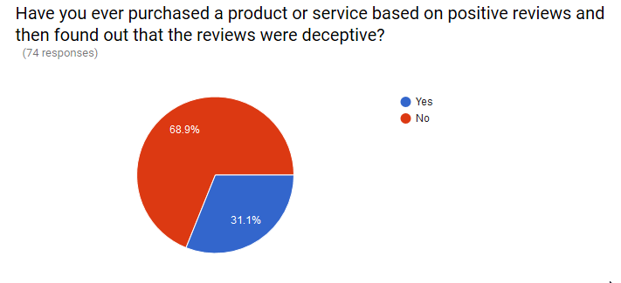
The Problem
Use of survey (google form) to know the problem
More than 30% of people experienced the problem.

Slide 3
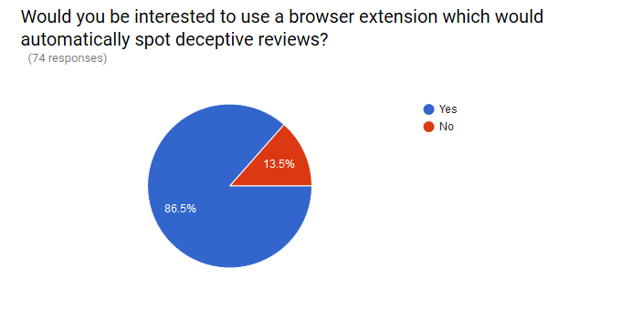
Motivation
Use of survey (google form) to know how much people would be interested.
More than 86% people are interested to have a solution i.e. Spot-It browser extension

Slide 4
Proposed Business Case
Spot-It browser extension
To classify and flag genuine and fake reviews displayed on the page.
In our implementation, as 1st phase we will build 2 models.
General model that gives real/fake categorical identifier based on content and features extracted from the content. As 1st phase, The model will be trainied using restaurant reviews data only. In addition, the model will be deployed and exposed to public using REST API.
Specific model, This model uses anomaly detection method to develop a model to detect the “outlier” reviews based on user/business metadata as first step, then use the general model to refine the solution and reduce false positive errors. I.e. fake positive reviews.

Slide 5
Idea of detecting fake reviews
Quote from Cornell University’s research paper→
"Truth-tellers and deceivers differ in the use of keywords referring to human behavior and personal life, and sometimes in features like the amount of punctuation or frequency of "large words." In parallel with previous analysis of imaginative vs informative writing, deceivers use more verbs and truth-tellers use more nouns."
Features extracted from the test→
mount of punctuation
total verbs - total nouns
length of the review.

Slide 6
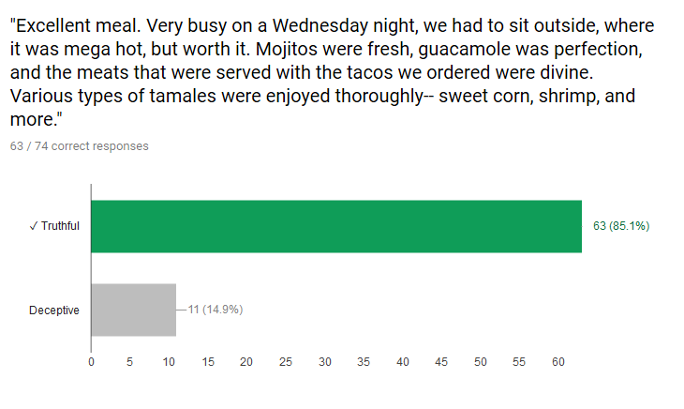
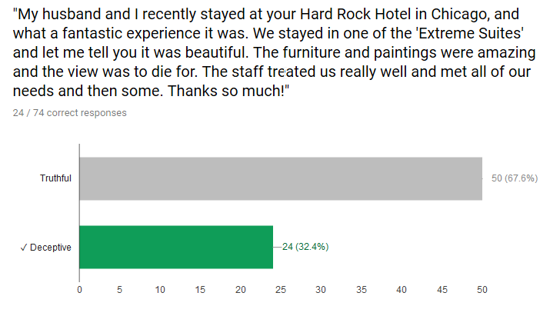
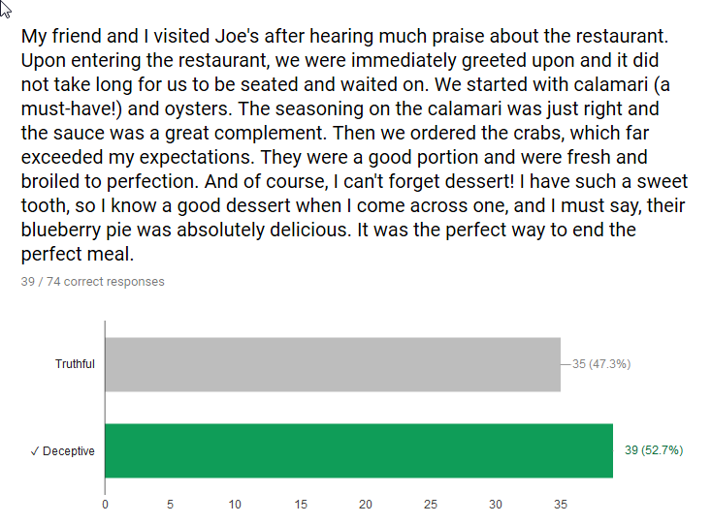
Data Collection
Review’s Dataset
Deceptive reviews Dataset – Cornell
Yelp Dataset – out of 2 Million reviews only restaurant related reviews were considered for the prototype model
Check if people can identify fake/genuine reviews through a survey
Easy to identify genuine positive reviews (top) than identifying fake positive reviews (below)

Slide 7

Approach
Train linear - support vector machine using
Features from text classifiers – ngram(1,3)
Features which differentiates informative and imaginative writing
Ratio of verbs, nouns and punctuations
Linear support vector machine learns
Weight vector –W
Bias term – B
2 step Math approach
Anomaly Detection – using Elliptic Envelope algorithm with yelp dataset
Text based classification - using cornell deceptive reviews dataset

Slide 8
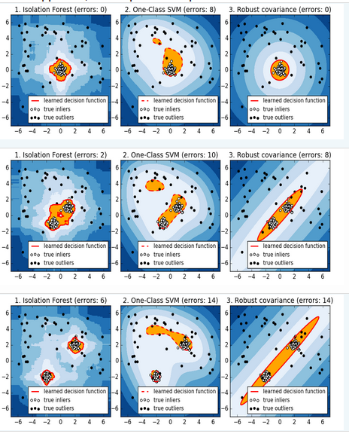
Step1 - Anomaly Detection
Elliptic Envelope Algorithm
It is different from -
Isolation Forrest Algorithm
One Class SVM Algorithm
Features used
user_review_count
user_average_stars
user_friends_count
business_rate
business_review count
Data used - Yelp reviews of restaurant buisness.

Slide 9

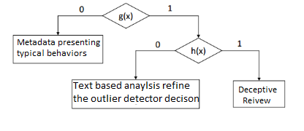
Step2 - Text Classifier
g(x) → anomaly detection function
h(x) → outlier detector - text classifier function
Features used
amount of punctuation
total verbs - total nouns
length of the review
Flow→ So a given review will be classified as a deceptive one if it has been detected as an outlier by the anomaly detector and then classified as a deceptive review by the text classifier.

Slide 10
SPOT-IT Detectors
Based on this idea we built two types of detectors.
→ An offline detector which detects the fake reviews based on the above mentioned 2 step approach from Yelp offline database json files
→ An online real time detector which takes the reviews from Yelp website given the business Id with the help of Yelp API and classifies the review based on the 2 step approach.

Slide 11
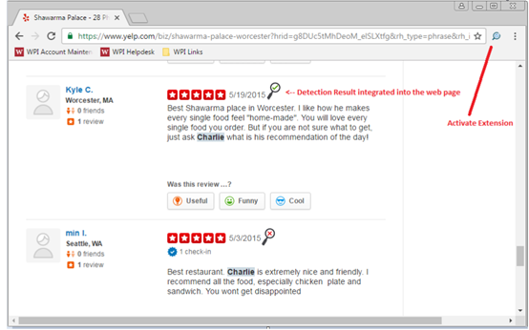
SPOT-IT Browser extension

Slide 12
Conclusion
A Novel approach that could be used by end-users using browser extension our integrated on enterprises back-end.
Could be easily tuned to different applications such as detecting fake news and rumors in the social media.

Slide 13


Thank you…

