Slide 1
SPOT-IT
Flag Deceptive Reviews
Group#6
Yousef Fadila - Rahul Ghadge - Praneeth nooli

Slide 2
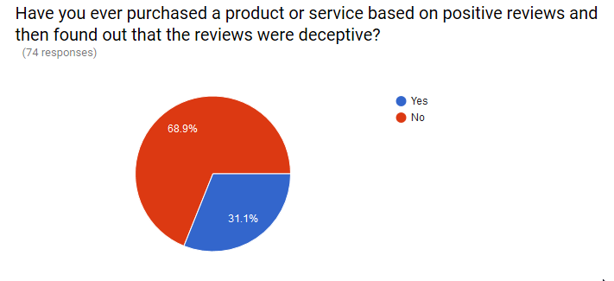
The Problem
WPI Survey:
Fake Reviews in the news:
Fake Reviews in the news!
Samsung probed in Taiwan over 'fake web reviews',
Woman Paid To Post Five-Star Google Feedback,
Are You Buying Reviews For Google Places?,
The Best Book Reviews Money Can Buy,
For $2 a Star, an Online Retailer Gets 5-Star Product Reviews,

Slide 3

The Future BASED ON TRUST
The fast growing market of peer-to-peer sharing capacity is based on reviews’ honesty.

Slide 4
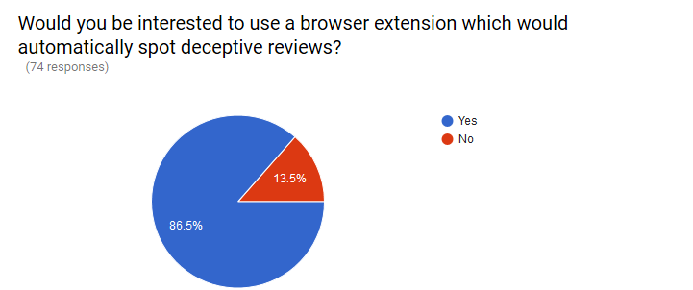
The Solution: SPOT-IT
Deployment-ready solution to automatically spot deceptive reviews.
86.5% of the responder find it valuable to have automatic deceptive reviews spotter.

Slide 5
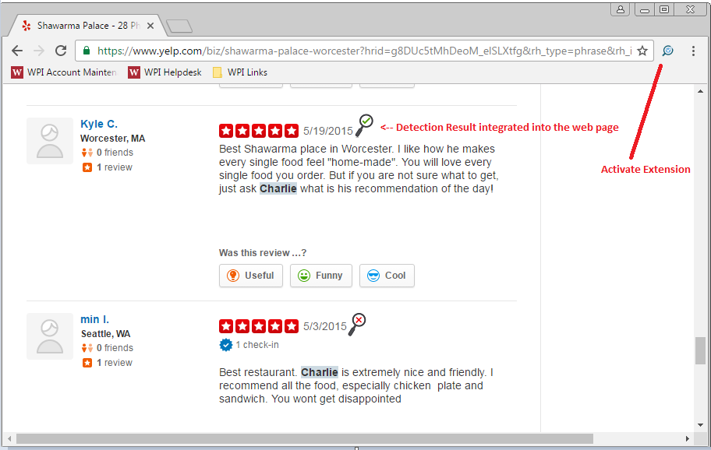
Using Spot-It

Slide 6
Applications And Deployment
A Novel approach that could be used by end-users using browser extension our integrated on enterprises back-end.
Could be easily tuned to different applications such as detecting fake news and rumors in the social media.

