Slide 1
GRAPHICAL PASS
Protect sensitive information from hackers by implementing robust security measures to ensure data integrity and confidentiality.

Slide 2
Why don’t we use ALPHANUMERICS. ?
Hackers use automated tools to systematically try various combinations of words, numbers, and characters to crack passwords.
It lacks complexity and can be vulnerable to various hacking techniques, such as brute force attacks.
Repetitive characters reduce the entropy randomness of the password, making it easier for hackers to guess or crack.
Alphanumeric passwords can be more complex and challenging to remember.

Slide 3
Why Pictorial Password . ?
As an image has many pixels it become extremely challenging for hackers to accurately predict the exact locations.
Random brute-force methods are ineffective in cracking spots.
Enhance the security measures applied to safeguard sensitive information.
Can be utilized to securely store sensitive information, including financial data, identification details and more.

Slide 4
Demo of usage:

Slide 5
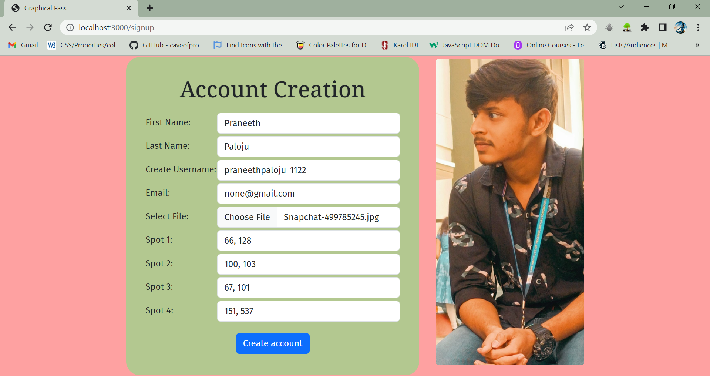
CREATE AN ACCOUNT TO BEGIN:

Slide 6
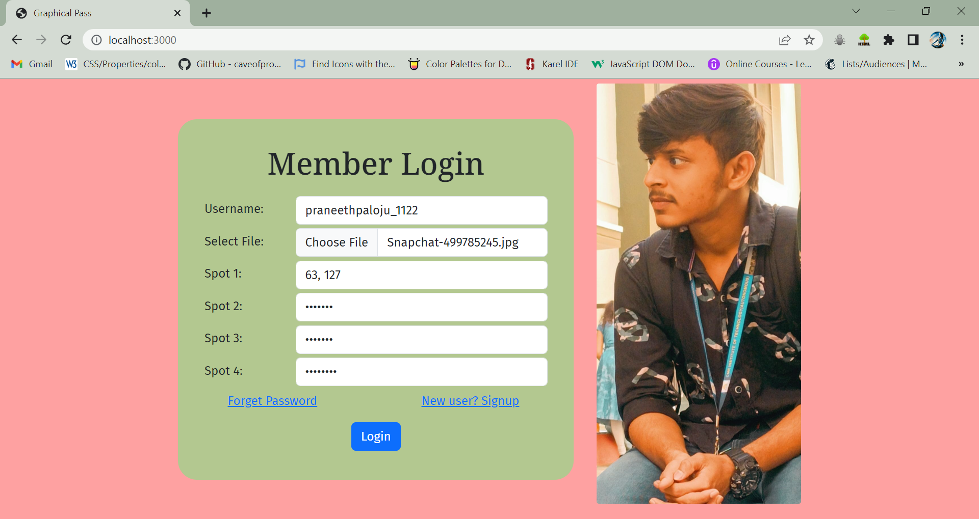
LOGIN TO USE:

Slide 7
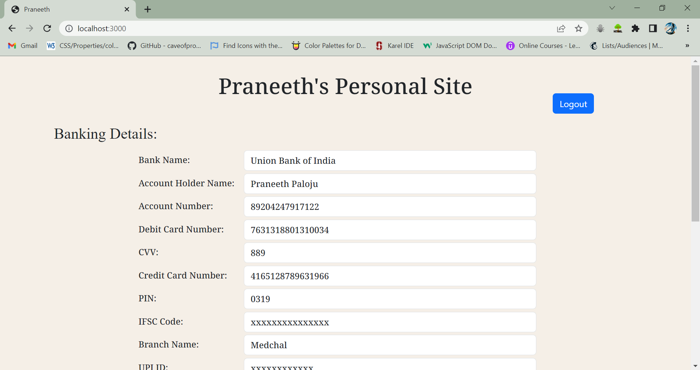
YOUR PERSONAL SITE:

Slide 8
LOGOUT ONCE DONE..

Slide 9
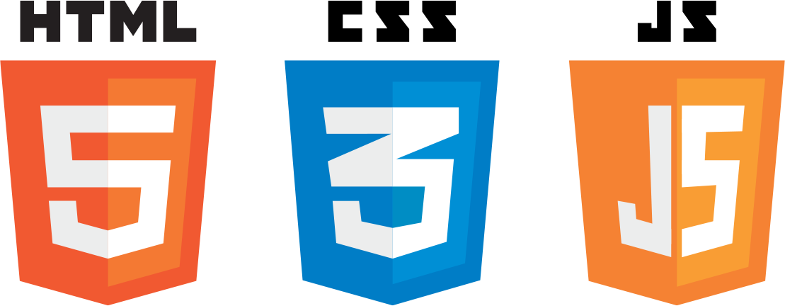


What we used to do this. ?
FRONTEND:
HTML
CSS
BOOTSTRAP FRAMEWORK
JAVASCRIPT
BACKEND:
NODEJS

Slide 10
Thank you.
Done By:
Praneeth Paloju
Jahnavi
Saicharan
Pasha Hussain

