Slide 1
13th INTERNATIONAL CONFERENCE ON COMPUTING, COMMUNICATION AND NETWORKING TECHNOLOGIES (ICCCNT)
Paper Title : RL2NdgsNet: Reinforcement learning based efficient classifier for mediastinal lymph nodes malignancy detection in CT images
Authors information:
Author | Designation | Affiliation
Posina Praneeth | Student | Dept. of Electronics & Communication, KL University, Hyderabad
Abothula Dhana Lakshmi | Student | Dept. of Electronics & Communication, KL University, Hyderabad
Dr. Hitesh Tekchandani | Professor | Dept. of Electronics & Communication, KL University, Hyderabad
Dr. Shrish Verma | Professor | Dept. of Electronics & Communication, National Institute of Technology, Raipur, Chhattisgarh, India.
Dr. Narendra D. Londhe | Associate Professor | Dept. of Electrical Engineering, , National Institute of Technology, Raipur, Chhattisgarh, India.

Slide 2
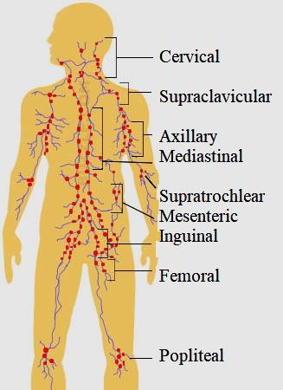
Introduction
The lymphatic system is a large network of tissues and organs like lymphatic vessels, lymph nodes (LNs), and lymphoid tissues that help to clean and remove toxins, waste, and other unwanted materials from the human body.
Cancer is life-threatening due to its metastasis nature. The spreading of tumor cells from the primary organ to other organs is called cancer metastasis.
LNs are often the first organs in which metastases form. Tumor cells uses LNs as a medium for metastasis.
In current oncological practice diagnosis of LNs in benign and malignant categories is done by invasive procedures like biopsy and fine needle aspiration cytology (FNAC).
These invasive procedures having limitations of pain, risk associate with anesthesia, nerve or vessel injury, cost, time consuming, hospital stay, and complexity due to their complicated anatomical location.
Medical imaging (like X-ray, USG, CT, and MRI) based diagnosis approaches are non-invasive and painless procedures for the cancer detection. Computed tomography (CT) is easily available, cost effective and popularly used radiological modality for cancer detection.
But manual inspection of medical images are time consuming, fatigue, and requires highly expert knowledge.
LNs in Human Body

Slide 3
Related Work
But manual inspection of medical images are time consuming, fatigue, and requires highly expert knowledge.
To overcome these shortcomings, many researchers have developed image processing based algorithms for automated detection of malignancy in MLNs.
These algorithms can be grouped into size based, CT texture feature based, and radiomics feature based approaches.
These algorithms needs huge manual feature selection and their calculation and hence limits their performances and uses in standard clinical practices.
Deep Learning (DL) based networks are revolutionizing the entire technology industry and putting a similar influence on medical imaging related tasks like lesion detection and diagnosis as well. Few researchers applied DL for the same in-tended task of malignancy detection in MLNs.

Slide 4
Reinforcement Learning
Reinforcement learning is the state-of-the-art Deep Learning approach that involve learning of mapping situations to actions for maximizing the rewards. Based on these rewards next actions are decided.
In this work we have proposed reinforcement learning based deep learning network named – RL2NdgsNet (reinforcement learning based lymph nodes diagnosis network), for diagnosis of mediastinal lymph nodes (MLNs) in benign and malignant categories.

Slide 5
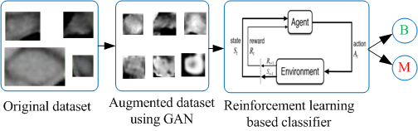
Workflow of the proposed approach
As the DL approaches are data driven techniques and the size of the available dataset is small, hence to populate the dataset the authors have utilized generative adversarial network (GAN) based data augmentation approach. The work-flow of the proposed methodology is shown below in figure
Workflow of the proposed approach. B = Benign, M = Malignant.

Slide 6
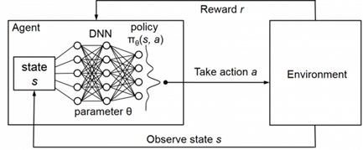
Methodology
The Q-Learning algorithm involves learning a Q-table ('Q' is referred for quality) including the expected future reward for each state and action.
The agent uses the Q-table to make the best decision for each state by selecting the action that maximizes the expected future rewards.
The limitation of Q learning is that it becomes inefficient for complicated environments with multiple possibilities and outcomes.
Deep RL solves this problem by merging the Q learning approach with deep learning models.
The basis of deep Q-learning is the training of a neural network for estimating the various Q values for each action given a state. From this training the optimal Q values and network parameters will be learned.
In the proposed approach we are using Deep Q Networks (DQN) which helps in effective prediction of Q values for the proposed task.
Workflow of the DQN based RL algorithm.

Slide 7
Deep Q-Network
The DQN architecture contains two neural networks, namely Q network and the Target (T) network, and also an Experience Replay component.
The Q network is the agent that is trained to generate the optimal state-action value.
The architecture of these networks is the same, but the weights are different. The weights from the Q net-work are replicated to the target network for every N steps.
Using both these networks, the learning process becomes more stable, and the algorithm learns more effectively
Experience Replay feature was introduced to make network updates more stable. The transitions are added to the replay buffer (training data) at each time step of data collection.
Epsilon greedy strategy is used to achieve the balance between exploitation and exploration.
This exploration rate represents the likelihood that our agent will explore rather than exploit the environment.

Slide 8
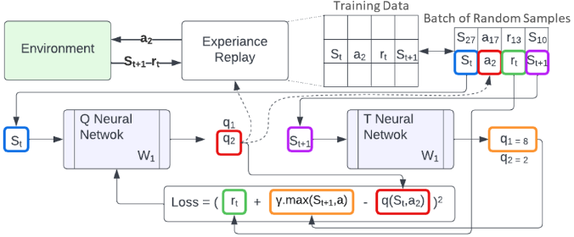
Experience replay chooses an ε-greedy action (benign or malignant) for the current image state, executes it in the environment, and returns a reward.
This observation is saved as a sample of training data. To generate a training sample.
We now select a random batch of samples from this training data, ensuring that it includes both older and newer samples. The training data from this batch is then sent into the Q net-work.
The Q network predicts the Q value based on the current image state and action in each data sample. The T network is not functional in our algorithm. Since every state is a terminal state, there are no input and output values for the T network. As a result the max Q value for next state is assumed to be zero.
To train the Q network, the Loss is computed using the predicted Q Value and Target Q Value from the data sample.
𝐿=(𝑟𝑡+ 𝛾.𝑄(𝑆𝑡+1,𝑎)−𝑄(𝑆𝑡,𝑎𝑡))2
Where, 𝐿 is Loss, 𝑟𝑡+ 𝛾.𝑄(𝑆𝑡+1,𝑎) is target Q value and 𝑄(𝑆𝑡,𝑎𝑡) is predicted Q value.
Workflow of DQN

Slide 9
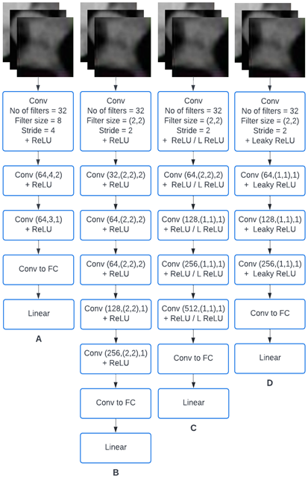
CNN Policy
CNN policy is a DQN implementation policy class. In this paper we are using the Stable baselines library to get the CNN Policy for efficient training of the agent.
A cnn_extractor attribute for feature extraction of the input scaled images is present in the CNN policy function.
To have more flexibility over the network architecture, in this paper we have proposed a custom CNN Policy.
In this custom CNN policy a modified cnn_extractor architecture is utilized which expects scaled images as input tensor.
This architecture will return a linear tensor from which features are extracted. The network architecture of our proposed custom CNN policy is depicted in Fig. 4(D).

Slide 10
Experimental setup
The Gym framework is utilized for evaluating the proposed RL2NdgsNet.
The gym library consists the collection of various test problem environments. A gym environment is helpful in creating or developing the problem environment and defining actions.
The initial state of the RL problem is defined by describing the type and shape of our action_space. We set this to Discrete - 2 since we have two classes of legitimate actions, benign and malignant.
Similarly, observation space has been defined, which contains all of the data in the environment that the agent will observe.
Since we are working with the images it is set as Box(0,255,[height,width,1]) for greyscale pixels.
Later the agent's rewards are calculated, for a correct label prediction, the agent receives one point.

Slide 11
Dataset details
For the proposed study, MLNs dataset is taken from “Texture Analysis and Synthesis of Malignant and Benign Mediastinal Lymph Nodes in Patients with Lung Cancer on Computed Tomography” paper by Pham et al.
In this dataset there are total 271 MLNs CT images in which 138 are benign and 133 are malignant.
To significantly increase the dataset, the GAN based augmentation approach was utilized
After augmentation there are total 6000 images available for experimentation in which 3000 are benign and 3000 are malignant.
The size of images of base dataset varies from 16x24 to 122x112 hence before feeding to GAN networks they are resized to 50x50.

Slide 12
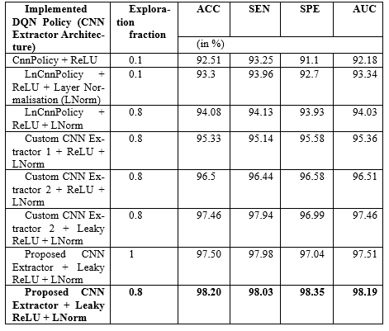
Results
Table 1. Performance evaluation parameters of all the proposed DQN policy models.
All the simulations were performed on the Google Colab platform using Keras DL and Stable-baselines RL library.
The results of all the proposed and implemented models are summarized in Table 1.
The proposed CNN extractor architecture approach achieves ACC = 98.2%, SEN = 98.03%, SPE = 98.35% and AUC = 98.19%.
It’s observable from Table 1 that, the proposed method-ology achieves improvement of 5.69% in ACC, 4.78% in SEN, 7.25% in SPE, and 6.01% in AUC compared to basic CnnPolicy.

Slide 13
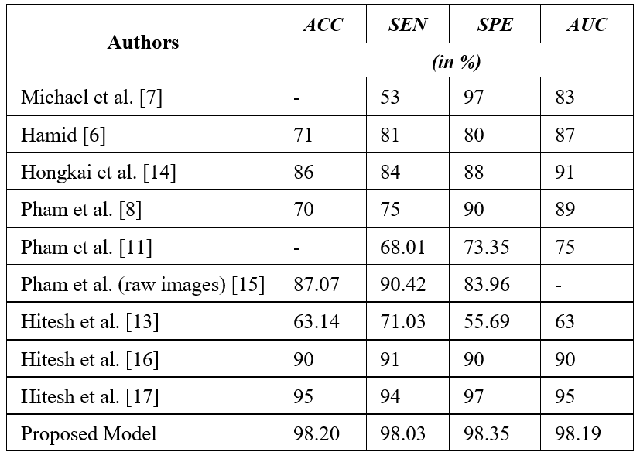
Results
Table 2. Performance metrics obtained from related works.
Table 2 represents the performance metrics obtained from related works.
It’s noticeable from Table 2 that the proposed approach attaints improvement of 3.20% in ACC, 4.03% in SEN, 1.35% in SPE, and 3.19% in AUC.

Slide 14
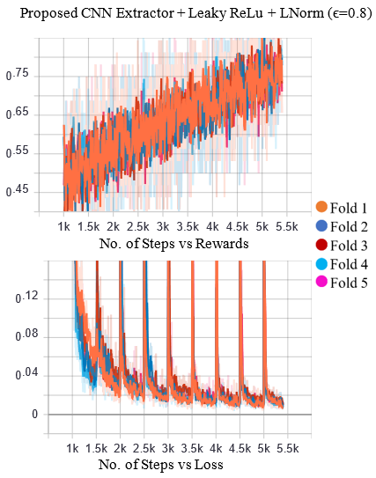
These graphs shows the time steps (represents 5400 training images) versus reward and loss curve while performing the training for Proposed CNN Extractor + Leaky ReLu + Lnorm (ϵ=0.8) with respect to 5-fold validation.
The first 1000 steps of the model are used to generate samples for the replay buffer. Upon reaching 1000 steps, learning begins. Hence, we find the curves starting from the 1k mark.
The model gradually starts learning from there. The spikes at regular intervals in the loss curve are due to the replication of weights from the Q network to the T network for every 500 steps.
The continuous increase in reward and decrease in loss values suggest the increase in performance by the model.
The number of steps versus reward and loss curve of Proposed CNN Extractor + Leaky ReLu + Lnorm (ϵ=0.8).

Slide 15
Conclusion and Future Scope
In this paper the RL based DL architecture named RL2NdgsNet is proposed for classification of benign and malignant MLNs in CT images.
The achieved results signifies the utility of the proposed modification in policy network helps in improvement of performance.
The utilised GAN based augmentation approach solves the data scarcity problem.
The wise selection of augmentation methods and their amalgamation surely leads to deeper and successful learning of networks.
The optimized selection of activation function and exploration fraction improves the performance of proposed RL2NdgsNet.
The results comparison with state-of-the-art related works validates the significance of the proposed approach.
The proposed work limited to severity assessment of LNs only, but may be nearby organs are also at risk.
Hence, in future work, generalizable RL will be explored for more utility and applications of RL in healthcare.

Slide 16
Thank You

