Slide 1
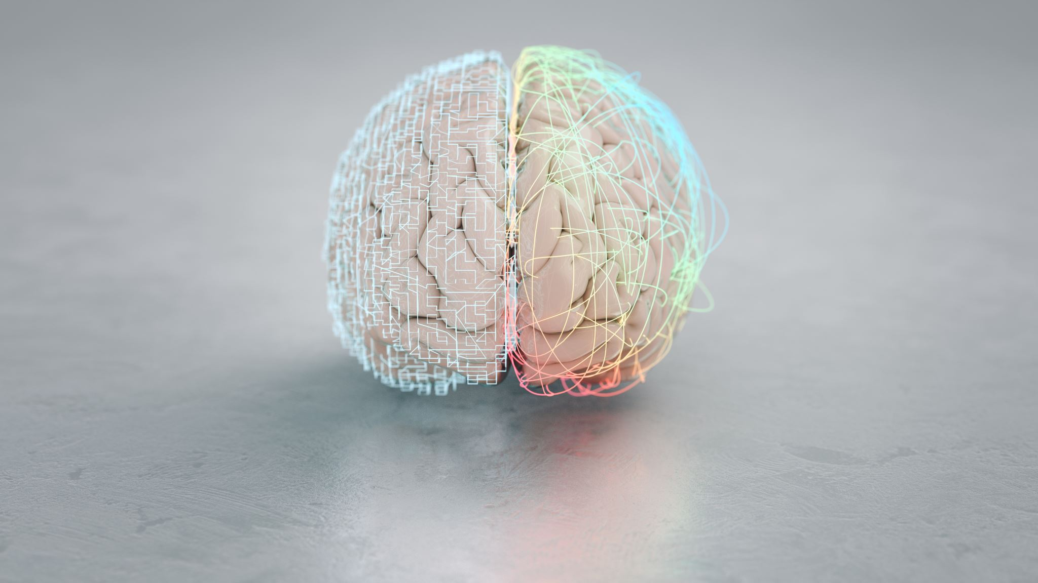
Text Generation AI
PLS Praneeth (190340065)
V Sai Kalyan (190340090)
P Hruday Sathya (190340062)

Slide 2

INTRODUCTION
Natural Language Processing (NLP) is a growing field that aims to enable computers to understand and generate human language
Text generation AI has potential to revolutionize industries, including creative writing and customer service
Project aims to develop a model that can generate high-quality stories, utilizing Classic Literature in ASCII dataset and various transformer techniques.

Slide 3
LITRATURE SURVEY
Markov models were one of the earliest approaches to text generation, but their effectiveness in capturing long-term dependencies is limited.
Deep learning-based models, such as RNNs and Transformers, have shown great promise in generating high-quality text, with Transformers leveraging the attention mechanism to capture long-term dependencies.
Recent studies have proposed novel text generation models, such as GPT-RNN, that combine the advantages of both RNNs and Transformers to generate high-quality text.
Text generation has been applied to various domains, including storytelling, which requires a deep understanding of language and narrative structure.
In the following sections, we will explore the different approaches and techniques used for text generation and their applications in storytelling.

Slide 4
DATASET & PREPROCESSING
The dataset used in this project is the Classic Literature in ASCII dataset.
The dataset consists of a diverse range of genres, including fiction, non-fiction, poetry, and drama.
Pre-processing of the data is an important step before training any natural language processing model.
Lower-casing was the first pre-processing step performed to convert all the text to lower case.
Stop word removal was used to remove common words that do not carry any significant meaning in a sentence.
Stemming was used to reduce a word to its root form.
Ticktoken tokenization is a modified form of word-level tokenization that splits the text into smaller units called ticks.
The pre-processing steps helped in reducing the noise and improving the quality of the data.

Slide 5
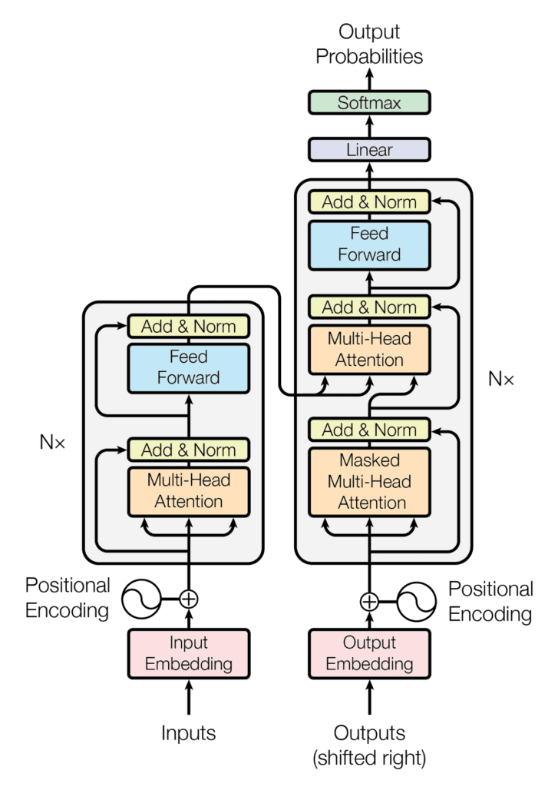
ARCHITECTURE
The transformer-based architecture was first introduced by Vaswani et al. in their paper "Attention Is All You Need."
The architecture utilizes the self-attention mechanism to capture the relationship between all the words in a sentence.
The encoder and decoder are the two main components of the transformer-based architecture.
The encoder reads the input sequence and produces a set of hidden representations, while the decoder generates the output sequence based on these representations.
The attention mechanism is a key component which allows the model to selectively focus on specific parts of the input sequence when generating the output.
Figure 1: Transformer Network

Slide 6
RESULTS
The table displays the training and validation loss values of the model during the training process.
At the beginning of training, both the training and validation loss values are high and gradually decrease as the training progresses, indicating that the model is improving and learning to generalize better.
Although the validation loss begins to level off around step 4000, the gap between the training and validation loss is not large, indicating that the model is not overfitting too severely.
Table 1: Train Loss and Validation Loss for 10000 steps.

Slide 7
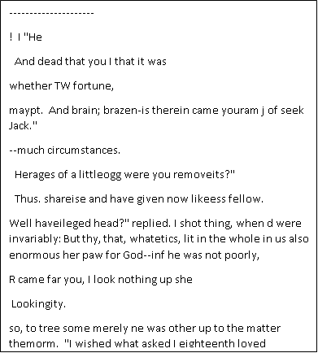
GENERATED TEXT
---------------------
!n't I speak
Hear Sime?"
A GREAT sound of lights to have filled with soft and
white particles. To have yet made a peculiar voice like an invisible
lines, and the root in the veins of Eternal crying lower through
the
the wall, and the multitude of friend lay black, wiping hands in
exotics with great wrath.
"If you were Lucifer or person Pumpkinhead," said the Lion; "but,
Colonel, we swear only throw angels like light, prayers, and the strangers
inside, an example of lavishly, standing on those Kanies and
early brother. But should you scound your woman?"
"What sort of you mean to have to do was made sharing there?"
he answered.
Step 1: The early texts generated by the language model were not very coherent or meaningful. This is not unexpected, as the model requires a significant amount of training data and tuning to produce high-quality outputs.
Step 10K: After 10000 steps, Generated text is coherent and cohesive, but some nonsensical phrases may occur due to the diverse training data.

Slide 8
DISSCUSSION
The model successfully generated coherent and imaginative text samples with good syntax and style.
Limitations included difficulty with coherent plot creation and occasional repetitive or nonsensical output.
Future work includes optimizing the model architecture and expanding the dataset for training and incorporating additional sources of data.
Potential directions for future work include exploring different optimization techniques and pre-training methods.

Slide 9
CONCLUSION
Developed a transformer-based language model that generates coherent and grammatically correct text using classic literature dataset
Applied pre-processing steps such as lower-casing, stop word removal, stemming, and tokenization before training the model
Model generates text with high coherence and cohesiveness, but has some limitations in terms of grammar and flow of words
Recommendations include further optimization of the model to improve its grammar and flow of words and expansion of the dataset to include more diverse sources of text.

Slide 10
THANK YOU

