Slide 1
PROJECT TITLE : Oil Spill Detection
PIP104 University Project-II
Review-3
Batch Number:GCAI07
ROLL NUMBER | NAME
20211CAI0169 | P V SAI PRANEETH
20211CAI0171 | B SATYA CHARAN
20211CAI0172 | HARI PRADHAN S D
20211CAI0163 | T BHARGAV NAIDU
Under the Supervision of,
Dr. Murali Parameswaran
Professor
School of Computer Science & Engineering
Presidency University

Slide 2
Introduction
Objective: Develop an automated system for early detection of oil spills at sea by integrating AIS (Automatic Identification System) and satellite datasets to enhance environmental protection and maritime safety.
Approach: Leverage real-time vessel tracking with AIS data and advanced remote sensing technologies to monitor anomalies such as erratic movements, sudden speed changes, or distress signals.
Impact: Early identification of potential oil leaks or spills enables timely and efficient response, mitigating environmental damage and promoting sustainable maritime practices.

Slide 3
Github link
The Github link provided should have public access permission.
Github Link
https://github.com/praneethpuli/OIL-SPILL-DETECTION

Slide 4
Dataset
Dataset is of csv format containing features
Structure & Size : The dataset contains 937 entries with 50 columns, including features (f_1 to f_49) and a target column for classification.
Feature Types : There are 39 floating-point features and 11 integer features, potentially representing physical, environmental, or spatial characteristics relevant to oil spill detection.
Target Variable : The target column is binary (0 or 1), indicating whether an oil spill was detected (1) or not (0).

Slide 5
Literature Review
Author(s) | Title | Journal/Conference | Algorithms | Dataset | Outcomes
Anne H.S. Solberg | Oil spill detection by satellite remote sensing (2005) | Research gate | Uses SAR(Synthetic Aperture Radar) to capture 2D images. KNN – K Nearest Neighbours Edge detection | Synthetic aperture radar (SAR) images. | Effective detection of oil spills using satellite imagery.
Konstantinos N. Topouzelis | Oil Spill Detection by SAR Images (2008) | MDPI | SAR CNN | SAR (Synthetic Aperture Radar) images. | Improved accuracy in differentiating oil spills from look alike algae.
Suman Singha | Satellite Oil Spill Detection Using Artificial Neural Networks (2005) | IEEE | ANN Image Processing | Satellite images. | Increased detection accuracy of oil spills using artificial neural networks (ANN).
Kan Zeng | Oil spill detection by imaging radars: Challenges and pitfalls (2003) | Science Direct | SVM KNN Bayesian Classifiers | Imaging radar data. | Identified challenges in using imaging radar (e.g., SAR) for oil spill detection.
Anne H. Schistad Solberg | Oil Spill Detection in Hybrid-Polarimetric SAR Images (2014) | IEEE | SVM Random Forest ANN | Hybrid-polarimetric SAR (Synthetic Aperture Radar) images. | Improved oil spill detection using hybrid-polarimetric SAR imaging techniques.

Slide 6
Existing method
Traditional systems for oil spill detection primarily use satellite image analysis, but they often rely on older methods and techniques that are less efficient. These methods typically use manual image processing or basic machine learning algorithms such as logistic regression, linear classifiers, or simple decision trees. The existing systems face several challenges, including limited accuracy due to oversimplified models, reliance on manual feature extraction, and poor generalization to diverse environments or new types of oil spills. They also lack real-time processing capabilities and cannot always distinguish smaller or more complex oil spills. Furthermore, these systems generally do not provide detailed recommendations or actionable insights, reducing their effectiveness in oil spill containment and management.

Slide 7
Proposed Method
Machine Learning Algorithms: Utilizes Support Vector Machine (SVM), Random Forest, and XGBoost to classify image patches as oil spills or non-oil spills.
Feature Extraction: Leverages spectral and spatial features from satellite imagery to improve classification accuracy.
Backend Development: Processes data using Python to support the oil spill detection framework.
Real-Time Monitoring: Enables rapid identification and response to marine pollution incidents.
Scalability and Sustainability: Provides an efficient and environmentally sustainable solution for maritime ecosystem protection.

Slide 8
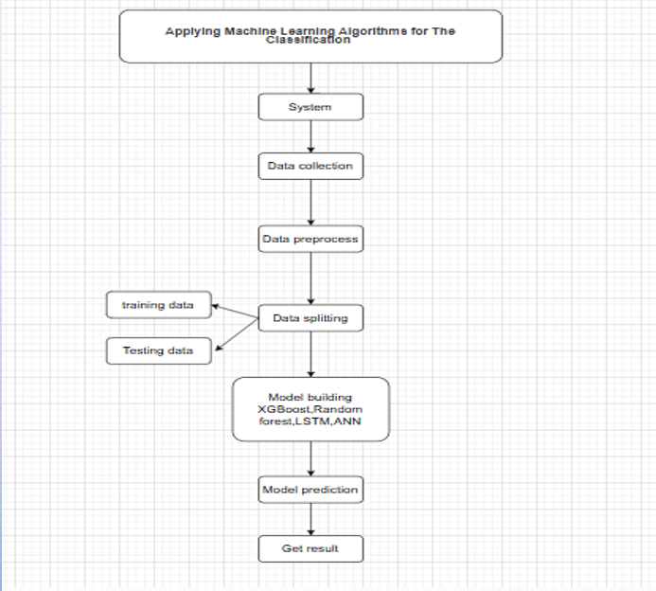
Architecture Diagram

Slide 9
Objectives
Automated Oil Spill Detection
Develop an automated system that uses AIS and satellite imagery to detect oil spills with high accuracy, enhancing maritime safety and environmental protection.

Slide 10
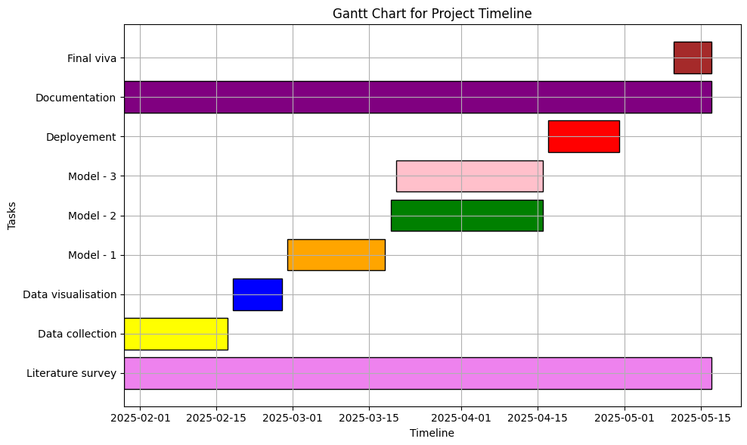
Timeline of Project

Slide 11
Expected Outcomes
Enhanced Detection Accuracy: The system is designed to significantly improve oil spill detection accuracy by integrating advanced machine learning and deep learning models with multi-source data. This integration leverages detailed spectral and spatial features from SAR imagery and AIS vessel data, ensuring that subtle indicators of oil spills are captured while minimizing false positives.

Slide 12
Conclusion
The proposed system represents a significant advancement in automated marine monitoring by effectively integrating satellite SAR imagery with AIS vessel data. By leveraging sophisticated machine learning and deep learning algorithms, the framework accurately identifies oil spill incidents, even in challenging environmental conditions, while minimizing false positives. The real-time monitoring and alert components enable immediate stakeholder notification, facilitating swift response actions that are crucial for mitigating environmental damage. Furthermore, the user-friendly interface ensures that the system is accessible and scalable, promoting sustainable marine ecosystem management. Overall, this integrated approach sets a new benchmark for efficient, data-driven oil spill detection and rapid intervention in marine pollution scenarios.

Slide 13
References
[1] A. Solberg, “Remote sensing of ocean oil-spill pollution,” Proc. IEEE, vol. 100, no. 10, pp. 2931–2945, Oct. 2012.
[2] M. M. Espeseth, C. Brekke, C. E. Jones, B. Holt, and A. Freeman, “The impact of system noise in polarimetric SAR imagery on oil spill observations,” IEEE Trans. Geosci. Remote Sens., vol. 58, no. 6, pp. 4194–4214, Jun. 2020.
[3] A. H. S. Solberg, C. Brekke, and P. O. Husoy, “Oil spill detection in Radarsat and Envisat SAR images,” IEEE Trans. Geosci. Remote Sens., vol. 45, no. 3, pp. 746–755, Mar. 2007.
[4] O. Garcia-Pineda et al., “Classification of oil spill by thicknesses using multiple remote sensors,” Remote Sens. Environ., vol. 236, 2020, Art. no. 111421.
[5] M. Migliaccio, A. Gambardella, and M. Tranfaglia, “SAR polarimetry to observe oil spills,” IEEE Trans. Geosci. Remote Sens., vol. 45, no. 2, pp. 506–511, Feb. 2007.
[6] Y. Dong, Y. Liu, C. Hu, I. R. MacDonald, and Y. Lu, “Chronic oiling in global oceans,” Science, vol. 376, no. 6599, pp. 1300–1304, 2022.
[7] Y. Li and Y. Zhang, “Synthetic aperture radar oil spills detection based on morphological characteristics,” Geo-Spatial Inf. Sci., vol. 17, no. 1, pp. 8–16, 2014.
[8] S. Tong, X. Liu, Q. Chen, Z. Zhang, and G. Xie, “Multi-feature based ocean oil spill detection for polarimetric SAR data using random forest and the self-similarity parameter,” Remote Sens., vol. 11, no. 4, pp. 1–20, 2019, Art. no. 451, doi: 10.3390/rs11040451.
[

Slide 14
References
[9] F. Bandiera, A. Masciullo, and G. Ricci, “A Bayesian approach to oil slicks edge detection based on SAR data,” IEEE Trans. Geosci. Remote Sens., vol. 52, no. 5, pp. 2901–2909, May 2014.
[10] A. Buono, F. Nunziata, M. Migliaccio, and X. Li, “Polarimetric analysis of compact-polarimetry SAR architectures for sea oil slick observation,” IEEE Trans. Geosci. Remote Sens., vol. 54, no. 10, pp. 5862–5874, Oct. 2016

Slide 15
Thank You

