Slide 1
Detecting oil spills at marine environment using Automatic Identification System (AIS) and satellite datasets
PIP2001 Capstone Project
Review-0
Batch Number:GCAI08
Under the Supervision of,
Dr. MURALI PARAMESWARAN
Professor
School of Computer Science and Engineering
Presidency University
Roll Number | Student Name
20211CAI0169 20211CAI0171 20211CAI0163 20211CAI0172 | PULI VENKATA SAI PRANEETH BACHHU SATYA CHARAN TATIKONDA BHARGAV NAIDU HARI PRADHAN S D
Name of the Program: B.TECH
Name of the HoD: ZAFAR ALI KHAN
Name of the Program Project Coordinator: Mr. Amarnath
Name of the School Project Coordinators: Dr. Sampath A K / Dr. Abdul Khadar A / Mr. Md Ziaur Rahman

Slide 2
Content
Problem Statement
Github Link
Analysis of Problem Statement
Timeline of the Project
References

Slide 3
Problem Statement Number : 360
Organization: Ministry of earth sciences
Category (Hardware / Software / Both) : Software
Problem Description : Background: The impact of oil spills at sea is multifaceted, affecting the environment, economy, public health, and society at large. Preventing spills through stringent regulations, improved technology, and better safety practices is crucial to mitigate these devastating effects. Automatic oil spill detection using Automatic Identification System (AIS) and satellite datasets is essential for environmental protection, public health and safety, economic stability, regulatory enforcement, technological advancement, and operational efficiency. This approach enables timely and effective responses to oil spills, mitigating their impact and promoting sustainable maritime practices. Integrating AIS and satellite datasets significantly enhances the early detection of oil spills at sea by combining real-time vessel tracking with advanced remote sensing capabilities. Detailed description: The automatic identification of oil leaks and spills from ships and vessels using AIS (Automatic Identification System) and satellite datasets involves integrating real-time tracking and advanced remote sensing technologies to monitor marine environments effectively.

Slide 4
Problem Statement Number:
AIS provides crucial information such as the vessel's unique identifiers (IMO number, call sign), real-time positional data (latitude, longitude), speed over ground (SOG), course over ground (COG), heading, type of vessel, dimensions, draught, destination, estimated time of arrival (ETA), and cargo details. To detect a vessel in distress, AIS data have to be monitored for anomalies, such as sudden changes in speed or course, erratic movements, or unexpected stops. These irregularities can signal potential distress, prompting further investigation. Once detecting the distress, the same location/vessel have to be monitored using space borne satellite datasets for oil leaks, orientation of the vessel and its change in datum. The integration of AIS data with satellite datasets, enhances the ability to detect oil leaks early and can respond to situations efficiently. As far as study area, any of the below options may be considered. Option 1 : off Mumbai: https://drive.google.com/file/d/1HUisEfMA20ilODdeoRYVneG2i1ZbRBNB/view?usp=drive_link Option 2 :Gulf of Mexico – North American waters: https://drive.google.com/file/d/1_iEcojaZNaezOqKwxHtCenjgOW58lPgA/view?usp=drive_link Expected solution: Automated oil spill detection system for early detection of oil spills A software/tool/system to be developed for detecting oil spills/vessel in distress with suitable methodology that involves programming in python. The tool/system should detect the anomalies in AIS around the vessel. The distress/anomaly zone has to be monitored for oil spills using Satellite datasets. This can help in early detection of oil leak from a ship or vessel. The information can be passed on to the regulatory authorities for quicker and efficient response.
Difficulty Level: Complex

Slide 5
Github Link
The Github link provided should have public access permission.
Github Link
https://github.com/praneethpuli/OIL-SPILL-DETECTION

Slide 6
Analysis of Problem Statement
Technology Stack Components :
Front end : HTML, CSS, JAVA SCRIPT
BACKEND : PYTHON, FLASKS
ALGORITHMS : CNN

Slide 7
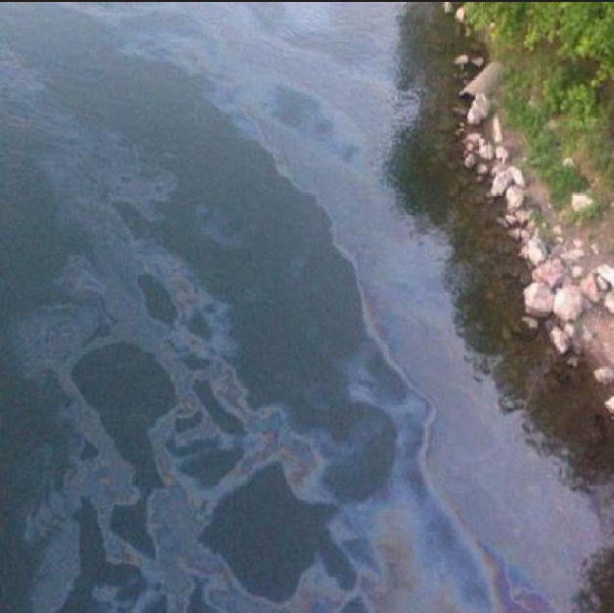
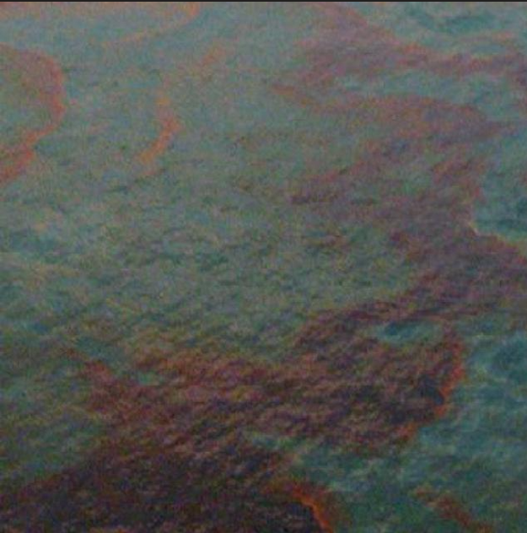
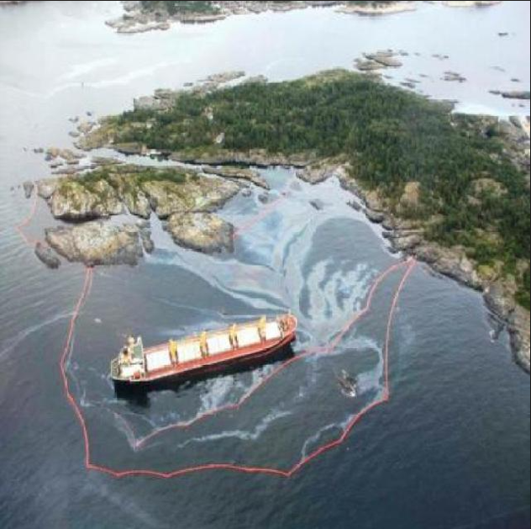
Analysis of Problem Statement
Dataset : Oil spill images

Slide 8
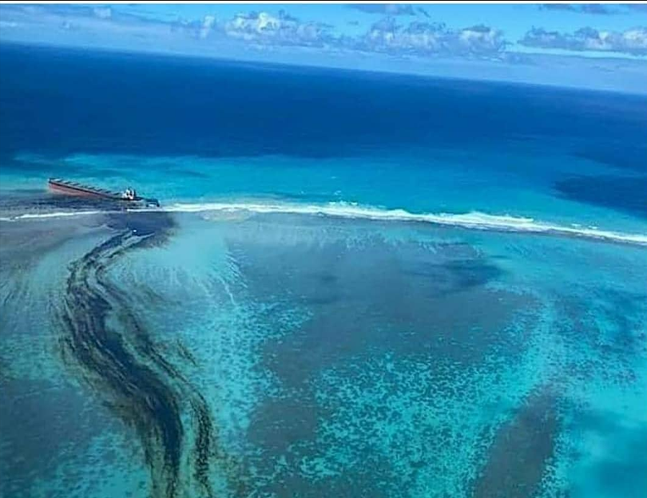
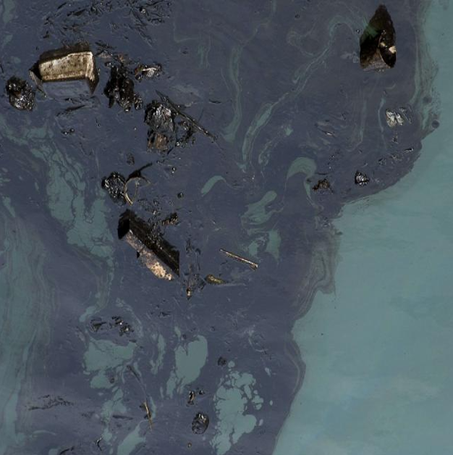
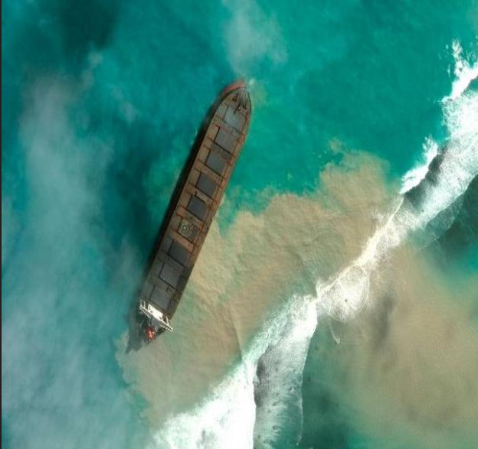
Analysis of Problem Statement
Dataset : Oil spill images

Slide 9
Analysis of Problem Statement (contd...)
Software Requirements :
Programming languages : Python
Machine Learning & Data Processing Tools: TensorFlow/PyTorch
OpenCV (for image processing as satellite images are used)
Scikit-learn (for basic ML models)
Pandas & NumPy (for data manipulation)

Slide 10
Analysis of Problem Statement (contd...)
Hardware Requirements :
Processor: Intel i5/i7 or AMD Ryzen 7/9 (or higher)
RAM: 12/16GB
Storage: 512GB SSD or higher (Recommended: 1TB SSD for large datasets)
GPU (For Deep Learning):NVIDIA RTX 3060/3070+ (Minimum)NVIDIA A100/Tesla V100 (For cloud-based training)
Operating System: Windows 10/11

Slide 11
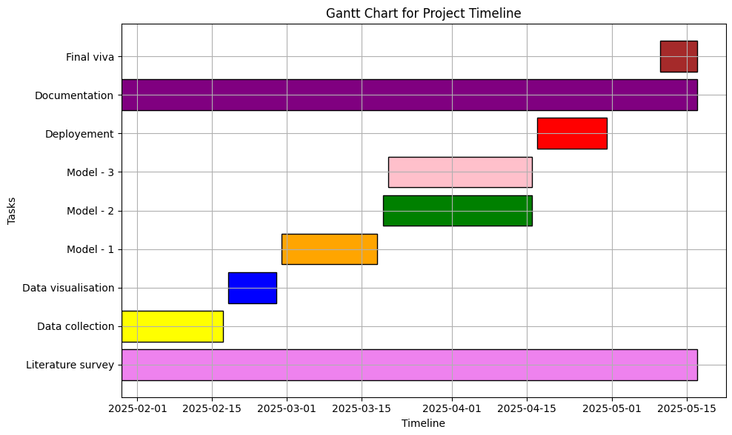
Timeline of the Project (Gantt Chart)

Slide 12
References (IEEE Paper format)
[1] Schwehr, Kurt D., and Philip A. McGillivary. "Marine Ship Automatic Identification System (AIS) for enhanced coastal security capabilities: an oil spill tracking application." In OCEANS 2007, pp. 1-9. IEEE, 2007.
[2] Zhu, Gaoru, Zhenglei Xie, Honglei Xu, Nan Wang, Liguo Zhang, Ning Mao, and Jinxiang Cheng. "Oil spill environmental risk assessment and mapping in coastal China using automatic identification system (AIS) data." Sustainability 14, no. 10 (2022): 5837.
[3] Fournier, Mélanie, R. Casey Hilliard, Sara Rezaee, and Ronald Pelot. "Past, present, and future of the satellite-based automatic identification system: Areas of applications (2004–2016)." WMU journal of maritime affairs 17, no. 3 (2018): 311-345.
[4] Yan, Zhaojin, Yijia Xiao, Liang Cheng, Song Chen, Xiao Zhou, Xiaoguang Ruan, Manchun Li, Rong He, and Bin Ran. "Analysis of global marine oil trade based on automatic identification system (AIS) data." Journal of Transport Geography 83 (2020): 102637.
[5] Ma, Xiaoshuang, Jiangong Xu, Jun Pan, Jie Yang, Penghai Wu, and Xiangchao Meng. "Detection of marine oil spills from radar satellite images for the coastal ecological risk assessment." Journal of Environmental Management 325 (2023): 116637.

Slide 13
References (IEEE Paper format)
[6] Mera, David, José M. Cotos, José Varela-Pet, Pablo G. Rodríguez, and Andrés Caro. "Automatic decision support system based on SAR data for oil spill detection." Computers & Geosciences 72 (2014): 184-191.
[7] Trieschmann, Olaf, Leendert Bal, Marin Chintoan-Uta, Samuel Djavidnia, Anne Marie Hayes, Marc Journel, Pedro Lourenco-Bento, Sonja Pelizzari, Machteld Price, and Jorge del Rio Vera. "Identification of Oil Spills by Satellite." In ESA Living Planet Symposium, vol. 686, p. 257. 2010.
[8] Mizukoshi, Noriyoshi, Tsuyoshi Watanabe, and Kazuo Ouchi. "Operational system for ship detection and identification using sar and ais for ships of illegal oil discharge." image 13 (2019): 19.
[9] Bisen, Tanmay, Aastha Shayla, and Susham Biswas. "Predicting Oil Spills in Real-Time: A Machine Learning and AIS Data-Driven Approach." In Networking and Parallel/Distributed Computing Systems: Volume 18, pp. 99-115. Cham: Springer Nature Switzerland, 2024.
[10] Wright, Darren, Carol Janzen, Robert Bochenek, Jessica Austin, and Edward Page. "Marine observing applications using AIS: automatic identification system." Frontiers in Marine Science 6 (2019): 537.

Slide 14


