Slide 1
REALTIME ACCENT TRANSLATION
PIP2001 Capstone Project
Review-0
Batch Number : GCAI08
Under the Supervision of,
Dr. MURALI PARAMESWARAN
School of Computer Science and Engineering
Presidency University
Roll Number | Student Name
20211CAI0169 | P.V.SAI PRANEETH
20211CAI0171 | BACHHU SATYA CHARAN
20211CAI0172 | HARI PRADHAN S. D
20211CAI0163 | T. BHARGAV NAIDU
Name of the Program: Computer Science and Engineering(Artificial Intelligence and Machine Learning )
Name of the HoD: Dr. Zafar Ali Khan N
Name of the Program Project Coordinator: Dr. Afroz Pasha
Name of the School Project Coordinators: Dr. Sampath A K / Dr. Abdul Khadar A / Mr. Md Ziaur Rahman

Slide 2
Content
Problem Statement
Github Link
Analysis of Problem Statement
Timeline of the Project
References

Slide 3
Problem Statement Number : PSCS96
Organization: Harman
Problem Description: Conference calls have become order of the day. Participants attend the conference calls from various locations and nationalities and speak the language differently. This causes hurdles in ability to understand and also how quickly a thought is communicated. This problem is to develop a real time accent translation system based on the recipients' and deliverer's accents. The idea is to achieve far better understanding during conference calls, which will make the communication far more effective
Difficulty Level: Complicated

Slide 4
Github Link
The Github link provided should have public access permission.
Github Link
https://github.com/praneethpuli

Slide 5
Analysis of Problem Statement
Technology Stack Components:
Speech – to – Text API : Google cloud, Azure
Accent Adaption models
Machine translation APIs : Google cloud translation APIs, Microsoft translator API, AWS translate
Text – to – Speech Engines : Tacotron, Google TTS, Open TTS
High-performance server for real-time processing
Frontend : React.js, Websockets, Bootstrap
Backend : Node.js, Python Flask/Django
APIs : Google Cloud, Microsoft Azure

Slide 6
Analysis of Problem Statement (contd...)
Software Requirements :
Operating System: Linux (Ubuntu), macOS, or Windows.
Database : SQL
Hosting : AWS, Google cloud or Azure
Hardware Requirements :
Processor: Intel Core or equivalent.
RAM: 8 GB (minimum), 16 GB (recommended for handling multiple processes like training models, testing, and processing audio files).
Storage: 250 GB SSD (minimum), 500 GB recommended for datasets and model storage.
Graphics Card (Optional): A mid-range GPU such as NVIDIA GTX 1050 if you plan to use GPU acceleration for model training.

Slide 7
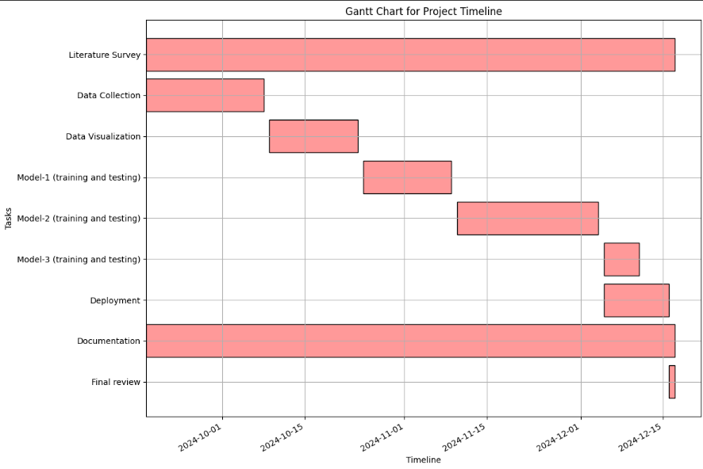
Timeline of the Project (Gantt Chart)

Slide 8
References (IEEE Paper format)
Zhao, Guanlong, Shaojin Ding, and Ricardo Gutierrez-Osuna. "Converting foreign accent speech without a reference." IEEE/ACM Transactions on Audio, Speech, and Language Processing 29 (2021): 2367-2381.
Ding, Shaojin, Guanlong Zhao, and Ricardo Gutierrez-Osuna. "Accentron: Foreign accent conversion to arbitrary non-native speakers using zero-shot learning." Computer Speech & Language 72 (2022): 101302.
Quamer, Waris, Anurag Das, John Levis, Evgeny Chukharev-Hudilainen, and Ricardo Gutierrez-Osuna. "Zero-shot foreign accent conversion without a native reference." Proc. Intespeech (2022).
Simard, Michel, and Alexandre Deslauriers. "Real-time automatic insertion of accents in French text." Natural Language Engineering 7, no. 2 (2001): 143-165.
Goel, Nagendra Kumar, Mousmita Sarma, Saikiran Valluri, Dharmeshkumar Agrawal, Steve Braich, Tejendra Singh Kuswah, Zikra Iqbal, Surbhi Chauhan, and Raj Karbar. "CaptionAI: A Real-Time Multilingual Captioning Application." In INTERSPEECH, pp. 4632-4633. 2019.
Hasler, Béatrice S., Oren Salomon, Peleg Tuchman, Amir Lev-Tov, and Doron Friedman. "Real-time gesture translation in intercultural communication." Ai & Society 32 (2017): 25-35.

Slide 9
Literature review
This research focuses on automatic speech recognition (ASR) systems, particularly in handling varied accents.
It reveals that accented speech poses challenges for both human listeners and automatic systems, emphasizing the importance of improving ASR systems to accommodate accent diversity.
It emphasizes the importance of prosody and how accents can impact the clarity of spoken language in communication systems.
This examines the challenges of developing voice recognition systems that are both inclusive of multiple accents and scalable.
This study discusses the effect of non-native accents on speech intelligibility.

Slide 10


