Slide 1
PROJECT TITLE : REAL TIME ACCENT TRANSLATION
PIP104 University Project-II
Review-2
Batch Number:GCAI08
ROLL NUMBER | NAME
20211CAI0169 | P V SAI PRANEETH
20211CAI0171 | B SATYA CHARAN
20211CAI0172 | HARI PRADHAN S D
20211CAI0163 | T BHARGAV NAIDU
Under the Supervision of,
Dr. Murali Parameswaran
Professor
School of Computer Science & Engineering
Presidency University

Slide 2
Introduction
Real-time accent translation for English language speech is a cutting-edge technology aimed at transforming spoken English from one accent to another in real-time, enhancing global communication and accessibility. The project focuses on converting English accents while preserving the speaker's meaning, tone, and style. It combines automatic speech recognition (ASR) also Wav2vec to convert spoken English into text, and text-to-speech (TTS) synthesis to generate natural-sounding English speech with the desired accent. By utilizing deep learning models, the system is designed to operate with low latency, ensuring seamless and intelligible real-time accent conversion. This technology has potential applications in customer service, international collaboration, and media, making English communication more inclusive and understandable across different regions.

Slide 3
Abstract
The Real-Time Accent Translation project bridges linguistic and cultural barriers by providing a real-time solution to accent-related communication challenges. Using advanced speech recognition, machine learning, and audio processing, the system identifies a speaker's accent and converts it into a target accent while maintaining meaning, tone, and intent. It enhances speech clarity by filtering background noise and analyzing relevant audio features. The project has wide-ranging applications, including improving customer service interactions, fostering inclusivity in education, and ensuring accurate communication in healthcare. In global business, it promotes smoother international collaboration by overcoming accent barriers. By addressing accent diversity, the system enables effective communication in multilingual settings and supports cross-cultural interactions. This innovation improves accessibility for non-native speakers and creates an inclusive communication environment. Despite challenges in managing variations in pronunciation, intonation, and rhythm, the system evolves with advancements in machine learning and NLP, offering significant potential for broader applications and adaptability.

Slide 4
Literature Review
Author(s) | Year | Title | Journal/Conference | Key Findings/Contributions
M.D Rahmy Athas P. Pirapuraj | 2024 | CallTran: Voice Translation for End-to-End Communication over the Internet | https://ieeexplore.ieee.org/abstract/document/10493835/keywords#keywords | Spech-to-speech Google API Speech Recognition Machine Translation Speech Synthesis
Cang, Heª Feng, Dan^{b;} | 2024 | Accentron: Foreign accent conversion to arbitrary non-native speakers using zero-shot learning | Journal of Computational Methods in Sciences and Engineering | Information security, Internet of Things technology, deep learning, oral instant translation model, English corpus
Pratham Singh Rana Kalpana . Chahat . Soham Kr Modi Anup Lal Yadav | 2024 | Advancements in Real-Time Voice Conversion Technologies: A Comprehensive Analysis of Techniques | 10.21437/Interspeech.2022-10729 | Real-time Voice Conversion, Speech Synthesis, Neural Vocoder, Speaker Encoder, Multispeaker Synthesis, Transfer Learning, WaveNet Architecture, Human-Computer Interaction
Kazuki Yamauchi Yuki Saito Hiroshi Saruwatari | 2024 | Cross-Dialect Text-To-Speech in Pitch-Accent Language Incorporating Multi-Dialect Phoneme-Level BERT | http://dx.doi.org/10.2139/ssrn.4931626 | Speech synthesis Voice recognition WaveGan
Shaojin Ding Guanlong Zhao Ricardo Gutierrez-Osuna | 2022 | Accentron: Foreign accent conversion to arbitrary non-native speakers using zero-shot learning | https://doi.org/10.1016/j.csl.2021.101302 | Foreign accent conversion Speech synthesis Computer-assisted pronunciation training

Slide 5
Existing method Drawback
Limited Language and Accent Support :
Real-time accent translation systems often prioritize popular languages and standard accents, neglecting regional variations. This leads to poor performance or exclusion for users speaking less common accents or dialects. Accurately capturing pronunciation differences and linguistic nuances across diverse accents is challenging. Expanding support requires extensive training data and complex linguistic models. However, achieving universal coverage remains resource-intensive and technically demanding.
Latency Issues :
Real-time accent translation systems often face delays due to the heavy computational demands of speech recognition, accent adaptation, and language translation. These delays disrupt natural communication flow, especially in high-speed conversations. Factors like suboptimal algorithms, hardware limitations, and large data processing requirements exacerbate the problem. Reducing latency requires efficient algorithms and advanced hardware like GPUs. However, achieving near-instant translation remains a significant technical challenge.
Accuracy Challenges :
Real-time accent translation struggles with inconsistencies in pronunciation, slang, and speech speed, leading to translation errors. These inaccuracies can result in miscommunication, especially in critical contexts like business or healthcare. Variations in speaker tone, pitch, and contextual meaning further complicate the process.

Slide 6
Proposed Method
Speech-to-Text (STT) Models:
Wav2Vec 2.0: A state-of-the-art self-supervised learning model by Facebook AI, which performs well for speech recognition tasks.
Accent Detection Models :
CNN or RNN-based Models: Convolutional Neural Networks (CNN) or Recurrent Neural Networks (RNN) are commonly used for accent recognition. They can be trained on accented speech data to detect accents.
Accent Adaptation (Translation) Models :
Voice Conversion Models (e.g., CycleGAN-VC): These models can be used to adapt one accent to another by transforming speech characteristics while maintaining the original content.
Tacotron2: This model generates speech from text and can be adapted for accent translation if trained on different accent data.
Text-to-Speech (TTS) Models :
FastSpeech 2: A fast and efficient TTS model that converts text into natural-sounding speech. It can be trained on different accent datasets.
Multi-Band MelGAN: A high-quality neural vocoder that synthesizes speech from Mel-spectrograms.

Slide 7
Objectives
Real-time Speech Recognition and Translation:
Develop a system that can recognize speech in real-time, detect the speaker's accent, and translate it into a user-preferred or neutral accent without losing context or meaning.
Latency Minimization:
Focus on reducing processing delays to ensure the system delivers translations with minimal lag, enhancing the real-time user experience.
3.Speaker Differentiation:
Implement functionality to recognize and differentiate between multiple speakers in a conversation, ensuring accurate accent translation for each participant.

Slide 8
Methodology
Data Collection and Preprocessing:
Gather diverse English accent datasets and preprocess them for noise reduction and phonetic labeling.
Speech Recognition and Accent Detection:
Use Automatic Speech Recognition (ASR) and machine learning models to detect the speaker's accent and convert speech to text.
Accent Translation Using Deep Learning:
Implement deep learning models (RNNs, LSTMs, or Transformers) to translate accents, focusing on phoneme-level translation or end-to-end neural models.
Speech Synthesis (Text-to-Speech):
Use TTS models like gtts to convert the translated text back into speech with the desired accent.
Real-time Optimization:
Optimize models for low latency using techniques like model pruning and streaming ASR/TTS for real-time translation.

Slide 9
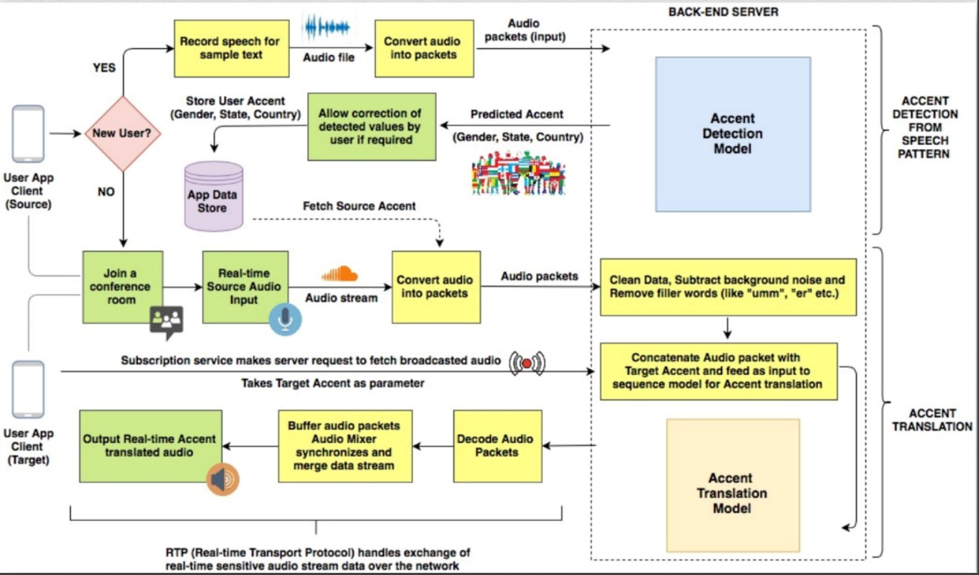
Architecture Diagram

Slide 10
Pseudo Code
# Load pre-trained Wav2Vec 2.0 model and processor for transcription
processor = Wav2Vec2Processor.from_pretrained("facebook/wav2vec2-base-960h")
model = Wav2Vec2ForCTC.from_pretrained("facebook/wav2vec2-base-960h")
import numpy as np
def extract_audio_features(audio_file_paths):
features = []
for file_path in audio_file_paths:
try:
audio, sr = librosa.load(file_path, sr=16000)
# Extract multiple features
mfcc = librosa.feature.mfcc(y=audio, sr=sr, n_mfcc=20)
spectral_centroid = librosa.feature.spectral_centroid(y=audio, sr=sr)
spectral_bandwidth = librosa.feature.spectral_bandwidth(y=audio, sr=sr)
rms = librosa.feature.rms(y=audio)
# Combine features into a single vector
feature_vector = np.concatenate((
np.mean(mfcc, axis=1),
np.mean(spectral_centroid, axis=1),
np.mean(spectral_bandwidth, axis=1),
np.mean(rms, axis=1) ))
features.append(feature_vector)
except Exception as e:
print(f"Error processing {file_path}: {e}")
continue # Skip problematic files
features = np.array(features)
scaler = StandardScaler()
return scaler.fit_transform(features)
# Normalize features

Slide 11
Pseudo Code
# Extract featuresfeatures = extract_audio_features(audio_files)
print("Extracted features. Shape:", features.shape)
# Save the extracted features to a .
npy filenp.save('/content/drive/MyDrive/extracted_features.npy', features)
# Optionally, you can also save the features as a CSV if preferredimport pandas as
pddf = pd.DataFrame(features)
df.to_csv('/content/drive/MyDrive/extracted_features.csv', index=False)
def transcribe_audio(audio_path):
try:
# Load the audio file at the specified sample rate
audio, rate = librosa.load(audio_path, sr=16000)
# Process the audio for the model
input_values = processor(audio, sampling_rate=rate, return_tensors="pt").input_values
# Run the model to get logits (predictions)
logits = model(input_values).logits
# Get the predicted IDs (most likely tokens)
predicted_ids = torch.argmax(logits, dim=-1)
# Decode the predicted IDs back to text
transcription = processor.batch_decode(predicted_ids)[0]
print(f"Transcription successful for {audio_path}")
return transcription
except Exception as e:
print(f"Error transcribing {audio_path}: {e}")
return None

Slide 12
Pseudo Code
# Define the cluster label you want to inspect
cluster_to_inspect = 4
# Replace with the desired cluster label
# Get all audio files belonging to the selected cluster
cluster_samples = [audio_files[i] for i in range(len(audio_files)) if cluster_labels[i] == cluster_to_inspect]
# Limit the number of samples to inspect to the first 5 or fewer if there are not enough
for sample in cluster_samples[:5]:
# Limit to first 5 samples for testing
try:
transcription = transcribe_audio(sample)
if transcription:
print(f"File: {sample}")
print(f"Transcription: {transcription}\n")
else:
print(f"Transcription failed for {sample}\n")
except Exception as e:
print(f"Error processing {sample}: {e}\n")

Slide 13
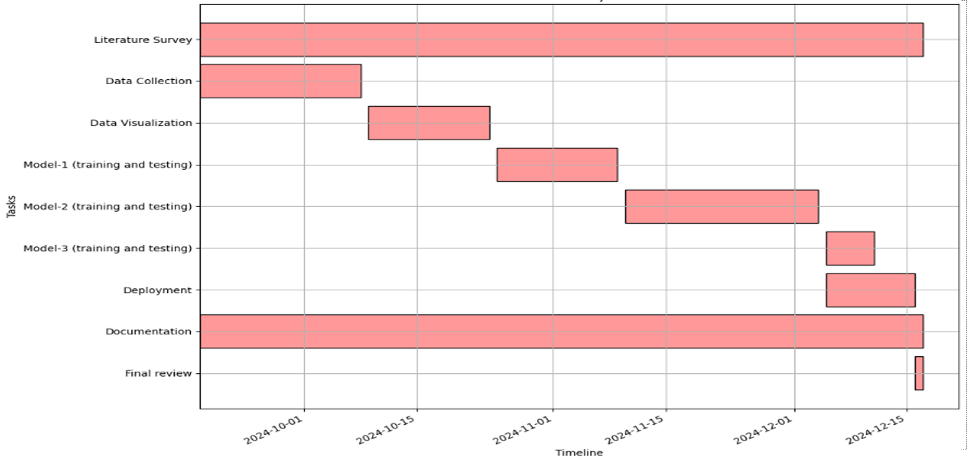
Timeline of Project

Slide 14
Expected Outcomes
Accurate Accent Translation:
The system will effectively translate speech from one accent to another in real-time, preserving the original meaning and context while ensuring clarity for the listener.
Improved Communication:
Users from diverse linguistic backgrounds will experience smoother communication, with reduced misunderstandings due to accent differences, making conversations more accessible and inclusive.
Real-time Performance:
The solution will deliver accent translations with minimal latency, providing a seamless, near-instant experience suitable for live conversations, virtual meetings, and other real-time applications.

Slide 15
Conclusion
Minimized Miscommunication:
The real-time accent translation system will reduce the risk of misinterpretation or confusion caused by unfamiliar accents, ensuring that key messages are conveyed accurately and reducing the need for clarifications during conference calls.
Enhanced Collaboration:
By reducing barriers caused by accent differences, the system will foster better collaboration among participants from various locations and nationalities, making conference calls more productive and efficient.
Seamless Real-Time Experience:
The system's ability to provide low-latency accent translation ensures that communication flows smoothly without interruptions, maintaining the natural pace of conversation and improving the overall conference call experience.

Slide 16
References
Ranzato, Irene. "The Cockney persona: the London accent in characterisation and translation." Perspectives 27, no. 2 (2019): 235-251.
Ding, Shaojin, Guanlong Zhao, and Ricardo Gutierrez-Osuna. "Accentron: Foreign accent conversion to arbitrary non-native speakers using zero-shot learning." Computer Speech & Language 72 (2022): 101302.
Nakamura, Satoshi. "Overcoming the language barrier with speech translation technology." Science & Technology Trends-Quarterly Review 31 (2009).
Quamer, Waris, Anurag Das, John Levis, Evgeny Chukharev-Hudilainen, and Ricardo Gutierrez-Osuna. "Zero-shot foreign accent conversion without a native reference." Proc. Intespeech (2022).
Solórzano Jr, Ramón, and Dialog América. "ACCENT GENERACIÓN." Technofuturos: Critical Interventions in Latina/o Studies (2007): 335.
Nguyen, Tuan-Nam, Ngoc-Quan Pham, and Alexander Waibel. "Accent Conversion using Pre-trained Model and Synthesized Data from Voice Conversion." In Interspeech, pp. 2583-2587. 2022.

Slide 17
Thank You

