Slide 1
PROJECT TITLE : REAL TIME ACCENT TRANSLATION
PIP104 University Project-II
Review-1
Batch Number:GCAI08
ROLL NUMBER | NAME
20211CAI0169 | P V SAI PRANEETH
20211CAI0171 | B SATYA CHARAN
20211CAI0172 | HARI PRADHAN S D
20211CAI0163 | T BHARGAV NAIDU
Under the Supervision of,
Dr. Murali Parameswaran
Professor
School of Computer Science & Engineering
Presidency University

Slide 2
Introduction
Real-time accent translation for English language speech is a cutting-edge technology aimed at transforming spoken English from one accent to another in real-time, enhancing global communication and accessibility. The project focuses on converting English accents while preserving the speaker's meaning, tone, and style. It combines automatic speech recognition (ASR) to convert spoken English into text, and text-to-speech (TTS) synthesis to generate natural-sounding English speech with the desired accent. By utilizing deep learning models, the system is designed to operate with low latency, ensuring seamless and intelligible real-time accent conversion. This technology has potential applications in customer service, international collaboration, and media, making English communication more inclusive and understandable across different regions.

Slide 3
Literature Review
Author(s) | Year | Title | Journal/Conference | Key Findings/Contributions
Guanlong Zhao Ricardo Gutierrez Osuna Shaojin Ding | 2021 | Converting Foreign Accent Speech Without a Reference | IEEE/ACM Transactions on Audi... | Synthesizers, Training, Acoustics, Speech processing, Decoding, Computational modeling, Transforms
Shaojin Ding Guanlong Zhao Ricardo Gutierrez-Osuna | 2022 | Accentron: Foreign accent conversion to arbitrary non-native speakers using zero-shot learning | Computer Speech & Language | Focuses on a specific accent pair (Indian English to Standard American English), providing insights into challenges and solutions.
Tuan Nam Nguyen Ngoc Quan Pham Alexander Waibel | 2022 | Accent Conversion using Pre-trained Model and Synthesized Data from Voice Conversion | 10.21437/Interspeech.2022-10729 | Accent conversion (AC) aims to generate synthetic audios by changing the pronunciation pattern and prosody of source speakers (in source audios) while preserving voice quality and linguistic content
Waris Quamer Anurag Das John Levis | 2021 | Zero-Shot Foreign Accent Conversion without a Native Reference | nsf.gov | Foreign accent conversion (FAC) aims to transform nonnative speech to have the accent (or pronunciation patterns) of a native speaker while retaining the speaker identity.
Ann Lee Hongyu Gong Juan Pino | 2021 | Textless Speech-to-Speech Translation on Real Data | https://arxiv.org/abs/2112.08352v2 | Explores the use of transfer learning to improve accent translation performance, especially with limited data.

Slide 4
Proposed Method
Speech-to-Text (STT) Models:
Wav2Vec 2.0: A state-of-the-art self-supervised learning model by Facebook AI, which performs well for speech recognition tasks.
DeepSpeech: Another highly effective ASR (Automatic Speech Recognition) model designed by Mozilla, known for its real-time processing capabilities.
Accent Detection Models :
CNN or RNN-based Models: Convolutional Neural Networks (CNN) or Recurrent Neural Networks (RNN) are commonly used for accent recognition. They can be trained on accented speech data to detect accents.
Accent Adaptation (Translation) Models :
Voice Conversion Models (e.g., CycleGAN-VC): These models can be used to adapt one accent to another by transforming speech characteristics while maintaining the original content.
Tacotron2: This model generates speech from text and can be adapted for accent translation if trained on different accent data.
Text-to-Speech (TTS) Models :
FastSpeech 2: A fast and efficient TTS model that converts text into natural-sounding speech. It can be trained on different accent datasets.
Multi-Band MelGAN: A high-quality neural vocoder that synthesizes speech from Mel-spectrograms.

Slide 5
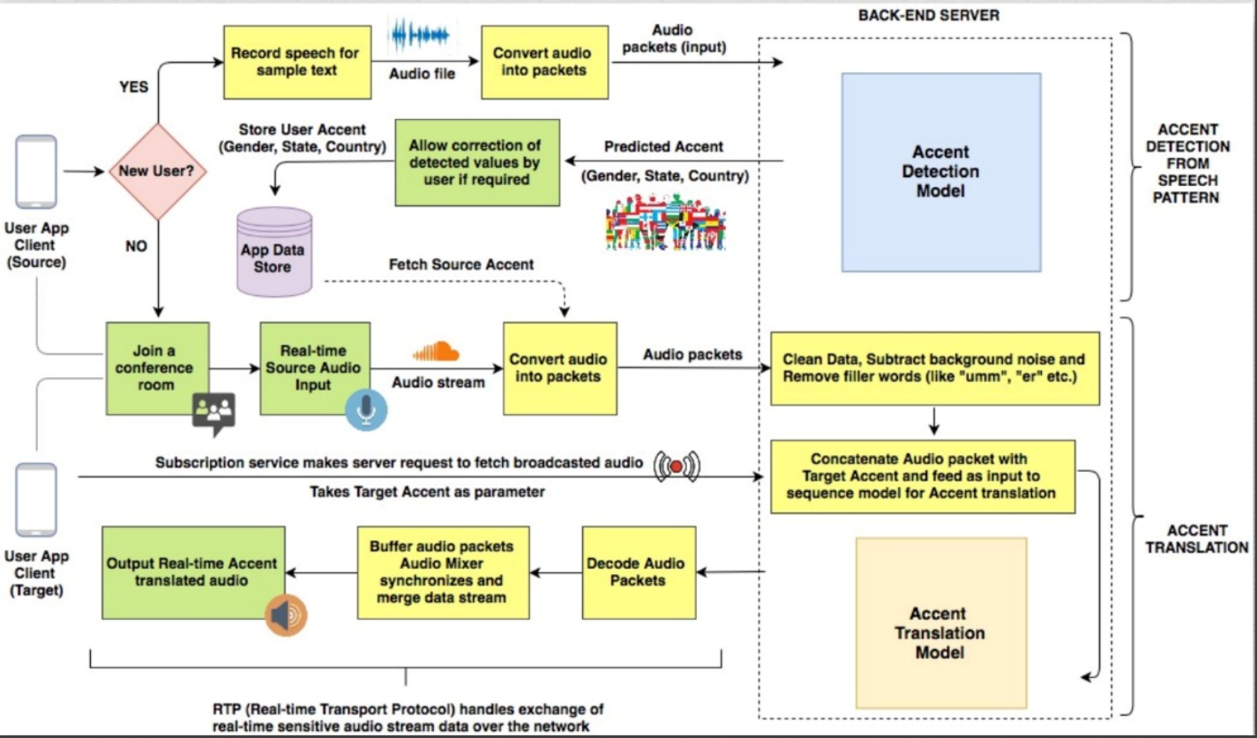
Architecture Diagram

Slide 6
Objectives
Real-time Speech Recognition and Translation:
Develop a system that can recognize speech in real-time, detect the speaker's accent, and translate it into a user-preferred or neutral accent without losing context or meaning.
Latency Minimization:
Focus on reducing processing delays to ensure the system delivers translations with minimal lag, enhancing the real-time user experience.
3.Speaker Differentiation:
Implement functionality to recognize and differentiate between multiple speakers in a conversation, ensuring accurate accent translation for each participant.

Slide 7
Methodology
Data Collection and Preprocessing:
Gather diverse English accent datasets and preprocess them for noise reduction and phonetic labeling.
Speech Recognition and Accent Detection:
Use Automatic Speech Recognition (ASR) and machine learning models to detect the speaker's accent and convert speech to text.
Accent Translation Using Deep Learning:
Implement deep learning models (RNNs, LSTMs, or Transformers) to translate accents, focusing on phoneme-level translation or end-to-end neural models.
Speech Synthesis (Text-to-Speech):
Use TTS models like Tacotron 2 or WaveNet to convert the translated text back into speech with the desired accent.
Real-time Optimization:
Optimize models for low latency using techniques like model pruning and streaming ASR/TTS for real-time translation.

Slide 8
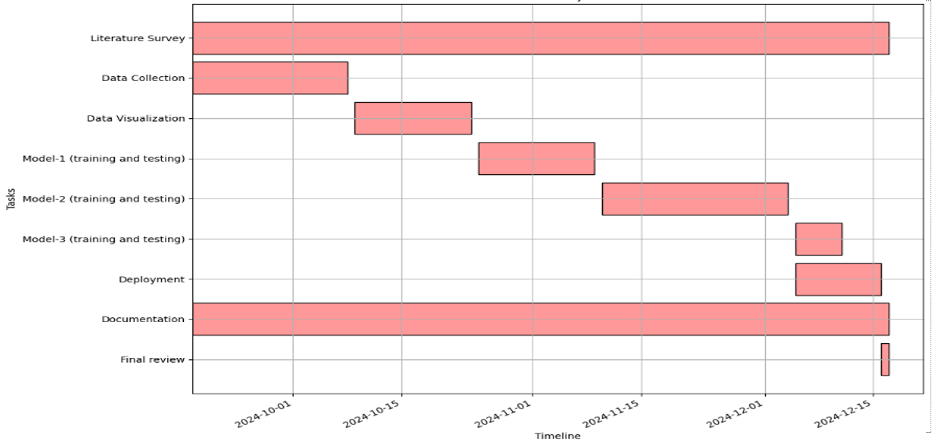
Timeline of Project

Slide 9
Expected Outcomes
Accurate Accent Translation:
The system will effectively translate speech from one accent to another in real-time, preserving the original meaning and context while ensuring clarity for the listener.
Improved Communication:
Users from diverse linguistic backgrounds will experience smoother communication, with reduced misunderstandings due to accent differences, making conversations more accessible and inclusive.
Real-time Performance:
The solution will deliver accent translations with minimal latency, providing a seamless, near-instant experience suitable for live conversations, virtual meetings, and other real-time applications.

Slide 10
Conclusion
Minimized Miscommunication:
The real-time accent translation system will reduce the risk of misinterpretation or confusion caused by unfamiliar accents, ensuring that key messages are conveyed accurately and reducing the need for clarifications during conference calls.
Enhanced Collaboration:
By reducing barriers caused by accent differences, the system will foster better collaboration among participants from various locations and nationalities, making conference calls more productive and efficient.
Seamless Real-Time Experience:
The system's ability to provide low-latency accent translation ensures that communication flows smoothly without interruptions, maintaining the natural pace of conversation and improving the overall conference call experience.

Slide 11
References
Ranzato, Irene. "The Cockney persona: the London accent in characterisation and translation." Perspectives 27, no. 2 (2019): 235-251.
Ding, Shaojin, Guanlong Zhao, and Ricardo Gutierrez-Osuna. "Accentron: Foreign accent conversion to arbitrary non-native speakers using zero-shot learning." Computer Speech & Language 72 (2022): 101302.
Nakamura, Satoshi. "Overcoming the language barrier with speech translation technology." Science & Technology Trends-Quarterly Review 31 (2009).
Quamer, Waris, Anurag Das, John Levis, Evgeny Chukharev-Hudilainen, and Ricardo Gutierrez-Osuna. "Zero-shot foreign accent conversion without a native reference." Proc. Intespeech (2022).
Solórzano Jr, Ramón, and Dialog América. "ACCENT GENERACIÓN." Technofuturos: Critical Interventions in Latina/o Studies (2007): 335.

Slide 12
Thank You

