Slide 1

Analysis of Montgomery County Crash Reporting Drivers Data.
Praneeth Ravirala
AIT580-005
G01448129

Slide 2
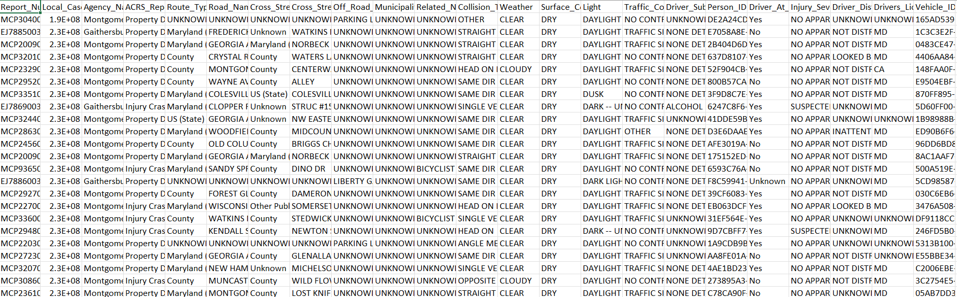
About Dataset
‘Montgomery County Crash Reporting Drivers’ Dataset contains 167208 Rows and 43 columns
The ‘NOIR’ features of dataset are:
1.Nominal: Weather, Light, Driver_At_Fault
2.Ordinal: Driver Substance Abuse, Injury Severity
3.Ratio: Speed Limit
4.Interval: Location
Reasons For Choosing the dataset:
Identify the factors involving the road accidents, thereby taking preventive actions to reduce the frequency of accidents and fatalities in future.
It also helps the Government in making the road Infrastructure Sustainable and Safer to the People by altering the Traffic rules and Road Engineering Methods.

Slide 3
Phases of Study and Tools
Phases of Study:
1.Data Cleaning
2.Data Transformation
` 3.Statistics
4.Visualisation
Tools:
1.R
2.Python
3.Sql
4.MS-Excel

Slide 4
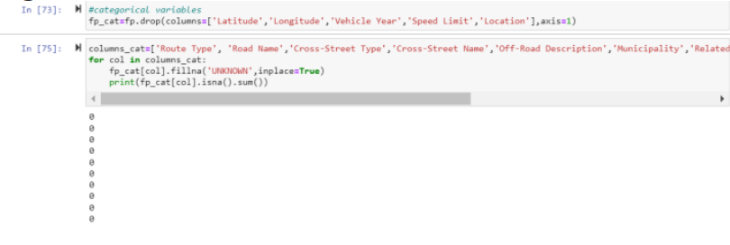
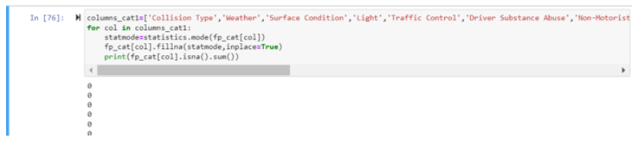
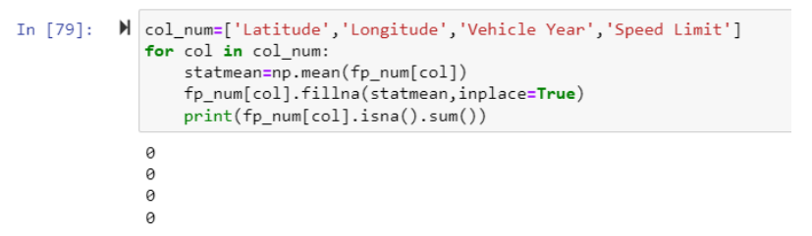
Data Cleaning Using Python
I have removed null values by replacing with ‘UNKNOWN’ for some of the categorical Variables.
Replaced Null values by Imputing with mode in categorical and with mean in numerical variables.
Removed Unnecessary Columns

Slide 5
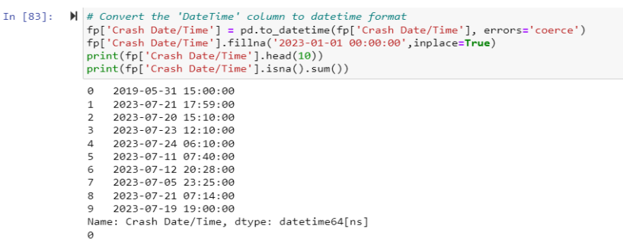
Data Transformation Using Python
‘The Crash Date/Time’ variable contains date and time at which the accident happened which is then converted to useful format by using datetime() function in python

Slide 6
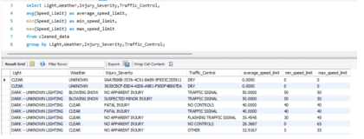
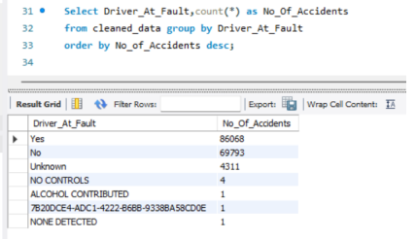
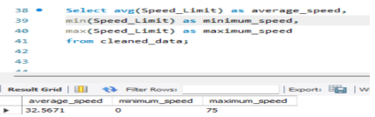
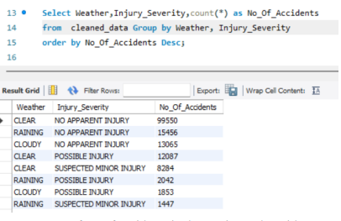
Statistics using SQL.
My Study Consists of Implementing Statistical Techniques such as Grouping, Min, Max and Mode using Sql language with MySql Workbench.

Slide 7
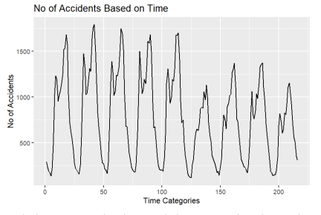
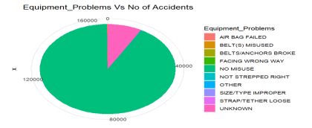
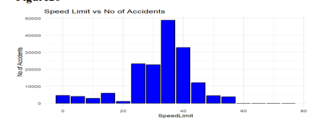
Visualisation & Interpretation using R
The final phase is Visualising the statistics to analyse the data and interpret the results. It helps us to answer the research questions.
1. What are the features in your dataset that you want to focus to reach your goal?

Slide 8
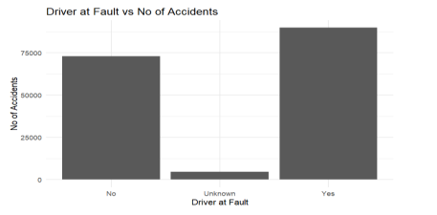
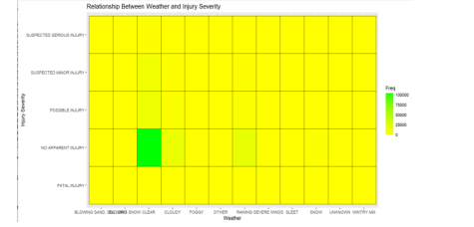
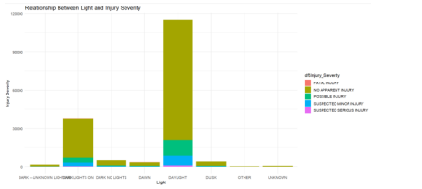
Visualisation & Interpretation using R
2. What are the causes of vehicle accidents on Montgomery county?

Slide 9
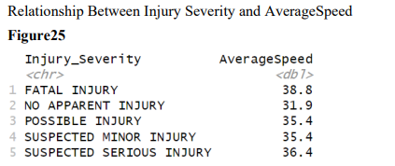
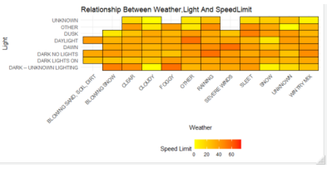
Visualisation & Interpretation using R
3. Is there any relation between speed limit and injury severity?
Multivariate Analysis:->

Slide 10

Lessons Learned from this Project
Understand the phases involved in Data Analytics Project
Explore Tools and Technologies that are available for Data Analysis
Explore Libraries in python & R which are used for cleaning and Visualisation
Understand the Relationships between different types of variables and their importance towards reaching goal point.
Understand how to make analysis specific to the framed research questions.

