Slide 1
UNIT- II
Harmony in the Human Being
Human Being is more than just the Body.
Harmony of the Self (‘I’) with the Body.
Understanding Myself as Co-existence of the Self and the Body.
Understanding Needs of the Self and the needs of the Body.
Understanding the activities in the Self and the activities in the Body.

Slide 2
Human Being is more than just the Body
Introduction:
There is the familiar shape and structure of a human being that is immediately apparent to us. Imagine someone with similar human body-like features. But in addition to the body, there is also the alive-ness of the person — the entity that keeps the body 'alive' and makes it operate in various ways. We perceive this aliveness in the activities demonstrated by the person like their seeing, ti listening, walking, and eating, etc. This aliveness is called Jivana.
Thus, a human being is a coexistent body and jivan. This jivan refers to itself as 'I' (self). Thus we say "I am so and so" or "I feel tired" or happy" and not "my body is happy". This I or self is also called 'consciousness' and is the sentient con of the human being. The human being is the sum total of sentiments and physical aspect, the self (I) and the body there is exchange of information between the two, i.e. 'I' and body exist together and are related. The flow of information from T to the body and from body to the 'I'.

Slide 3
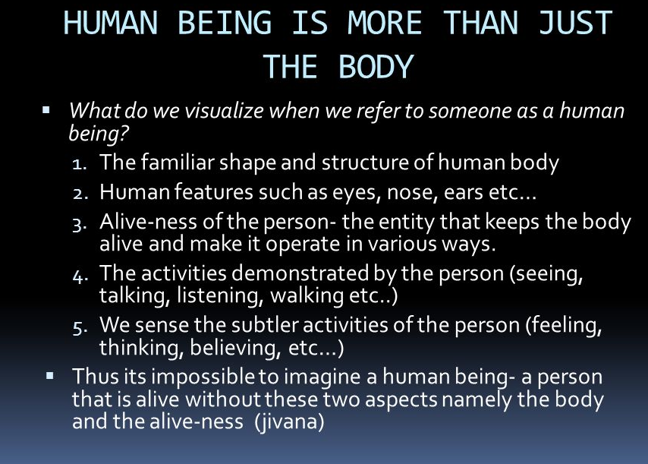

Slide 4
Harmony of the Self (‘I’) with the Body
The human body is a self-organized unit with a highly sophisticated mechanism. It is made up of several organs such as the heart, lungs etc. and various glands, all of which work in a close co-ordination.
The body is made up of cells and each cell of the body has a role to play in the overall working of the body. Each cell is Self-organized and participates in the Self- organization of the body as a whole.
-All the activities in the body keep the body fit for the use of “I”
Harmony of the “I” with the Body:
The harmony of “I” with the body is:
i. In the form of Sanyama (Self-Regulation) on part of “I” ii. In the form of Svasthya (Health) on part of the “Body”

Slide 5
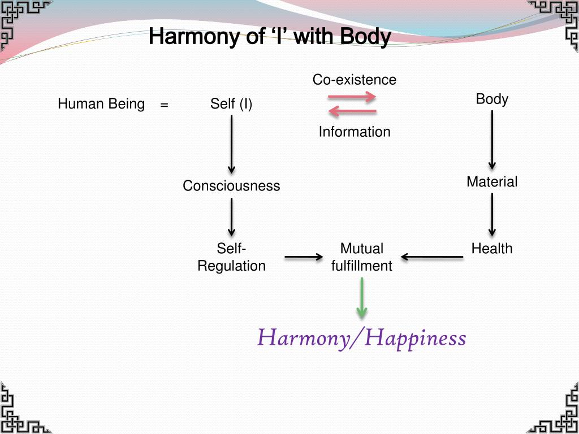

Slide 6
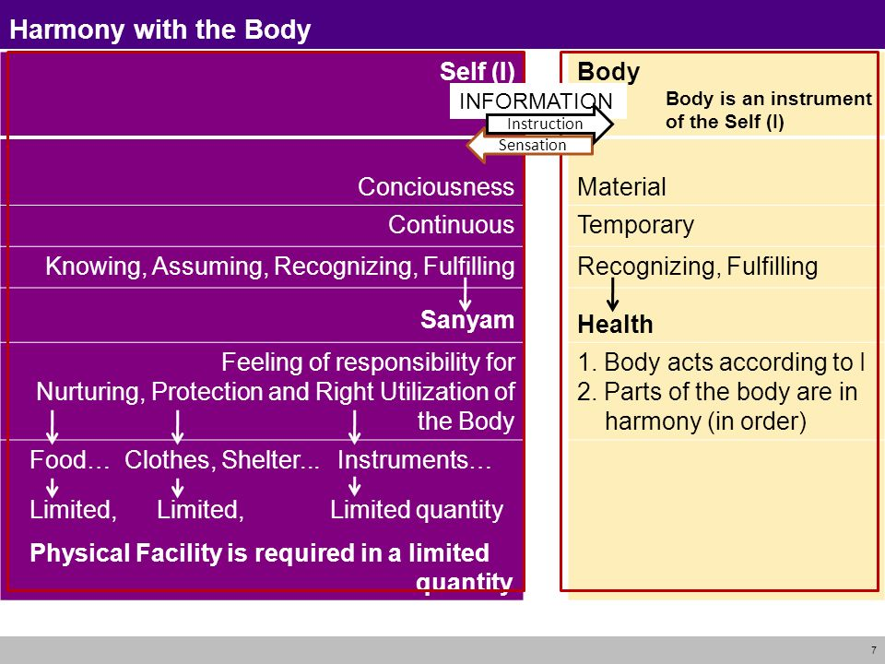

Slide 7
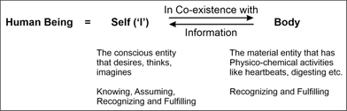
Understanding Myself as Co-existence of the Self and the Body
The human being is a co-existence of conscious Self (I) and material Body. Conscious entity (Self) performs activities of knowing, assuming, recognizing and fulfilling whereas material entity (Body) performs only activities of recognizing and fulfilling.

Slide 8
Understanding The Human Being As Co-Existence of Self “I” & “Body”
Human being is more than just a Body. She/he is a co-existence of both the self(i/Jivana) and the Body.
There is an exchange of information between the two. Our body acts according to the suggestions given by our “Jivana”.
Human Being
Physical Body
Alive-ness (I or Self)

Slide 9
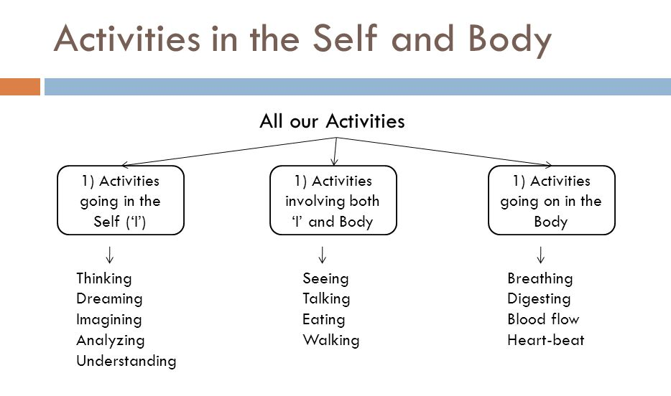

Slide 10
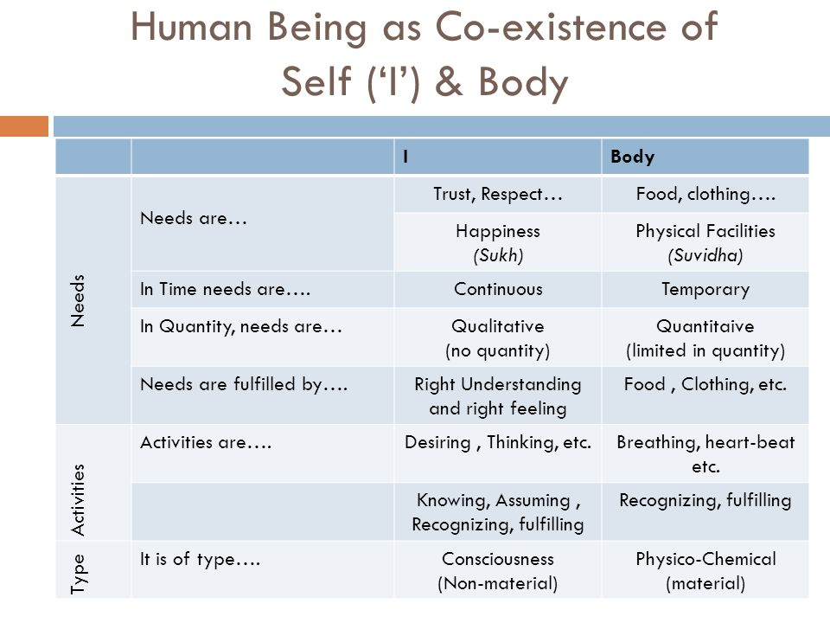

Slide 11
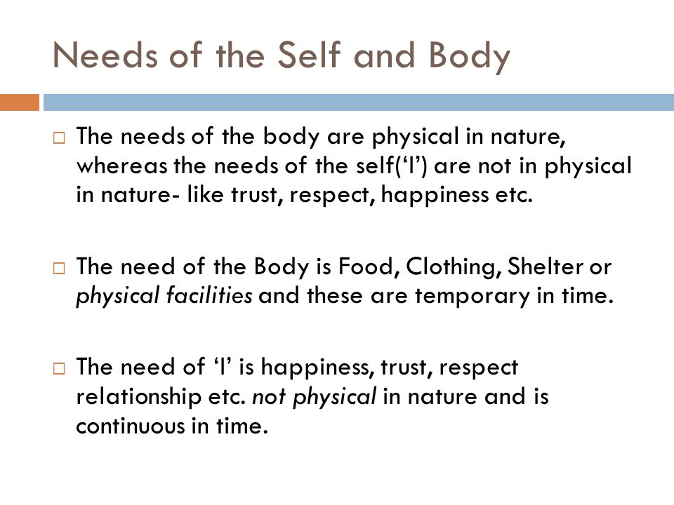
Understanding Needs of the Self and the needs of the Body
Self ( I ) needs respect, happiness, trust etc. Thus, the need of Self is to live in state of continuous happiness. Needs of body are quantitative and temporary in nature whereas needs of Self are qualitative and continuous in nature. Activities like imagining, dreaming, thinking, choosing, understanding etc.
Needs of the Self(I) and Body:

Slide 12
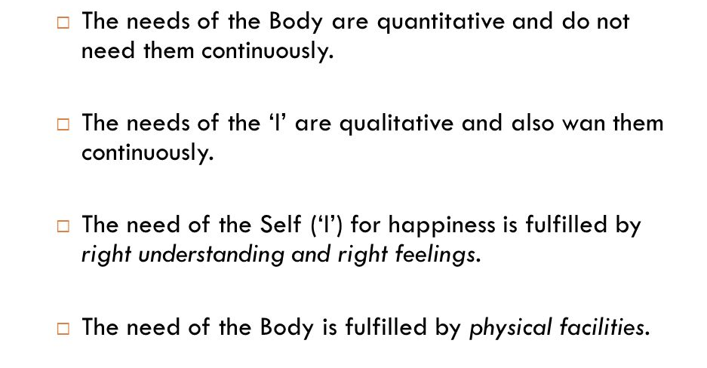

Slide 13
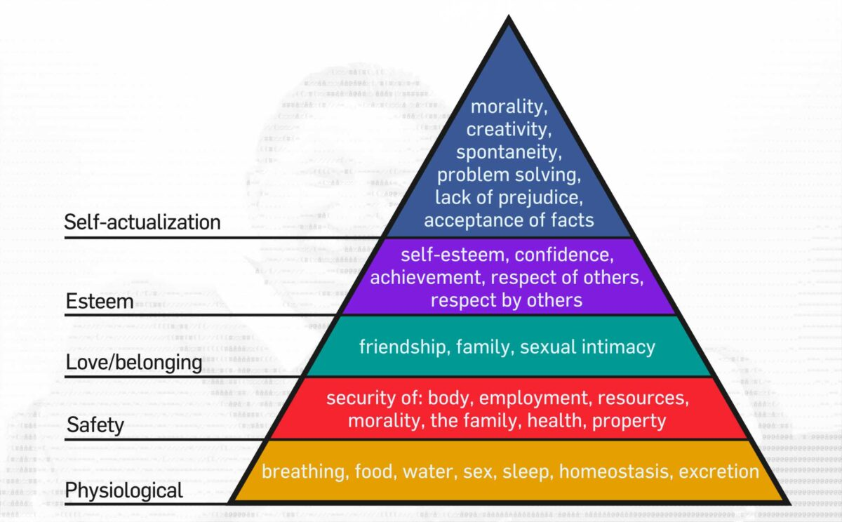
Abraham Maslow’s Hierarchy of Needs Theory:

Slide 14
Understanding the needs of self I and Body (Suka and Suvidha):
The needs of the self(or “I”) and the body can be broadly categorized into two categories: sukh (happiness) and suvidha (convenience). Here’s a closer look at these two needs:
Suka: Sukh refers to the psychological and emotional needs of the self, and includes feelings of happiness, fulfillment, and contentment.
Relationships: Positive and meaningful relationships with others can provide a sense of belonging, security and happiness.
Personal growth: Pursuing personal growth and self-discovery can help the self to better understand itself, its values, and what truly brings joy and fulfillment.
Spirituality: Engaging in spiritual practices can help the self-connect with a deeper sense of meaning and purpose, which can contribute to feelings of happiness and peace.
Creativity: Engaging in creative pursuits can help the self-tap into its imagination and express its individuality, which can contribute to feelings of joy and fulfillment.

Slide 15
Suvidha refers to the physical and material needs of the body, and includes the provision of food, shelter, safety, and physical comfort.
Examples of these needs include:
Food: The body requires nourishment in the form of food to provide energy and support growth and repair.
Shelter: The body requires a safe and secure place to live to protect against the elements and provide a sense of security.
Safety: The body requires a safe and secure environment to thrive, free from harm and danger.
Physical comfort: The body requires physical comfort, including adequate sleep, physical activity, and hydration, to function optimally.

Slide 16
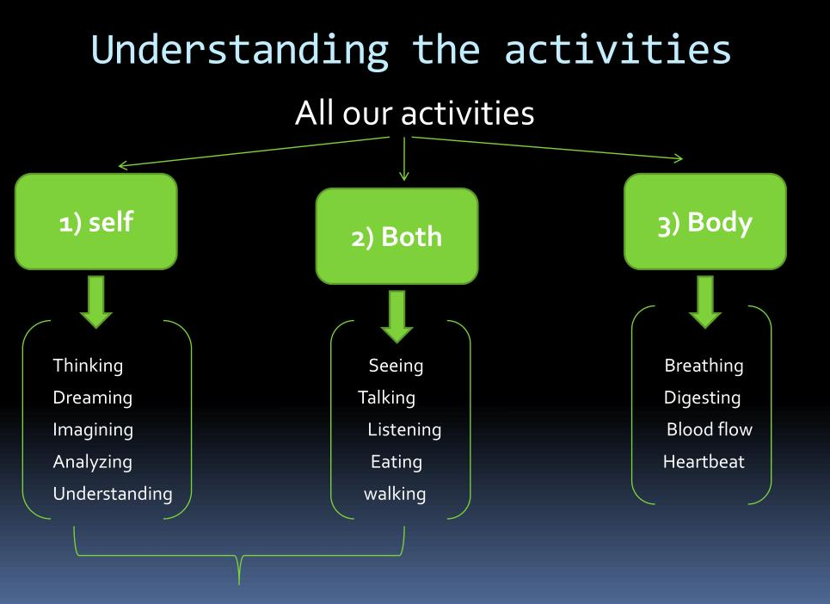
Understanding the activities in the Self and the activities in the Body
Conscious entity (Self) performs activities of knowing, assuming, recognizing and fulfilling whereas material entity (Body) performs only activities of recognizing and fulfilling. There is a need to work for physical facilities of Body.

Slide 17
The self is conscious in nature while the body is physico-chemical in nature. The interaction is the 'I' and the body is in the form of exchange of information. So the focus of attention is on two categories of attributes of the self, namely, the powers of the self and the corresponding activities as the mi outcomes of these powers.
1. Power: This means the basic capacity in the self (I).
They are: desires, thoughts and expectations.
2. Activities: The activities are: imaging, analyzing, and selecting/tasting. The activity of analyzing breaking down the image into various parts or to open it up. Selecting/tasting is with the expectation fulfilling our desires with the expectation of happiness. The activity of selecting/tasting is the basic via which the self interacts with the body.
A simple example to understand these activities is a follow:
• We may have a desire to have respect by being the owner of a big house. This is in the form of imagination we have an image in us of fulfillment of this need for respect via a house.
• Based on this desire, we start working out the details of the house. Example: no. of rooms, on floor in will stay. The image of wanting respect from the house is split into many parts — this is analyzing. The activity of analyzing means breaking down the image into various parts.
• Now that we have worked out the details of the house, we go about choosing the size, color etc.

Slide 18
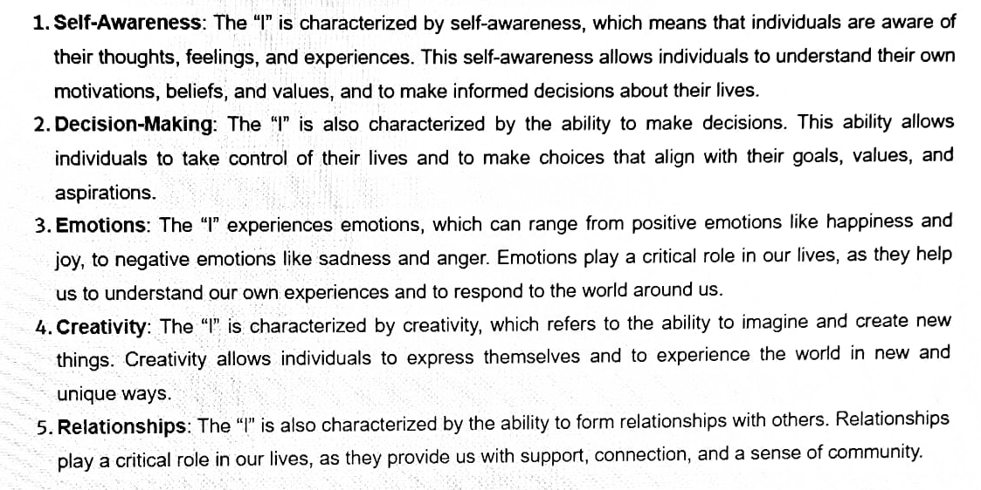
Understanding the characteristics and activities of “I” and Harmony in “I”
Characteristics:

Slide 19
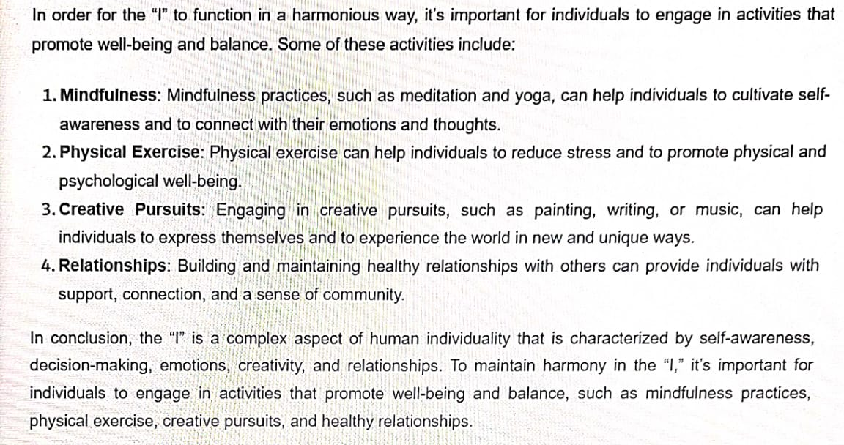
Activities:

Slide 20
THE-END

