Slide 1
UNIVERSAL HUMAN VALUES
UNIT- I
Introduction to Value Education
Value Education, Definition, Concept and Need for Value Education.
The Content and Process of Value Education.
Basic Guidelines for Value Education.
Self-exploration as a means of Value Education.
Happiness and Prosperity as parts of Value Education.

Slide 2
UNIT- I
Introduction to Value Education
The word "value" is derived from the Latin word 'Valerie' meaning to be strong aid vigorous. To be of value is to have a certain virtue. The sense of value is an essential attribute of the human consciousness.
Meaning:Value education helps students to become ethical and moral individuals who can contribute positively to society. It not only teaches them about values but also helps them to develop critical thinking skills, empathy, and a sense of responsibility towards themselves and others.
Definitions:
Education means the training for the country and love for the nation - Chanakya
Education is realization of self -Shankaracharya
Education is an all round drawing out of the best child & man body,
Mind & spirit. -Mahatma Gandhi
Education is the natural, harmonious & progressive development of
Man’s innate power -Pestalozzi
The term "education" is derived from the Latin words educare, meaning "bring up, rear, educate", primarily related to the mind, and educere, meaning "bring out, lead forth", and refers to the bodily level.

Slide 3
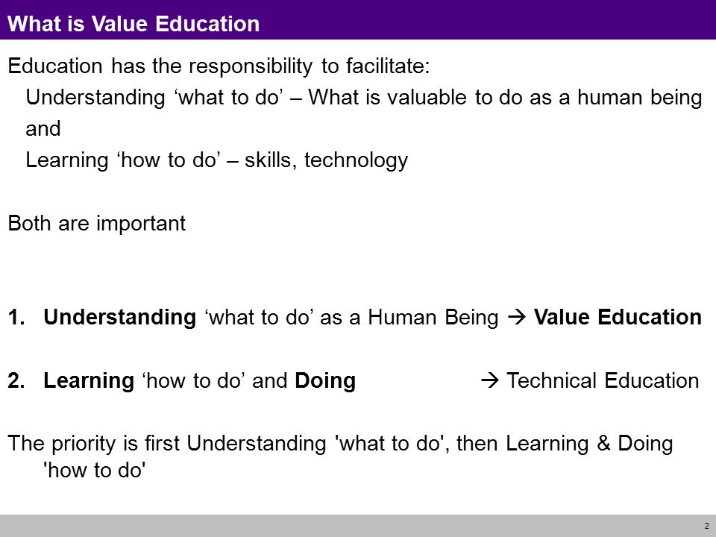

Slide 4
Types, Importance and Need for Value Education
Values education refers to the aspect of the educational practice which entails that moral or political values as well as norms, dispositions and skills grounded in those values are mediated to or developed among students. Values education can be referred to as explicit or implicit.
Types of Value Education:
Cultural Value
Cultural values are concerned with what is right and wrong, good and evil, as well as conventions and behavior. Language, ethics, social hierarchy, aesthetics, education, law, economics, philosophy, and many social institutions all reflect cultural values.
Moral Value
Ethical principles include respecting others' and one's own authority, keeping commitments, avoiding unnecessary conflicts with others, avoiding cheating and dishonesty, praising people and making them work, and encouraging others.
Personal Values
Personal values include whatever a person needs in social interaction. Personal values include beauty, morality, confidence, self-motivation, regularity, ambition, courage, vision, imagination, and so on.
Spiritual Value
Spiritual worth is the greatest moral value. Purity, meditation, yoga, discipline, control, clarity, and devotion to God are examples of spiritual virtues.
Spiritual value education emphasizes self-discipline concepts. satisfaction with self-discipline, absence of wants, general greed, and freedom from seriousness.
Social Value
A person cannot exist in the world unless they communicate with others. People are looking for social values such as love, affection, friendship, noble groups, reference groups, impurity, hospitality, courage, service, justice, freedom, patience, forgiveness, coordination, compassion, tolerance, and so on.

Slide 5
Importance of Value Education:
Value education ought to be integrated into the educational process rather than being considered a separate academic field. The value of value education can be understood from many angles. The following are some reasons why value education is essential in the modern world-
It aids in making the right choices in challenging circumstances, enhancing decision-making skills.
It cultivates important values in students, such as kindness, compassion, and empathy.
Children's curiosity is sparked, their values and interests are developed, and this further aids in students' skill development.
Additionally, it promotes a sense of brotherhood and patriotism, which helps students become more accepting of all cultures and religions.
Due to the fact that they are taught about the proper values and ethics, it gives students' lives a positive direction.
It aids students in discovering their true calling in life—one that involves giving back to society and striving to improve themselves.
A wide range of responsibilities come with getting older. Occasionally, this can create a sense of meaninglessness, which increases the risk of mental health disorders, midlife crises, and growing dissatisfaction with one's life. Value education seeks to fill a void in peoples' lives in some small way.
Additionally, people are more convinced and dedicated to their goals and passions when they learn about the importance of values in society and their own lives.

Slide 6
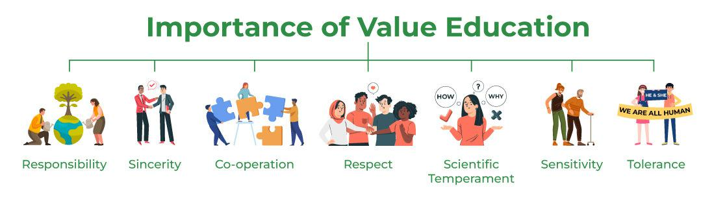

Slide 7
Need of Value Education:
Value education is the process of teaching and learning about the principles and ideals that are considered important in life. It is an essential component of education because it helps individuals to develop a set of values that will guide their behavior and decision-making.
1.Developing moral and ethical values: Value education helps individuals to develop a strong moral and ethical compass, which is essential for living a fulfilling and meaningful life. It helps them to understand the difference between right and wrong and to make decisions based on what is fair, just, and good for others.
2.Promoting positive social behavior: Value education encourages individuals to behave in a way that is respectful and considerate of others. It helps them to develop empathy and compassion and to understand the importance of cooperation, collaboration, and teamwork.
3.Building character and resilience: Value education helps individuals to develop the personal qualities and characteristics that are necessary for success in life. This includes traits such as honesty, integrity, responsibility, perseverance, and self-discipline.
4.Preparing for responsible citizenship: Value education helps individuals to understand their roles and responsibilities as members of a community and to become active and engaged citizens who contribute to the common good.
5.Creating a more peaceful and harmonious world: Value education promotes peace, harmony, and tolerance and helps individuals understand the importance of working together to create a more peaceful and just world.

Slide 8
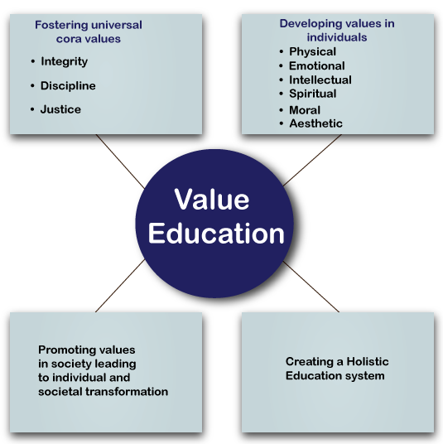
Purpose of Value Education:

Slide 9
Content of Value of Education:
Scope of VE includes:
All dimensions (thought, behavior, work and realization)
All levels(individual, family, society and nature –existence)
Content will be understand:
My self
My happiness
My aspirations , the goal of human life comprehensively
The other entities nature
The innate inter connectedness
The co-existence in the nature-existence
The role of human being in this nature entirely

Slide 10
Process of Value of Education:
Process has to be that of self-exploration. This includes two things
verification at the level of self acceptance
Experiential validation in living
There can be many ways to impart knowledge to students. The process should be easily understandable. There can be following four methods that can be adopted for value education:-
Individualized Learning:- This is the highly interactive way of learning the values. This is very personal one to one interaction with the learner. The basic drawback of this type of this type of learning as we are the part of a society and we should develop all those values in student as well.
Group Learning:- The group working is always different from individual working. Some students are lack behind from interpersonal skills. The group learning helps these students in overcoming these problems. This method teaches co-operation and co- ordination among the members of the group.
Project Learning:- This is one of the best methods of learning. The projects are basically real life problems and students needs to find out the solutions on the basis of their value system. This teaches the concept of self- explanation and Self- verification to do best in their respective field.
Open Learning:- Open learning is a teaching method i.e. among others, founded on the work of ‘Maria Montessori’. Open learning is supplied to allow pupils self-determined, independent and interest-guided learning.

Slide 11
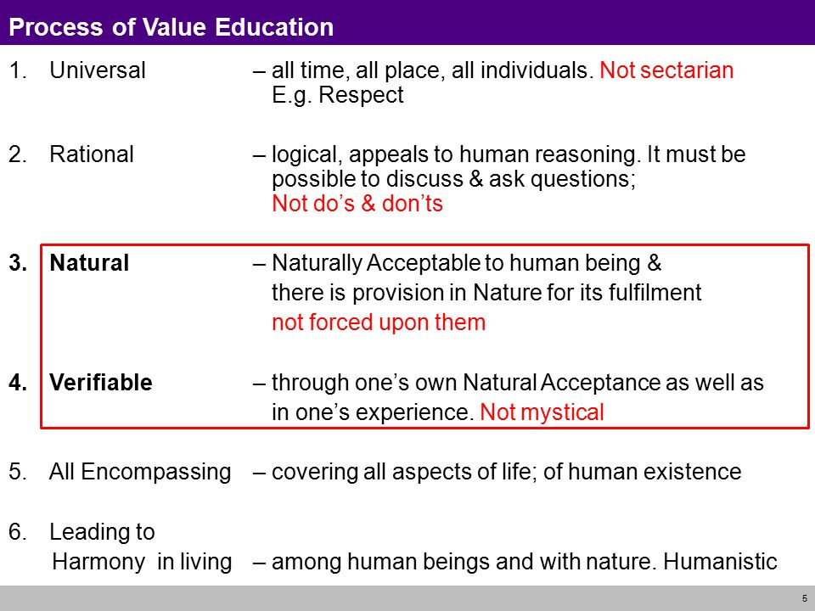
Basic Guidelines for Value Education:

Slide 12
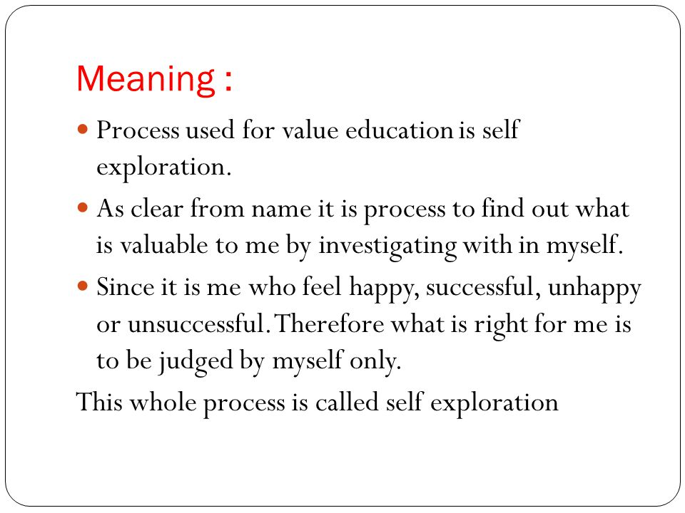
Self-exploration as a means of Value Education:

Slide 13
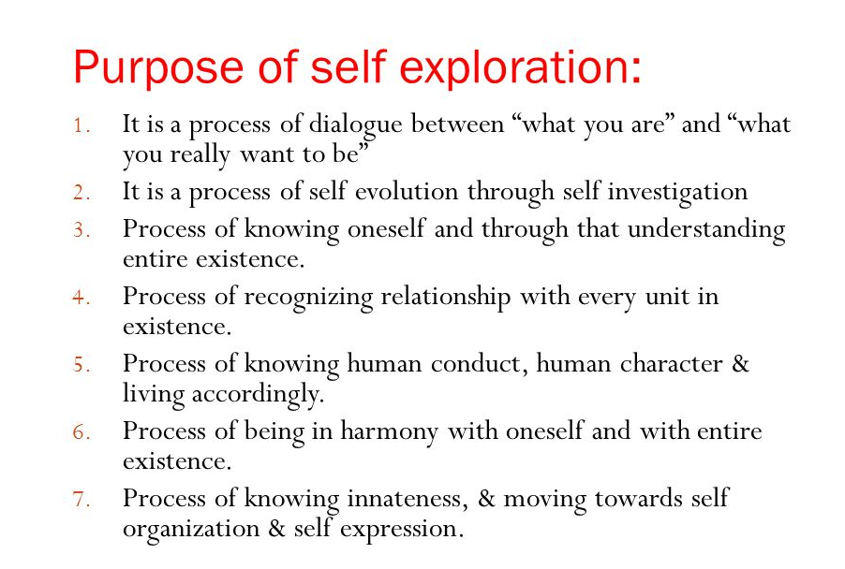

Slide 14
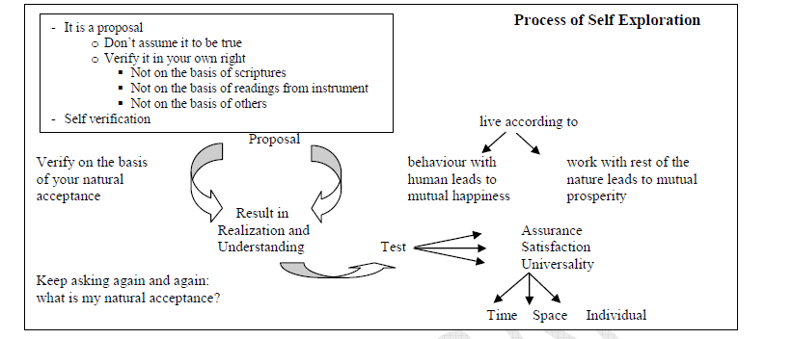
Process of Self Exploration:

Slide 15
Happiness and Prosperity as parts of Value Education:
Meaning of Happiness:
Happiness may be defined as being in harmony/synergy in the state/ situation that I live in. "A situation in which I live, if there is harmony in it then I like to be in that state / situation. The state of is happiness." Happiness is a state of mind or feeling characterized by contentment, love, satisfaction, pleasure or joy. Happiness may be described as consisting of positive emotions and positive activities. may be three kinds of happiness: pleasure, engagement, and meaning.
Meaning of Prosperity:
The feeling of having or making available more than required physical facilities is prosperity. all of us feel that wealth alone means prosperity and try to explain this phenomenon based on this non-exist half fact. We are trying to achieve happiness and prosperity by maximizing accumulation and consumption of physical facilities. It is becoming anti-ecological and anti-people, and threatening the human itself For prosperity, two things are required-
1. Identification of the required quantity of physical facilities, and
2. Ensuring availability / production of more than required physical facilities. We can be prosperous only if there is a limit to the need for physical facilities. If there is no what so ever be the availability the feeling of prosperity cannot be assured. Secondly, just assessing the need is not enough. We need to be able to produce or make av; more than the perceived need.

Slide 16
Vision of a Happy and Prosperous Life:
We are trying to achieve happiness and prosperity by maximizing accumulation and consumption of physical facilities. It is becoming anti-ecological and anti-people, and threatening the human survival itself. Some of the consequences of such trend are summarized below:
At the level of individual – rising problems of depression, psychological disorders, suicides, stress, insecurity, etc.
At the level of family – breaking of joint families, mistrust, and conflict between older and younger generations, insecurity in relationships, divorce, dowry tortures, etc.
At the level of society – growing incidence of terrorism and naxalism, rising communalism, spreading casteism, racial and ethnic struggle, wars between nations, etc.
At the level of nature – global warming, water, air, soil, noise etc. pollution, resource depletion of minerals and mineral oils, etc.
All the problems are a direct outcome of an incorrect understanding, our wrong notion about happiness and prosperity and their continuity – this is an issue for serious exploration.

Slide 17
THE-END

