Slide 1
UNIT III
Harmony in the Family and Society and Harmony in the Nature
Family as a basic unit of Human Interaction and Values in Relationships.
The Basics for Respect and today’s Crisis: Affection, e, Guidance, Reverence, Glory, Gratitude and Love.
Comprehensive Human Goal: The Five Dimensions of Human Endeavour.
Harmony in Nature: The Four Orders in Nature.
The Holistic Perception of Harmony in Existence.

Slide 2
Family as a basic unit of Human Interaction and Values in Relationships
Understanding harmony in the Family; The basic unit of human interaction. Harmony in the family and society refers to a state of peaceful coexistence and cooperation among individuals. In human-human relationships, harmony is achieved through mutual respect, trust, and understanding.
Harmony in Family:
1.Relationship IS and it exists between the Self (‘I’) and the other Self (‘I’).
2.The Self (‘I’) has feelings in a relationship. These feelings are between ‘I’ and ‘I’.
3.These feelings in the Self (‘I’) are definite. i.e. they can be identified with definiteness.
4.Recognizing and fulfilling these feelings leads to mutual happiness in relationship.
Recognizing and Fulfilling Feelings Leads to Mutual Happiness in a Relationship.
•Once we have recognized the existence of human relationships, we are subsequently able to identify the feelings (values)
.•It leads to mutual fulfillment
•Justice is the recognition of values (the definite feelings) in relationship, their fulfillment, the right evaluation of the fulfillment resulting in mutual happiness (Ubhay-tripti).

Slide 3
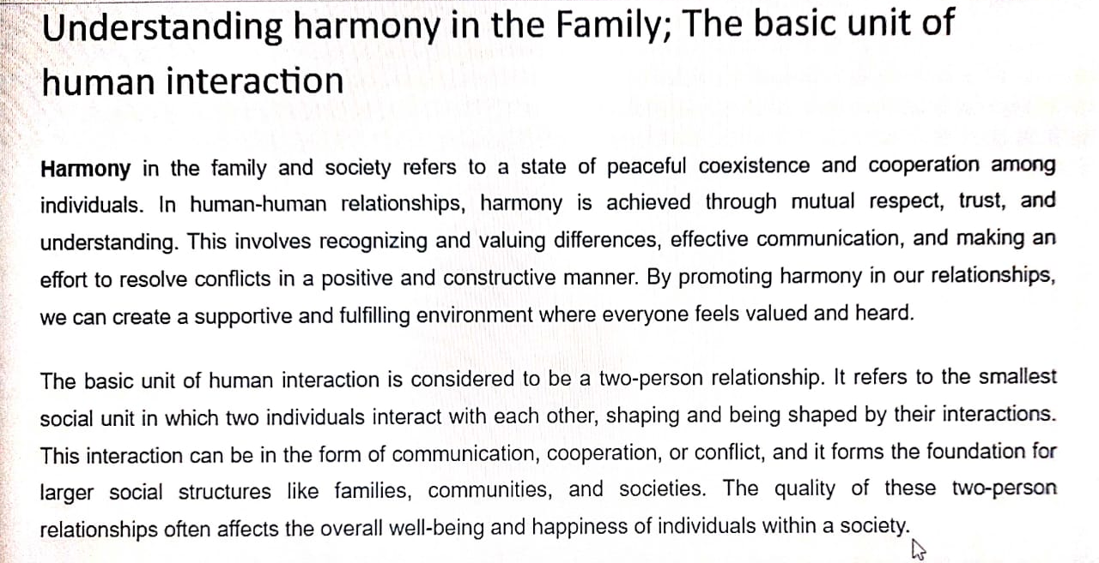

Slide 4
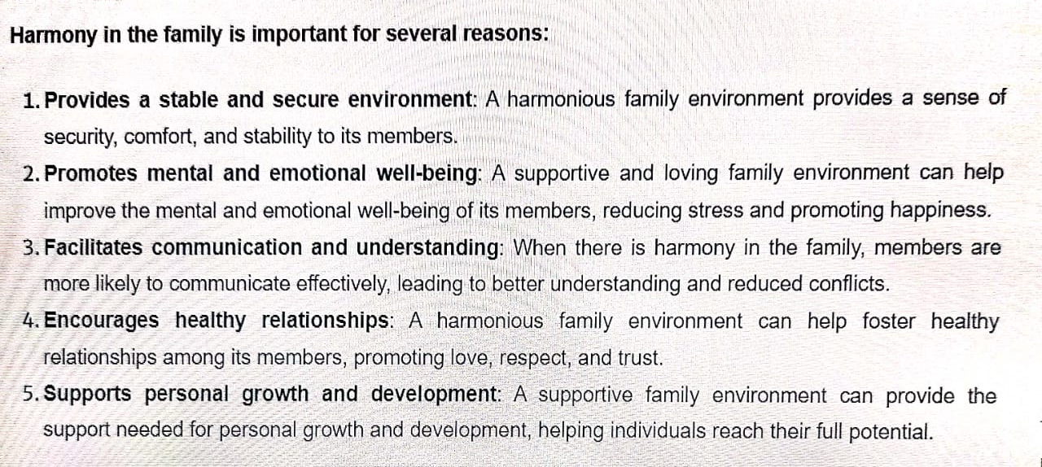

Slide 5
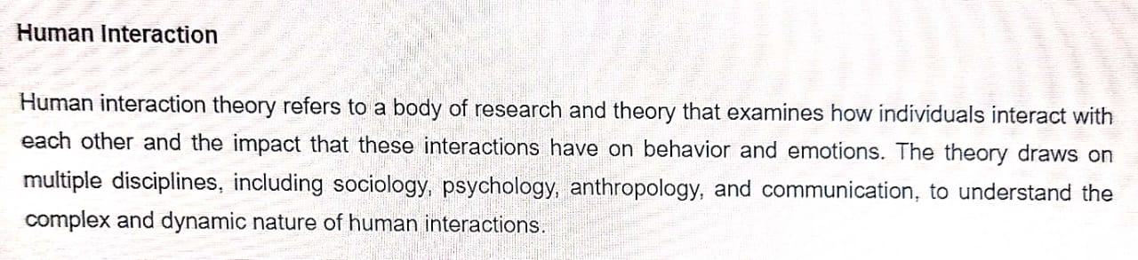
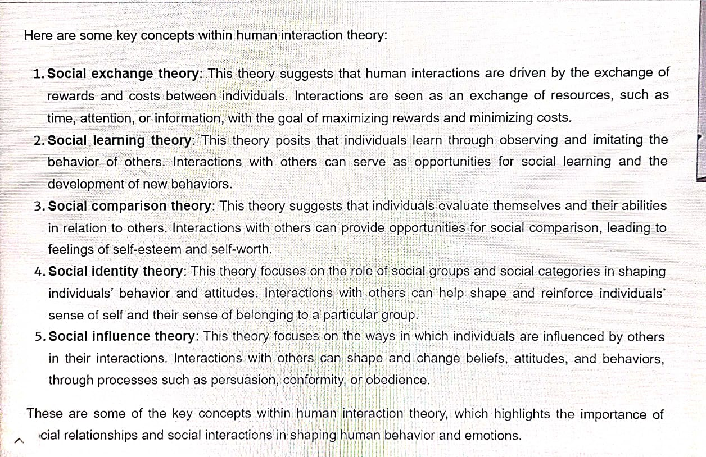

Slide 6
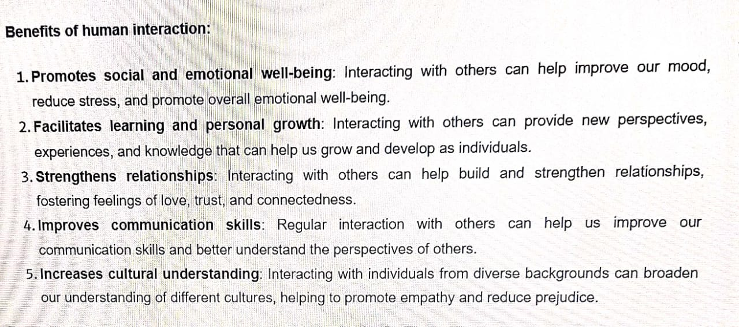

Slide 7
Feeling in Relationship:
The Basics for Respect and today’s Crisis: Affection, e, Guidance, Reverence, Glory, Gratitude and Love:
1- Trust
2- Respect
3- Affection
4- Care
5- Guidance
6- Reverence
7- Glory
8- Gratitude
9- Love

Slide 8
Respect, Reverence, Glory and Gratitude
Basic human aspiration = Continuous happiness
= To achieve excellence
Excellence
Understanding Harmony &
Living in Harmony
Continuous Happiness
Respect – For all (It is the right evaluation)
Reverence – For those who have achieved excellence
Glory – For those who have made effort for excellence
Gratitude – For those who have made effort for my excellence
at all 4 levels
In the Human Being
In Family
In Society
In Nature/Existence

Slide 9
Feelings:
Trust I am assured that the other intends my happiness & prosperity. The other is similar to me. I have a feeling of being related to the other
Respect Right evaluation. We can make effort together.
We are complementary to each other.
Fulfilling the responsibility in the relationship unilaterally from my side ensures my happiness
Affection Acceptance of the other as one’s relative
Care Responsibility & commitment for nurturing and protecting the body of one’s relative
Guidance Responsibility & commitment for ensuring Right Understanding and Right Feeling in the self of one’s relative
Reverence Acceptance for Excellence
Glory Acceptance for those who have made effort for Excellence
Gratitude Acceptance for those who have made effort for my Excellence
Love The feeling of being related to all

Slide 10
Comprehensive Human Goal: The Five Dimensions of Human Endeavour:
Comprehensive human goals are right understanding, prosperity, fearlessness and co-existence.
Programs needed to achieve the comprehensive human goals are:
1. Education - Right Living
2. Health - Self Regulation
3. Justice - Preservation
4. Production - Work
5. Exchange - Storage
Education - Right Living: Education refers to understanding harmony at all four levels of living. While right living refers to commitment and preparedness to live in harmony at all four levels of living.
Health - Self Regulation: refers to a feeling of responsibility for nurturing, protecting and rightly utilizing the body. When the body is fit to act according to the needs of the self (I'), and there is harmony among the parts of the body, it is referred to as health
Justice - Preservation: Justice refers to harmony in the relationship between human beings, while preservation refers to harmony in the relationship between human beings and the rest of nature.
Exchange - Storage: Exchange refers to the exchange of physical facilities between the members of the society, while storage refers to the storage of physical facilities that are left after fulfilling the needs of the family.

Slide 11
We can now see how these five dimensions of humanistic society are able to ensure the human goal:
Education - Right living leads to Right understanding:
Having the process of education and right living leads to the right understanding in the individual.
Health - Self-Regulation leads to Prosperity:
Having the program for health and leads to well being of the body and identification of need for physical facilities which along with production ensures the feeling of prosperity in the family
Justice - Preservation leads to Fearlessness and Co-existence (respectively):
Ensuring justice in the relationship, or mutual fulfillment in the relationship on the basis of values like Trust, Respect, etc leads to fearlessness in society, while of nature - via enrichment, protection and right utilization leads to co-existence in nature.
Production - Work leads to Prosperity and Co-existence:
Production and work are for physical facilities, and this leads to a feeling of prosperity in the family. Production is done in harmony with nature, and hence, this also leads to co-existence with nature.
Exchange - Storage leads to Prosperity and Fearlessness:
When we store and exchange for mutual fulfillment and not for exploitation, then it leads to fearlessness (trust) in society.

Slide 12
How can the comprehensive human goals of Right understanding, prosperity, fearlessness and existence create harmony in society:
What is the comprehensive human goal & Explain how this is conducive to sustainable happiness and prosperity for all:
In order to facilitate the fulfillment of the basic aspirations of all human beings in society, the following comprehensive human goal needs to be understood.

Slide 13
1. Right understanding is necessary for human beings, for all human beings. When one does not have the right understanding, one remains disturbed and also acts in a manner so as to create disharmony with other human beings as well as with the rest of nature.
2. Prosperity is needed in every family. Prosperity in the family means that the family is able to identify its needs and is able to produce/ achieve more than its requirements.
3. Trust in society means every member of society feels related to everyone else and therefore there are trust and fearlessness.
4. Co-existence in nature means there are a relationship and complementarity among all the entities in nature including human beings.

Slide 14
This is the comprehensive human goal:
With a little exploration, we find that all four are required for human society. We are not satisfied with anything less than this. This is the basic minimum requirement to ensure sustainable happiness and prosperity. We can't cut down any of them. This is the minimum level that each one of us wants, and also the maximum we can think of. We can't think of anything more than this. This is the target for each one of us, the whole human race and the human tradition. The moment we leave anyone of them out there will be a loss of continuity, and the goal cannot be achieved.

Slide 15
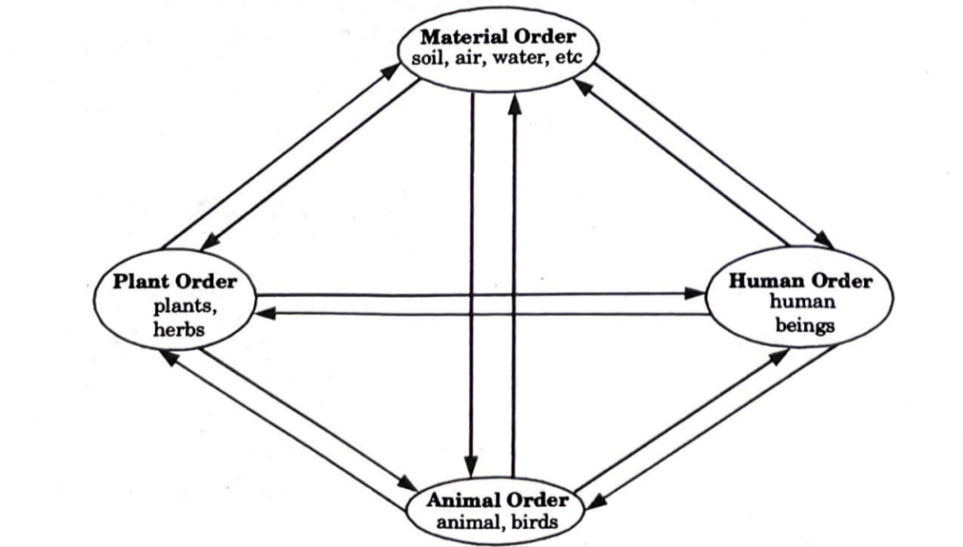
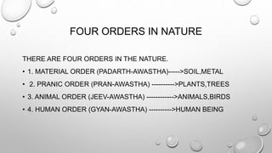
Harmony in Nature: The Four Orders in Nature:

Slide 16
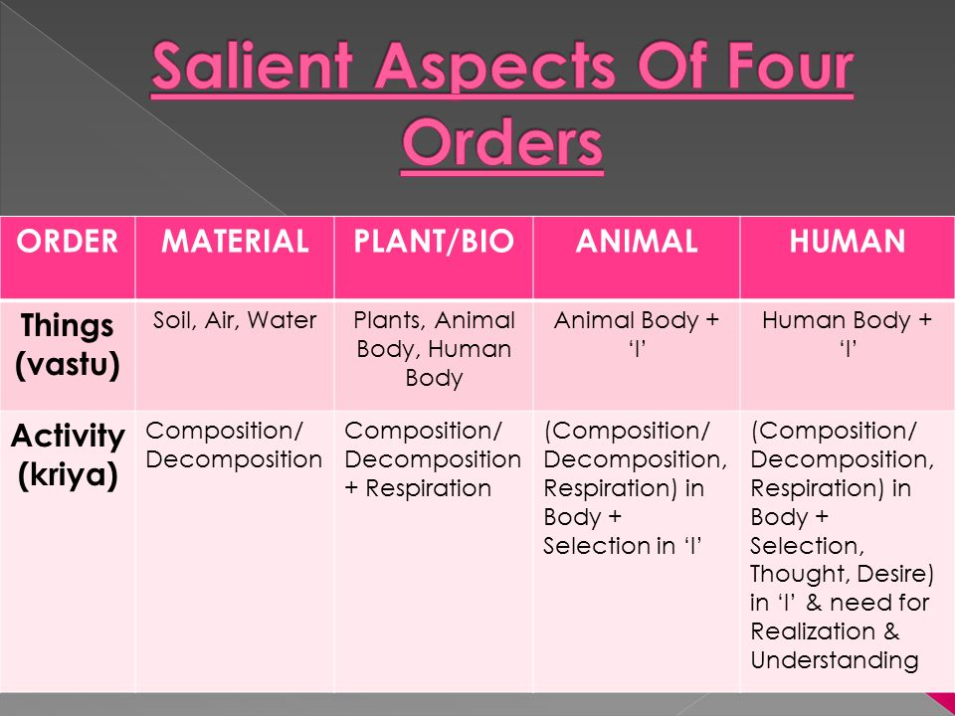

Slide 17
The Four Orders in Nature :
Material, plant, animal, and human orders all contain core values. These are known as their natural characteristics or suabhava.
Four orders are mutually fulfilled; these orders are:
Material Order:
The majority of this order’s members are not living beings. This hierarchy also includes many types of energy such as sound, light, heat, magnetic, and gravitational energy. The primary feature of this sequence is composition/decomposition. They can be combined to make larger objects, and larger units can be divided into smaller ones. They are not produced nor destroyed. For example, the atomic energy is release and generated during nuclear fission and fusion.
Plant /Bio Order:
They range from single-cell organisms like fungus and algae to water plants, herbs, shrubs, and trees. They can reproduce, receive nutrients from the outside world, digest, assimilate, and grow. They also feed the animals and the human race. As a result, the natural feature of this order is to nurture. Excess nutrition, on the other hand, can hurt or “worsen” our bodies.
.

Slide 18
Animal Order:
This order’s members are living organisms. They share many characteristics with the plant order. They are able to move faster than plants. This order’s natural characteristic is that they understand or are aware of the fact that they exist the quality of Self(I), and hence they have an intellectual capability. This understanding also brings out the excess, which is harshness, because they know they may meet their demands through violence and cruelty towards members of other orders or within their own order
Human Order:
They are the most developed of the four orders.
They are living organisms with personal qualities that are equal to those of the plant and animal orders. They are self-sufficient and self-conscious. They have qualities such as patience, courage, and kindness. These skills are unique to them. However, human nature has a tendency to depart from its key attributes. This has resulted in so many conflicts and conflicts in their fundamental element.

Slide 19
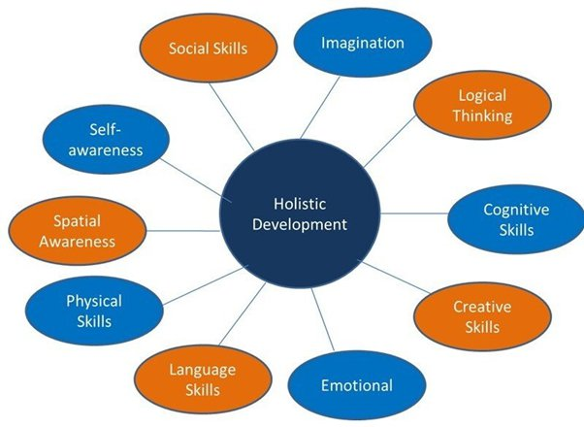
The Holistic Perception of Harmony in Existence:
Introduction: Holistic of harmony at all levels of existence refers to the understanding that all things in the universe are interconnected and interdependent, and that harmony exists at all levels of existence from the individual to the collective, from the physical to the spiritual.

Slide 20
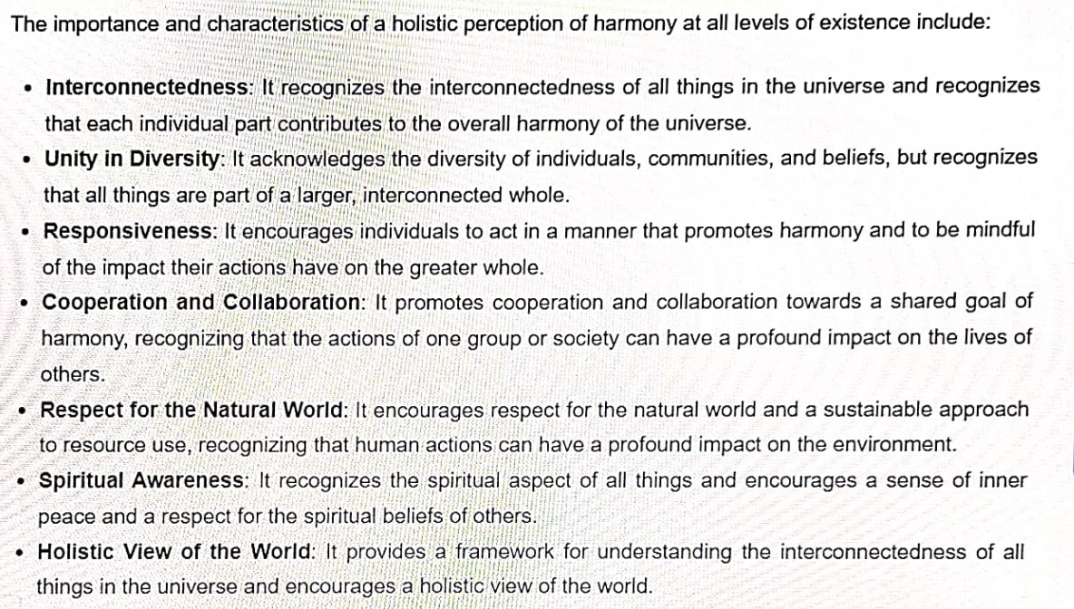

Slide 21
THE-END

