Slide 1
UNIT IV
Social Ethics
The Basics for Ethical Human Conduct.
Defects in Ethical Human Conduct.
Holistic Alternative and Universal Order.
Universal Human Order and Ethical Conduct.
Human Rights violation and Social Disparities.

Slide 2
The Basics for Ethical Human Conduct
Introduction: The definitiveness of Ethical Human Conduct is in terms of values, policies and character. Ethical conduct is the foundation of professional ethics. Depends on three things, namely- 1) Values 2) Policies 3) Character Values- Values are a part of our ethical conduct.
The right understanding gained through self-exploration enables us to identify the definitiveness of human conduct which may also be called the ethical human conduct. It is the same for all human beings. So we are also able to understand the universality of ethical human conduct which is in consonance with the universal human values. Unless we have the right understanding, we are not able to identify the definitiveness of ethical human conduct.

Slide 3
Characteristics of ethical human conduct:
It is a combined representation of – Values , policies and character. Values help us to live in harmony with family, character helps us to live harmoniously in the society and policies help us to maintain harmony with the orders of nature.
Values (Mulya): Values can be witnessed in relationships. The ability to recognize the relationships is due to imagination and being self organized in work. It enables us to understand the relationship between various orders of nature too. We have many relations in life, but the actual purpose of relationship is to be understood. For example, the purpose of relationship between parents and children is fulfillment and protection and living in order. Trust is the functional value that helps us to maintain the continuity of relationship.
Policy (Niti): The assets of an individual include the self ‘I’, the body and the physical resources. It is important that proper coordination exists between them. Policies are the rules which when followed help us to protect, enrich and utilize adequately the various assets possessed by us.
One must evaluate his conduct based on the above three dimensions and self exploration alone bridges the gap between conduct and the ethical human conduct. A human being can be called prosperous and successful if he blends his professional skills with ethical human conduct.
Character (Charitra): Character is determined by the values one incorporates in his life. It is the outcome of the values he possesses, his perception, imagination and the experiences gained during his life time. The characteristics of good character include-
- Having personal trustworthy relationships
- Access to rightful acquiring of wealth
- Compassionate behavior and work

Slide 4
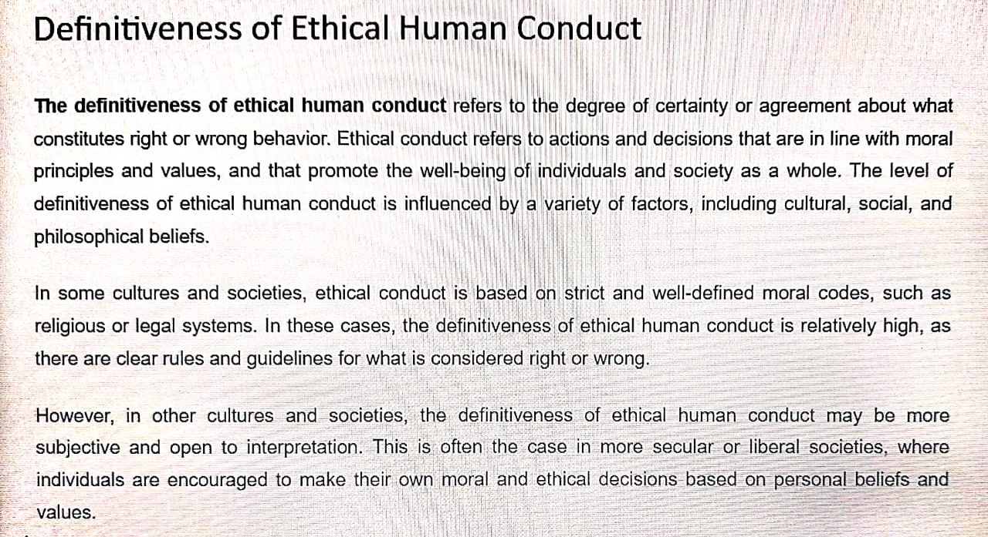
Defects in Ethical Human Conduct

Slide 5
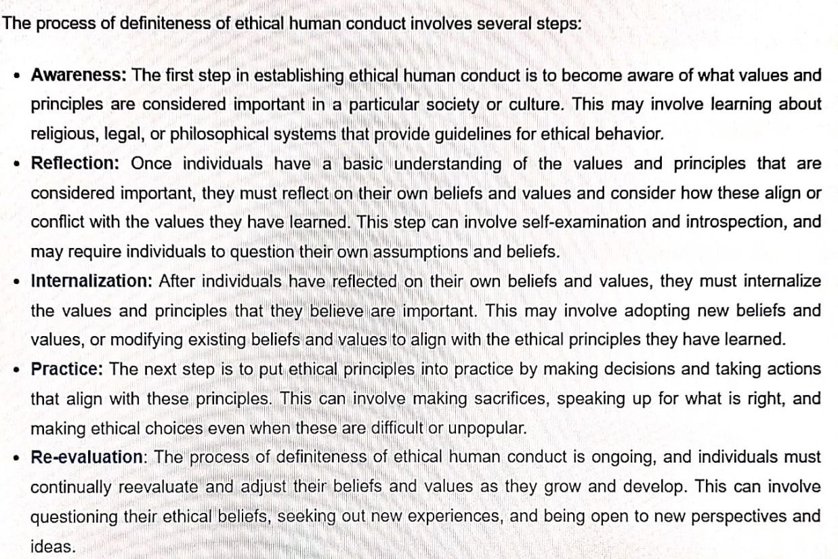

Slide 6
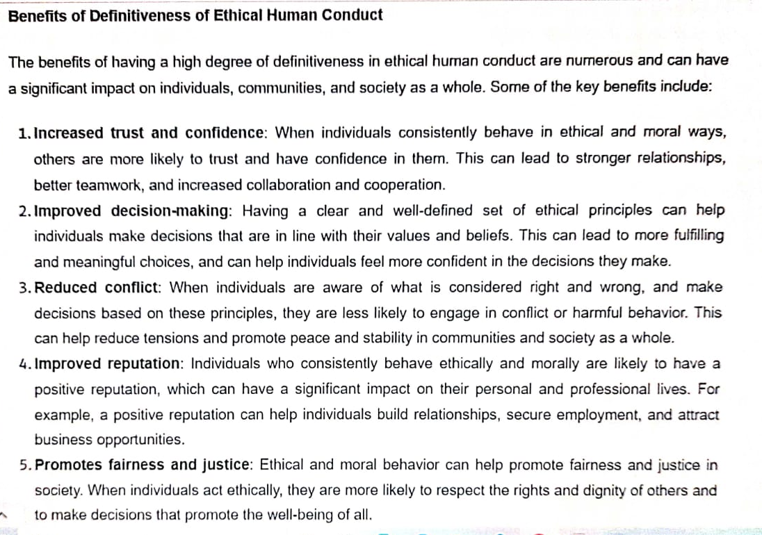

Slide 7
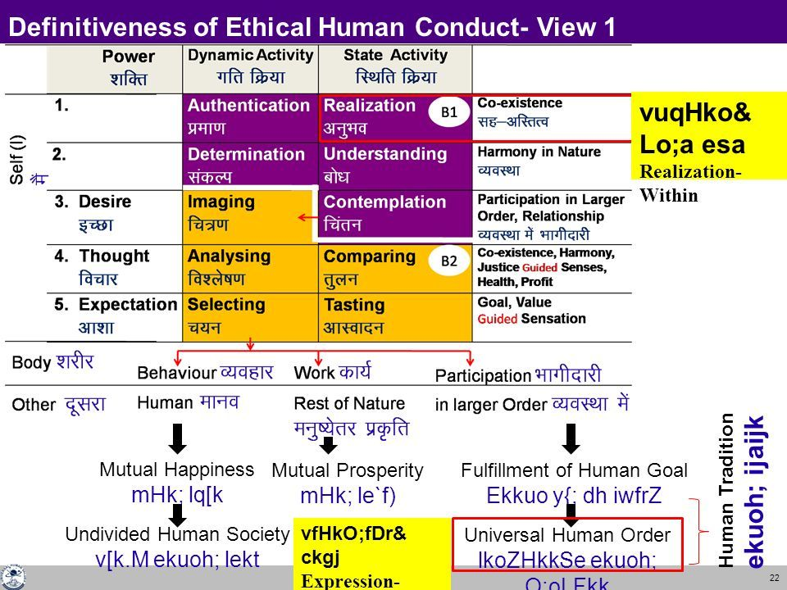

Slide 8
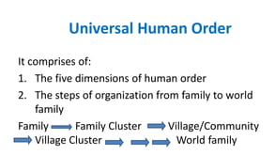
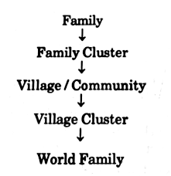
Holistic Alternative and Universal Order & Universal Human Order and Ethical Conduct

Slide 9
The implications of value-based living can be studied in the following terms:
At the level of the individual — Transition towards happiness and prosperity will take place at the individual level. It will instill self confidence, spontaneous joyfulness, peace, contentment and bliss in the self, and also perseverance, bravery and generosity in living of the individual.
At the level of the family - Mutual fulfillment in relationships, prosperity in the family, sustenance of joint families, family as the building block of societal order in place of law enforcing bodies, respect for all without differentiation on the basis of age, gender, caste, race, money, post, creed, etc.
At the level of the society — Fearlessness in the society, holistic systems for education, health, justice, production, exchange and storage, harmony between nations, world growing as a family.
At the level of nature — Co-existence of all units in nature, earth getting more and more suited for sustenance of all entities on the globe, balance of seasons, proper development

Slide 10
Holistic Alternative – Basis for Humanistic Education and Humanistic Constitution:
The right understanding prepares us for moving towards the ‘holistic alternative’ (universal human order, Swarajya) which will be sustainable as well as conducive to fulfill the basic human aspirations for all human beings. It will be a mode of living that is self-satisfying, people-friendly, and eco-friendly. Then all human ingenuity, all the knowledge, and skills available can be harnessed to actualize such a model of living.
The primary step to move towards the holistic alternative is to develop the right understanding among human beings and the commitment to live accordingly and then to develop the requisite skills and know-how to implement the right understanding in real life.
Humanistic education: Humanistic education will incorporate appropriate integration of values and skills so that human beings are able to understand their physical needs correctly and adopt suitable techniques and production systems to cater to these needs in an eco-friendly ad people-friendly manner.
Humanistic constitution: The right understanding also provides us the basis for a humanistic constitution which is essential to provide clear guidelines and policy framework conducive to the development of an un-fragmented human society and a universal human order. Working towards the comprehensive human goal and developing the competence for ethical human conduct will be among the salient directive principles of a humanistic constitution. It will safeguard social justice in the true sense.

Slide 11
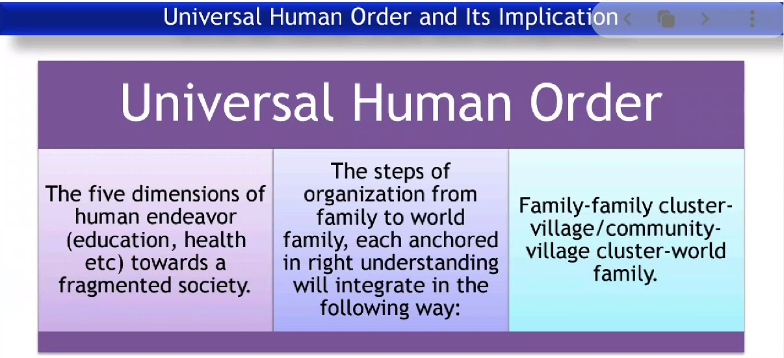

Slide 12
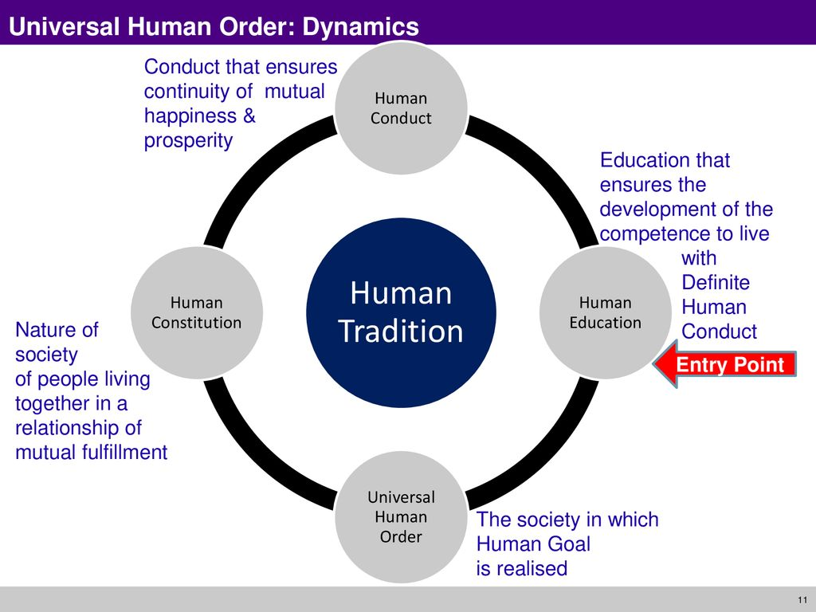

Slide 13
Human Rights violation and Social Disparities
Human Rights violation: A human rights violation is the disallowance of the freedom of thought and movement to which all humans legally have a right. While individuals can violate these rights, the leadership or government of civilization most often belittles marginalized persons.
A human rights violation is the disallowance of the freedom of thought and movement to which all humans legally have a right.
While individuals can violate these rights, the leadership or government of civilization most often belittles marginalized persons.
This, in turn, places these people in the cycle of poverty and oppression. Individuals who approach life with the attitude that not all human lives are of equal value then perpetuate this cycle.

Slide 14
Types of Human Rights Violations:
Directly or Intentionally:
Violations can either be intentionally performed by the state and or come as a result of the state failing to prevent the violation.
When a state engages in human rights violations, various actors can be involved such as police, judges, prosecutors, government officials, and more.
The violation can be physically violent in nature, such as police brutality, while rights such as the right to a fair trial can also be violated, where no physical violence is involved.
Failure by the state to Protect Rights:
It occurs when there's a conflict between individuals or groups within a society.
If the state does nothing to intervene and protect vulnerable people and groups, it's participating in the violations.
In the US the state failed to protect black Americans when lynching's frequently occurred around the country.
Children's Rights:
National Crime Records Bureau (NCRB) data reveals a total of 1,28,531 crimes against children were recorded in India last year (2020), implying that an average of 350 such cases were reported each day during the pandemic.

Slide 15
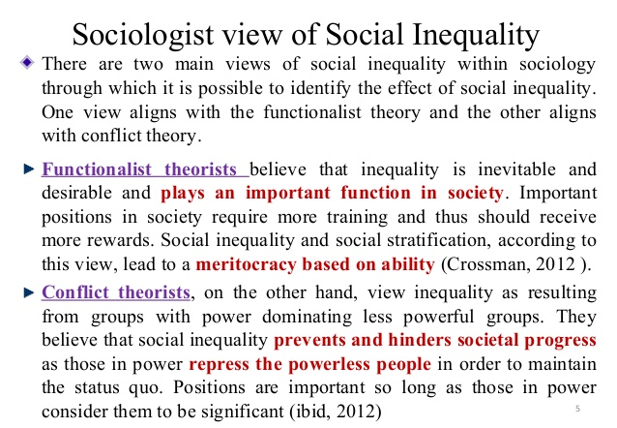
Social Disparities:
There are five systems or types of social inequality: wealth inequality, treatment and responsibility inequality, political inequality, life inequality, and membership inequality. Political inequality is the difference brought about by the ability to access governmental resources which therefore have no civic equality.

Slide 16
THE-END

