Slide 1
UNIT V
Professional Ethics
Value based Life and Profession.
Professional Ethics and Right Understanding.
Competence in Professional Ethics.
Issues in Professional Ethics – The Current Scenario.
Vision for Holistic Technologies, Production System and Management Models.

Slide 2
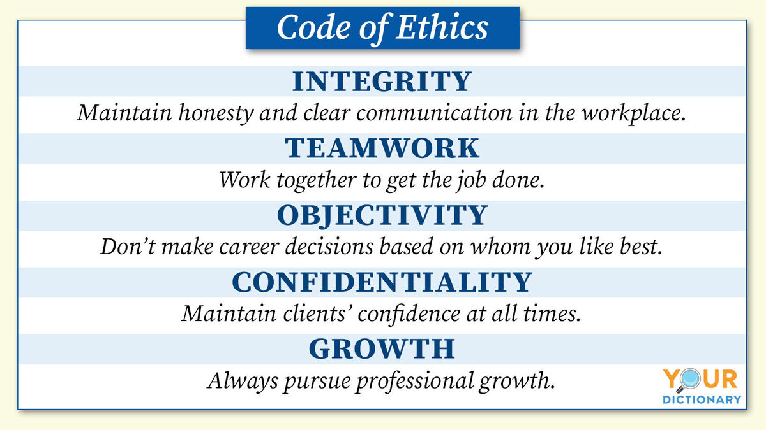
Value based Life and Profession(Professional Ethics)
Introduction: Some of the important components of professional ethics that professional organizations necessarily include in their code of conduct are integrity, honesty, transparency, respectfulness towards the job, confidentiality, objectivity etc.

Slide 3
value of ethics in profession or life:
Ethics are usually described in relation to values, as they are the moral philosophy and implementation of one's values. Personal or professional ethical codes give the ability to recognize what is right, fair, honorable and righteous.
Professional ethics are important for several reasons. First, most professionals have an informational advantage over those they serve. ... Professional ethics will provide the useful function of identifying these moral hazards and providing the appropriate avoidance or work-around strategies.
DIFFERENT TYPES OF ETHICS:
Includes your personal values and moral qualities.
Influenced by family, friends, culture, religion, education and many other factors.
Examples: I believe racism is morally wrong. I am in favor of abortion.
Personal ethics can change and are chosen by an individual.
PROFESSIONAL ETHICS:
Ethics that the majority of people agree on.
Many philosophers argue there is no such ethics.
Do we have the same ethics in the world? Do we have the same ethics in the U.S.? Does everyone in your family share the same ethics?
Examples: Murdering people for the sake of murder is wrong.
Notice how this would change in the context of self-defense.
Common ethics have to be very general to avoid disagreement.

Slide 4
IMPORTENCE OF ETHICS:
Primarily it is the individual, the consumer, the employee or the human social unit of the society who benefits from ethics. In addition ethics is important because of the following:
SATISFYING BASIC HUMAN Needs: Being fair, honest and ethical is one the basic human needs. Every employee desires to be such himself and to work for an organization that is fair and ethical in its practices.
CREATING CREDIBILITY: An organization that is believed to be driven by moral values is respected in the society even by those who may have no information about the working and the businesses or an organization. Infosys, for example is perceived as an organization for good corporate governance and social responsibility initiatives. This perception is held far and wide even by those who do not even know what business the organization is into.
UNITING PEOPLE AND LEADERSHIP: An organization driven by values is revered by its employees also. They are the common thread that brings the employees and the decision makers on a common platform. This goes a long way in aligning behaviors within the organization towards achievement of one common goal or mission.
IMPROVING DECISION MAKING: A man’s destiny is the sum total of all the decisions that he/she takes in course of his life. The same holds true for organizations. Decisions are driven by values. For example an organization that does not value competition will be fierce in its operations aiming to wipe out its competitors and establish a monopoly in the market.
LONG TERM GAINS: Organizations guided by ethics and values are profitable in the long run, though in the short run they may seem to lose money. Tata group, one of the largest business conglomerates in India was seen on the verge of decline at the beginning of 1990’s, which soon turned out to be otherwise. The same company’s Tata NANO car was predicted as a failure, and failed to do well but the same is picking up fast now.
SECURING THE SOCIETY: Often ethics succeeds law in safeguarding the society. The law machinery is often found acting as a mute spectator, unable to save the society and the environment. Technology, for example is growing at such a fast pace that the by the time law comes up with a regulation we have a newer technology with new threats replacing the older one. Lawyers and public interest litigations may not help a great deal but ethics can.

Slide 5
Professional Ethics and Right Understanding
Profession: The participation of human beings in the larger order to pursue the Comprehensive Human Goal
à It is a participation involving production and production related activities. It helps to provide physical facilities for oneself and one’s family.
Professional Education: The education which helps to acquire the specific skills and knowledge for any profession
Professional Ethics (also called Ethical Conduct of Profession) : right utilization of one’s professional skills
à A competent professional should carry out his profession with Right Understanding, Dexterity and Commitment. His efforts should be conducive to human welfare, to the happiness and prosperity of everyone and to the enrichment of nature.

Slide 6
To have competence in professional ethics, one should have:
· Clarity about the Comprehensive Human Goal
· Confidence in yourself and in harmony at all levels
· Competence of mutually fulfilling behavior with ethical conduct
· Competence of mutually enriching interaction with nature
· Competence of actualizing/ implementing of one’s understanding
Issues in Professional Ethics – The Current Scenario
Issues such as Corruption, Tax evasion, Cut-throat competition, Consumer Exploitation, Adulteration, Endangering Public Health and Safety, Hoarding (accumulating) and Overcharging, Unethical Advertisements and Sales Promotions etc.
Examples:
a Bhopal Gas Tragedy, Chernobyl Disaster
à Hawala and Benami transactions
à Drug mafia, Builders’ mafia, Arms mafia
à Promoting harmful products like Pan masala etc.

Slide 7
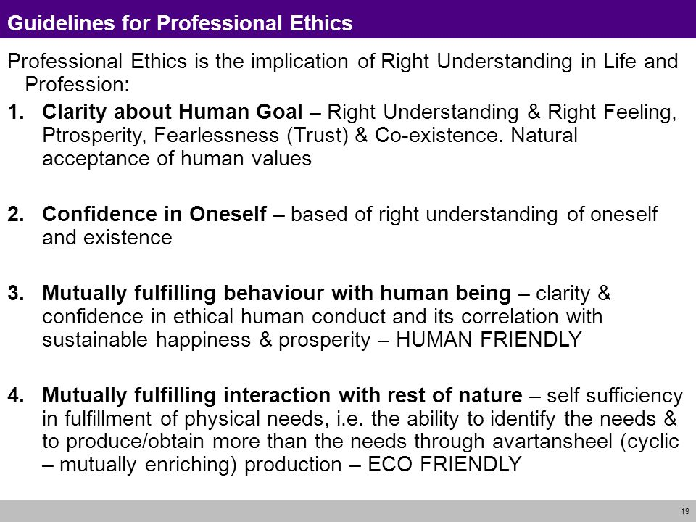

Slide 8
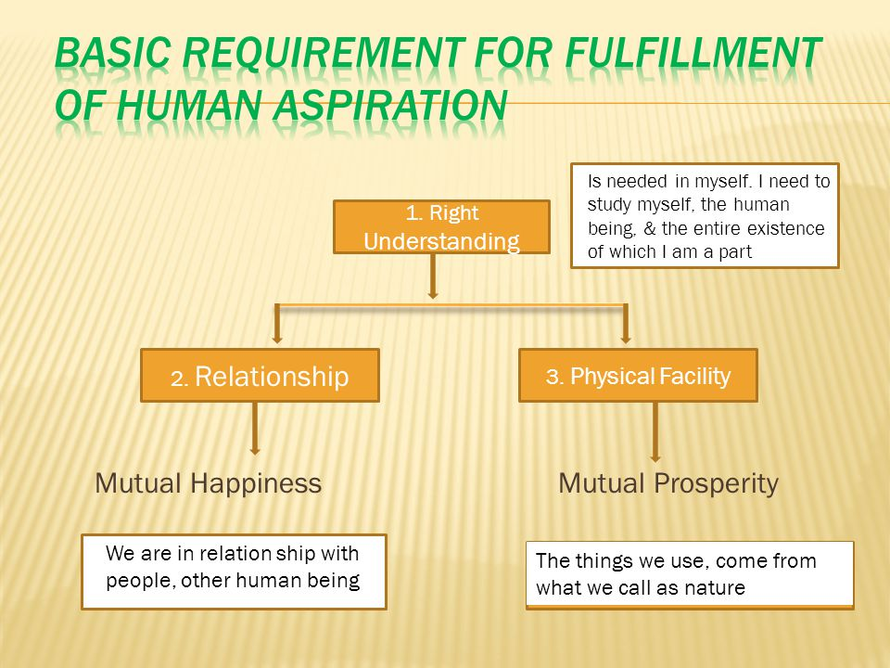

Slide 9
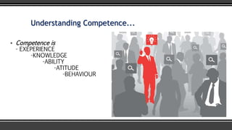
Competence in Professional Ethics
Competence:
Competence is the ability of an individual to do a job property.
A competency is a set of defined behaviors that provide a structured guide enabling the identification, evaluation and development of the behaviors in individual employees.
Understanding Competence:
Competence is:
EXPERENCE
KNOWLEDGE
ABILITY
ATTITUDE
BEHAVIOUR

Slide 10
Building Competency in YOU:
Communication
Achievement/results orientation
Customer focus
Teamwork
Leadership
Planning and organizing
Business awareness
Flexibility and adaptability
Developing others
Problem-solving
Analytical thinking
Building relationships

Slide 11
Professional competence:
By having competencies defined in the organization, it allows employees to know what they need to be productive.
For competencies where employees are lacking, they can learn.
It allows employees to know what they need to be productive.
It allows employees to how to make sustainable production.
It also make one to do production by keeping in mind the human values.

Slide 12
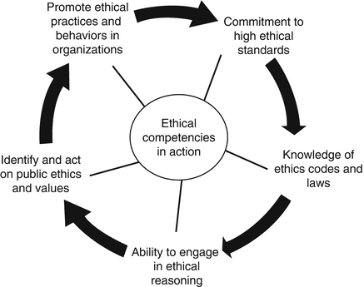

Slide 13
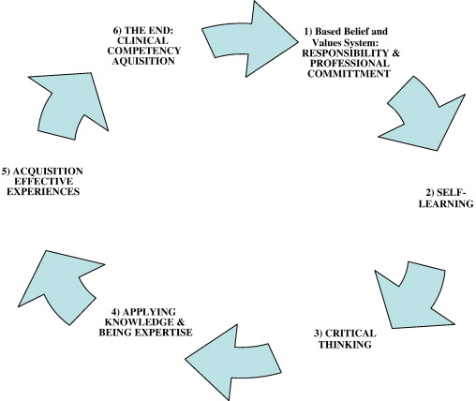

Slide 14
Issues in Professional Ethics – The Current Scenario
Issues such as Corruption, Tax evasion, Cut-throat competition, Consumer Exploitation, Adulteration, Endangering Public Health and Safety, Hoarding(accumulating) and Overcharging, Unethical Advertisements and Sales Promotions.
The way out:
Introducing Awareness Programmers, New Courses, Case Studies
By administering Others & Prescribing Codes of ethical Conduct for professions.
Carrying out intensive audits.
Implementing strict laws and harder punishments
Carrying out “Sting Operations”
Encourage whistle blowing by individuals and Groups

Slide 15
Vision for Holistic Technologies, Production System and Management Models:
Vision for Holistic Technologies, Production systems and Management Models:
The Holistic Criteria for Evaluation:
There are three broad criteria to guide the development of technologies and systems conducive to human welfare:
1. Catering to appropriate needs and lifestyles
2. People friendly
3. Eco friendly
More specifically, it can be described as follows:
Criteria for technologies –
· Catering to real human needs
· Compatible with natural systems and cycles
· Facilitating effective utilization of human body, animals, plants and materials
· Safe, user friendly and conducive to health
· Producible with local resources and expertise as far as possible
· Promoting the use of renewable energy resources
· Low cost and energy efficient
· Enhancing human interaction and cooperation
· Promoting decentralization
· Durability and life cycle recyclability of products
Vision for Holistic Technologies, Production System and Management Models

Slide 16
Criteria for Production Systems
What to produce?
How to produce?
For whom to produce?
And how much to produce?
Criteria to judge the appropriateness of production systems
· Optimal utilization of local resources and expertise
· Economic viability and sustainability
· Priority for local consumption
· Matching the pattern of production with the availability/producibilityin the local environment and the pattern of consumption
· Decentralized systems capable of meaningful employment of people in the community
· Facilitating production by masses and not mass production in a centralized mode
· Promoting individual creativity and sense of accomplishment
· Using people-friendly and eco-friendly technologies
· Ensuring requisite quality of production
· Safe and conducive to health of persons involved in production as well as to others.

Slide 17
Criteria for Humanistic Management Models:
· The whole unit working as a well-knit family
· Cooperative and motivational
· Ensuring correct appraisal of human labor
· Targeting employer-employee as well as consumer satisfaction and not profit maximization
· Sharing of responsibility and participative mode of management
· Continuous value addition of the persons involved
· Effectively integrating individual competencies and complimentarily

Slide 18
A Critical Appraisal of the Prevailing Systems:
à The present day models have been developed from the materialistic world view.
à They are using latest scientific knowledge and sophisticated technologies
à But they are incompatible with ecology and not conducive to Human Welfare.
à Heavily dependent on non-renewable sources causing depletion as well as pollution
à Natural resources, labor etc. are being substituted with the artificial ones.
à More complicated systems which are highly capital and energy intensive
à Although labeled as user friendly, and of being superior quality products or systems, they are not conducive to human welfare.

Slide 19
Learning from the Systems in Nature and Traditional Practices:
To gain an insight into the holistic systems we need to learn from the systems of nature and from traditional practices. The modern world is living with a wrong notion that nature is meant to be controlled and exploited for human enjoyment. This is what is termed as development these days. But in reality, human beings are an integral part of this self-sustaining nature. Hence it is essential that they live in harmony with nature.
Similarly, with the increase in knowledge and skills, and changing needs, many improvisations are being made in technologies. But they are not as eco-friendly and people-friendly as the traditional practices. Hence, it is necessary that the improvisations should recognise and retain the good qualities of the traditional practices.

Slide 20
THE-END

