Slide 1
Enterprise Real Estate
Operations Platform
Unified Infrastructure for High-Velocity Lead Engagement
Voice calling · WhatsApp outreach · Access governance · Analytics · CRM · Control center
Notes:
Set up the professional tone and the overarching platform positioning before any single capability is shown.

Slide 2
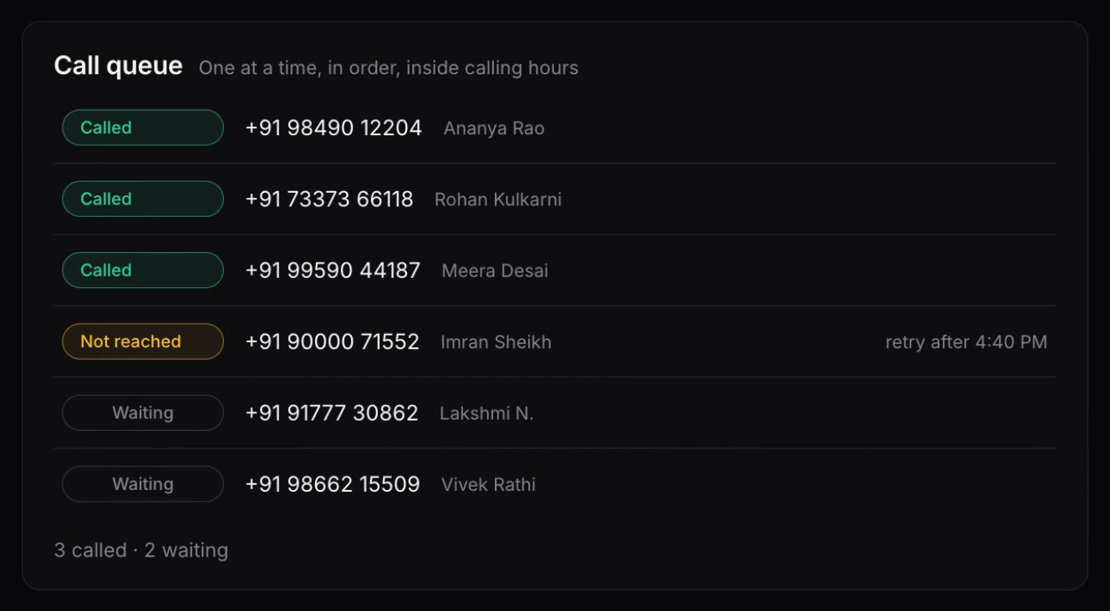
Automated Voice Queue Execution
Paste an entire list of client numbers into a single input.
The dialer works down the queue back-to-back, with no manual redialing.
Each number carries a live status: waiting, on the call, reached, or retrying.
Calls go out only inside the hours you set.
Queue-based voice calling
2
Notes:
Detail the call workflow. An operator enters multiple client phone numbers simultaneously into one input array; the dialing system then sequences them back-to-back in an active live calling queue. Screenshot: the call queue with numbers loaded and statuses advancing.

Slide 3
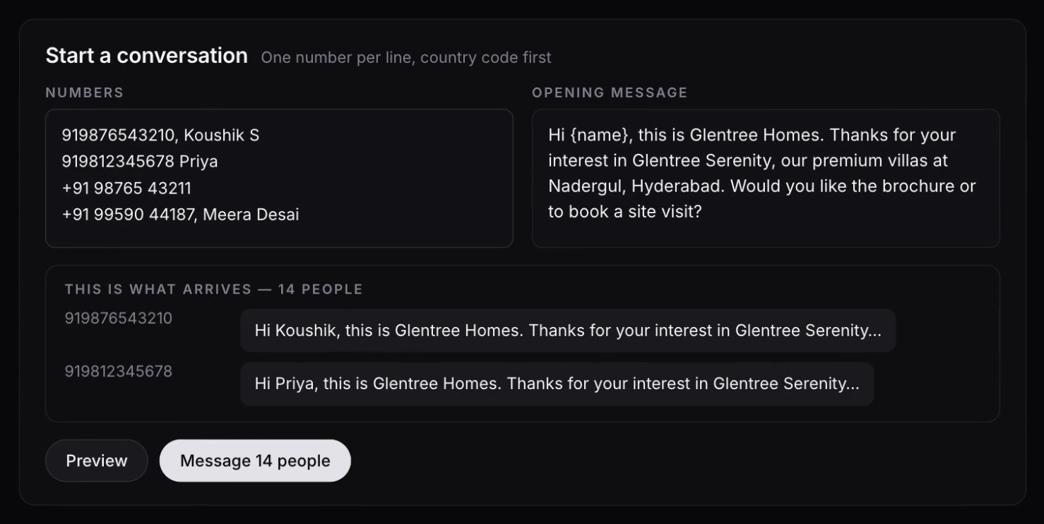
Automated WhatsApp Outreach Pipeline
Load an entire recipient batch in one paste, names included.
Preview the exact message every contact receives before anything sends.
The agent texts them consecutively, spaced apart, with no manual sending.
Delivery is confirmed per recipient and counted against the batch.
Multi-recipient messaging
3
Notes:
Detail message queue mechanics. Multiple recipient contacts are loaded into an automated messaging batch and the platform texts them consecutively without manual intervention. Screenshot: the batch composer with its preview block, or the sending queue with delivery confirmations.

Slide 4
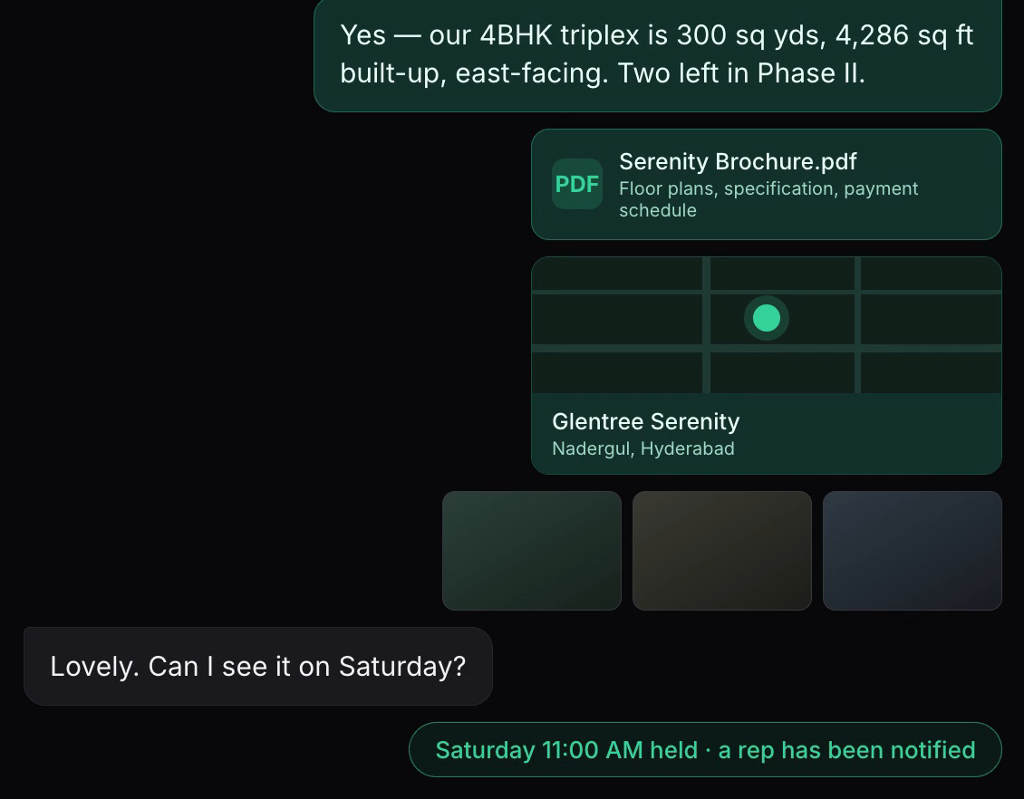
Luxury 4BHK Villa Asset Delivery
The agent answers a 4BHK enquiry with the live configuration and price.
It sends the digital brochure straight into the conversation.
It drops the exact site location as a map card.
Architectural imagery of the 4BHK layout follows in the same thread.
Rich media dispatch
4
Notes:
Showcase digital property marketing. The agent dispatches rich media into the active number queue: digital brochures, geo-location map coordinates and architectural images of a 4BHK layout. Screenshot: the conversation carrying the brochure card, the location card and the image strip.

Slide 5
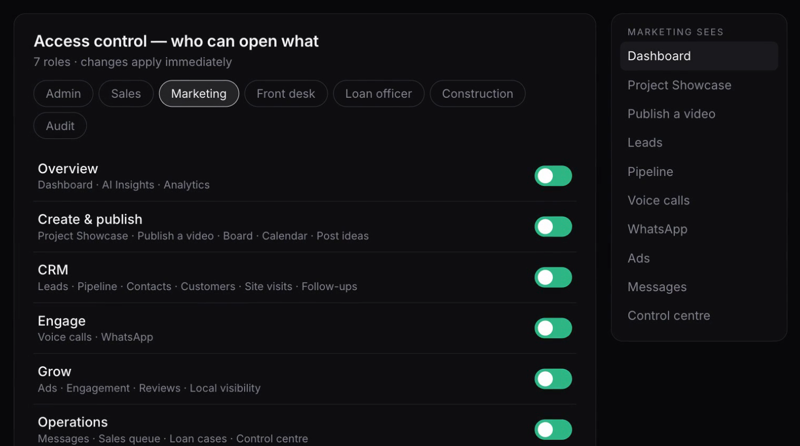
Security & Access Governance (RBAC)
Every area of the platform is a switch, grouped by the decision it represents.
Switch an area off for a role and it leaves that person's view entirely.
Restricted staff, agent dashboards and administrative windows stay separate.
Permission changes take effect immediately, for everyone.
Role-based access control
5
Notes:
Demonstrate operational permissions. The system switches instantly between restricted staff views, agent communication dashboards and administrative configuration windows. Screenshot: the access matrix with role selected, or the refusal a restricted user meets.

Slide 6
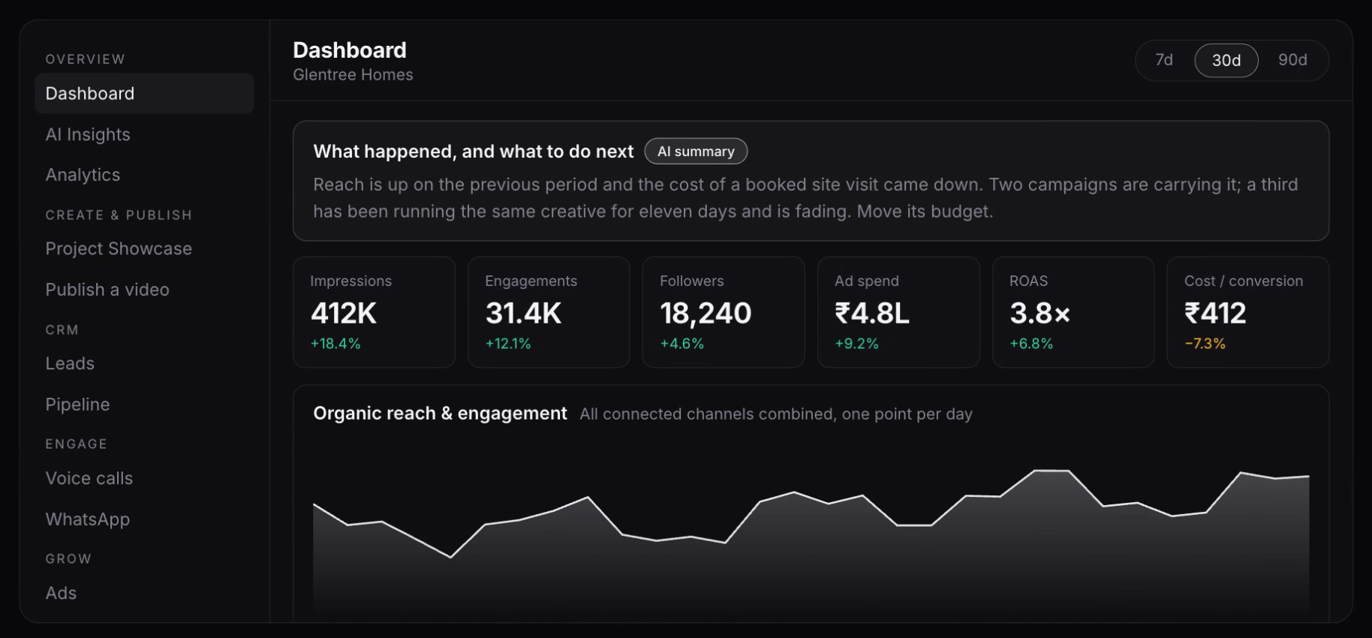
Performance Tracking & Timeline Metrics
One executive view: reach, engagement, spend, return and cost per conversion.
Switch the whole screen between 7-day, 30-day and 90-day windows.
Every figure and every graph re-reads itself against the window you choose.
A written summary states what happened and what to act on next.
Executive analytics
6
Notes:
Showcase executive analytics. Operational progress graphs, performance metrics and lead response times filter across 7-day, 30-day and 90-day macro views. Screenshot: the dashboard with the range selector visible.

Slide 7
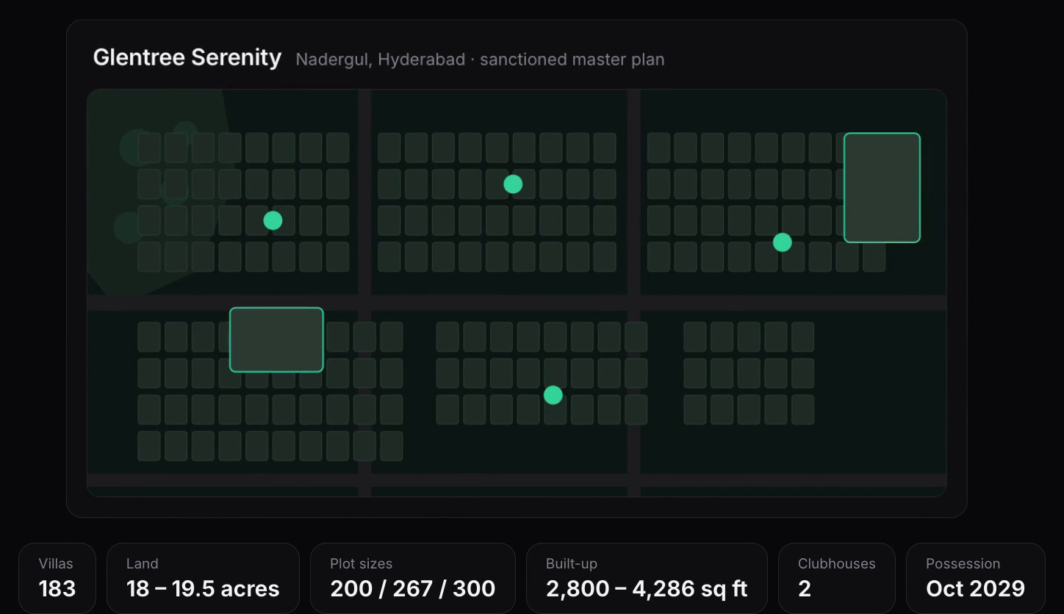
Content Syndication & Property Showcasing
The Villa Showcase holds the full inventory: plots, sizes, built-up area, possession.
Project material is presentation-ready and drawn from the live records.
Publish a video once and send it to every channel in a single action.
Captions, destinations and progress are handled in one window.
Marketing hub
7
Notes:
Showcase marketing tools. The centralized Villa Showcase digital inventory matrix alongside the native 'Publish a Video' single-click deployment interface. Screenshot: the showcase master plan with its stat row, or the publish window mid-deployment.

Slide 8
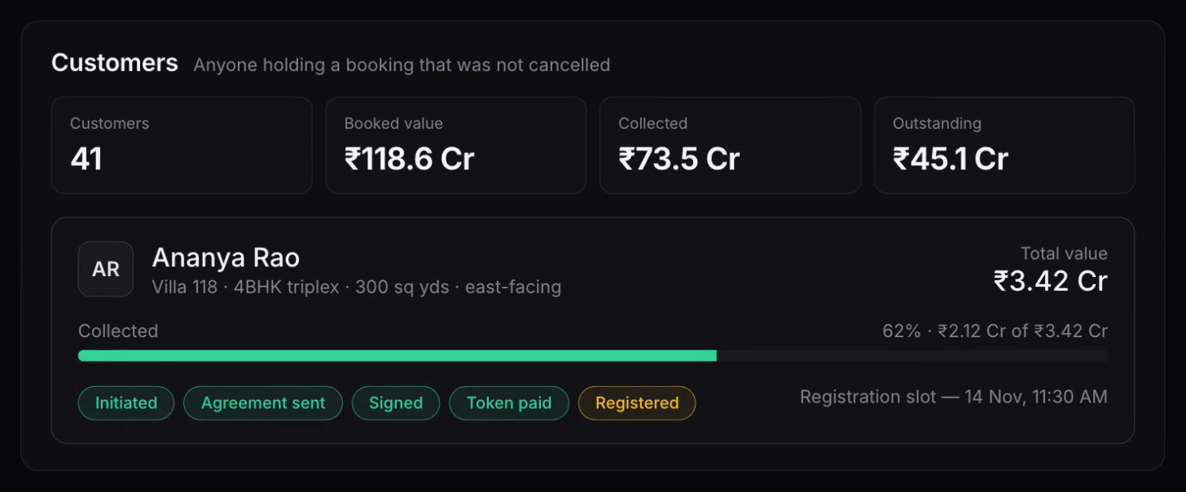
Pipeline CRM & Ad Performance Tracking
Customer cards carry total value, amount collected and the exact booking stage.
The pipeline runs from first enquiry through to registration.
Live campaign performance sits beside the pipeline it feeds.
Spend, return and cost per site visit are tracked campaign by campaign.
Lead management and paid acquisition
8
Notes:
Detail lead management and paid acquisition. Fully updated CRM customer pipeline index cards run alongside live ad campaign click-through trackers and cost analytics. Screenshot: a customer card with its payment meter and booking stages, or the ad performance view.

Slide 9
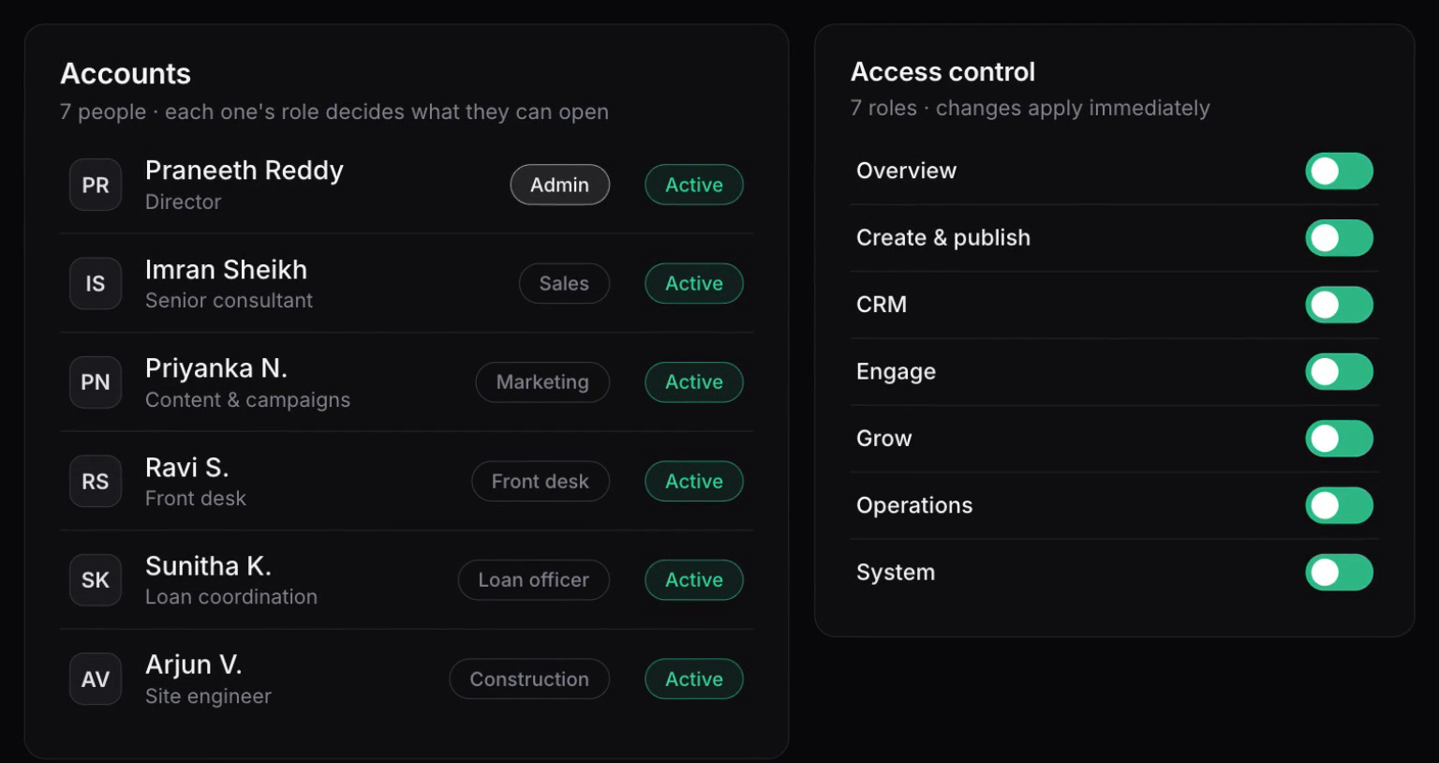
Global Operations Control Center
A single inbox holds every live customer conversation across the operation.
Administrators oversee every account, role and permission from one screen.
Active call queues and messaging batches are visible while they run.
The team's own internal threads sit beside the work they concern.
Central communication hub
9
Notes:
Demonstrate master system supervision. The real-time centralized customer messaging inbox acts as the system-wide control center from which administrators track every live campaign and call queue. Screenshot: the control center with accounts beside the access matrix, or the unified inbox.

Slide 10
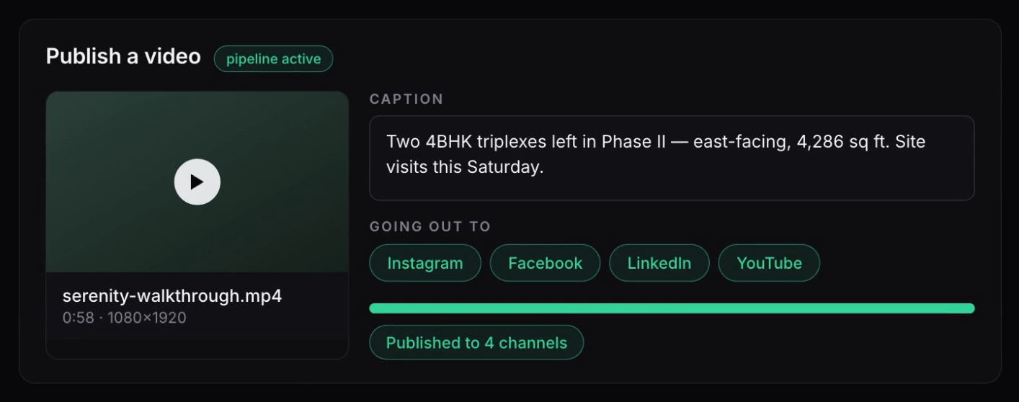
Publishing Automation — Live Today
Every video goes out to all connected channels in a single action.
The caption and the description are written for each post automatically.
Comments on the published post are answered interactively.
Nothing is uploaded, titled or retyped by hand.
Content automation
10
Notes:
What is running today: a video is uploaded to all social channels with an AI-generated caption, description and interactive comment handling. Screenshot: the publish window with all four channels completed.

Slide 11
Roadmap — Phase 2 and Phase 3
Phase 2 — Thumbnail approval
A thumbnail is generated for every video and sent to you on WhatsApp or Telegram.
Accept it, or reply with an edit and a new one comes back.
On approval it publishes at the right size for each platform.
Phase 3 — Video from an idea
Describe an idea or a prompt and the video is generated, with everything above.
A standing schedule — Tuesday and Thursday, say — proposes the idea itself.
You confirm on your phone; it publishes to the channels you choose.
What comes next
11
Notes:
Current implementation: the video is uploaded to all social media with an AI-generated caption, description and interactive comment.
Phase 2: a thumbnail is generated and sent to you on Telegram or WhatsApp for verification. If it looks right you accept it; otherwise choose Edit, say what to change, and a new thumbnail comes back. On acceptance it publishes directly, at the screen resolution each social platform expects.
Phase 3: an AI-generated video from a prompt or an idea, with all of the above. Plus a standing automation trigger — for example every Tuesday and Thursday at a set time — which creates an idea and sends it to your Telegram or WhatsApp. Once you agree it generates the video and the thumbnail, sends them back for confirmation, and on your approval publishes to all, or to the selected, social platforms.

Slide 12
Thank You
Next steps
Walk the platform end to end with your sales and marketing leads.
Load your own projects, pricing and contact lists.
Go live on a single villa project, then widen it across the portfolio.
Notes:
Closing slide. Thank the room and leave them with three concrete next steps rather than a generic sign-off.

