Slide 1


SMART INDIA HACKATHON 2026
Satyameva
Problem Statement ID –
Problem Statement Title-Verification System
Tamper
Proof
Academic
Credential
Theme- Blockchain and Cybersecurity
PS Category- Software Team ID- 10
Team Name (Registered on portal) - CypherX

Slide 2
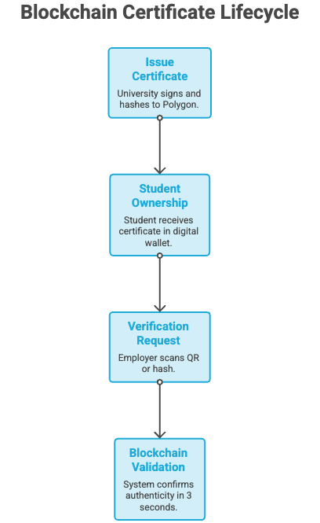


Satyameva
CypherX
Blockchain based certificate issuance and instant verification replacing weeks of manual checks and fake degree fraud with a 3 second, tamper-proof QR scan.
Whats the USP?
What is Satyameva?
Decentralized (no single server)
Free / near zero cost per check
Satyameva transforms certificates into tamper proof blockchain
credentials that students own and anyone can
verify instantly.
Instant
(3-second verify)
Why Satyameva?
Cryptographically tamper proof
Student owned (self sovereign)
Revocable on-chain (can invalidate anytime)

Slide 3



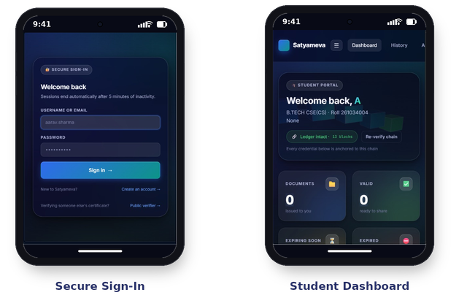
TECHNICAL APPROACH
CypherX
Techstack and Ui mockups
Process/ Implementation flow
University fills certificate details & signs digitally (private key)
Frontend
React.js/ HTML+js
Backend
Node.js
+
Web3.js
Database SQLite, SQLAlche
-my ORM
Security SHA-256, HMAC-SHA256, PBKDF2
Blockchain
Custom PoW engine
Smart contract generates SHA-256 hash & mints it on Polygon
Certificate PDF is AES-256 encrypted & stored on IPFS
Methodology
Student receives certificate +
QR code in digital wallet
Synchronous Processing
Cryptographic Tamper Proofing
Seamless Notifications
Employer scans QR / instant on-chain verification (~3 sec)

Slide 4


FEASIBILITY AND VIABILITY
CypherX
~2sec
blockchain transaction / certificate mint time
₹0.08
Cost per certificate on Polygon network
₹8Lakh
total cost to issue 1 crore (10M) certificates
Phase Rollout Roadmap
Key compromise → Multi-sig wallet (2-of-3) + on-chain revocation
Risk and mitigation
strategy
No smartphone access - Printable QR + Phase 3 SMS lookup
Phase 1
Pilot at own college
Phase 4
National scale
(40M+ students)
Phase 2 state university network
Phase 3
UGC
mandate+ SMS lookup
Adoption resistance → Pilot in-house, then push for UGC mandate
DigiLocker overlap → Complementary trust layer, not a replacement

Slide 5

IMPACT AND BENEFITS
CypherX
~99.99%
faster verification: 2–4 weeks
→ 3 seconds
~99.99%
cheaper per check:
₹500–₹2,000 → ₹0.08
40M+
higher-education students in India (addressable scale)
40,000+
fake degrees officially caught in India every year
(reported cases only)
1
Social:Restores trust in degrees; protects genuine graduates
from fraud stigma.
Benefits Created
2
Economic: Cuts verification fees saves ~₹500-2000 Cr at 1 crore certificates.
3
Environmental: Fully paperless no mailers or couriers between institutions..
4
Policy: Aligned with NEP 2020 and Digital India.

Slide 6
RESEARCH AND REFERENCES
CypherX

