Slide 1

DATA INSIGHTS WEBAPP
By:
B.Rishith Reddy(18311A1208)
K.Chaitra(18311A1223)
P.Praneeth(18311A1241)
Under the Guidance of:
Dr. Sunil Bhutada

Slide 2
PROBLEM STATEMENT
The main objective of our project is to build an application in python using streamlit which enables user to understand the data first and try to gather as many insights from it. Pandas profiling is an open source Python module with which we can quickly do an exploratory data analysis with just a few lines of code.

Slide 3
ABSTRACT
Exploratory data analysis (EDA) is used by data scientists to analyze and investigate data sets and summarize their main characteristics, often employing data visualization methods. The first step in data analysis is to observe the statistical values of the data to decide if it needs to be preprocessed in order to make it more consistent. It helps determine how best to manipulate data sources to get the answers you need, making it easier for data scientists to discover patterns, spot anomalies, test a hypothesis, or check assumptions. This application was build in python using pandas-profiling and streamlit which enables user to understand the data first and try to gather as many insights from it. Pandas profiling is an open source Python module with which we can quickly do an exploratory data analysis with just a few lines of code. Besides, if this is not enough to convince us to use this tool, it also generates interactive reports in web format that can be presented to any person, even if they don’t know programming. Streamlit is an open-source app framework for creating and deploying data science applications. Streamlit helps data scientists and machine learning engineers to develop performant applications. This application helps to improve understanding of variables by extracting averages, mean, minimum, and maximum values, etc. Discover errors, outliers, and missing values in the data. Identify patterns by visualizing data in graphs such as box plots, scatter plots, and histograms. Hence, the main goal is to understand the data better and use tools effectively to gain valuable insights or draw conclusions.

Slide 4
REQUIREMENTS
HARDWARE REQUIREMENTS:
Processor : Any Update Processer
RAM : Min 4 GB
Hard Disk : Min 100 GB
SOFTWARE REQUIREMENTS:
Operating System : Windows family
Technology :Python 3.6
IDE : Spyder
Front-End Technology : StreamLit

Slide 5
INTRODUCTION:
Our Data Science based DATA INSIGHTS application activity comprises of 6 services. In this project, these services are explained. Exploratory data analysis is about In statistics exploratory data analysis is an approach to analyzing data sets to summarize their main characteristics often with visual methods. A statistical model can be used or not but primarily EDA is for seeing what the data can tell us beyond the formal modelling or hypothesis testing task. EDA in python uses data visualization to draw meaningful patterns and insights. It also involves the preparation of datasets for analysis by removing irregularities in the data. Normalization refers to rescaling real valued numeric attributes into a 0 to 1 range. Data normalization is used in machine learning to make model training less sensitive to the scale of features. This allows our model to coverage to better weights and in turn leads to a more accurate model. Pandas profiling is an open source Python module with which we can quickly do an exploratory data analysis with just a few lines of code. Besides, if this is not enough to convince us to use this tool.

Slide 6
It also generates interactive reports in web format that can be presented to any person, even if they don’t know programming. In short, what pandas profiling does is save us all the work of visualizing and understanding the distribution of each variable. It generates a report with all the information easily available. Data visualization is a graphical representation of data in order to interactively and efficiently convey insights to clients customers and stakeholders in general. It is a way to summarize your findings and display it in a form that facilitates interpretation and can help in identifying patterns or trends.

Slide 7
LITERATURE SURVEY
Importance Of Data Visualisation:
Data visualization is an interdisciplinary field that deals with the graphic representation of data. It is a particularly efficient way of communicating when the data is numerous as for example a time series.
From an academic point of view, this representation can be considered as a mapping between the original data (usually numerical) and graphic elements(for example, lines or points in a chart). The mapping determines how the attributes of these elements vary according to the data. In this light, a bar chart is a mapping of the length of a bar to a magnitude of a variable. Since the graphic design of the mapping can adversely affect the readability of a chart, mapping is a core competency of Data visualization.
Data visualization has its roots in the field of Statistics and is therefore generally considered a branch of Descriptive Statistics. However, because both design skills and statistical and computing skills are required to visualize effectively, it is argued by some authors that it is both an Art and a Science.
Research into how people read and misread various types of visualizations is helping to determine what types and features of visualizations are most understandable and effective in conveying information.

Slide 8
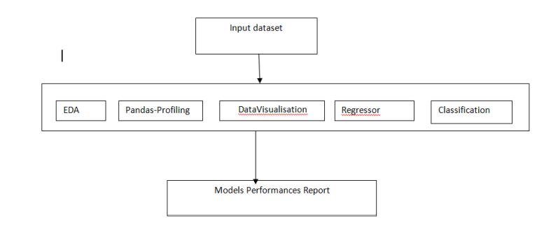
ARCHITECTURE DIAGRAM

Slide 9
Modules:
The proposed system was developed using python, streamLit and other data science libraries like numpy, pandas, etc.
Dataset Used:
The dataset is given as input to the model it can be any dataset in csv form. We have publically available data from kaggle.
Exploratory Data Analysis:
In this data analysis we are exploring the how many columns of data are present in the dataset so we can view the data quickly by using this analysis. It shows head of the data present in the dataset.

Slide 10
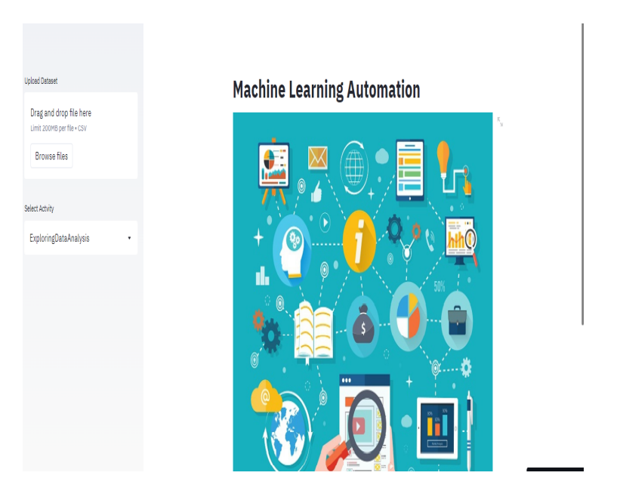
OUTPUT SCREENS:

Slide 11
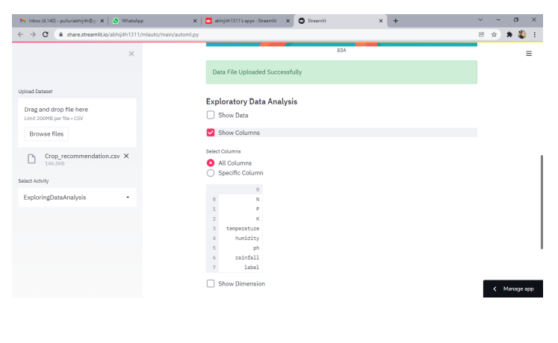
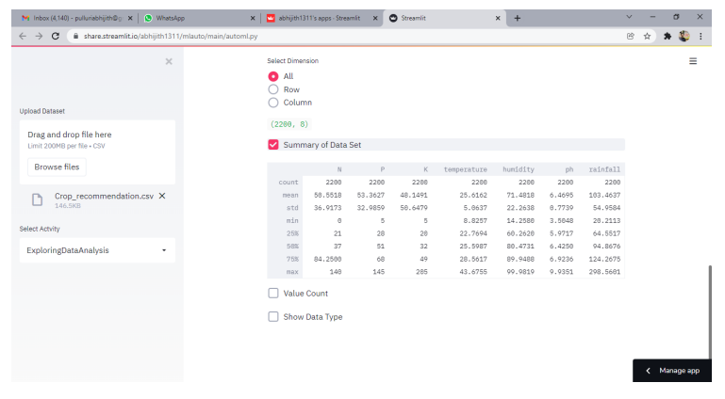
EDA:
DIMENSIONS:

Slide 12
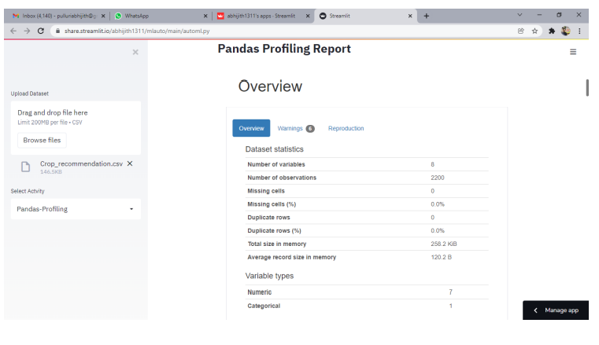
Pandas profiling:

Slide 13
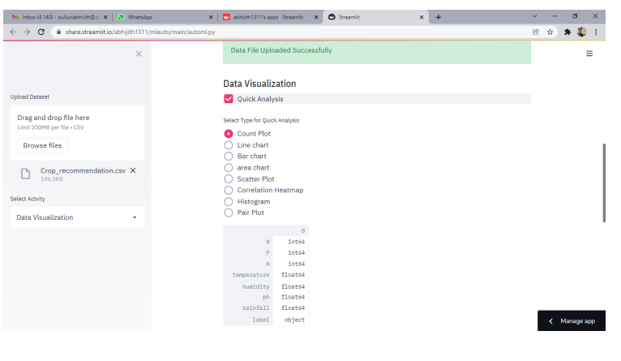
Data Visualisation:

Slide 14
Testing process:
Firstly, we will start testing with individual module and will perform unit testing on that. So we successfully verify and validate all modules by successively integrating each module. Moreover, checking the work done was very important to reduce risk factor. Checking was being ultimately handled by testing but interim checking was required. So we planned work done by one member was tested by other for some time and again revolved for other level check. This technique proved to be very much helpful as it came out with innovative ideas to reduce error very low level. The objective of this testing phase is to prove that the developed system satisfies the requirements defined earlier. Several types of tests will be conducted in this phase. Testing is an important phase of system development because it can ensure the system matches the specifications.

Slide 15
Advantages:
Easy UI for non coder background people.
Help in understanding data and decision making process.
Helps in speed up the pipe line of model building.
Can be used as hand book of datascientist.
Understandble user interface.

Slide 16
CONCLUSION
This project helps the Data Scientist or Data Engineers to reduce their efforts and Time in understanding the data. This application helps in Decision making like selecting the right feature selection, feature engineering, etc.
FUTURE ENHANCEMENT:
Future Enhancements Of this application is to add AutoML features, custom models deployment with user defined hyper parameters and make the predictions of new data in Webapp itself.

